Slide 1
City of Fort Worth
Environmental Management Division
Use of Benchmark Monitoring Results to Prioritize Industrial Stormwater Inspections
EPA Region 6 Stormwater Conference
October 5, 2016
Cody Whittenburg, Environmental Program Manager

Slide 2
Outline
Benchmark Reporting Requirements
City of Fort Worth Industrial Compliance Program
Scope and Methods
Results
Conclusion and Discussion
Questions

Slide 3
City of Fort Worth
Environmental Management Division
Benchmark Reporting Requirements

Slide 4
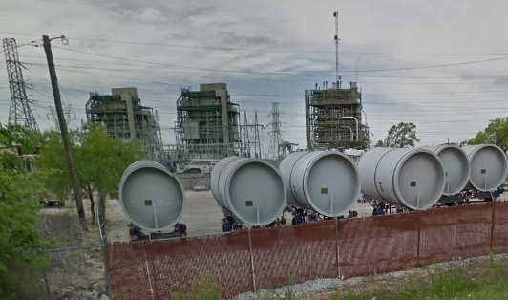
What is the multi-sector general permit (MSGP)?
Permit for industrial stormwater runoff, covering runoff from areas for manufacturing, processing, material storage, and waste-material disposal.
30 industrial sectors, based on standard industrial classification code
Notes:
Photo: power plant in Fort Worth, Sector O

Slide 5
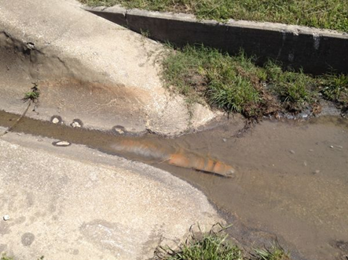
What is benchmark monitoring?
Sector specific outfall sampling for the purpose of characterizing discharge from regulated activities.
Notes:
Photo: An outfall that can be sampled for benchmark parameters

Slide 6
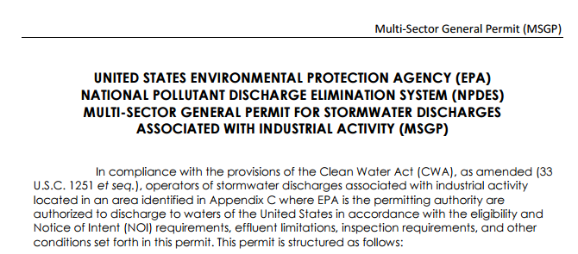
National Pollutant Discharge Elimination System (NPDES, New Mexico and Tribal Nations)
U.S. Environmental Protection Agency (EPA)
Permit MSGP (2015)
Quarterly benchmark monitoring
Report quarterly to EPA using netDMR within 30 days of receiving lab report
Average quarterly results
If no exceedance in year 1, no additional benchmark sampling for permit term
Notes:
For benchmark monitoring, EPA notes that sampling results must be submitted to EPA no later than 30 days after receiving laboratory results for each quarter that benchmark samples are required to be collected per Part 6.2.1.2. For any of monitored outfalls that did not have a discharge within the reporting period, permittees must report using NetDMR that there was “no data” for that outfall no later than 30 days after the end of the reporting period.
If the average of the 4 quarterly benchmark samples does not exceed the benchmark value- no additional benchmark sampling is required for the permit term
“For benchmark monitoring, note that you are required to submit sampling results to EPA no later than 30 days after receiving your complete laboratory results for all monitored outfalls for each quarter that you are required to collect benchmark samples, per Part 6.2.1.2.
netDMR- net discharge monitoring report

Slide 7
Oklahoma Pollution Discharge Elimination System (OPDES)
Oklahoma Department of Environmental Quality (ODEQ)
Permit OKR05 (2011)
Submit Annual Comprehensive Site Compliance Evaluation Report by March 1st
In lieu of Benchmark Monitoring Reporting
Notes:
Question: what if the annual report is not submitted??
The 2016 permit is currently in review. It has not been approved yet.

Slide 8
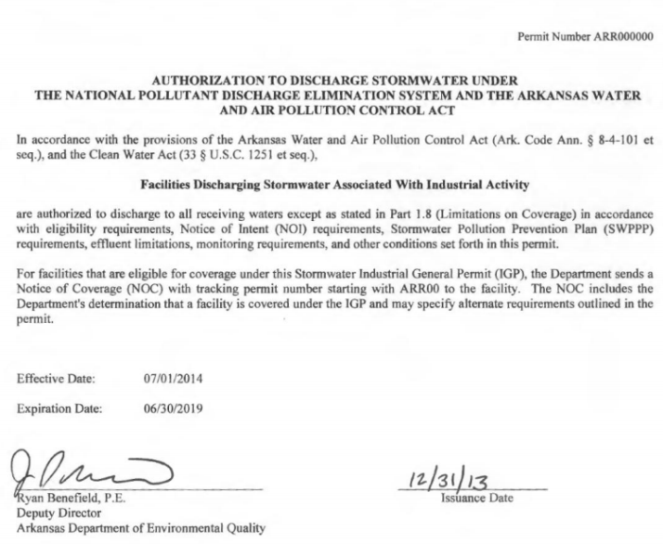
NPDES and Arkansas Water and Air Pollution Control Act
Arkansas Department of Environmental Quality (ADEQ)
Permit ARR000000 (2013)
Annual benchmark monitoring
pH and TSS benchmark parameters for ALL facilities
Additional sector-specific benchmark parameters
Include results in Stormwater Annual Report (SWAR)
Alternatives to benchmark values
Notes:
Pg. 18
Facilities can submit suggested alternatives to the listed benchmark values for review by the state (pg. 23)
-SWPPP must explain alternative and justify the alternative value.
-Alternatives must be submitted to ADEQ for review
SWAR does not need to be submitted to ADEQ, but the department will audit facilities

Slide 9
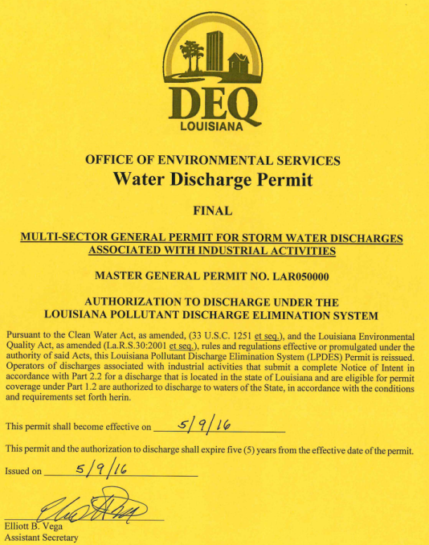
Louisiana Pollutant Discharge Elimination System (LPDES)
Louisiana Department of Environmental Quality (LDEQ)
Permit LAR050000 (2016)
Quarterly benchmark monitoring in years 2 and 4 of the permit
Each outfall (unless substantially similar)
Waiver for year 4 if average of year 2 results do not exceed benchmark values
Submit results annually on DMR form
Notes:
Benchmark sampling pg. 24
Reporting requirements pg. 51 of permit

Slide 10
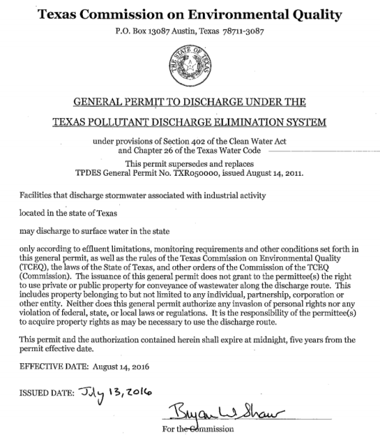
Texas Pollutant Discharge Elimination System (TPDES)
Texas Commission on Environmental Quality (TCEQ)
Permit TXR050000 (2016)
Semi-annual benchmark sampling
Average results from multiple outfalls
Submit results to TCEQ annually by March 31st
Years 1 and 2 after permit issued: collect and submit benchmark data
Waiver available for years 3 and 4
Notes:
Results of analyses for sampling during the first two benchmark monitoring years must be submitted to TCEQ before March 31st of each year following sample collection. The reported values must be the average yearly result of analysis for each specific pollutant discharged under a specific SIC code, rather than an outfall-by-outfall, basis
Results of the average of the two semiannual benchmark analysis during the third and fourth monitoring years must be retained on site, unless the results exceed benchmark levels, in which case, the results must be submitted to TCEQ’s Wastewater Permitting Section (MC-148) by March 31st of each year following sample collection
waiver for years 3 and 4 if no exceedances in years 1 and 2

Slide 11
EPA Region 6 Benchmark Monitoring Summary
State | Sampling Frequency | Waiver/Exceptions | Reporting Requirements
New Mexico | Quarterly | If no exceedance during year 1, exempt for rest of permit term | -Average quarterly results -Report quarterly -Submit on netDMR
Oklahoma | Not Applicable | In lieu of benchmark, submit Annual Comprehensive Site Compliance Evaluation Report | -Submit annually to ODEQ
Arkansas | Annual | TSS and pH benchmarks for ALL facilities | -Include in SWAR, not required to submit to ADEQ
Louisiana | Quarterly | -Benchmarks only monitored in years 2 and 4 of permit -Waiver for year 4 if no exceedances in year 2 | -Submit annually on DMR
Texas | Semi-Annually | If no exceedance in years 1 and 2, waiver may be obtained for years 3 and 4 | -Average semi-annual results -Report annually
Notes:
Summarize here that our use of benchmarks to prioritize inspections may not be useful for all states due to differences in permit requirements

Slide 12
City of Fort Worth
Environmental Management Division
City of Fort Worth Industrial Compliance Program

Slide 13
City of Fort Worth
Population: 833,319
Area: 353 mi²
16th largest city in the United States
Population growth: 42.34% increase from 2000-2013
Notes:
What else??

Slide 14
City of Fort Worth Industrial Compliance Program
573 active industrial facilities
Facility inspections conducted at least once per five year MS4 permit term
118 require benchmark monitoring
Benchmark reports to be submitted annually
Use Field ID database to track facilities, inspections and monitoring records
Notes:
This only includes industrial facilities NOT concrete batch plants
Benchmark monitoring is performed by permitted industrial facilities in certain sectors to assess the effectiveness of stormwater pollution prevention plans.
As of 2016, there are 118 permitted facilities within the City of Fort Worth required to complete annual sampling for benchmark parameters. Many industries that report benchmarks in Fort Worth are in Sectors J (Sand and Gravel Mining), AA (Fabricated Metals), M (Auto Salvage Yards) and N (Scrap Recycling Facilities).
The average of semi-annual samples is submitted.
Using an online database, Fort Worth is able to maintain records of benchmark monitoring results. The database is also used to track all inspections, violations and corrective actions for each permitted facility.

Slide 15
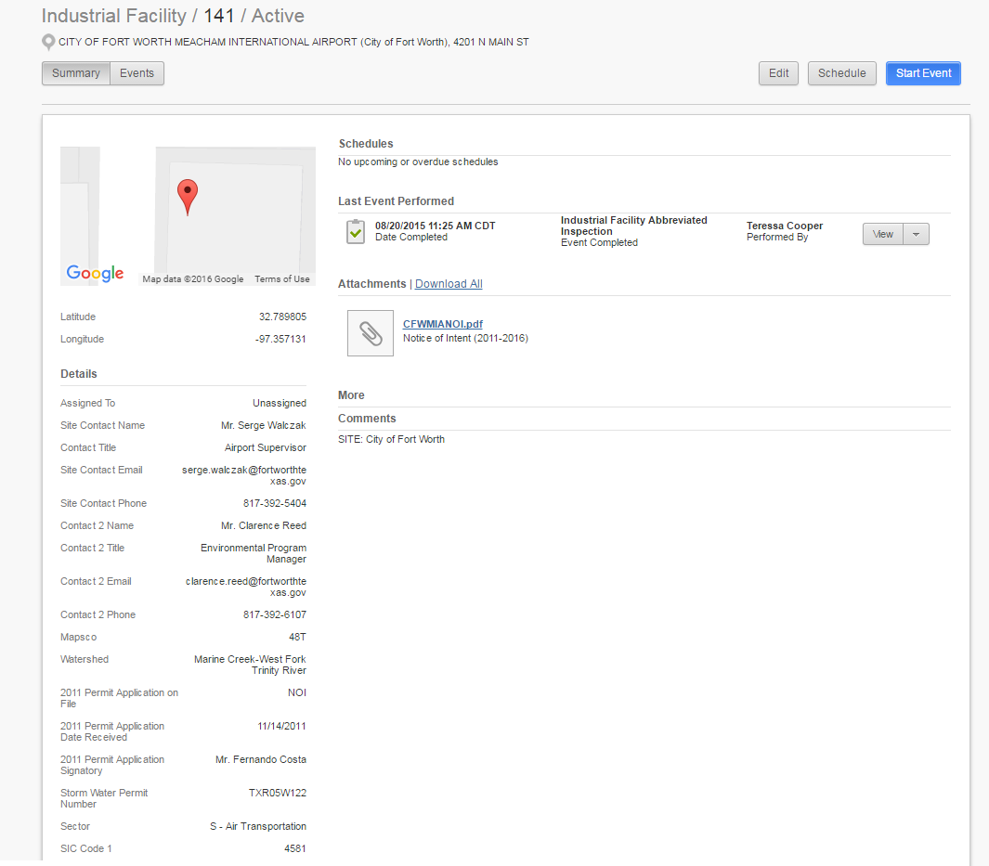
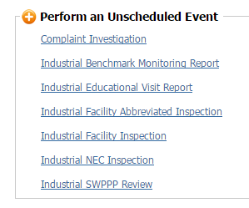
City of Fort Worth Industrial Compliance Program
Field ID
Notes:
Home screen for a facility- each facility is given a unique identifier- in this case City of Fort Worth Meacham International Airport is Facility 141.
Explain the information on the home screen for the facility.
The Start Event button allows you to choose from several options…

Slide 16
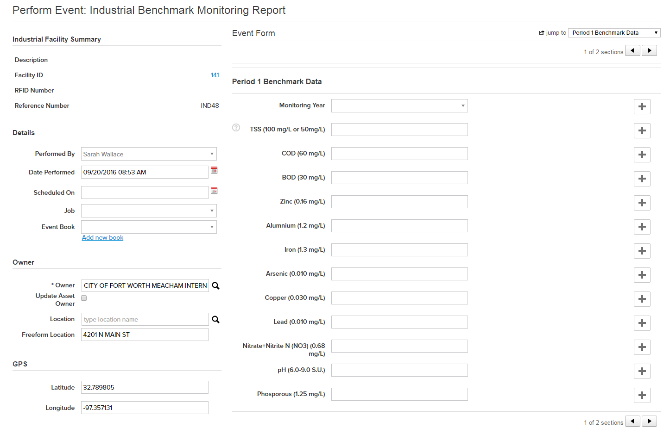
City of Fort Worth Industrial Compliance Program
Notes:
If you selected Industrial Benchmark Monitoring Report, this interface opens and you can enter benchmark data and upload the report that is submitted.

Slide 17
City of Fort Worth
Environmental Management Division
Scope and Methods

Slide 18
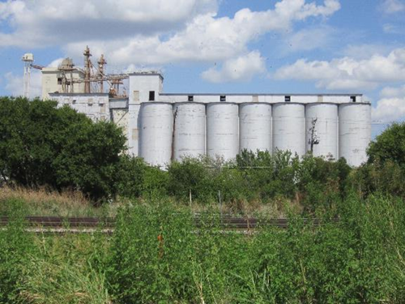
Scope
Years 2013-2015
Facilities that had an inspection violation
Facilities that exceeded a benchmark parameter
Did not include multiple failures or exceedances
Sample size of 32 facilities
Notes:
In order to enhance Fort Worth’s industrial compliance program, benchmark monitoring results and inspection outcomes from 2013-2015 are compared. Analysis seeks to determine if benchmark results are useful indicators of permit violations to aid in prioritizing inspections
Years were chosen because we started using our current database in 2013.
Failed inspections include SWPPP or facility failure. Benchmark- any parameter was exceeded
The picture is of a feed plant in Fort Worth

Slide 19
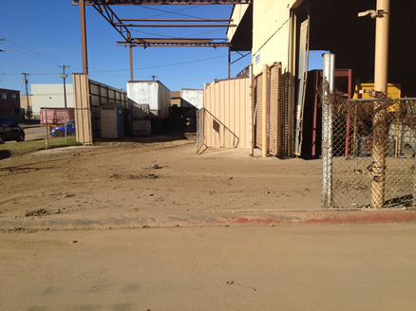
Methods: Sample Size
Extract data from Field ID for facilities that had inspection violations 2013-2015
Extracted data from Field ID for facilities that exceeded benchmark parameters 2014-2016
Compared inspection violations to benchmark exceedances to determine sample size
Notes:
Benchmark reports are submitted by March 31st of following year (hence difference time frame) 2016 dated benchmark are associated with 2015.
Photo: Scrap yard that has a housekeeping violation

Slide 20
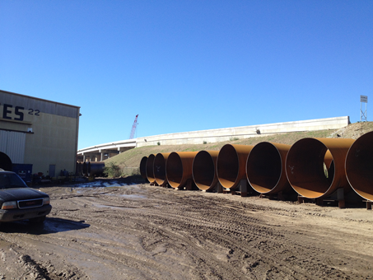
Methods: Data Analysis
Chi-Square test and contingency table
Inspection violation by category
BMPs
Good Housekeeping
Periodic Inspections
Quarterly Visual Monitoring
Records
Training
Notes:
Test for independence between failed inspection and benchmark exceedance
Categorize inspection violations for facilities that exceeded benchmark parameters
Photo: Tank car production facility with BMP/good housekeeping violation

Slide 21
City of Fort Worth
Environmental Management Division
Results

Slide 22
Results: Chi-Square Test
Null Hypothesis H₀
Facility inspection violations are independent of benchmark exceedances
Alternative Hypothesis H₁
Facility inspection violations are not independent of benchmark exceedances
Notes:
Contingency table, df=1, alpha=0.05

Slide 23
Results: Chi-Square Test
Degrees of freedom=1
α= 0.05, 95% confidence interval
Χ²= 0.528
 | Inspection Violation | No Inspection Violation
Benchmark Exceedance | 32 | 43 | 75
No Benchmark Exceedance | 12 | 22 | 34
 | 44 | 65 | 109
Notes:
Contingency table, df=1, alpha=0.05
32 facilities both exceeded benchmark requirements and had an inspection violation (this was our sample size for this presentation)

Slide 24
Results: Chi-Square Test
Based on the results, we cannot reject the null hypothesis
There is no statistically significant relationship between facility inspection violations and benchmark exceedances (p=0.05)
42% of facilities with a benchmark exceedance also had an inspection violation
Notes:
Based on the chi-square value and chi square distribution table,

Slide 25
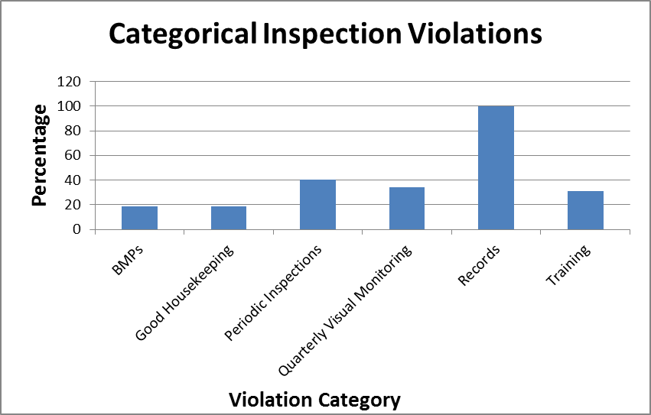
Results: Inspection Violation Category
Inspection violations for facilities that failed inspections and exceeded benchmark parameters
Notes:
n=32

Slide 26
City of Fort Worth
Environmental Management Division
Conclusion and Discussion

Slide 27
Conclusions
Weak relationship between benchmark exceedance and inspection violations
Cautionary use to prioritize facility inspections
Most common inspection violations
Records/documentation
Periodic inspections
Quarterly visual monitoring
Notes:
Take into account the # of benchmark exceedances, we just looked at if they exceeded at least once
Increase number of inspections/frequency- see if that reduces benchmark exceedances

Slide 28
Discussion
Inspection frequency vs. benchmark frequency
Account for recurring benchmark exceedances
Target facilities that exceed a benchmark during consecutive years
Increase sample size
Region 6 comparison
Notes:
Take into account the # of benchmark exceedances, we just looked at if they exceeded at least once
Increase number of inspections/frequency- see if that reduces benchmark exceedances

Slide 29
Discussion
Facility Accountability
External benchmark sampling
Additional benchmark sampling by regulatory agency/contractor
Limited staff and resources
Use benchmark exceedances as a guide for inspection prioritization
Not a strong relationship
City of Fort Worth is planning to increase inspection frequency
Notes:
how representative benchmark monitoring performed by the facility really is, and the possibility of sampling by regulatory agency or independent contractor

Slide 30
City of Fort Worth
Environmental Management Division
Questions
Teressa Cooper
teressa.cooper@fortworthtexas.gov
817-392-5457
Sarah Wallace
sarah.wallace@fortworthtexas.gov
817-392-6301

