Slide 1
State of the Pharr district
Pedro R. Alvarez, P.E.
District Engineer
November 16, 2017

Slide 3
3rd Party Motorists Drivers
Distracted
Under the influence
Speeding
Unrestrained
Statewide Fatalities = 3,370 (9/day)
Pharr District Fatalities = 128
Statewide Unrestrained Vehicle Occupant Fatalities = 943
Pharr District Unrestrained Vehicle Fatalities = 33

Slide 4
Pharr District: Overview
Population | 1,291,048
Area (Sq. Miles) | 8,812
Lane Miles | 6,287,555
Daily Vehicle Miles | 18,887,511
Registered Vehicles | 898,491
TxDOT Employees | 308
The Pharr District plans, designs, builds, operates and maintains the state transportation system within its eight counties.
The district is a coastal district, has 14 international crossings and is a NAFTA corridor.

Slide 5
Hidalgo County MPO
Harlingen - San Benito MPO
Brownsville MPO
MPOs in PHARR DISTRICT
Notes:
ONLY TxDOT DISTRICT IN THE STATE WITH 3 MPOs
FEDERAL CENSUS RECOGNIZES 3 MPOs SERVING 3 DISTINCT URBANIZED AREAS
25 MPOs IN THE STATE
SERVE AS THE PLANNING AGENCY FOR HIGHWAY CONSTRUCTION AND TRANSIT PROJECTS
2 OF THE 3 MPOs ARE CLASSIFIED AS TRANSPORTATION MANAGEMENT AREAS (TMAs) HAVING A POPULATION GREATER THAN 200,000 AND RECEIVE DEDICATED CATEGORY 7 AND TAP FUNDING

Slide 6
Hidalgo County RMA
Cameron County RMA
Cameron
RMAs in PHARR DISTRICT
Notes:
ONLY TxDOT DISTRICT IN THE STATE WITH TWO REGIONAL MOBILITY AUTHORITIES (RMAs)
CREATED SPECIFICALLY TO DEVELOP LARGER PROJECTS, INCLUDING TOLL ROADS
CREATED TO PROVIDE MORE LOCAL DECISION-MAKING AUTHORITY
CONSIDERED BOTH A PLANNING AND IMPLEMENTATION AGENCY
SOMETIMES CALLED A “MINI TxDOT” BECAUSE THEY HAVE MANY OF THE SAME POWERS AS TxDOT (PLAN, DESIGN, FINANCE, BUILD, MAINTAIN, OPERATE, EMINENT DOMAIN, ISSUE BONDS, ETC.)

Slide 7
Pharr District Projects

Slide 8
Construction Projects across the District
Under contract for construction:
48 projects
$455 Million
Substantially completed recently:
15 projects
$ 106 Million

Slide 9
Roadside Maintenance Expenditures
ROUTINE MAINTENANCE
Sweeping $2,282,369.60
Pavement Markings $2,011,945.00
Crack Seal $750,000.00
Bridge Related $1,204,350.00
Traffic Related $1,742,636.00
Seal Coat $2,107,000.00
Overlay $5,325,276.00
FM Mowing $732,000.00
Palm Tree Removal $270,000.00 Miscellaneous $3,711,465.00
Purchase Orders $380,000.00
TOTAL $20,517,041.60
STATE USE PROGRAM
Janitorial $186,184.18
Landscape Maintenance $141,630.00
MBGF Repair $969,666.67
Mowing/Litter (EXPWY) $774,566.00
Mowing/Litter (FM'S) $864,444.00
Debris Removal $208,800.00
Drain Inlet $90,000.00
Grounds Maintenance $28,134.00
TBSIF $14,479.80
Secretarial Assistant $27,480.00 Tree Trimming $173,400.00
TOTAL $3,478,784.65
GRAND TOTAL $23,995,826.25

Slide 10
Pharr District Major Projects

Slide 11
TxDOT Development Projects
TxDOT Project List
SH 68
I-2/I-69C Interchange
Donna International Bridge
Pharr International Bridge
SL 195 (Roma-Rio Grande City)
I-69 E (NB Frontage Road
and Bicycle Lane Improvements)
US 83 La Joya Relief Route
I-2 @ Bicentennial
US 281 (FM 490 to FM 3066)
US 83 (Starr and Zapata County)
US 77 (Kenedy County)

Slide 12
SL 195 (Roma-Rio Grande City)
Project Scope: To provide a four lane divided highway on new location,
approximately 17 miles, around Roma and Rio Grande City
Limits: FM 755 to Loma Blanca Road
Coordination with local officials and development of schematic
and environmental document
Anticipated Completion dates for major phases
Schematic: 12/1/2016
Environmental Clearance: 7/1/2017
PS&E: 8/1/2018
ROW Acquisition: 1/1/2019
Utilities: 7/1/2019
Letting: 7/1/2019
Notes:
Currently updating the alignments to meet new roadway design criteria and working on new option for the Loma Blanca connector at Roma.

Slide 13
I-2/I-69C Interchange
Project Scope: Provide relief to the traveling public along the
I-2/I-69C Interchange by developing and constructing 2-lane connectors
In each direction (S-W, S-E, E-N, and W-N)
Preliminary studies have been done by the Texas A&M Transportation
Institute and the TxDOT Bridge Division
The estimated cost of reconstructing the connectors and improvements
to roadway approaches is $150 Million
A more detailed study is being initiated through a consultant
Phase 1: Consultant has been acquired to preform an analysis to determine
Available options for addressing the interchange
Notes:
I-2 / I-69C Interchange
The I-2/I-69C interchange is one of two major interchanges in the TxDOT Pharr District. During peak times, there is a higher presence of vehicles that slows down the flow of traffic through the interchange. The highest point in average daily traffic that feeds into the system is over 250,000 vehicles per day.
The Texas Transportation Institute studied the metering of some of the ramps that feed into the interchange. The results of the study did not show much overall improvements. TxDOT Bridge Division also studied the possibility of widening the existing direct connectors and determined that it was not feasible. The estimated cost of reconstructing the connectors, along with improvements to the roadway approaches, is approximately $120 million. Furthermore, alternative routes would have to be identified to handle the traffic flow of the over 250,000 ADT during the extended construction phase.
TxDOT Pharr District has initiated a work authorization for a consultant analysis to determine available options for addressing the interchange. The first phase of the analysis is expected to be completed by May 2016.
Sen. Hinojosa, Sen. Lucio and Rep. Martinez have expressed major concern with this issue.

Slide 14
SH 68
Project Scope: provide an additional north-south route
for the region and improve the long-term regional
transportation network
Partnership between Hidalgo County RMA and TxDOT
Proposed 22 mile new road that will connect I-2/US 83 to
I-69C/US 281
The initial preferred route generated significant feedback
from local community
In response to local input and significant impacts along the
preferred route, TxDOT is expanding the study area
New Road alternatives, based on feedback, will be presented
at next public meeting
Public Meeting scheduled for March 2016
Public Hearing scheduled for March 2018
Notes:
SH 68
As population and traffic increases so does the need for an additional north-south highways in the Rio Grande Valley. The SH 68 project has been identified as a potential project to provide an additional north-south route for the region and would also be an improvement to the long-term regional transportation network. The SH 68 project is a partnership between Hidalgo County RMA and TxDOT.
SH 68 is a proposed 22 mile new road that will connect I-2/US 83 to I-69C/US 281. The proposed road will connect with I-2/US 83 between Alamo and Donna and run north to I-69C/US 281 at FM 490, north of Edinburg.
The initial preferred route generated significant feedback from the local community. In response to local input, TxDOT is expanding the study area and performing an environmental impact study. With the expansion of the study area, new road alternatives based on public feedback will be presented in the next public meeting. While the environmental studies are ongoing, alternative options will be presented in a public meeting was held on March 15, 2016.
Rep. Martinez is supportive of the project and has closely monitored its progress.

Slide 15
Donna International Bridge
Federal Inspection Facility NB
New project requested by City of Donna
Environmentally cleared in November 2005
This project is Phase II of the Donna International Bridge Master Plan
Potential candidate for FAST Act Grants
NOTE: City of Donna is currently developing Phase I of their Master Plan (SB Empty Commercial Facility);
Notes:
DONNA INTL. BRIDGE (FEDERAL INSPECTION FACILITY NB)- PHASE II OF THE BRIDGE’S MASTER PLAN; NEWLY REQUESTED BY CITY OF DONNA. THE CITY IS ANTICIPATING HEAVY TRUCK TRAFFIC, THRU DONNA INTL. BRIDGE, WITH THE CREATION OF THE MAZATLAN-MATAMOROS HIGHWAY. HOWEVER, THEY NEED TO DEVELOP AND CONSTRUCT THE INSPECTION FACILITIES FOR THE TRUCK INSPECTIONS BY THE END OF 2018.
(SITE PLAN OF PLANNED INSPECTION FACILITIES IN THE FOLLOWING SLIDE.)

Slide 16
Donna International Bridge Site Plan
Notes:
SITE PLAN SHOWING THE 4 PHASES OF FACILITY DEVELOPMENT.
PHASE I- SOUTH BOUND EMPTY COMMERCIAL FACILITY (UNDER DEVELOPMENT) APPROX. $9 MILLION (FUNDED WITH CBI)
PHASE II- NORTH BOUND EMPTY COMMERCIAL FACILITY (PENDING DEVELOPMENT) APPROX. $22 MILLION (NOT FUNDED)
PHASE III- NORTH BOUND LOADED COMMERCIAL FACILITY (PENDING DEVELOPMENT) APPROX. $20 MILLION (NOT FUNDED)
PHASE IV- SOUTH BOUND LOADED COMMERCIAL FACILITY (PENDING DEVELOPMENT) APPROX. $11.2 MILLION (NOT FUNDED)
TOTAL COST FOR CONSTRUCTION & CONSTRUCTION ENGINEERING REQUIRED FOR PHASES II TO IV IS APPROXIMATELY $53.2 MILLION

Slide 17
Donna Intl. Bridge Phase I (SB Empty Commercial Facility)
Purpose: Develop the southbound inspection facilities at the Donna/ Rio Bravo International Port to transport commercial vehicles from the U.S. to Mexico.
Currently, only passenger automobiles are allowed into and out of the port.
Scope includes:
Reconstruction and widening of existing southbound roadway (meeting trailer requirements)
Addition of two (2) toll booths (total) at primary and secondary inspection stations
Upgrades to drainage facilities with respect to reconstruction modifications (minimal)
Installation of X-Ray (VACCUS) unit on Southbound facility (Subject to change)
Notes:
THIS SLIDE SHOWS THE STATUS OF THE DONNA INTL. BRIDGE PHASE I, CURRENTLY UNDER DEVELOPMENT BY CITY OF DONNA.

Slide 18
Donna Intl. Bridge Phase I (Status of Project)
Coordinated Border Infrastructure (CBI) funds allocated to project and approved by FHWA ($9 M for construction)
Environmental Assessment (EA) document approved
Additional Right-of-Way is not needed
Plans, Specifications, and Estimate (PS&E) package at 100%. Planning and Specifications discussion is being held between CBP, GSA, consultant PM, and TxDOT. (Plans subject to change upon review).
Update: Upon CBP review, 100% plans to be redesigned due to CBP requirements
Notes:
PHASE I TO BE FUNDED BY CBI FUNDS….APPROXIMATELY $9 MILLION FOR CONSTRUCTION ONLY. CITY OF DONNA IS FUNDING THE PS&E DEVELOPMENT.
ANTICIPATED LETTING: SEPTEMBER 2016

Slide 19
Border Infrastructure Funding (Rider 11B)
FY 16-17
FY 18-19 – To Be Determined
Notes:
Border Infrastructure Funding (Cat. 11-District Discretionary)
Border Infrastructure (FAST Act) and Rider 11(b) funding of $60 million will be distributed to three border districts (PHR, LRD, ELP), during FY2016 and FY2017, for projects within 50 miles of ports-of-entry.
The FAST Act authorized states that border Canada or Mexico to designate up to 5 percent of its Surface Transportation Block Grant Program funds (approximately $22 million in Texas) for border infrastructure projects.
Rider 11(b) in the General Appropriations Act 2016-2017 allocates additional funding each year of the 2016-2017 biennium to the three TxDOT Districts along the Texas-Mexico border. Sen. Hinojosa has been very interested in this funding

Slide 20
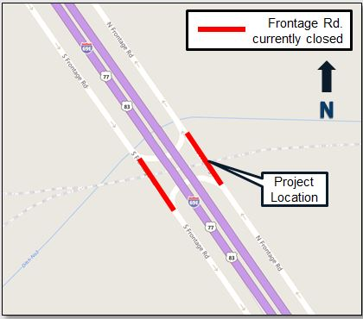
I 69-East NB Frontage Road and Bike Lane Improvements
Project scope: Provide continuous northbound frontage road between Merryman Road and Old Alice/Stillman Rd.
and Provide North/South movement across Union Pacific Railroad for pedestrians and bicyclists
Project was selected as the top priority by Brownsville MPO
To be funded by Category 7
Four options have been presented to the BMPO and City of Brownsville
No public involvement has taken place to date
Anticipated Letting: December 2017
Notes:
Project is located in Cameron County along IH69-E between Merryman Rd and Old Alice/Stillman Rd.
Proposed bridge structures along the north bound frontage roads crossing above the Union Pacific Railroad tracks.
The preferred Option by City of Brownsville and BMPO is estimated at $18 Million
Additional
ROW
Safety
Concerns
Access
Construction
Cost

Slide 21
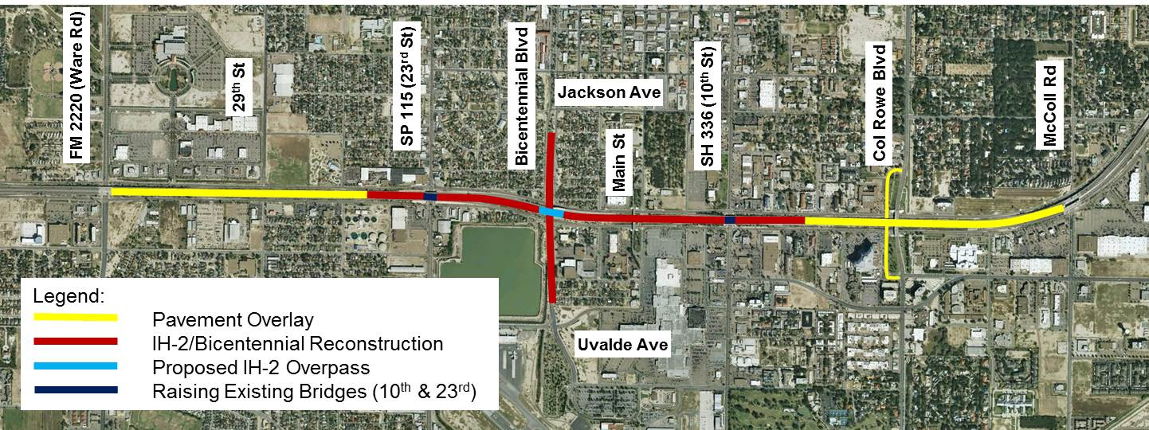
TxDOT Major Projects Under Construction
US 83 La Joya Relief Route
Project let in July 2015
Construction cost, over $87 Million
ROW Acquisition is pending for most of the project, but in process
Estimated completion date, June 2020
I-2 @ Bicentennial
Partnership with City of McAllen
Project let in November 2015
Construction cost, $46.1 Million
Estimated completion date, April 2019
Notes:
US 83 – La Joya Relief Route
This project consists of constructing a new four lane divided rural highway allowing improved east-west travel for through traffic to bypass the congested urban area in the city of La Joya. The new route will have a 38 ft. roadway in each direction consisting of a 4 ft. inside shoulder, two 12 ft. travel lanes, and a 10 ft. outside shoulder. There will be a 234 ft. median separating the east and west lanes. The median may be used for future expansion (potential for toll road improvements). The project will be constructed within a proposed 400 ft. right of way.
The project was let in July 2015 with an estimated cost of over $87 million (includes Proposition 1 funding). Right of way acquisition for most of the project is still pending. At this time the estimated completion date of the project is June 2020.
Rep. Martinez and Rep. Guerra have inquired about the project.
I-2 & Bicentennial
The project consists of interchange improvements at the intersection of I-2 and Bicentennial Blvd. in McAllen. Currently, the exit from westbound I-2 to Bicentennial Blvd. is closed, making it less convenient for drivers to access Bicentennial Blvd. from the interstate. Additionally, the overpasses at I-2 and 10th and 23rd streets are low and require high-profile vehicles to use extreme caution when traveling under I-2 on these nearby intersections. The project is a partnership between the City of McAllen and TxDOT.
The project will remove the existing I-2 underpass at Bicentennial Blvd. and replace it with an overpass. The project will also raise the overpasses on 23rd St. and 10th St. Bike and pedestrian improvements are also included to create safer bike and pedestrian access.

Slide 22
TxDOT Development Authority Projects
US 281 (FM 490 to FM 3066)
US 83 (Starr and Zapata Counties)
US 77 Kenedy County
SL 195
Notes:
US 281 (FM 490 to FM 3066)
Consultant on board to develop schematic and environmental document to upgrade to interstate standards for future I-69C designation from FM 490 north of Edinburg in Hidalgo County to FM 3066 south of Falfurrias in Brooks County
Approximately 40 miles
US 83 (Starr and Zapata Counties)
Acquire a consultant to develop PS&E for a four-lane divided highway from Loma Blanca Road in Starr County to FM 3169 in San Ygnacio in Zapata County
Approximately 30 miles
US 77 Kenedy County
Coordinating with FHWA to request an exception to interstate standards along segment of US 77 within Kenedy County to designate as I-69E.
Also, coordinating with FHWA for acceptable interim measures for interstate designation.
Approximately 50 miles

Slide 23
Pharr District RMA Major Projects

Slide 24
Hidalgo County Regional Mobility Authority Projects
Project List
SH 365 (Segments 1, 2, 3 and 4)
International Bridge Trade Corridor (IBTC)
Hidalgo County Loop Project (Section A)
Hidalgo County Loop Project (Section C)

Slide 25
SH 365 (Segments 1, 2, 3, and 4)
Project Scope: Develop and construct a four-lane
divided controlled access toll facility along a new
location (Segments 1 & 2), and a non-tolled divided
highway with an overpass at San Juan Road along
US 281 with the BSIF Connector (Segment 3)
Environmentally cleared in July 2015 (Segments 1-4)
ROW acquisition is on-going by HCRMA for Segments 1 & 2
Segment 1 and 2
From FM 396 (Anzalduas Highway) to US 281
(Military Highway), approx. 15.2 miles in length
Scheduled for letting November 2017 by HCRMA
Estimated cost: $162 Million
Segment 3 (US 281 and BSIF Connector)
Project was let in September 2015
Contract was awarded in November 2015
Bid Price: $19.4 Million by Foremost Paving, Inc.
Approximately 18 months to complete
Segment 4
Was cleared environmentally with segments 1-3
Not being developed at this time
Notes:
Hidalgo County RMA SIB Loan for SH 365 Project
The Hidalgo County Regional Mobility Authority has applied for a State Infrastructure Bank (SIB) loan in the amount of up to $42,210,000 to pay for costs of constructing Segments 1, 2, and the Border Safety Inspection Facility Connector (part of Segment 3) of the SH 365 project. TxDOT is a partner on the SH 365 project.
The SH 365 project includes three segments of construction of both toll and non-toll improvements from FM 396 (Anzalduas Highway) to US 281 (Military Highway) for a project length of 15.2 miles (project). Segments 1 and 2 are for construction of toll road improvements from FM 396 (Anzalduas Highway) to US 281 (Military Highway). Segment 3, which constitutes US 281 and the Border Safety Inspection Facility (BSIF) Connector, is a non-toll improvement from 0.45 Mile East of Spur 600 (Cage Blvd) to FM 2557 (Stewart Rd), and from Spur 29 (S Veterans Drive) to US 281 (Military Highway) below the San Juan Rd overpass.
On February 5, 2016, Hidalgo County officials commemorated the groundbreaking of State Highway 365. The project is intended to create a smooth flow of commercial traffic passing through the Rio Grande Valley from Mexico.
The beginning phase involves building a 2-mile overpass at the intersection of US 281 (Military Highway) and San Juan Road. The overpass will also be connected to the Pharr international port of entry and the Border Safety Inspection Facility. This first portion of the project is expected to be completed in 18 months and is slated to cost $19.4 million in state funding for construction.
The project is part of Hidalgo County RMA’s master plan for the “Hidalgo County Loop System”, a 120-mile long system that is expected to be completed in 25 to 30 years which includes State Highway 365, State Highway 68, the U.S. 83 Relief Route and the International Bridge Trade Corridor.
Preliminary approval of the SIB loan was given by the Commission in October of 2015. TxDOT Innovative Financing/Debt Management Office continues to work with the Hidalgo County RMA for final approval.
Sen. Hinojosa and Rep. Martinez have closely monitored the status of the SIB loan.

Slide 26
IBTC
Project Scope: Develop and construct a four-lane
access controlled toll-road from the interchange
with SH 365 near FM 3072 (Dicker Road) to I-2,
and from the Valley View Interchange to FM 493
In two phases
Approximate project length is 13.2 miles
Estimated construction cost: $122 Million
HCRMA will resume developing the Environmental
document this month
Schematics for all three segments are approximately
40%-60% complete
Phase 1
Construct a four-lane toll road from SH 365 to I-2
Construct a two-lane connector road from Valley
View Interchange to FM 493
Phase 2
Construct toll road main lanes and an additional
Frontage road from the Valley View Interchange
To FM 493
Notes:
IBTC Segments 1 - 3 consists of two phases of construction of toll improvements of independent utility from the Interchange with SH 365 near FM 3072 / Dicker Road to I-2 and from the Valley View Interchange to FM 493 for project length of 13.2 miles.
Phase 1 construction will consist of Segment 1 and 2 being initially built as a 2+2 tollroad with Segment 3 being built as a 1+1 lane connector road (1 lane each way) for connection between the Valley View Interchange and FM 493. Phase 2 construction (to be undertaken by the HCRMA at a later time) will consist of tollroad main lanes and an additional frontage road from the Valley View Interchange to FM 493.
The HCRMA has the ability to conduct most of the advanced planning on the entire project; but it will require that the IBTC be made into State on-system facility before exploring potential funding considerations with project stakeholders.

Slide 27
Cameron County Regional Mobility Authority Projects
Project List
South Padre Island 2nd Access
SH 550/ I-169
SH 32 West and SH 32 East
Outer Parkway
FM 1925 Extension
US 281 Connector
West Boulevard (formerly known as West Parkway)

Slide 28
South Padre Island 2nd Access
Project Scope: Develop a project to provide a second point of access between South Padre Island and the mainland.
The purpose of the proposed 2nd Access Project is: to facilitate congestion management during peak travel periods
and emergency evacuations; to provide the infrastructure necessary to support economic development, enhance safety
and mobility (both locally and regionally); and to deliver the much needed transportation system improvements in a timely
and environmentally sensitive manner.
Environmental Impact Statement
is under development in a partnership
between TxDOT, CCRMA, and FHWA
Environmental decision is expected
tentatively by Summer 2017
Industry Workshop was held on
March 1, 2016 at South Padre Island
One-on-One meetings were held
With interested developers during late
March/early April 2016
Project is currently unfunded
Notes:
2nd Access Project – South Padre Island
The Cameron County RMA, in partnership with TxDOT, is developing a project to provide a second point of access between South Padre Island and the mainland. The purpose of the proposed 2nd Access Project is: to facilitate congestion management during peak travel periods and emergency evacuations; to provide the infrastructure necessary to support economic development, enhance safety and mobility (both locally and regionally); and to deliver the much needed transportation system improvements in a timely and environmentally sensitive manner.
As currently envisioned, the limits of the proposed project would extend from SH 100 to Park Road 100, crossing the Laguna Madre. Connection points to SH 100 and Park Road 100 have not yet been determined and would be contingent upon the alternative ultimately selected for the proposed facility. A number of project alternatives - including possible route alternatives and the "no-build" alternative - have been identified and are being considered. Additional alternatives may be identified as the project is developed further.
The proposed 2nd Access Project is being developed in accordance with the National Environmental Policy Act (NEPA) of 1969. Accordingly, an environmental impact statement (EIS) is being prepared. An EIS is a full-disclosure, public document that is prepared when it is determined that a proposed action or project may cause significant impacts to the environment. An EIS includes an analysis of reasonable alternatives (including the "no build" alternative) and an assessment of potential project-related impacts to the natural and human environment. Through the EIS process, a broad range of environmental issues will be studied and the findings reported. Generally, impacts could include the following: water quality impacts (from construction activities and roadway storm water runoff); impacts to waters of the United States (takings of and/or modifications to wetlands); impacts to cultural resources; impacts to ecological resources (reduction in wildlife habitat); impacts to farmlands (conversion of farmland soils); and impacts to residents and businesses (potential relocations, displacements), including air and noise impacts from construction equipment and operation of the roadway.
The second access will consist of three major components; the mainland roadway, the Laguna Madre crossing bridge, and the island roadway. The route under consideration includes a four-lane road crossing across Laguna Madre with approximately 8 miles of tolled lanes. The total length of the second access will be about 17.6 miles. At the moment, the final environmental clearance is estimated to be approved by Summer 2017 by FHWA. Upon approval of the environmental clearance, construction can be expected to commence in 2017 or 2018.
Sen. Lucio is supportive of the project and has closely monitored its progress.

Slide 29
SH 550/ I-169
Project Scope: Develop and construct an access controlled toll road facility from I-69E/US 77 to SH 48,
at a new Port of Brownsville entrance
Project length: approximately 10 miles
Two gaps (shown in orange below) pending design and construction to complete the corridor
Gap #1, approximately $6 Million construction cost
Gap #2, approximately $14 Million construction cost
A segment of SH 550, from I-69E
to Old Alice Road (approx. 1.5 miles)
was designated as I-169
Notes:
I-169 (SH 550)
In 1991 federal legislation identified Farm-to-Market Road (FM) 511 from US 77, recently designated as Interstate 69 East (I-69E), to the Port of Brownsville as part of the High Priority Corridor 18 system on the National Highway System (NHS).
In August 2008, the Texas Transportation Commission took action to designate FM 511 from I-69E to Old Port Isabel Road as well as a proposed new section of roadway from Old Port Isabel Road to SH 48, at a proposed new Port of Brownsville entryway, as SH 550.
Once completed, SH 550 will extend approximately 10 miles connecting I-69E to SH 48 at the new Port of Brownsville entrance. Furthermore, as additional connecting access controlled four-lane divided tolled highway segments of SH 550 are completed and extended towards the port, subsequent Interstate designation requests for those segments would be made.
To advance the development and designation of the I-69 system in Texas, in response to the enacted federal legislation, TxDOT has conducted a study of a 1.5-mile segment of SH 550 in Brownsville, Texas, from I-69E to Old Alice Road which is an access controlled, four-lane divided highway (two lanes in each direction) tolled road. The construction of this segment of SH 550 was completed in early summer of 2015.
In December 2015, the Texas Transportation Commission designated a segment of the state highway system as I-169, concurrent with SH 550 from existing I-69E to Old Alice Road in the city of Brownsville, a distance of approximately 1.5 miles.

Slide 30
SH 32 West and SH 32 East
Project Scope: Reduce congestion for local and regional passenger vehicles in the SH 4 and SH 48 corridor through Brownsville by
providing an improved commercial vehicle facility from the Port of Brownsville to the Veterans Bridge at Los Tomates via
this new four-lane facility.
The new location roadway is anticipated to be the new Overweight/Oversize Corridor, once it is constructed.
The new location will also improve safety in the City of Brownsville by removing the Overweight/Oversize trucks
from within the urbanized area and the many school zones along the current route (SH4 and SH 48).
The project is being developed in two segments (SH 32 West, and SH 32 East)
SH 32 West
Limits: From US 77/I-69E to FM 3068
Estimated Const. Cost: $53.2 Million
Environmental Clearance expected by
December 2017
Anticipated Letting in
ROW Acquisition is pending
SH 32 East
Limits: From FM 3068 to SH 4
Estimated Const. Cost: $23 Million
Environmental Clearance expected by
December 2017
Anticipated Letting in
ROW Acquisition is pending
Project is partially funded with Pass
Through Tolls, and Federal funds.
Notes:
SH 32 – East Loop Corridor
The East Loop Corridor project aims to reduce congestion for local and regional passenger vehicles in the SH 4 and SH 48 corridor through Brownsville by providing an improved commercial vehicle facility from the Port of Brownsville to the Veterans Bridge at Los Tomates via this new four-lane facility.
All first response vehicles, including local and regional police, fire, and EMS services, will have safe access in the South and East Sector of Brownsville. The project will also enhance connectivity to the Brownsville/South Padre Island International Airport and the Airport Foreign Trade Zone. All international trade-related commercial traffic between the Port of Brownsville and the Veterans Bridge at Los Tomates will see a significant improvement in mobility.
The project is being led by the Cameron County RMA with funding partnerships with, TxDOT, the Port of Brownsville, Cameron County, TxDOT, and the City of Brownsville. SH 32 was awarded Rider 11(b) funding.

Slide 31
Outer Parkway
Project Scope: Develop and construct a four-lane access controlled toll road from US 77/I-69E to General
Brant Road.
Approximately 21.5 miles in length
This corridor would provide a more efficient
route for traffic traveling to or from
South Padre Island to the Interstate.
Anticipated construction cost: $180 Million
CCRMA will begin developing the project
schematic and environmental assessment
in the near future.
Notes:
Outer Parkway Project
This is a planned 21.5 mile tolled facility extending from I69E eastward to General Brant Rd. This corridor would provide a more efficient route for traffic traveling to or from South Padre Island to the interstate. Early corridor identification reports have shown the project to meet the needs of enhancing east to west mobility, improve efficiency of hurricane evacuation, and promoting economic development in the region.
TxDot has approved a five million dollar Toll Equity loan to promote the further study of the project in which the CCRMA plans to begin drawing on in FY2016 for the development of the schematic and Environmental studies.

Slide 32
FM 1925 Extension
Project Scope: Provide direct connectivity between I-69C in Hidalgo County and I-69E in Cameron County.
First collaborative project between
Cameron County RMA and Hidalgo County RMA
CCRMA will be the project lead
TxDOT will be coordinating with CCRMA in
the development of the schematic and
environmental process of this project
The environmental process is expected to
be completed in two years
The project was initially being developed
by TxDOT in 2006.
A public meeting was held in May 2007,
and schematic was 95% complete.
However, in 2008, development ceased
Due to financial constraints by the State.
In November 2015, TxDOT conducted a
“Needs Assessment” for this project.
Based on the forecasted traffic volumes, a Super 2 highway would be desirable by 2020. Future expansion
to a four-lane freeway may occur by 2035 to 2040.
Notes:
FM 1925 Extension
The project would provide direct connectivity between I-69C in Hidalgo County and I-69E in Cameron County. This would be the first collaboration between the Cameron County RMA and Hidalgo County RMA, in coordination with TxDOT.
Currently, the project plans and the environmental document are being developed. Assuming an Environmental Assessment process is all that is necessary, it is anticipated that environmental clearance will be acquired within two years. Cameron County RMA will be taking the lead role in developing the project

Slide 33
US 281 Connector and West Boulevard
Future Projects
US 281 Connector
West Boulevard (formerly West Parkway)
Notes:
US 281 Connector
CCRMA is planning to develop this project to provide a connection between US 281 Military Highway and I-69E, in the vicinity of SH 100
West Boulevard (formerly known as the West Parkway)
CCRMA is planning to develop this project to provide a connection between B&M Bridge and I-69E, approximately 8 miles.
This roadway would be constructed along the abandoned Railroad ROW that UPRR occupied before the construction and operation of the West Rail Railroad Relocation Project (operational as of August 2015).
This project would be a joint effort between CCRMA, Cameron County, and the City of Brownsville.
This project was previously being developed by CCRMA in 2008 as a toll road, but development stopped due to public input. (One Public meeting was held in May 2008.)

Slide 34
Cameron County Transportation Reinvestment Zone
Agreement between Cameron County and CCRMA was executed on December 29, 2105
Estimated to generate over $1.6 Billion over 50 years
Maximum Annual Tax Increment Transfer will not exceed 25% of Tax Increment annually
Over 50 projects are listed in the agreement as future development
Notes:
Cameron County Transportation Reinvestment Zone
In December 2015, Cameron County Commissioners approved an order establishing a County-Wide Transportation Reinvestment Zone (TRZ) that is projected to support approximately $1.6 billion in transportation projects that will promote safety, support development, and facilitate the movement of traffic in Cameron County. The County also approved an agreement between Cameron County and the Cameron County RMA (CCRMA) that identifies projects that are critical to the long term transportation infrastructure needs of the county.
The plan calls for the county to dedicate a portion of the tax increment on property in the TRZ to fund the development of some or all of the projects. This plan specifically calls for funds raised from the tax increment to be leveraged with other funding sources (federal, state and local) to finance the project development, rehabilitation/reconstruction of roads, and construction of new corridors. In approving the measure the Commissioners Court is assured that projects on the list will be developed accordingly and that the annual tax increment available to the CCRMA will be capped at 25%.
The proposed project improvements are short term, mid-term and long-term and will be built based on the project development demands and complexities of each individual project. Projects benefiting from the TRZ should begin to be selected over the course of the next 12 to 24 months.

Slide 35
Major Project Development Cost Summary
Entity | Number of Projects | Total Construction Cost
TxDOT Major Projects | 8 | $1,356,200,000
HCRMA Projects | 3 | $303,400,000
CCRMA Projects | 7 | $1,281,200,000
Total Major Projects Under Development by TxDOT, HCRMA, and CCRMA
$2.94 Billion

Slide 36
Funding Revenue Forecast
Dist. Funding Sources | FY 2018 | FY 2019
CATEGORY 1-12 | $ 145.45 | $ 105.58
RMC | $ 16.25 | $ 15.00
Pass Thru | $ - | $ -
LOCAL/RMA | $ 214.57 | $ 34.31
Letting Total | $ 376.27 | $ 154.89
Note: $ 170 M in FY 18 is SH 365 by HCRMA

Slide 37
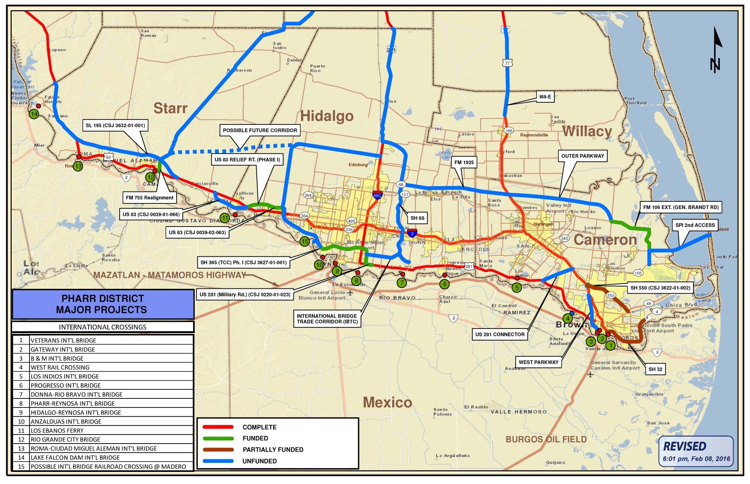
Questions?

Slide 38
Thank You!

