Slide 1
GRID, Reports, & Applications
Michael Chamberlain – TPP, Data Management
November 16, 2017

Slide 2
Table of contents
1
Data Management
3
2
Pre GRID
4 - 6
3
GRID
7 - 16
4
Reports
17
5
Planning Map
18-19
6
Open Data Portal
20
7
Closing
21

Slide 3
Data Management
Mapping Branch – Chris Bardash
GIS linework (313,656 miles of measured linework)
City Streets
County Roads
State Highways
Base Map layers
Administrative Boundaries (City, MPO, County, Maintenance)
Railroad Lines
Cemeteries
County Road Inventory
Statewide Planning Map
Open Data Portal
Project Tracker
ArcGIS Online
Statewide GIS Coordination
Roadway Inventory Branch – David Freidenfeld
Geo-spatial Roadway Inventory Database (GRID)
Training/User Management
Enhancements and Testing
Highway Performance Monitoring System (HPMS)
Annual Reports
Functional Classification
National Highway System
Texas Trunk
Urbanized Areas
Highway Designations (Minute Orders)
Statewide Roadway Inventory Coordination

Slide 4
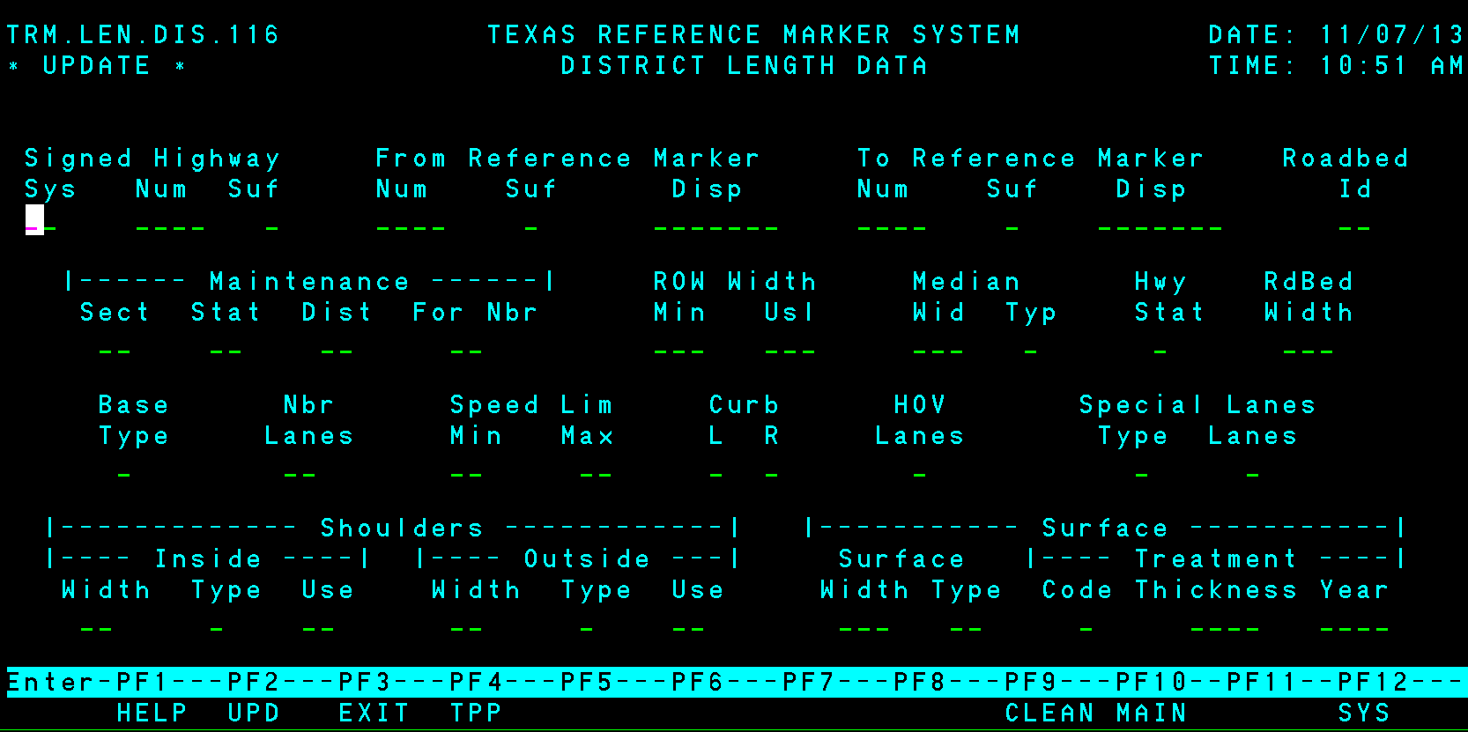
Pre GRID
Texas Reference Marker System (TRM)
Development began in 1988 and went live in 1995.
Only On System Highways
Reference Marker LRM (did not incorporate control section mile points or distance from origin LRMs)
Non-spatial
Limited business rules and data validation
Off System maintained in a different system (County Roads and City Streets)
Data maintainers worked in a temporary space and IT analysts wrote custom programs to submit changes to the system

Slide 5
Pre GRID (LRMs)
Reference Markers
DFOs
Control Section Milepoints
On-system Inventory management
GIS Roadway linework
Off-system Inventory management
Construction Project Management system
100
102
104
150
CSM
0
CSM
27
CSM
1
CSM
24
1086-01
1086-02
DFO
100
RM = 140 +1.7
DFO = 141.7
CSM = 15.7
DFO
150

Slide 6
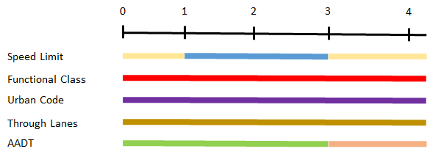
Pre GRID
Visualizing Attributes
External programs converted Marker and Displacement to Distance From Origin for visualization in GIS
Notes:
Mention that assets break at different locations

Slide 7
GRID
Project began in August 2009
Reviewed multiple proposals including Roads and Highways
Selected a custom solution (Geospatial Roadway Inventory Database)
2010 – Project design and system requirements
2011 – Project redesign and system requirements
2012 – System requirements
2013 – Initial components and data migration
2014 – Project consolidation, data migration, and testing
2015 – Project went live September 1st

Slide 8
GRID
GIS based
Multiple LRM’s (and remove old systems)
DFO, Markers, Control Section Mile Points, Latitude, Longitude Coordinates
Latitude and Longitude Coordinates determine locations
Normalized data model
One table per attribute
Business rules engine
500 business rules
Simplified workflow
No secondary team of IT folks to write the data back to the DB

Slide 9
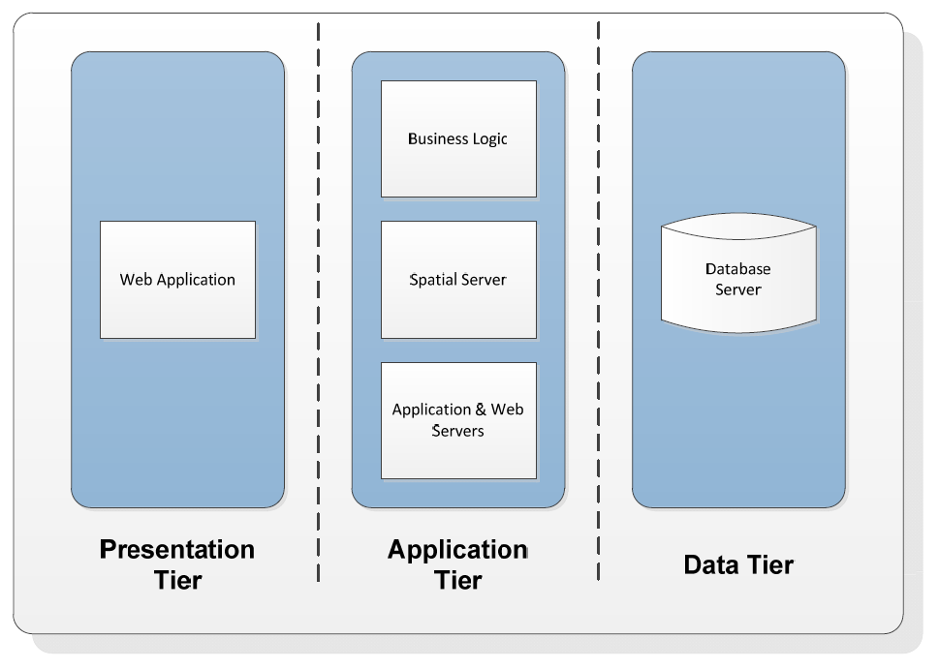
GRID
Web app
Hosted in the Amazon Cloud
Oracle Spatial DB
ArcGIS Server Mapping Component
HTML5 User Interface
Notes:
3 tier architecture

Slide 10
GRID
Added Latitude and Longitude as an LRM
TPP – Data Management uses construction plans, aerial photography, and GPS to manage GIS linework
Latitude/Longitude values are the underlying base reference
Distance from Origin (DFO) values are calculated based on feature length
GIS linework is passed to GRID where users manage Linear Referencing Systems (LRS) and 120+ attributes
Control Section
Reference Marker
X,Y
X,Y
X,Y
X,Y
X,Y
X,Y
X,Y
1
3
5
0
2
4
6
2
2
0
2
2
2
0001-01
0001-02
0001-03

Slide 11
GRID

Slide 12
GRID
Point and Click LRM Tools

Slide 13
GRID
GRID Asset Table
Basic table model for 120+ assets
Asset Type
Begin Lat
Begin Long
End Lat
End Long
Shape

Slide 14
GRID
Roadway Updates
Assets within 53’ tolerance are snapped to the new alignment
Realignment process applied to 120+ assets

Slide 15
GRID
Types of Users and Roles
TPP Users
Administrators: Create users, Assign Roles/Groups
ETL Users: Load Roadway (and other) GIS data
Reviewers: Assign/Review jobs
Maintainers: Work jobs
District Users (former TRM editors)
Reviewers: Assign/Review jobs
Maintainers: Work jobs
Edit Data within their District
Read Only Users
Access to the Map
Access to the LRS Readout Tools
All Editors must take formal training class (PLN-216)
Read Only users attend WebEx training
Weekly Asset Review Project - WebEx
TPP “Office Hours” to help District staff dedicate time to and ask questions about GRID
Every 4th Tuesday
Statewide Review of Assets Project (Maintenance Section, Surface Type, Median Type, Roadway Design, Number of Lanes)
Next meeting is December 5th due to the holiday schedule
Data Management Wiki
Notes:
GRID Geospatial Roadway Inventory Database System
Will replace TRM and RI as the roadway inventory for Texas.
TRM started in 1995.
RI in the mid 1950’s
Last hand drawn county maps 1992. Last MicroStation county maps 2001.
GRID brings the road map and road data into one geospatial format.
Users of GRID data
Highway Performance Monitoring System (HPMS)
Pavement Management Information System (PMIS)
Maintenance Division
CRIS
Traffic Operations – speed zones
TxDOT Administration and Planners
UTP Project Scoring
Top 100 Most Congested
Ad hoc requestors (public, legislature and government entities)

Slide 16
GRID
TxDOT Consumers of Roadway Inventory and GIS linework
Statewide Traffic Analysis and Reporting System (STARS)
Unified Transportation Program (UTP)
District Construction Information System (DCIS)
Pavement Management Information System (PMIS)
Crash Record Information System (CRIS)
TxDOT Districts and Divisions as part of their normal TxDOT work processes
External Consumers of Roadway Inventory and GIS linework
Federal Highway Administration (FHWA)
Texas Comptroller of Public Accounts
Texas Department of Motor Vehicles
Texas Department of Public Safety
Texas Natural Resources Information Service
Texas Commission on Environmental Quality
Texas Parks and Wildlife Department
All 254 Texas Counties

Slide 17
Reports
Attributes and Locations Summarized
At the end of the reporting year, we summarize the full body of attributes and location information into a series of reports. These reports are made available on TxDOT.gov and are the basis for all inventory related public information requests and statewide analysis within the next data year. The federal reporting deadline is June 15th.
Standard Reports
Highway Performance Monitoring System (HPMS), key ingredient for motor fuel tax reimbursements from FHWA
Annual Reports (PDF and GIS Version)
Multi-Year Roadway Data Tables (Excel Version)
County Road Inventory
Interesting Facts for 2016
 | On System | Off System | Total | State Rank
Centerline Miles | 80,483 | 233,172 | 313,656 | 1st
Lane Miles | 195,964 | 481,955 | 677,919 | 1st
Daily Truck VMT | 68,778,625 | 7,751,175 | 76,529,800 | 1st
Daily VMT | 537,150,365 | 204,005,017 | 741,155,382 | 2nd
Annual Reports

Slide 18
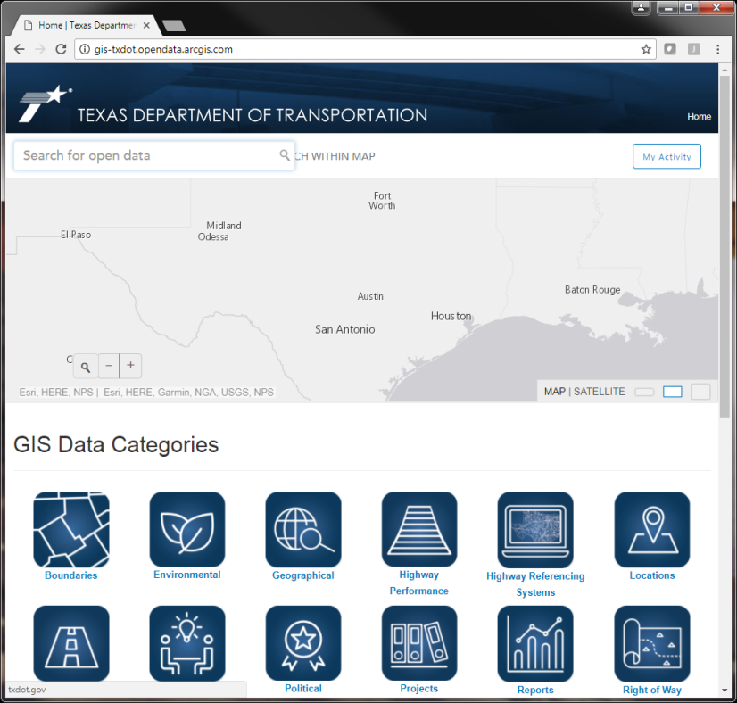
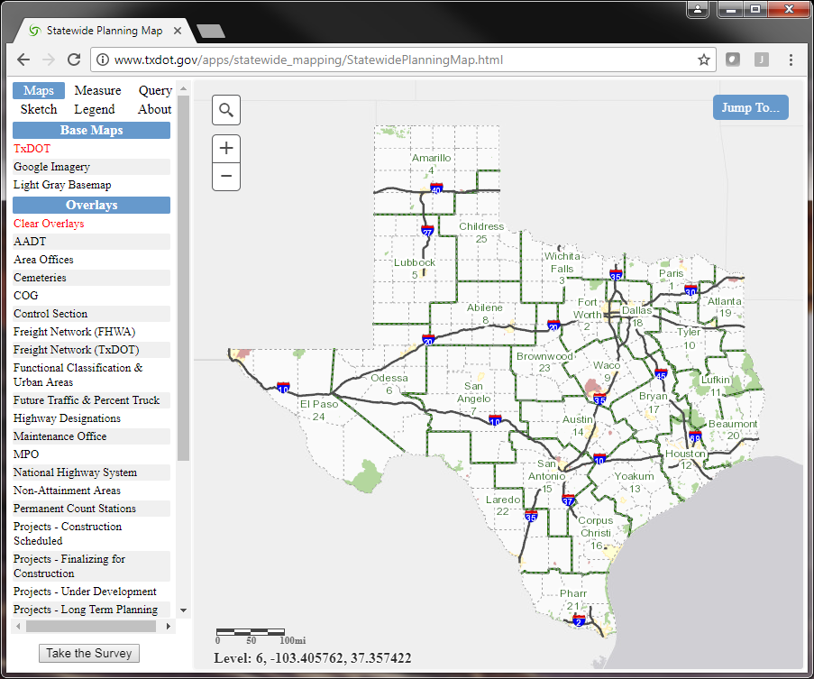
Applications
Applications allow users to visualize and query Attributes, Locations, and Systems
Think of applications as the finish line. All the work by Districts and TPP – Data Management maintaining the roadway inventory attributes, locations, and systems is put to use in applications.
Applications Available to the Public:
Statewide Planning Map
Open Data Portal

Slide 19
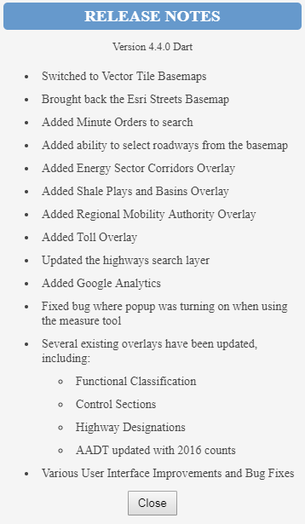
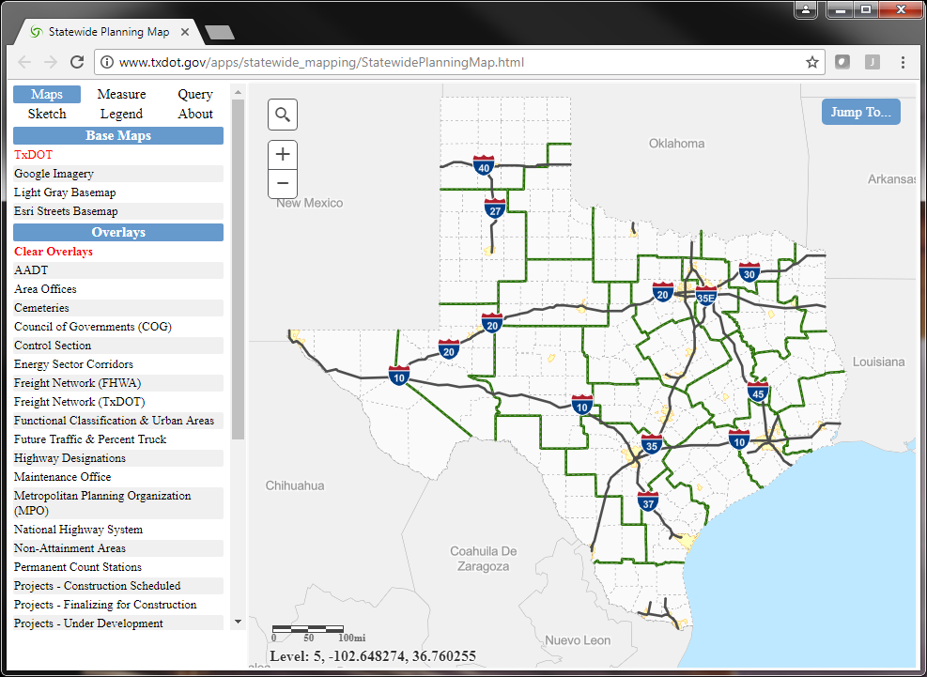
Applications - Statewide Planning Map
Statewide Planning Map

Slide 20
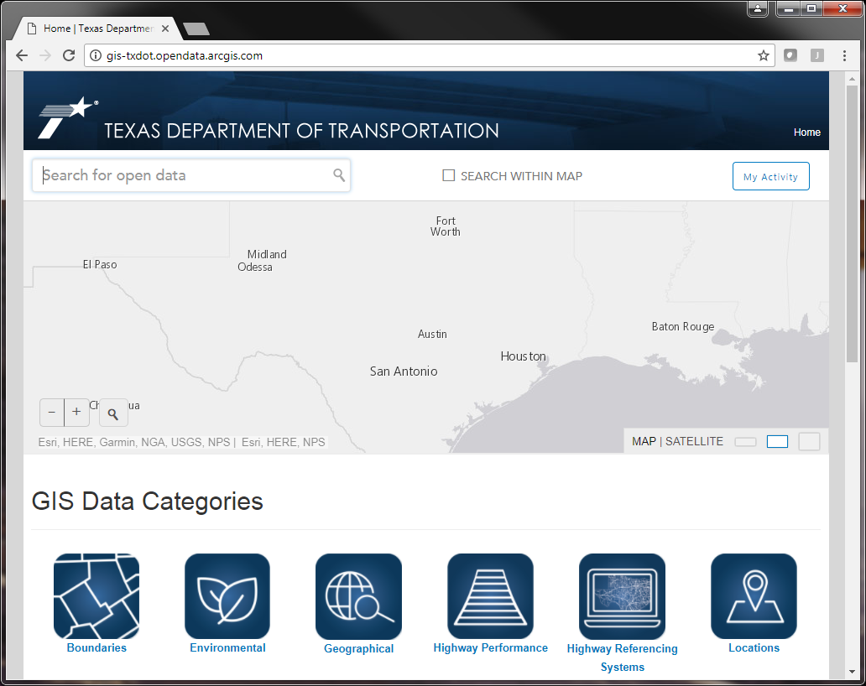
Applications – Open Data Portal
Open Data Portal
Think of the Open Data Portal as a Card Catalog.
Direct access to services, data, and metadata.

Slide 21
Closing
Important Links (you should know these by heart)
Statewide Planning Map
Open Data Portal
Annual Reports
ArcGIS Online
Project Tracker
Email Contacts
GIS: TPP-GIS@TxDOT.gov
Roadway Inventory: GRID@TxDOT.gov
Project Tracker: Project.Tracker@TxDOT.gov
Michael.Chamberlain@txdot.gov
Phone (my direct line)
512.486.5054
Thanks for your time!

