Slide 1
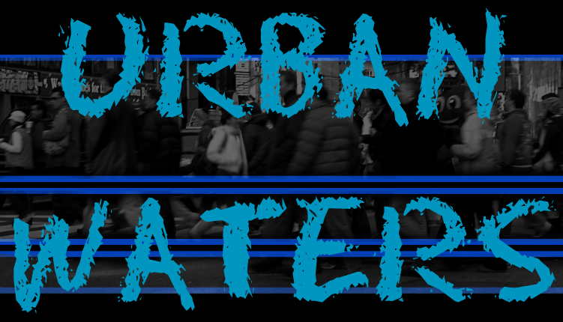
Urban Waters Learning Forum Adele Cardenas Malott, P.E. May 23,2017
Water Management Conference
SPI Pre-Day 2017

Slide 2
Today’s Discussion
UW Overview-Federal Partnership
What’s New in UW 2015/2016
Urban Waters Program (UW)
New Dynamics
Federally Led vs Locally Led
Engaging w/Partners in the UW Geographic Areas - Summaries
Turning the Rock – Where is the funding
Urban Waters Road Hazards

Slide 3
Urban Water Activities 2017
What’s New in the Urban Waters Federal Partnership…
Roy Simon
New Dynamics of UW…
Federally led vs Locally Led
17 locations Federally Led
2 locations Locally Led

Slide 4
Engaging with Partners in the UW Geographic Areas
UW Summary Sheets for 18 locations
Grantees that have not linked with UW Geographic Areas
Contact Listing for all 19 locations

Slide 5
Session 2 – Turning the Rock…Where is the Funding ?
Be in the Know…..
What are your funding concerns?
Are you “in the know” of where funding opportunities are?
How do you Hear or see funding announcements?
EPA staff will facilitate a discussion about how the Urban Waters Partnership can support your efforts – think outside of the box…..

Slide 6
Categories of Funding:
Federal Funding
Public/Private Partnership Funding
In-Kind Funding

Slide 7
Federal Partnership Linkages:
EPA(Environmental Protection Agency)
Clean Water Act (CWA) 319 Funds – Linkages
Clean Water Act (CWA) 106 State Revolving Fund (SRF)
Clean Water Act (CWA) 104(b)(3)
Urban Waters(UW) Small Grants- RFP

Slide 8
Federal Partnership Linkages:
Brownfields Grants
Environmental Education Grants
Environmental Justice Grants
Sustainable Communities – Joint RFP Opportunities
Technical Support/Sustainable Communities Building Block Training

Slide 9
Federal Partnership Linkages:
HUD (Housing & Urban Development)
Community Solutions:
CDBG – Community Development Block Grants
Strong City Strong Communities – SC2
Healthy Communities Designation
Promise Zone Designation
Main Street Designation
Sustainability Partnership(HUD/DOT/EPA)

Slide 10
Federal Partnership Linkages:
DOT(Department of Transportation)
Tiger Grants
FLAP (Federal Land Access Program) Grants
Climate Change/Resiliency
Sustainability Partnership

Slide 11
Federal Partnership Linkages:
DOI(Department of Interior)
FWS(Fish & Wildlife Service)
Environmental Education Employment Workgroup – UW MRG – Led by FWS(VISTA’s)
Technical Support regarding Restoration Impacts on Ecology of Endangered Species and Water Quality Linkages to waterways.
NPS(National Park Service)
RTC (Recreational Trail Conservation) Program
Groundwork USA formations supported NPS/EPA
Congressional Historic Trail Strategic Planning

Slide 12
Federal Partnership Linkages:
NPS - Continued
Technical Assistance for Strategic Planning activities supported with local AIA or University; example: Lafitte Corridor in New Orleans
USGS(United State Geological Survey) – Technical Support w/UW Mapping Exercises – resource rich in Stream and Drought Data

Slide 13
Federal Partnership Linkages:
FEMA(Federal Emergency Management Agency)
Technical Support – Emergency Management Funding to Communities Impacted by Natural Disasters; example: New Orleans
CDC(Center for Disease Control)
CDC Fellow Program
Health Linkages
Research Opportunities
Federal Reserve
Public/Private Partnership Economic Development Forums – Community Specific

Slide 14
Federal Partnership Linkages:
Commerce Department
NOAA(National Oceanic Atmospheric Agency)
Technical Support
Weather Service
Sea-Level Monitoring Programs
Research Capability
Climate
Oceans – Trash Program – Funding Opportunities
DOI/NOAA/EPA – Resilient Lands and Water Initiative to prepare natural resources for climate change
Technical Support from Texas to Maine – NOAA expanded Flood information Tool – promotes resiliency

Slide 15
Federal Partnership Linkages:
EDA(Economic Development Agency)
Linkage to supporting community synergies
Corporation for National Community Services
Provide Manpower
AmeriCore
Youth Core
Senior Core
VISTA’s

Slide 16
Federal Partnership Linkages:
USACE(United States Army Corps of Engineers)
Technical Support/provided project is listed as workload
Has Facilitation Services to support convening of groups, specific to project locations/supportive
Climate Resiliency aspects to restoration
Streamline Permitting as needed by project partners
PAS – Planning Assistance to State- Cost share
SFO – Support for Others
CAP -Continuing Authorities Program

Slide 17
Federal Partnership Linkages:
USDA(United States Department of Agriculture)
Infrastructure Opportunities Loan/Grant Programs
NRCS (Natural Resource Conservation Service)
Technical Support
FS (Forest Service)
Environmental Education Linkages
Research Opportunities/Linkages
Tree Planting/Canopy Study Opportunities
Community Garden Linkages – Technical Support

Slide 18
Federal Partnership Linkages:
USBR -Bureau of Reclamation
Climate and Resiliency
Water Smart Program
www.usbr.gov

Slide 19
UW Federal Partners Goal:
The Federal Partnership Teams Role: To Work in a Coordinated Fashion in Leveraging Resources and See On the Ground Results in the Communities
With the Goal: To restore and protect urban water bodies by engaging communities – particularly underserved communities – in activities that foster increased connection, understanding and ownership of their waters.
Notes:
For the National Water Program this provides a cohesive national framework for innovative work already happening at the Regional level. Supports goals of our programs in Storm Water Management, GI, TMDL implementation, Fish & Beach / Risk Communication, Water Quality Standards, Source Water Protection, Water Sector Workforce Development.

Slide 20
Questions and Answers?
Adele Cardenas Malott, P.E.
Senior Policy Advisor
214-665-7210
Cardenas.adele@epa.gov

