Slide 1
Optimum depth of Horizontal energy foundations for residential buildings
Carlos S. Aguirre & Thuy Vu, Ph.D
Department of Civil Engineering
University of Texas Rio Grande Valley

Slide 2
Outline
Geothermal Energy & Ground Source Heat Pump
Building Foundations & Energy Foundations
Barriers & Benefits
Research
Expected Outcome
Future Plans

Slide 3
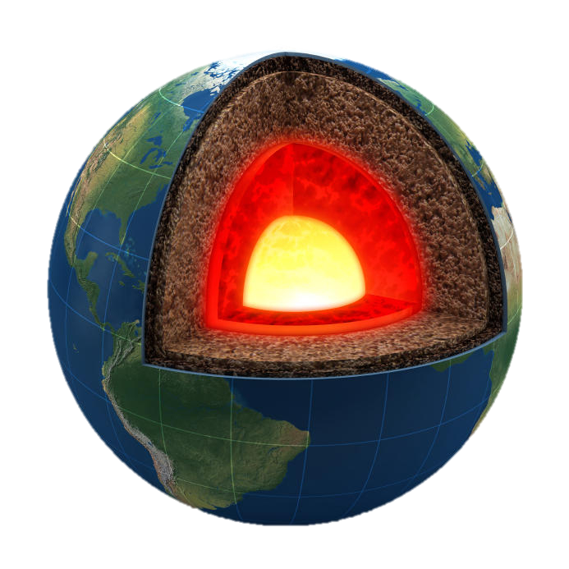
Geothermal Energy
Geo: earth
Thermal: heat
Heat energy produced by earths core
Dissipated and stored underground
1

Slide 4
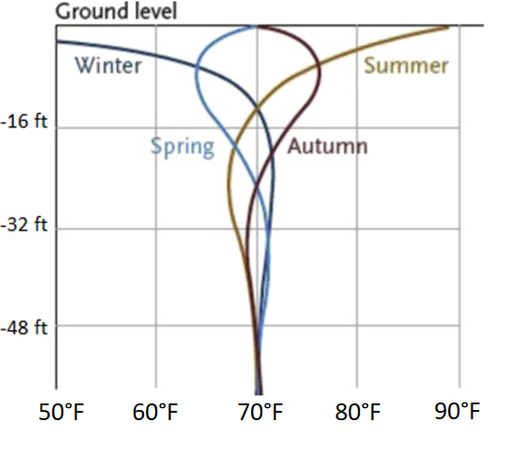
Geothermal Energy
At certain depth below the surface, the ground maintains a nearly constant temperature
Usually at a comfortable room temperature
2

Slide 5
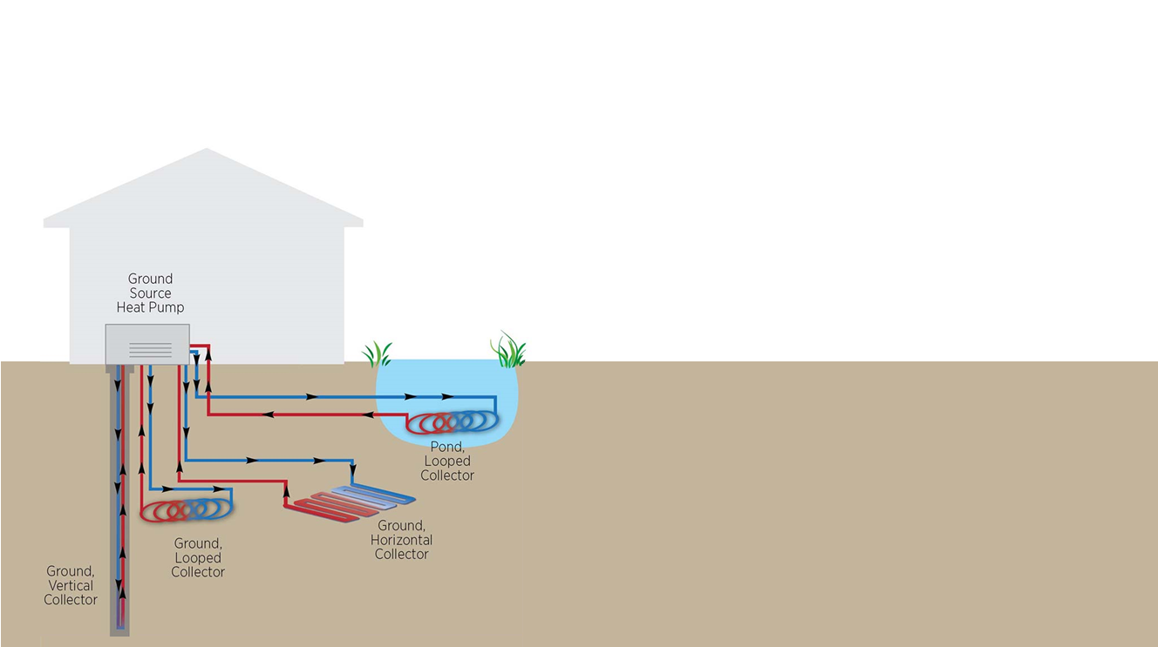
Ground Source Heat Pump
Air conditioning systems that utilizes geothermal energy
The Ground Source Heat Pumps (GSHP) work as a two-way refrigerator
Heat is not created, simply transferred to and from the earth
3

Slide 6
Ground Source Heat Pump
Heat injected into the ground to cool buildings in summer
Heat extracted from ground to heat buildings in winter
Heat accessed via circulating fluid that runs through the heat exchanger pipes buried in the ground
4

Slide 7
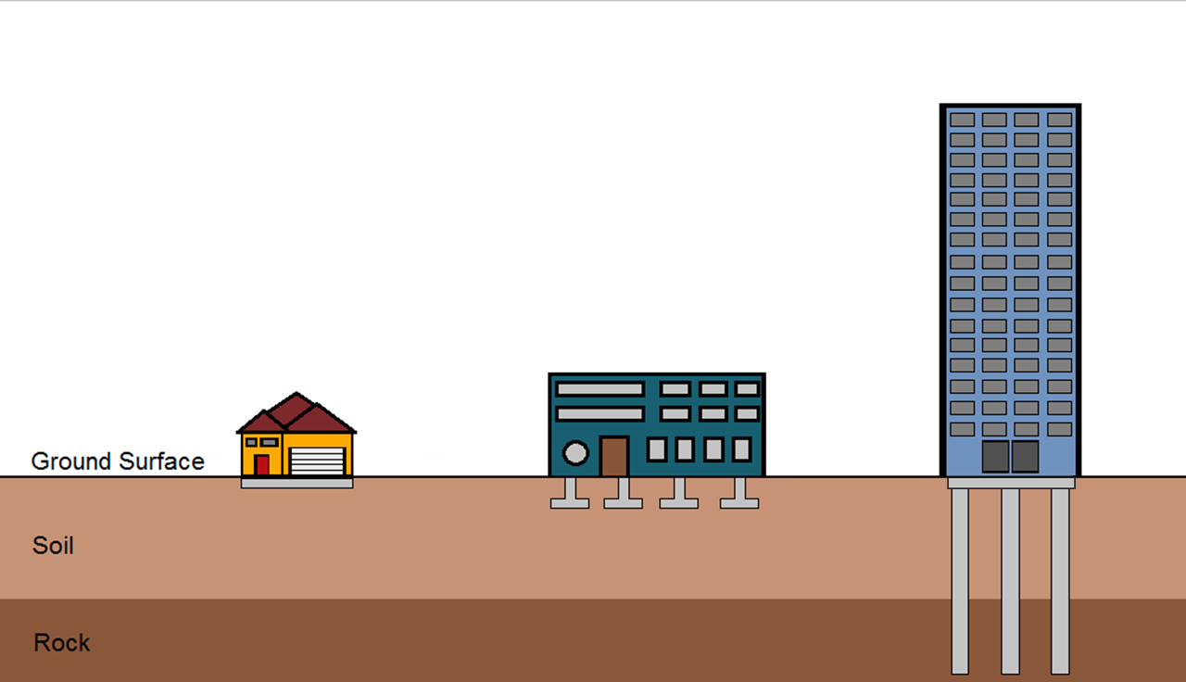
Building Foundations
Transfers loads to the earth.
Slab on grade foundation (Home)
Shallow foundation (Low-rise Building)
Deep foundation (Medium- to High-rise)
5

Slide 8
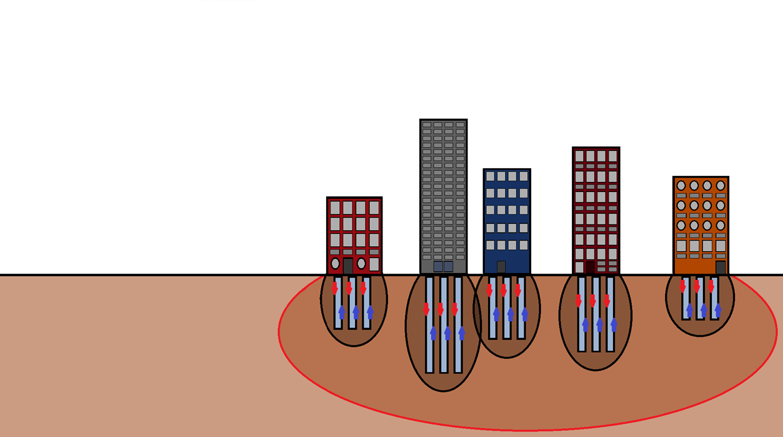
Energy Foundation
Energy Foundation = Buildings Foundation + GSHP
Incorporate the heat exchanger pipes of the GSHP with the buildings foundation
6

Slide 9
Barriers
High installation cost, around $15k more than conventional heating & cooling systems
Lack of new technologies and techniques to improve system cost and performance
Design limitations and ability to accommodate business planning infrastructure
Lack of consumer knowledge on system benefits
7

Slide 10
Benefits
Energy foundation will save up to 20% of installation cost compared to traditional horizontal GSHP
Heating and cooling costs reduced by 50–70% compared to conventional heating & cooling systems
Requires no outdoor unit
Sustain a longer life span
Reduces the carbon footprint
Tax write-offs
8

Slide 11
Research
Shallow depths ground temperature subject to seasonal fluctuations
With increasing depth, the more efficiently the system will perform
Correlation between depth and coefficient of performance (COP) not defined
9

Slide 12
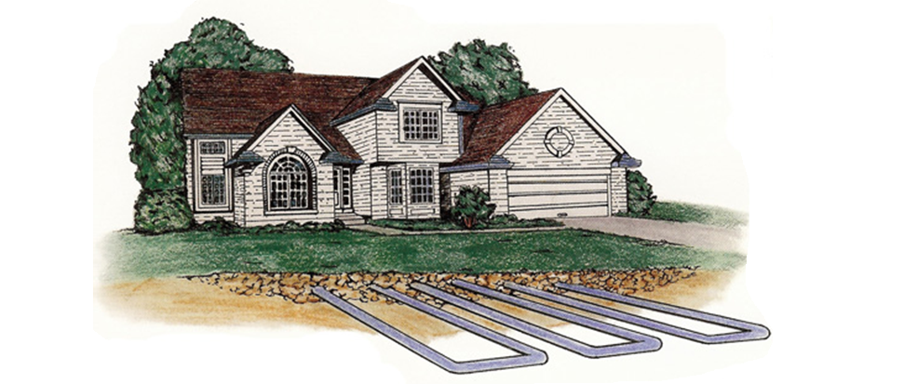
Objective
Conduct testing of a horizontal GSHP at varying depths
Identify a minimum depth at which the GSHP will operate with a high COP while still maintaining cost effectiveness
10

Slide 13
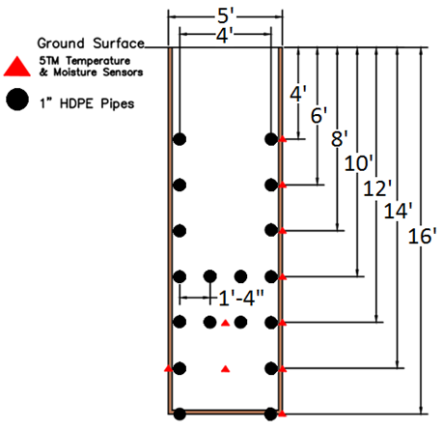
Design
Heat exchanger pipes cross section
200 feet long
Sensors at both ends
11

Slide 14
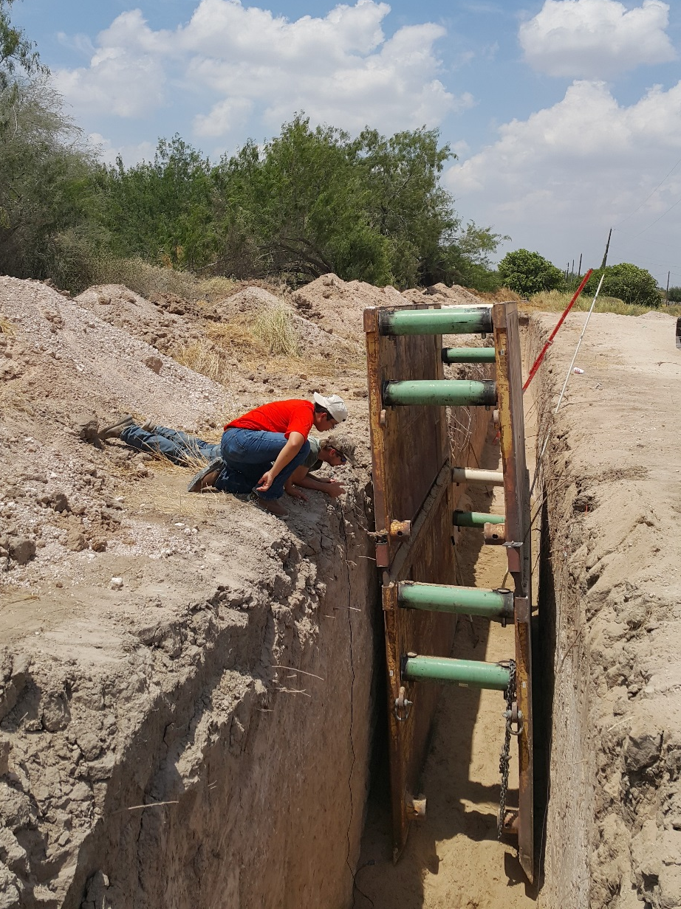
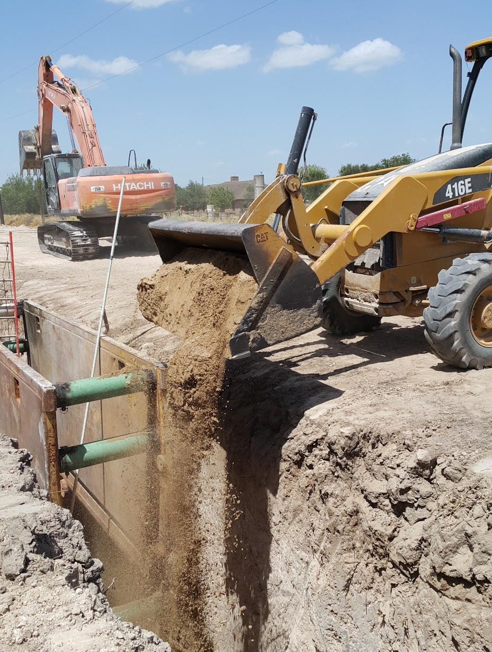
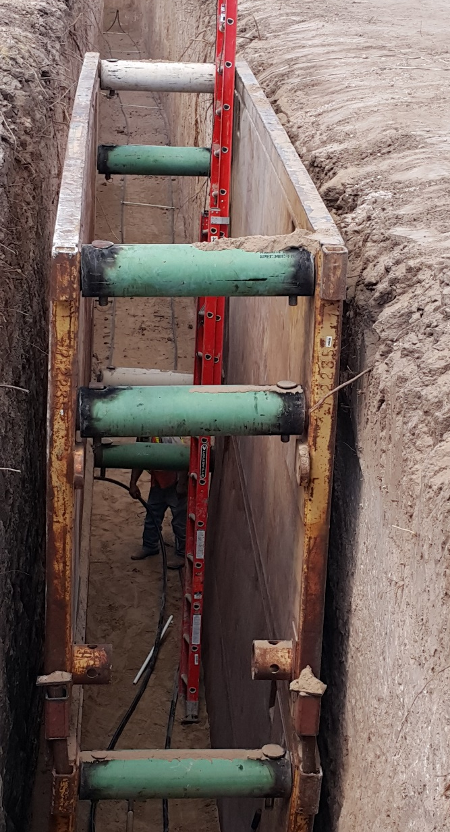
GST Construction
12
Trench, 5’ x 200’ x 16’
Placing temperature sensors
Back filling the trench with river sand

Slide 15
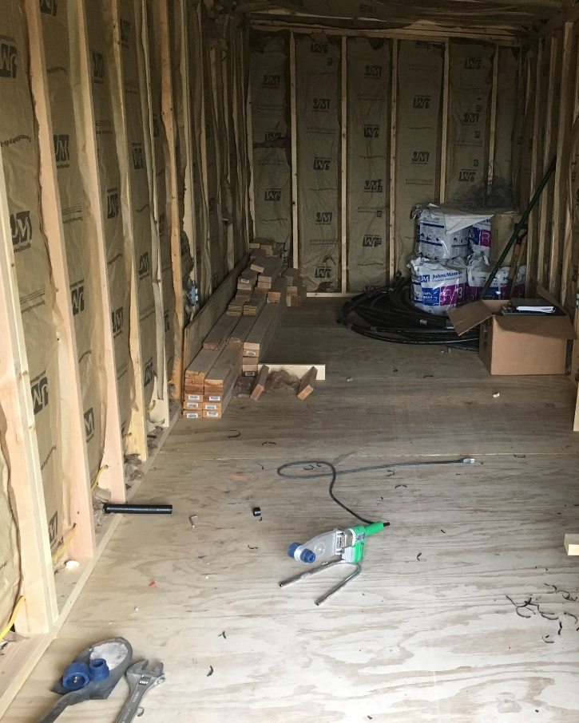
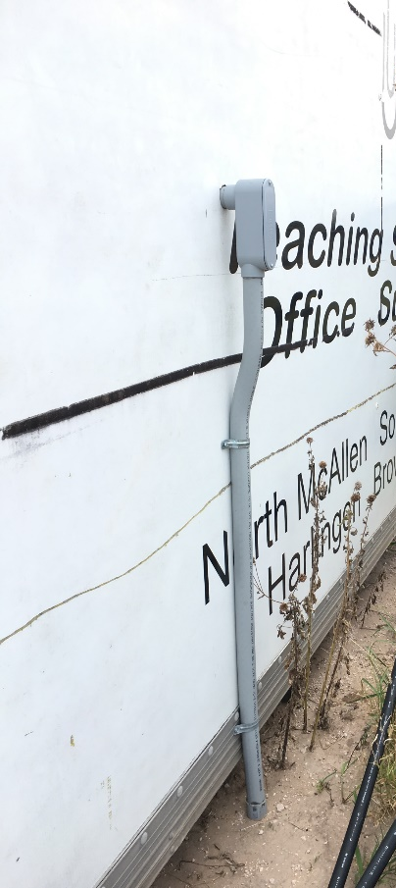
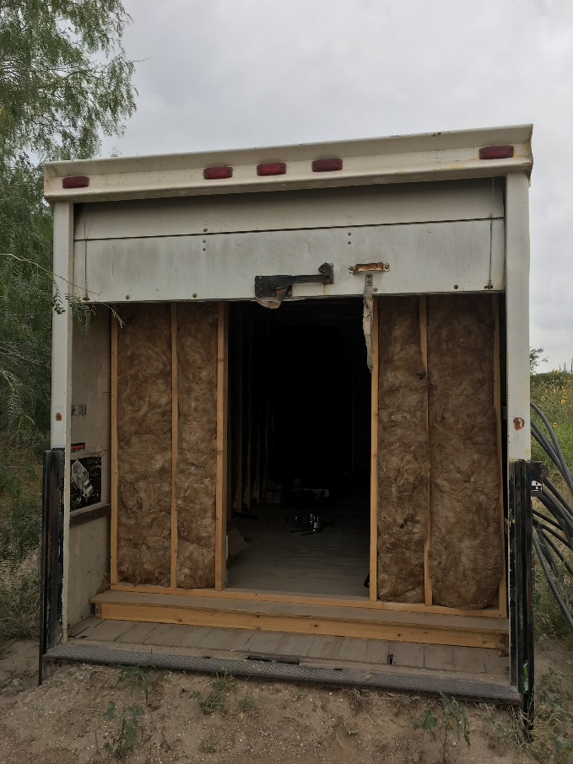
Construction
Electrical input
(Atlas Technologies)
13
Trailer with frame
Interior insulation of trailer

Slide 16
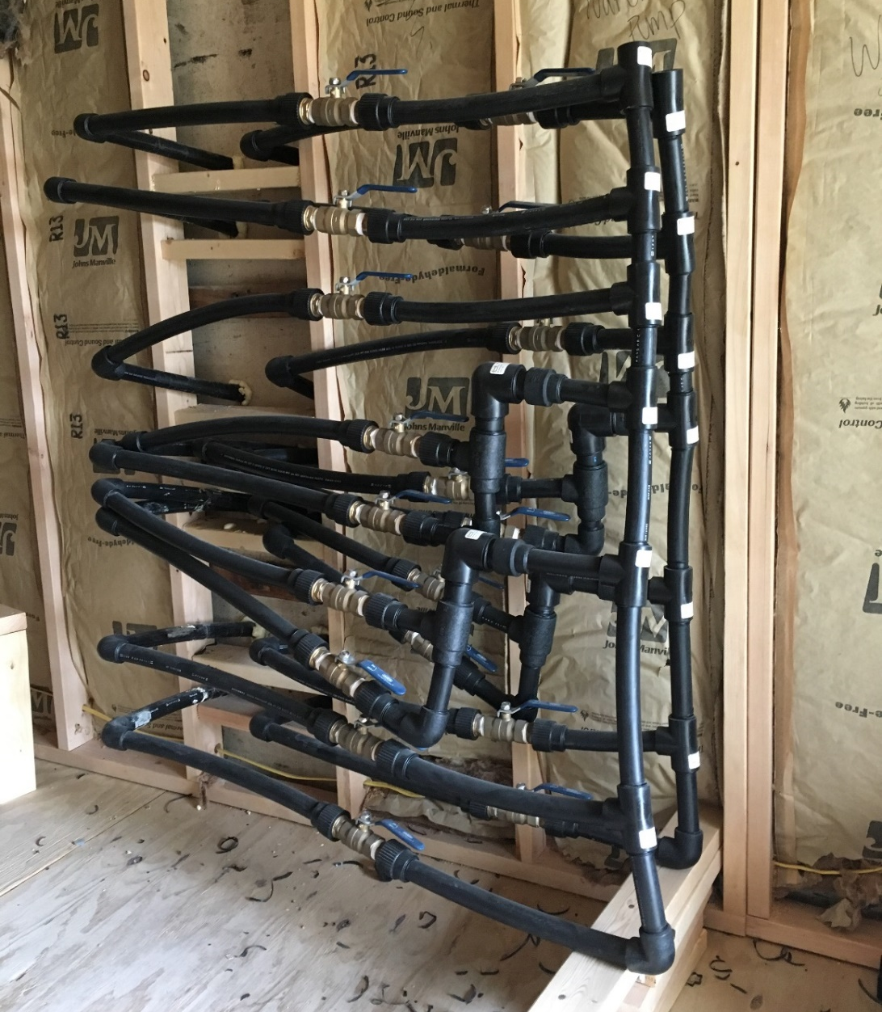
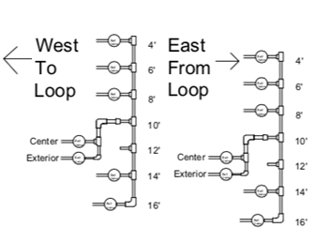
Construction
Pipe circuit
Design, Learn, Assemble
14

Slide 17
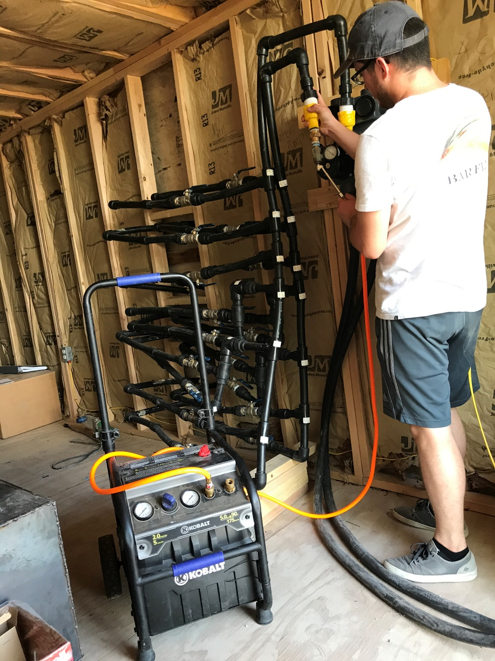
Construction
Pressure test found leaks
Revisit pipe configuration
Second pressure test proved repairs were successful
15

Slide 18
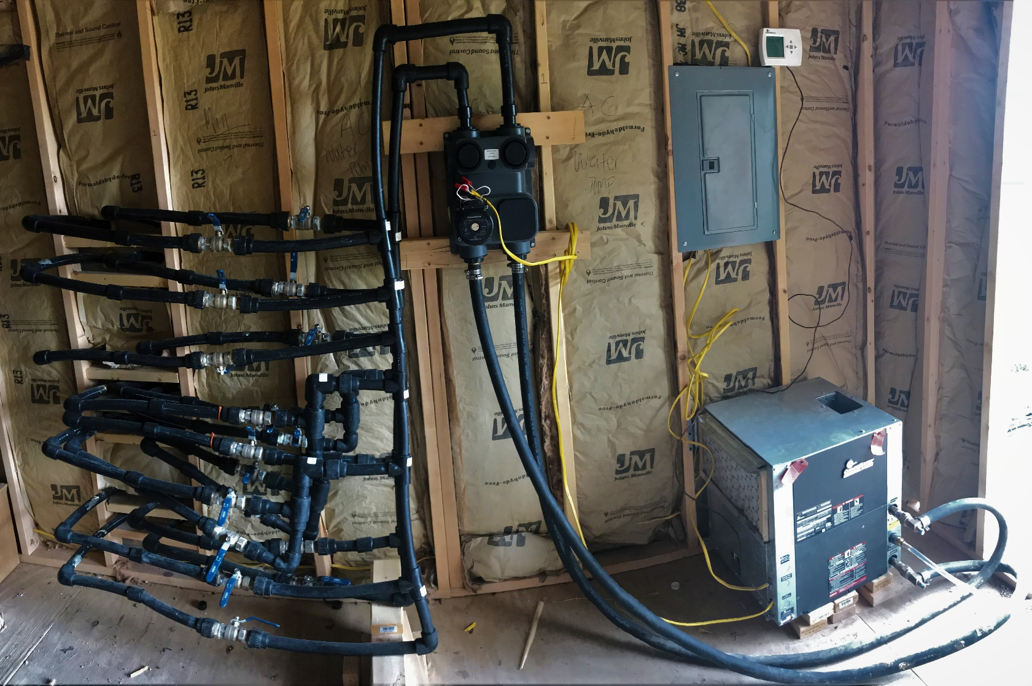
Completed Construction
Heat pump, thermostat, & flow controller installed
System ready for operation
16

Slide 19
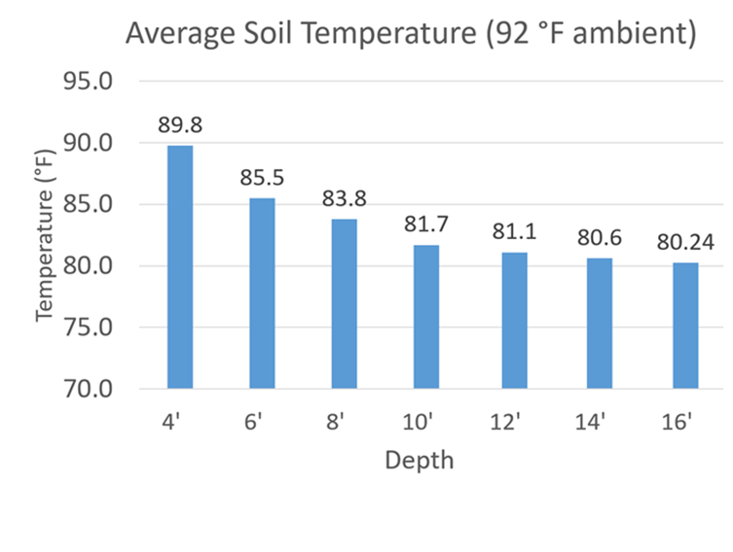
Initial Ground Temperature (August)
Enforces theory of ambient temperature effect on shallow depth
17

Slide 20
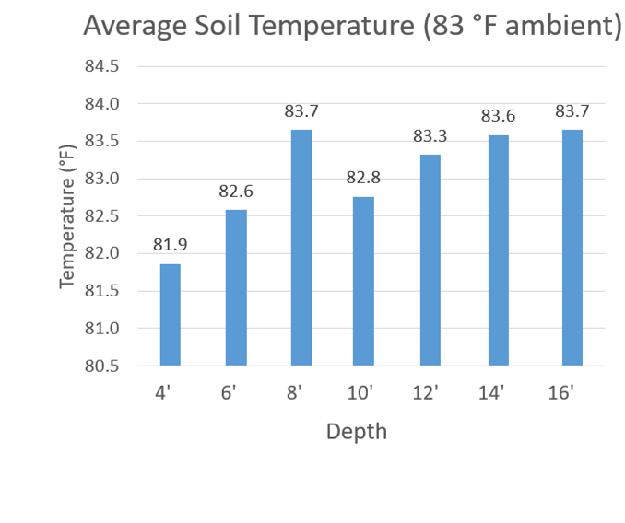
Ground Temperature Change After First Run With 16’ Loop Depth (November)
4’ depth temperature close to ambient
8’ depth temperature relatively constant from August (83.8° F) to November
Increase in temperature at 16’ from 80.24 ° F
Depths 12’ and 14’ demonstrate they have been effected
18

Slide 21
Coefficient of Performance (COP)
WATER | Pressure (psi) | Temperatue (°F)
Entering | 35 | 88
Leaving | 25 | 96
Amperage | 7.52
Voltage | 248
ΔT | 8
ΔP | 10
Flow (gpm) | 3
HE | 12000
ED | 1585.22
HC | 17408.76
COP | 3.22
19

Slide 22
Coefficient of Performance
CoP = $\frac{\text{how} \text{much} \text{energy} \text{system} \text{produces}}{\text{how} \text{much} \text{energy} \text{system} \text{uses}}$
Usually referred to as monetary value
= $\frac{\text{Cost}\text{ (\$) }\text{of} \text{energy} \text{produced}}{\text{Cost}\text{ (\$) }\text{of} \text{energy} \text{used}}$
3.22 = $\frac{\text{\$}\text{ 3.22}}{\text{\$}\text{ 1}}$
20

Slide 23
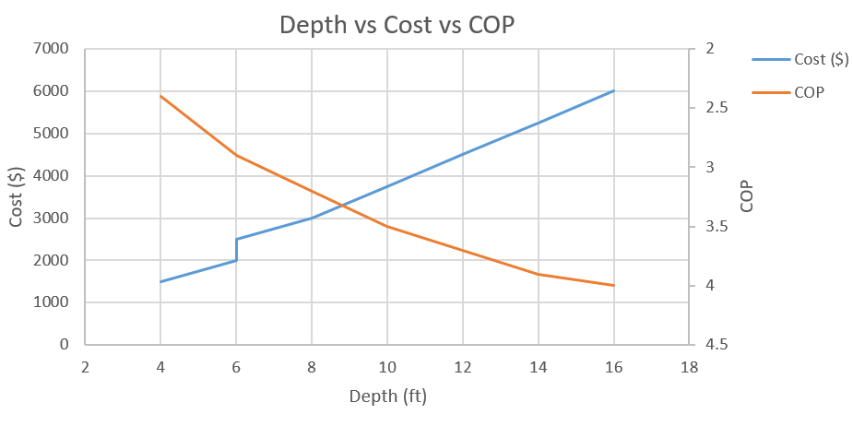
Expected Outcome
Cost includes ground removal/fill and protection walls at 6’
Price of unit and material are fixed
21

Slide 24
Ongoing and Future Plans
Testing of the GSHP with other depths
Alleviate the barriers previously discussed
Publicize results to share knowledge with the community
Provide cost savings that benefit consumers & the environment
22

Slide 25
Thank you! Question Comments
23

Slide 26
References
Sieminski A. Annual Energy Outlook 2017. AEO2017 Rollout Presentation. 2017.
Hughes, P.J., Geothermal (ground-source) heat pumps: Market status, barriers to adoption, and actions to overcome barriers. 2008.
Brandl H. Energy foundations and other thermo-active ground structures. Geotechnique. 2006;56(2):81-122.
24

