Slide 1

OUR
ETHICAL RESPONSIBILITY
IN THE
PUBLIC WORKS INDUSTRY
- LAMBERTO “BOBBY” BALLI, PE, PWLF

Slide 2
AGENDA
WHY ARE WE HERE ??
RESPONSIBILITIES OF THE PUBLIC WORKS PROFESSIONAL
DIFFERENCE BETWEEN RIGHT AND WRONG
HOW DO WE “WALK THE LINE”?

Slide 3
AGENDA
WHY ARE WE HERE ??
RESPONSIBILITIES OF THE PUBLIC WORKS PROFESSIONAL
DIFFERENCE BETWEEN RIGHT AND WRONG
HOW DO WE “WALK THE LINE”?

Slide 4
WHY ARE YOU HERE ??
WHY AM I HERE ??
PUBLIC WORKS IS A PASSION OF OURS!
IT’S IN OUR BLOOD!

Slide 5
QUALITIES OF A PUBLIC WORKS PROFESSIONAL
Genuine concern for our community
Not generally concerned about monetary gain
End result is important
Multi-Tasker
Plate spinner
Chain saw juggler
Disciplined and Responsible!

Slide 6
7 CHARACTERISTICS OF HIGHLY SUCCESSFUL GOVERNMENT LEADERS
Self-awareness
Authenticity
Reputation
Ethical Behavior
Willingness to Listen
Ability to Communicate
Optimism
CREDIT: John Kamensky, IBM Center for the Business of Government

Slide 7
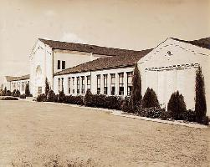
1937
Notes:
10/19/2017
7

Slide 8
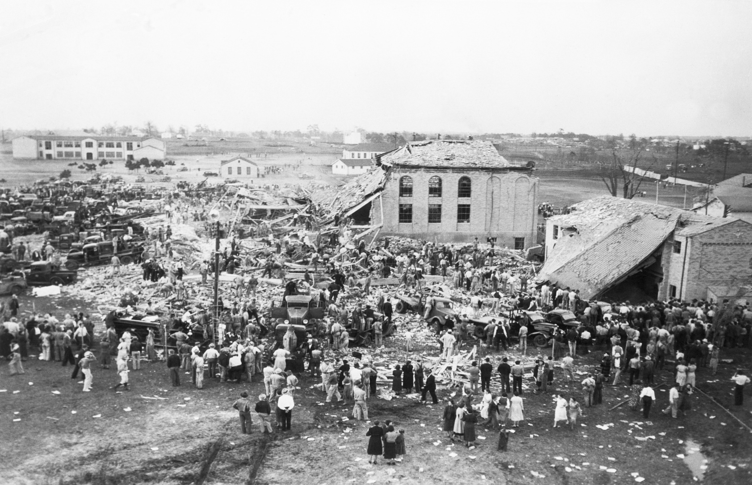
Notes:
10/19/2017
8

Slide 9
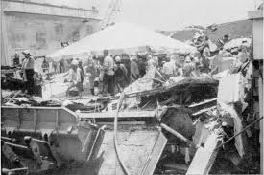
La Tienda Amigo Collapse, Brownsville Texas 1988

Slide 10
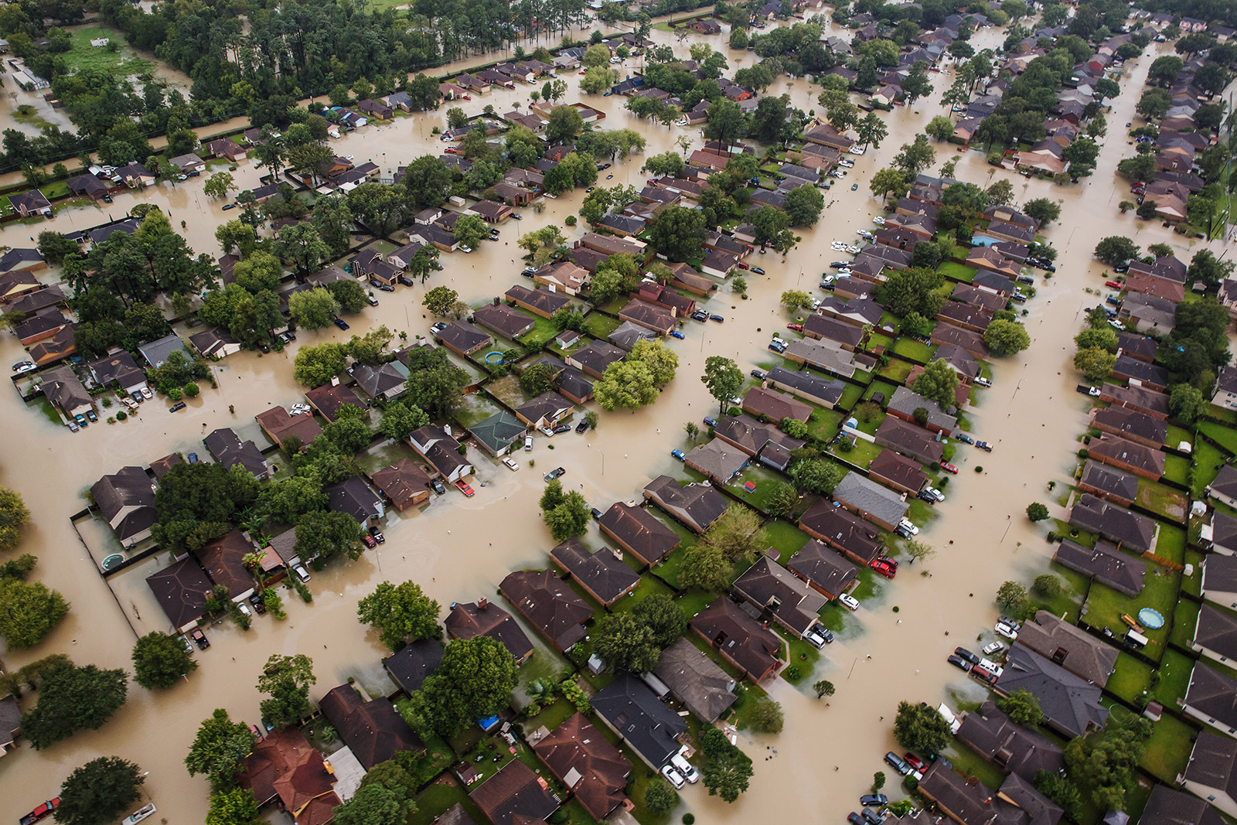
Hurricane Harvey,
TEXAS 2017

Slide 11
AGENDA
WHY ARE WE HERE ??
RESPONSIBILITIES OF THE PUBLIC WORKS PROFESSIONAL
DIFFERENCE BETWEEN RIGHT AND WRONG
HOW DO WE “WALK THE LINE”?

Slide 12
RESPONSIBILITIES OF A PUBLIC WORKS PROFESSIONAL
UNDERSTANDING OF LAWS AND RULES
TECHNICAL COMPETENCE
PROFESSIONALISM
COMMON SENSE/STREET SMART
ETHICAL RESPONSIBILITY

Slide 13
UNDERSTANDING LAWS AND RULES!
TEXAS LOCAL GOVERNMENT CODE
TEXAS ENGINEERING PRACTICES ACT
PROFESSIONAL SERVICES PROCUREMENT ACT
OTHER ENVIRONMENTAL and HEALTH/SAFETY

Slide 14
TEXAS LOCAL GOVERNMENT CODE
http://www.statutes.legis.state.tx.us/
FOR BOTH MUNICIPALITIES AND COUNTIES
  CHAPTERS 1 - 99
    BOUNDAIRES, TYPES/FORMS OF GOVERNMENT
    POWERS AND ENFORCEMENT
  CHAPTERS 101 – 150 +/-
    MUNICIPALITY AND COUNTY FINANCES AND BUDGET
  CHAPTERS 200 AND ON!!!
    ZONING, PURCHASING AND CONTRACTING
    FUN STUFF

Slide 15
TEXAS ENGINEERING PRACTICES ACT

Slide 16
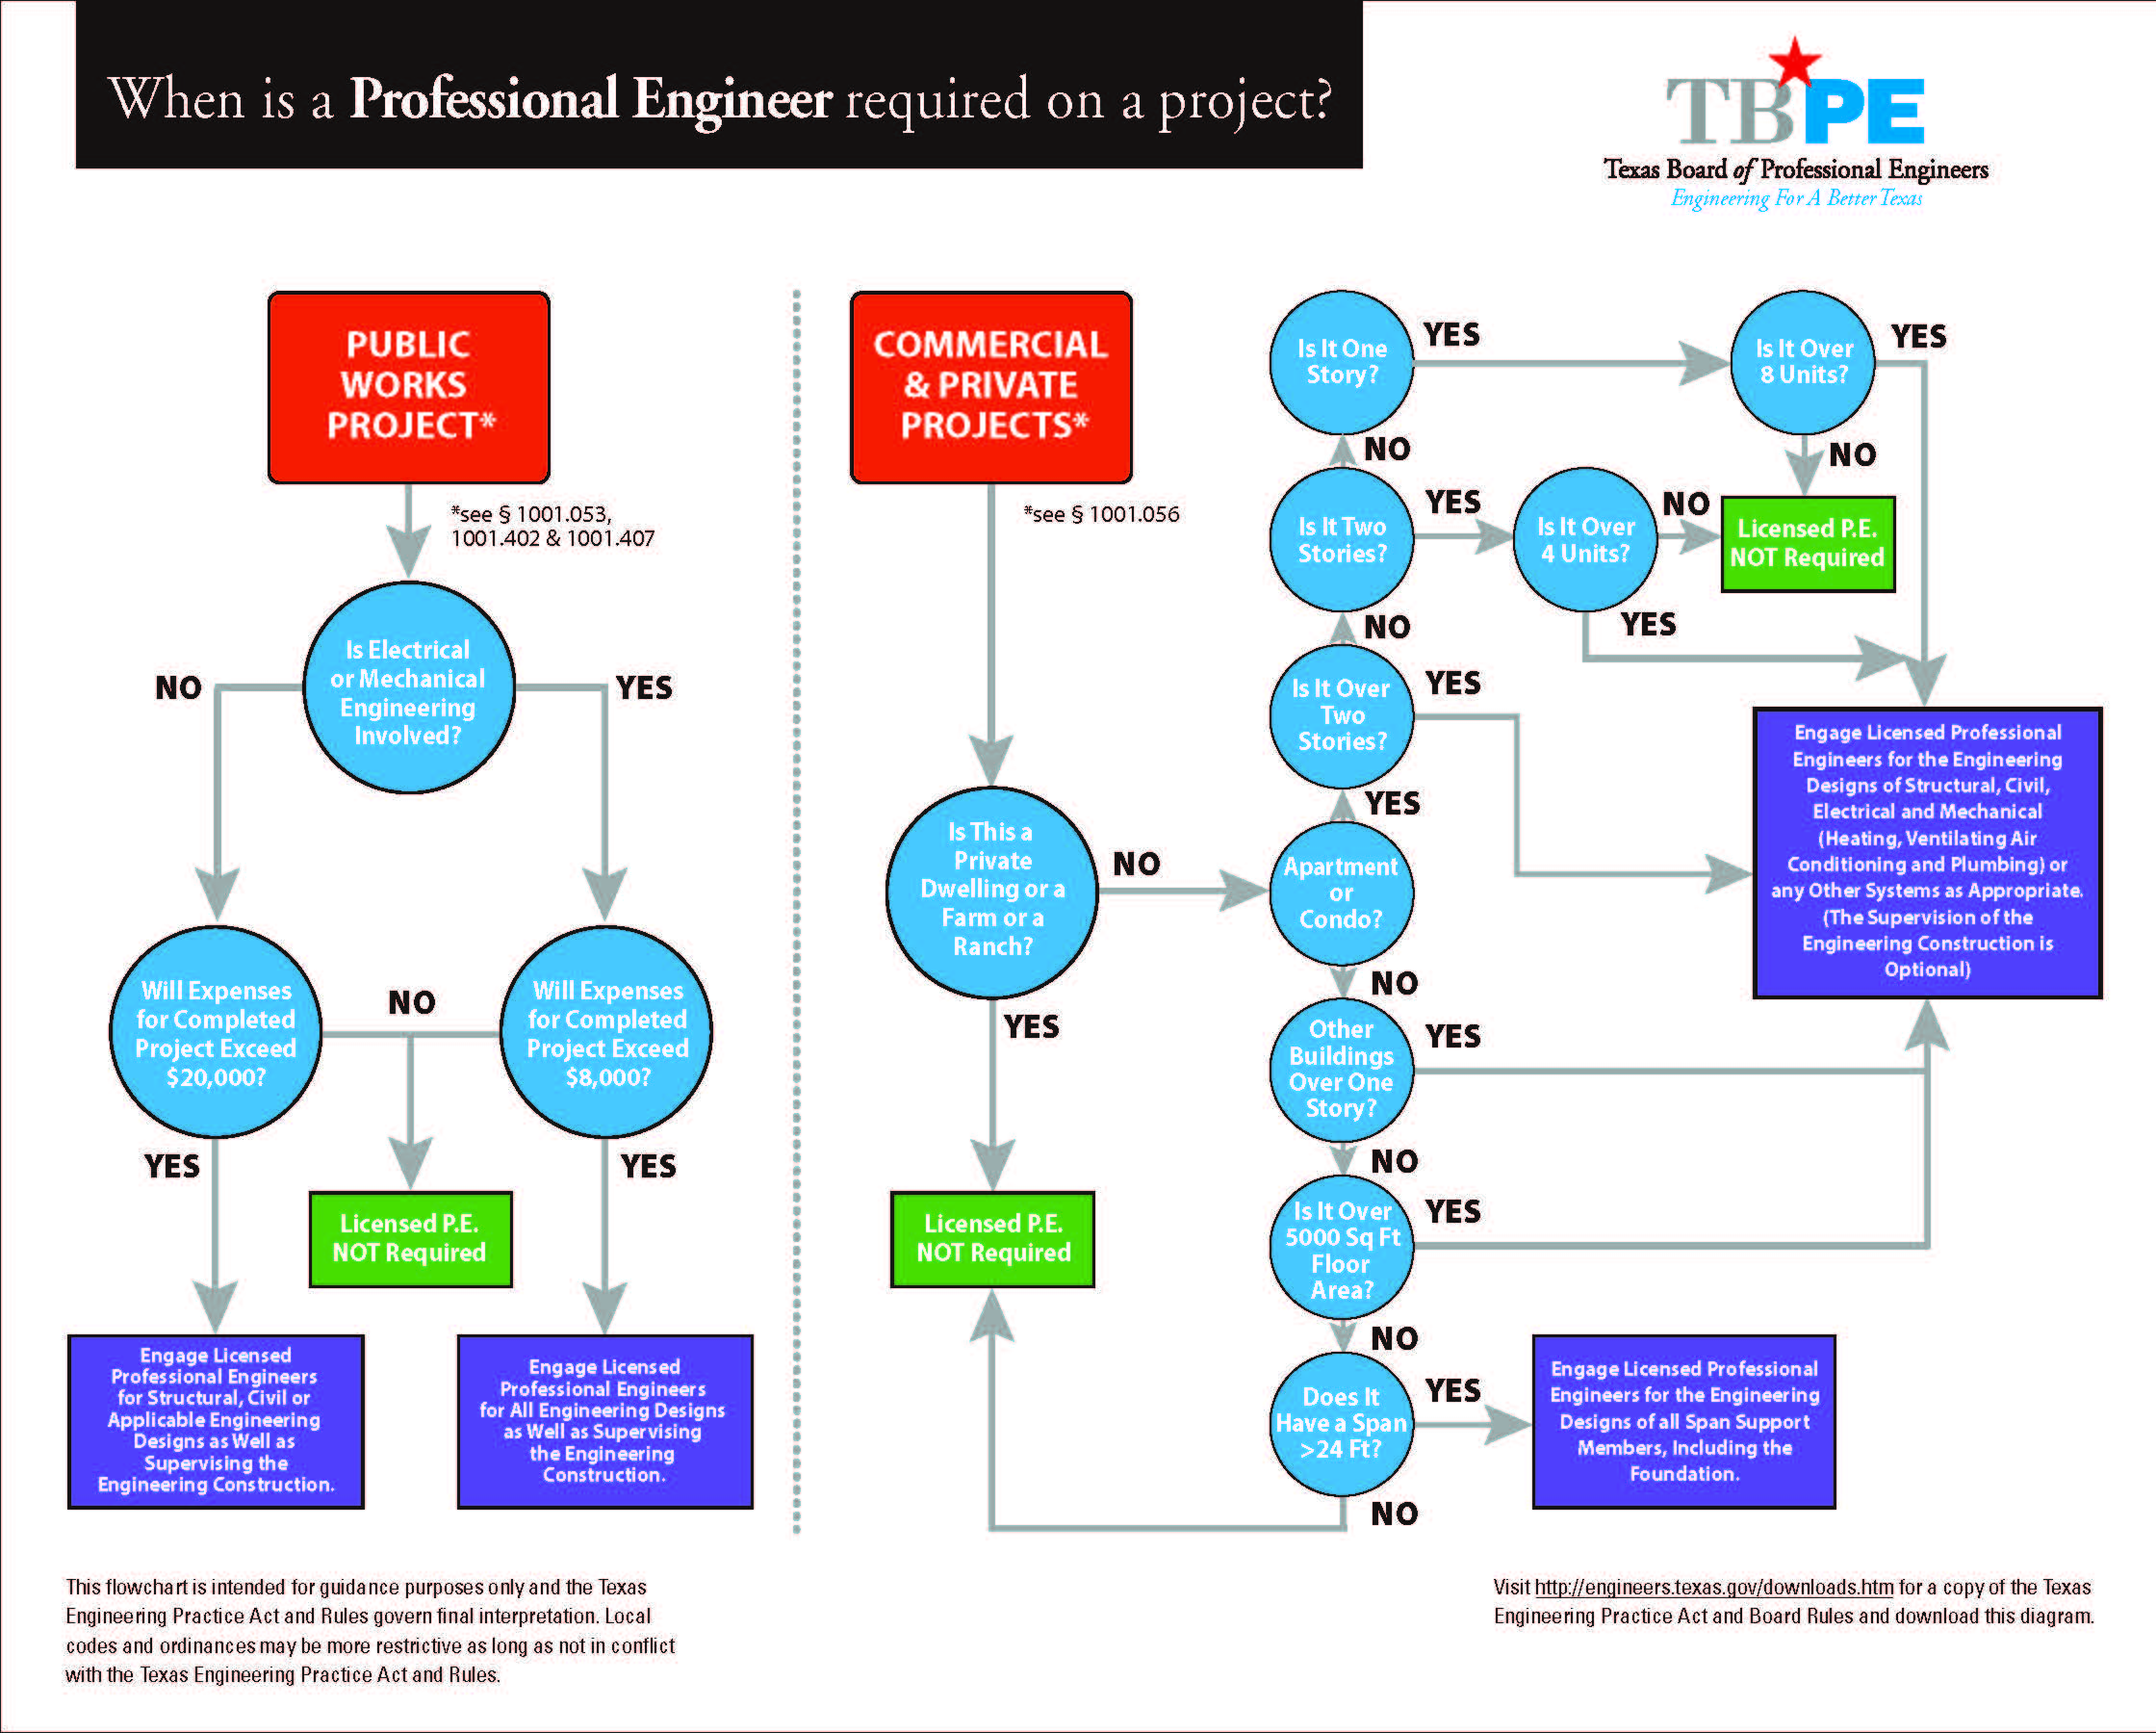

Slide 17
PROFESSIONAL SERVICES PROCUREMENT ACT

Slide 18
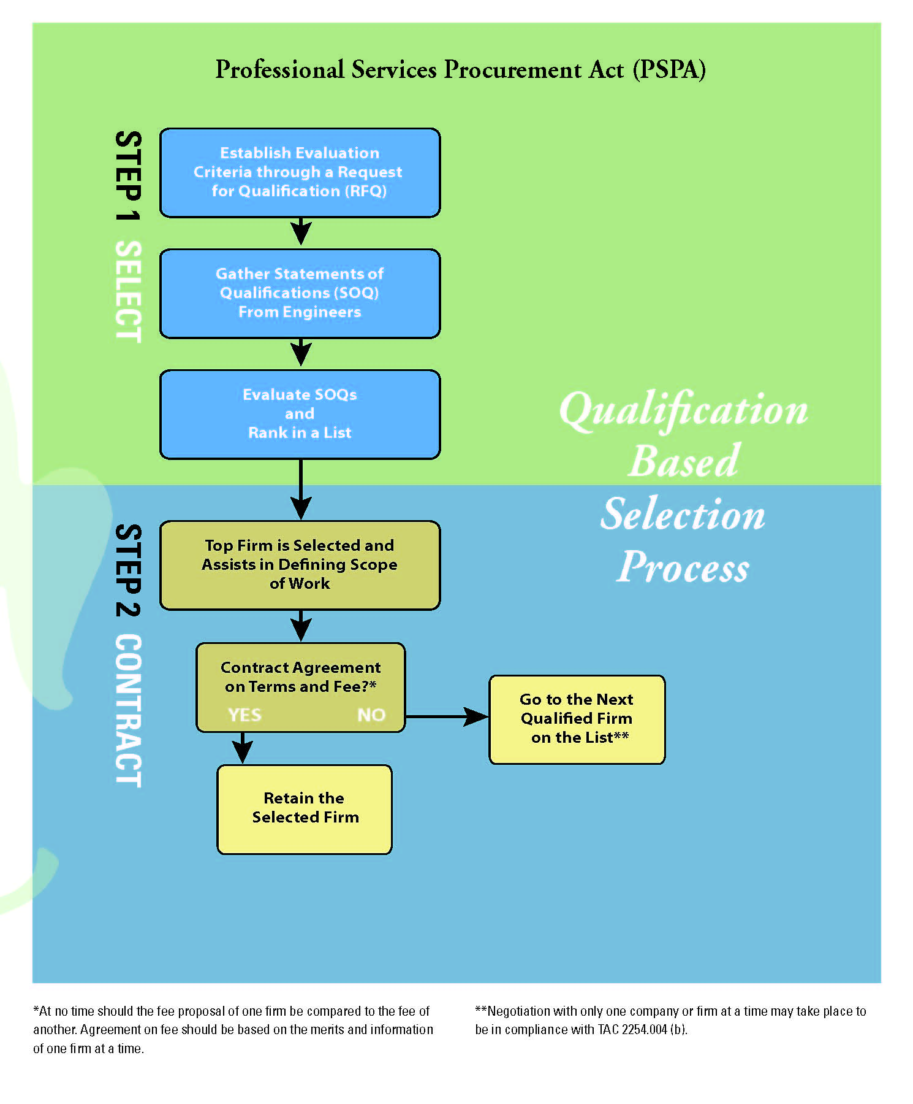

Slide 19
OTHER LAWS AND REGS
Texas Transportation Code
Texas Utilities Code
Texas Water Code
Texas Commission on Environmental Quality
  Water, Wastewater, Solid Waste etc
EPA, FEMA, HUD, USACE

Slide 20
RESPONSIBILITIES
TECHNICAL COMPETENCE
  Engineering, Fleet Maintenance, Solid Waste, Utilities etc
  Credentials – licenses and permits
PROFESSIONALISM
COMMON SENSE = STREET SMARTS

Slide 21
RESPONSIBILITIES OF A PUBLIC WORKS PROFESSIONAL
UNDERSTANDING OF LAWS AND RULES
TECHNICAL COMPETENCE
PROFESSIONALISM
COMMON SENSE/STREET SMART
ETHICAL RESPONSIBILITY!!!

Slide 22
PERCEPTION = EXPECTATIONS
Perception of Competence
Perception of Professionalism
Perception of Ethics
WHAT DOES THE PUBLIC THINK OF OUR ROLE?
  99% OF OUR JOB IS BASED
    ON PERCEPTION!!

Slide 23
AGENDA
WHY ARE WE HERE ??
RESPONSIBILITIES OF THE PUBLIC WORKS PROFESSIONAL
DIFFERENCE BETWEEN RIGHT AND WRONG
HOW DO WE “WALK THE LINE”?

Slide 24
Difference between
RIGHT and WRONG
SOMETIMES QUITE OBVIOUS!

Slide 25
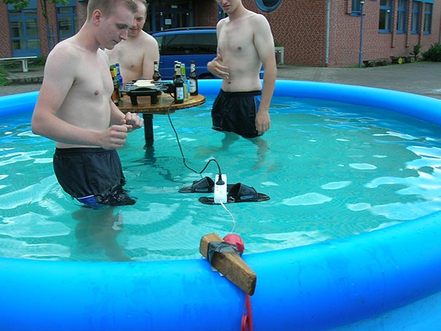
Difference between
RIGHT and WRONG

Slide 26
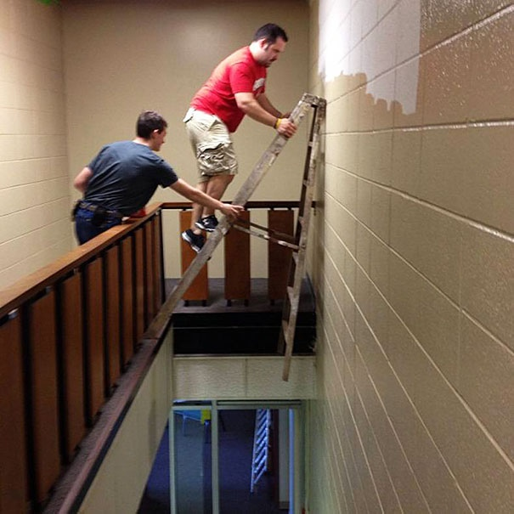

Difference between RIGHT and WRONG

Slide 27
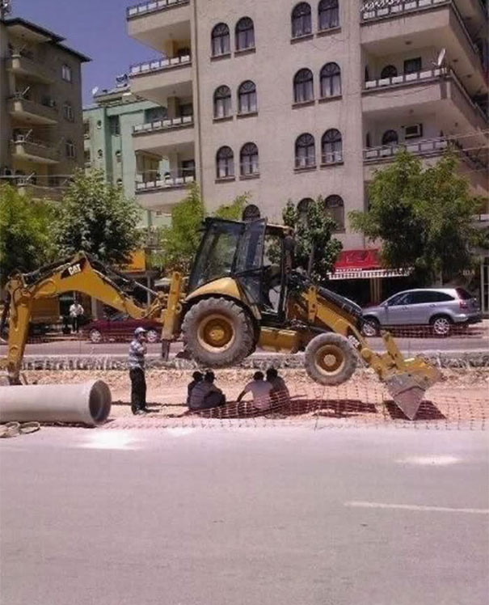


Slide 28
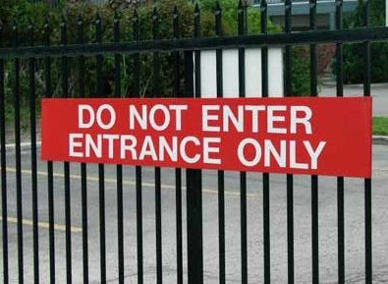
…and some NOT so very obvious!!!!

Slide 29
THE EIGHT ETHICAL TESTS!
The Golden Rule Test
The Truth Test
The What-If-Everybody-Did-This Test:
The Parents Test
The Religion Test
The Conscience Test
The Consequences Test
The Front Page Test
— Dr. Tom Lickona, Character Matters (www.Amazon.com)

Slide 30
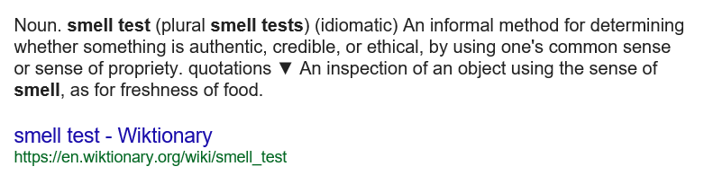
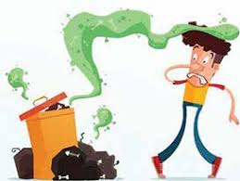
THE SMELL TEST!

Slide 31

THE SMELL TEST!

Slide 32
How do I define ETHICS?

Slide 33
How do I define ETHICS?

Slide 34
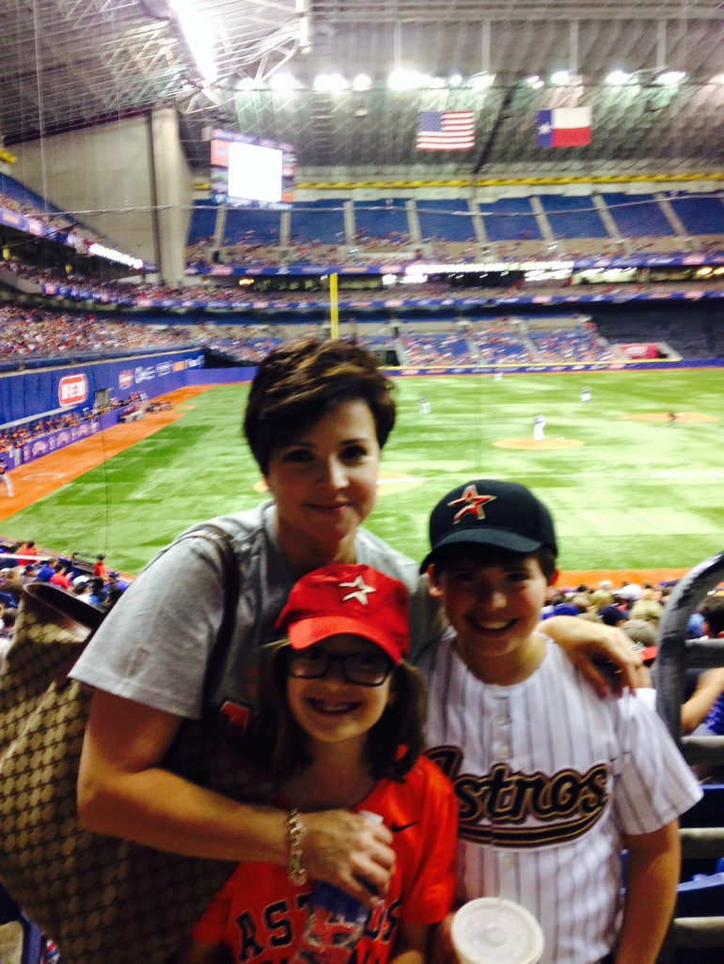
How do I define ETHICS?

Slide 35
AGENDA
WHY ARE WE HERE ??
RESPONSIBILITIES OF THE PUBLIC WORKS PROFESSIONAL
DIFFERENCE BETWEEN RIGHT AND WRONG
HOW DO WE “WALK THE LINE”?

Slide 36
“WALKING THE LINE”
Clear and Concise Communication
Clear and Concise Communication
Clear and Concise Communication
Communicate!
Communicate again!
Communicate again some more!

Slide 37
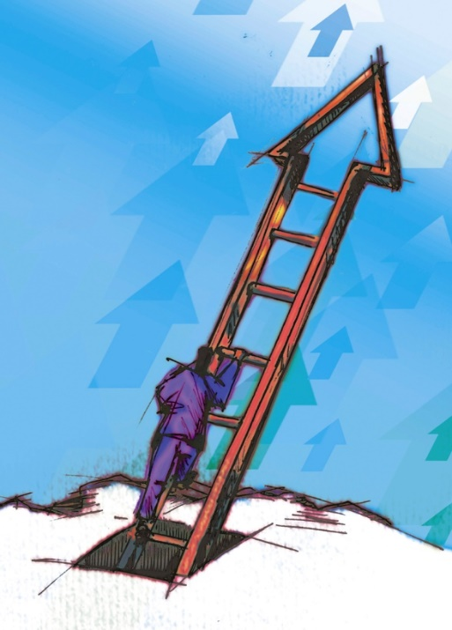
RESPONSIBILITIES TO YOURSELF!
Keep track of the expectations of your profession (Training, etc)
Utilize a Mentor
Manage well
  Management Courses
  Leadership Course
Social Media

Slide 38
RESPONSIBILITIES TO OTHERS
Have a protégé
Lead by example
Serve your community
  Civic organizations
  Religious organizations
  Professional organizations

Slide 39
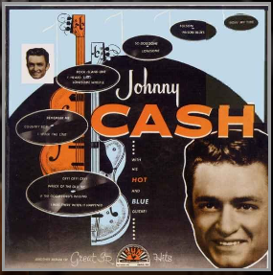
“WALK THE LINE”
  I keep a close watch on this heart of mine!
  I keep my eyes wide open all the time!
  I keep the ends out for the tie that binds!
  Because you're mine, I walk the line!

Slide 40
AGENDA
WHY ARE WE HERE ??
RESPONSIBILITIES OF THE PUBLIC WORKS PROFESSIONAL
DIFFERENCE BETWEEN RIGHT AND WRONG
HOW DO WE “WALK THE LINE”?

Slide 41
Thank you
Lamberto “Bobby” Ballí, PE, PWLF
  (210) 846-1097

