Slide 1
19th Annual Lower Rio Grande Valley Water Management & Planning Conference
May 23-27, 2017 South Padre Island, TX
The Legal and Practical Requirements
for Permitting Return Flows
Emily W. Rogers
Bickerstaff Heath Delgado Acosta LLP
3711 S. MoPac Expwy.
Bldg. 1, Suite 300
Austin, TX 78746
512-472-8021
erogers@bickerstaff.com

Slide 2
Overview
Terminology
Indirect Reuse
Law
Scenarios
Lower Rio Grande
Direct Reuse
Non-Potable
Potable

Slide 3
Terminology
State Water
Developed Water
Water Course
Return Flows
Indirect Reuse
Direct Reuse
Groundwater-based effluent
Surface water-based effluent
Bed and Banks permit
Environmental Flows

Slide 4
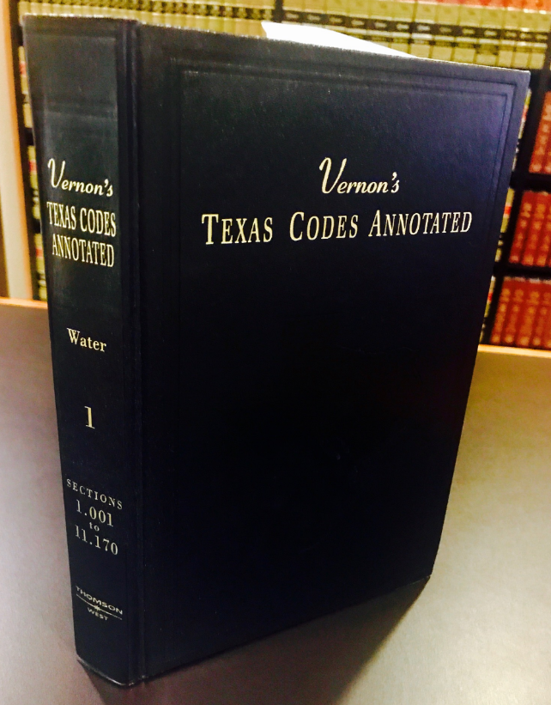
Indirect Reuse
Texas Water Code § 11.042 –
Delivering water down the banks and beds
Texas Water Code § 11.046 –
Return surplus water
Texas Water Code § 11.121 –
Permit Required
Edwards Aquifer Auth. v. Day case

Slide 5
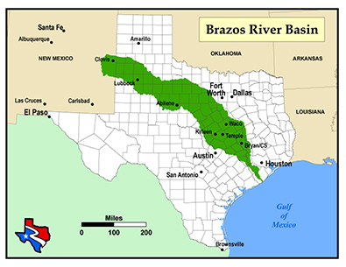
Brazos River Authority’s
System Operation Permit
Background of case
Dispute regarding treatment of return flows:
Executive Director’s position
Brazos’ position

Slide 6
Brazos River Authority’s
System Operation Permit
Commission’s decision:
 | Groundwater-Based Effluent | Surface water-Based Effluent
From BRA’s WWTP or its water right | § 11.042(b) Bed and Banks | § 11.042(c) Bed and Banks
From another’s WWTP | § 11.046(c) New Appropriation | § 11.046(c) New Appropriation

Slide 7
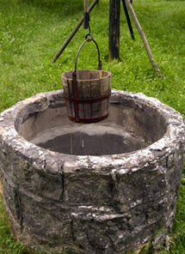
Requirements to Permit for
Indirect Reuse of Water
Where was the water originally from?
Surface water?
Groundwater?
2. Who owned the water?

Slide 8
Scenario 1: Groundwater-based Return Flows from City A and City A wants to reuse the water
Obtain a bed and banks permit from TCEQ under Texas Water Code § 11.042(b):
No environmental flow restrictions
No priority date
Carriage losses
Special condition if other water rights were granted in reliance

Slide 9
Scenario 2: Surface water-based Return Flows from City A and City A wants to reuse the water
Obtain a bed and banks permit from TCEQ under Texas Water Code § 11.042(c):
Conditions are unclear

Slide 10
Scenario 3: Groundwater-based Return Flows from City A and City B wants to reuse the water
Obtain a new appropriation pursuant to Texas Water Code § 11.046(c), § 11.121:
Water availability analysis
Priority date
Environmental flows
Options:
Agreement between City A and City B
City A a co-permittee
Obtain bed and banks under Texas Water Code § 11.042(b)

Slide 11
Scenario 4: Surface water-based Return Flows from City A and City B wants to reuse the water
Obtain a new appropriation pursuant to Texas Water Code § 11.046(c), § 11.121:
Water availability analysis
Priority date
Environmental flows
Options:
Agreement between City A and City B
City A a co-permittee
Obtain bed and banks under Texas Water Code § 11.042(c)

Slide 12
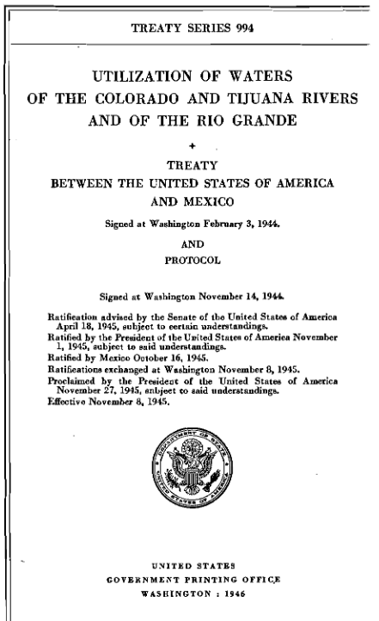
The Rio Grande Twist
The 1944 Treaty between the United States of America and Mexico

Slide 13
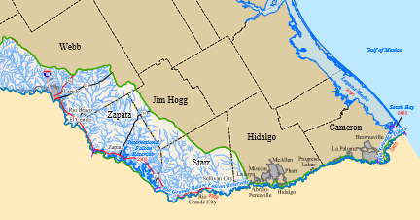
The Rio Grande Twist

Slide 14
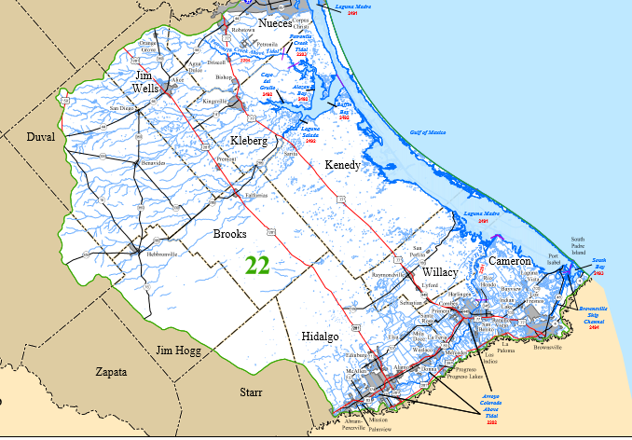
The Rio Grande Twist

Slide 15
Direct Reuse
30 Tex. Admin. Code Chapter 210 (non-potable reuse)
Safe Drinking Water Act
30 Tex. Admin. Code Chapter 290

Slide 16
Direct Reuse – Non-Potable Uses
210 Rules: Type I Reclaimed Water

Slide 17
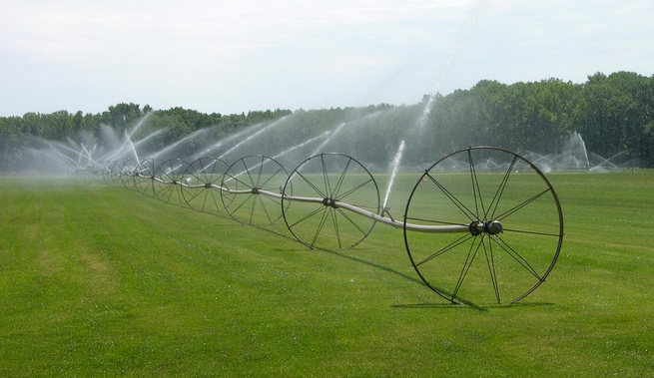
Direct Reuse – Non-Potable Uses
210 Rules: Type II Reclaimed Water

Slide 18
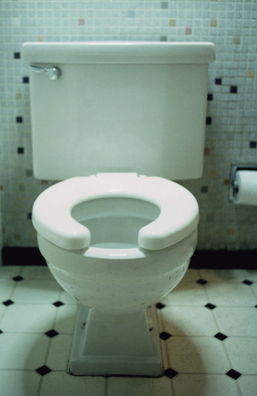
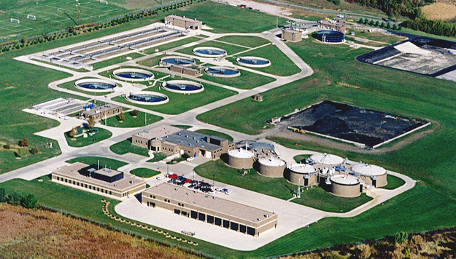
Direct Reuse – Non-Potable Uses
TCEQ’s Chapter 290 Requirements

Slide 19
Direct Reuse –Potable Reuse
Other Considerations:
Industrial wastewater discharge permit may be required. Tex. Water Code § 26.121.
Pretreatment requirements
Public Perception
Environmental Concerns
Project Examples in Texas:
Colorado River Municipal Water District Reuse Project for Big Spring, TX
City of Wichita Falls Emergency Reuse Project
City of Brownwood, TX Direct Reuse Project

Slide 20
Questions?
Emily W. Rogers
Tel: 512-472-8021
erogers@bickerstaff.com
Emily practices in the areas of water and environmental law, administrative law, and public law. She represents municipalities, river authorities and water districts before state and federal agencies on water and environmental permitting and enforcement matters.

