Slide 1

Serving the civil engineering community THROUGH ASCE
By: Dora E. Robles, P.E., CFM

Slide 2

What is ASCE?

Slide 3
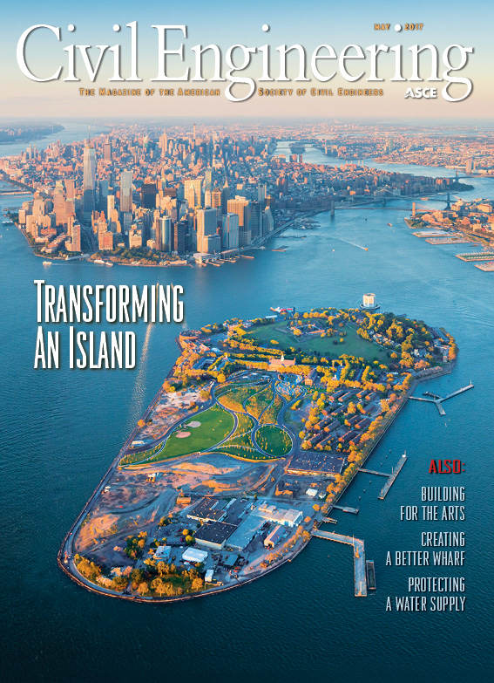
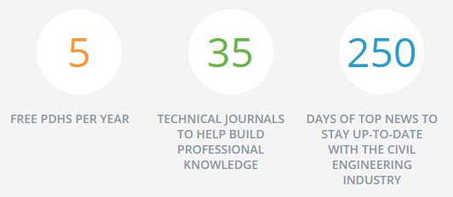




What can asce offer you?
Continuing Education
  Webinars
  Seminars
  5 Free PDHS a year
Technical & Professional Development
  Civil Engineering Magazine
  Institutes
  Publications
  ASCE specialty Conferences
Networking Opportunities
  Sections
  Branches
  Young Member Groups
  Student Chapters
Exclusive Members Discounts

Slide 4
- RIO GRANDE VALLEY

Slide 5
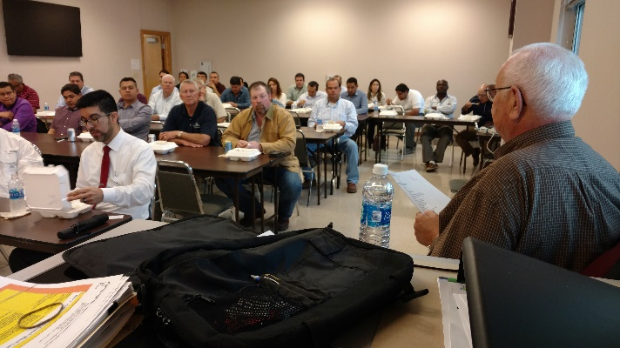
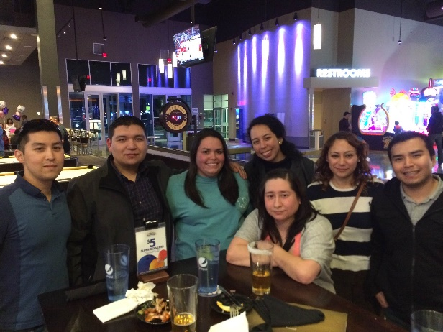
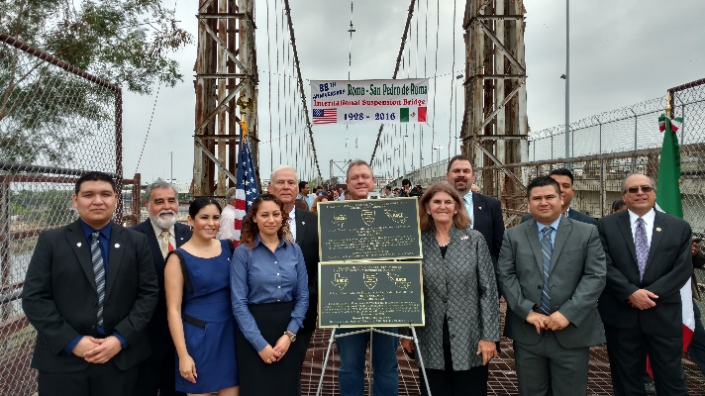
Rio Grande Valley Branch
Monthly Lunch & Learns
Young Member Socials
Partner in various local Conferences
Monthly Newsletter “Through the Pipeline”
Other Special Events

Slide 6
Joining ASCE ASCe.org
Membership Types:
  Licensed Engineer: PE’s or RPLS
  Student (Free membership)
  Affiliate: have an interest in advancing the purpose and objectives of ASCE and are not students or classically trained engineers or scientists
  Associate: EITs or SITs International Member
  Fellow
  Life Member: members for over 35 years and are over 65 years old (Exempt dues)
  Distinguished Member

Slide 7

http://www.dreambigfilm.com/
Branch is currently working on scheduling a local screening. Stay posted for updates!

Slide 8
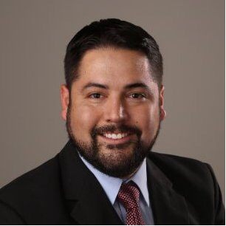
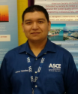
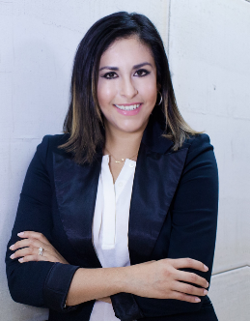
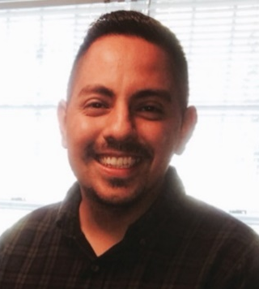
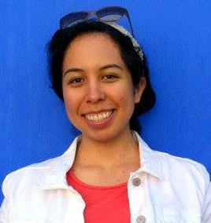
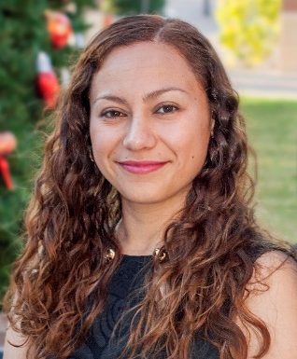
Thank you!
2016-2017 RGV BRANCH BOARD MEMBERS
Eugene Palacios, P.E.
Branch Director
Jesse Sanchez
President
Ethny Fantich, EIT
Vice-President
Humberto Lopez, EIT
Secretary
Maria Rangel, EIT
Treasurer
Dora E. Robles, P.E.
Newsletter Editor
Contact us at:
asce.rgv@gmail.com
RGV Branch Website Coming Soon!!

