Slide 1
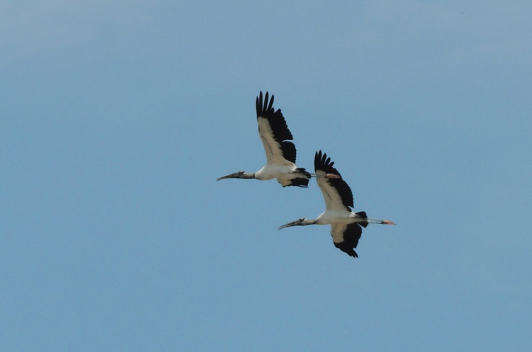
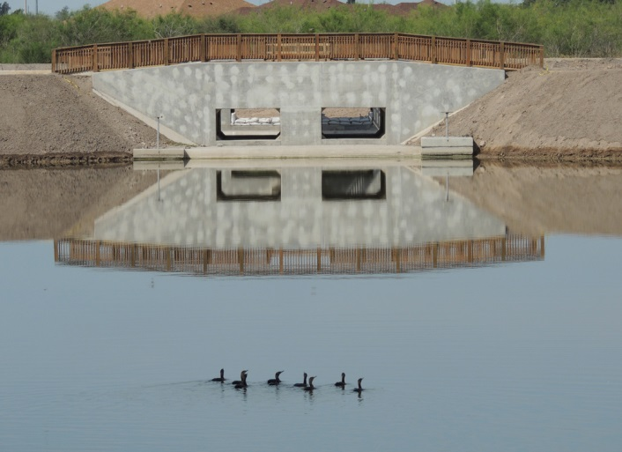
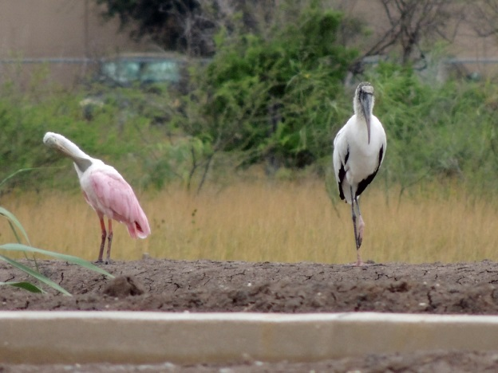
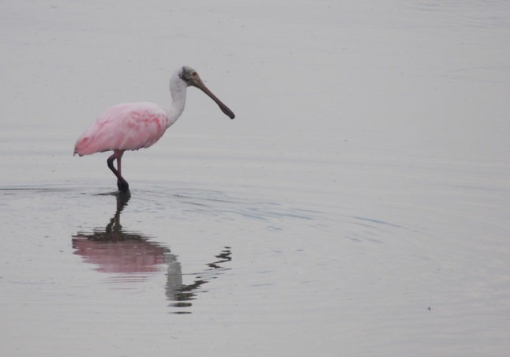
Jose Hinojosa, REM
General Manager
Santa Cruz Irrigation District #15
Lower Rio Grande Valley TPDES Stormwater Task Force
Chairperson
May 24, 2017
Strategic Planning – LRGV TPDES Stormwater Task Force

Slide 2
INTRODUCTIONS – TASK FORCE
Joe Hinojosa, Gen. Mgr., Santa Cruz Irrigation District #15
Chairperson, LRGV TPDES Stormwater Task Force
Jose Figueroa, Stormwater Mgr., City of Brownsville
Vice-Chair, LRGV TPDES Stormwater Task Force
Mardoqueo Hinojosa, P.E., City Engineer, City of Weslaco
Secretary, LRGV TPDES Stormwater Task Force
Melisa Gonzales, Stormwater Manager, City of Alamo
Past Chairperson, LRGV TPDES Stormwater Task Force
* Task Force Reps appointed by City Council, Board of Directors, Commissioners Court, etc. via interlocal agreements.

Slide 3
INTRODUCTIONS – TASK FORCE
City of Brownsville –Jose Figueroa City of La Feria – Paula Rodriguez
City of San Juan – Xavier Cervantes, AICP City of Donna – Roy Jimenez
City of Alton – Rudy Garza, CPM City of Edinburg – Robert Valenzuela, CSI, CEO
City of San Benito – Bryan Medina Cameron County DD#1– Hector Lerma
City of Los Fresnos – Raul Garcia City of Weslaco – Mardoqueo Hinojosa, P.E.
City of Mission – Juan De La Garza City of La Joya – Isidro Venecia
City of Primera – Javier Mendez City of Alamo – Ernesto Solis
Cameron County – Paolina Vega, P.E. City of Palmview – Ramon Segovia
Santa Cruz Irrigation District #15 – Joe Hinojosa, REM

Slide 4
Founded in 1998
Role
Stormwater Management
Watershed Management
Non Point Source Pollution Management
UTRGV facilitates organization/operations
Task Force supports
Research
Students
Community Outreach/Education
Interlocal Agreements guide partnership (by-laws)
Annual funding (membership fees)
18 members now
Mercedes (May 2017)

Slide 5
Objectives 2017
Fully transition the LRGV Task Force from the A&M System to the UT System
The Task Force will assist UTRGV:
develop a Water Center/Institute
develop a Graduate Program
establish an Estuary Program in South Texas
establish a Center of Excellence in South Texas
support civil engineering initiatives
in co-leading watershed protection plans

Slide 6
Objectives 2017
UTRGV will
manage the TPDES programs (primary role)
develop a region-wide internship program
re-vitalize the Task Force scholarship program
seek State and National conferences, events and initiatives to the Valley
Expand support to the Task Force to include solid waste, air quality, wastewater, planning and construction programs

Slide 7
Short Term Goals
Transition Task Force -A&M System to the UT System
2 year transition plan
Increase Membership – 18 local governments to date
Rancho Viejo, Palmhurst, Willacy County
Transition all Interlocal Agreements to UTRGV
Mission – Permit Compliance
UTRGV will not lose sight of priority (compliance)
Staff support (hire) and provide Outreach/Education
Program coordinator/Watershed coordinator
Administrative staff
Grant Symposiums/Conferences
Trainings, etc.

Slide 8
Long Term Goals
Main focus:
Stormwater Management Program (Compliance)
Education, Outreach and Training (UTRGV role)
Strategic Plan (SP) will be developed
Develop SP for the Task Force (for 5 years)
Develop RGV-Sustain Organization (new idea)
Include Task Force in the Civil Engineering SP
Establish major Water Institute in the LRGV

Slide 9
Thank you!
April 21, 2017

