Slide 1

HOW TO ADD A PAGE
WordPress

Slide 2
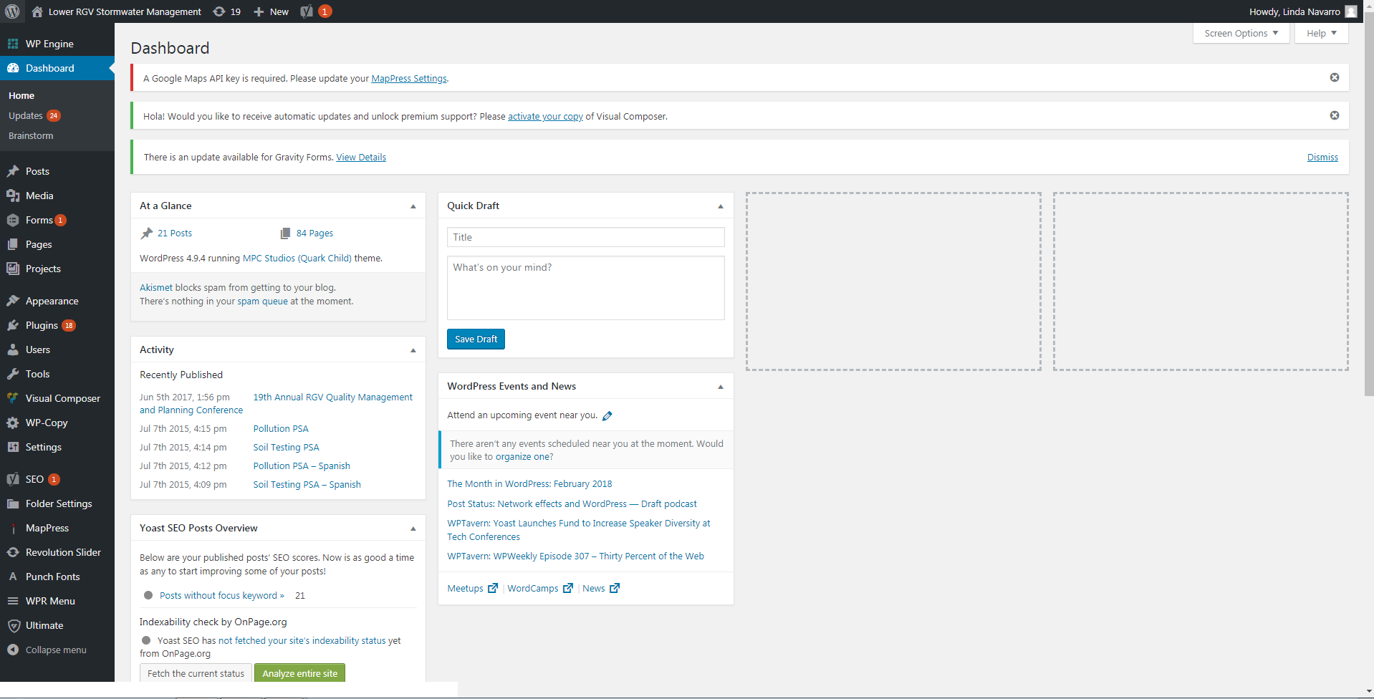
Notes:
First go to your dashboard then go to the pages tab.

Slide 3
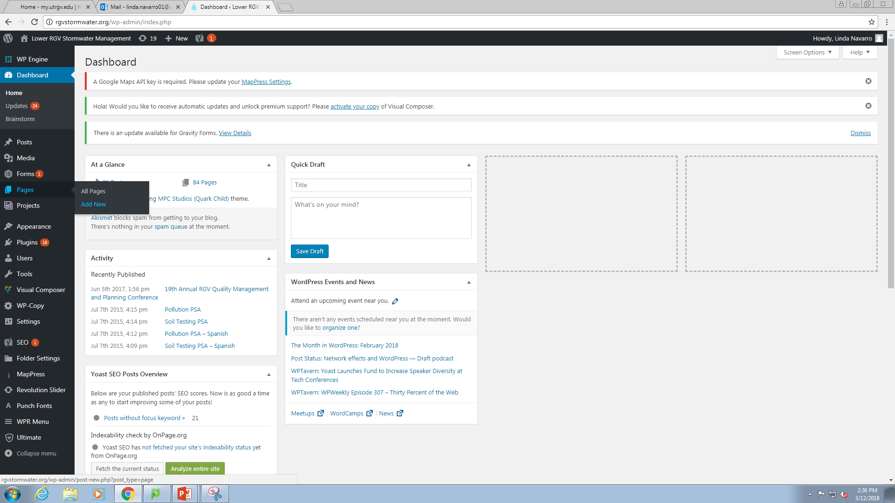

Slide 4
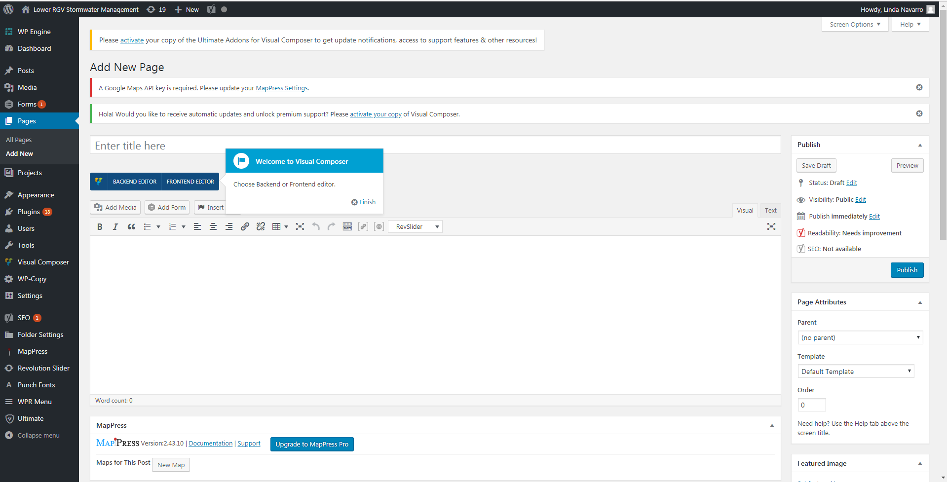

Slide 5
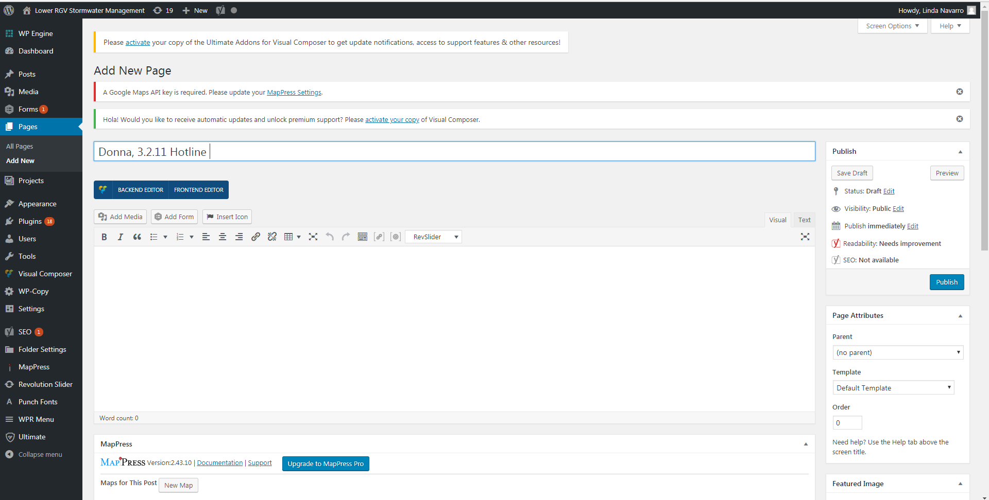
1
2
Notes:
Enter the name of the page you want to add to the folder and then publish it.
MAKE SURE TO TYPE THE CITY NAME FIRST, FOLLOW BY A COMMA

Slide 6
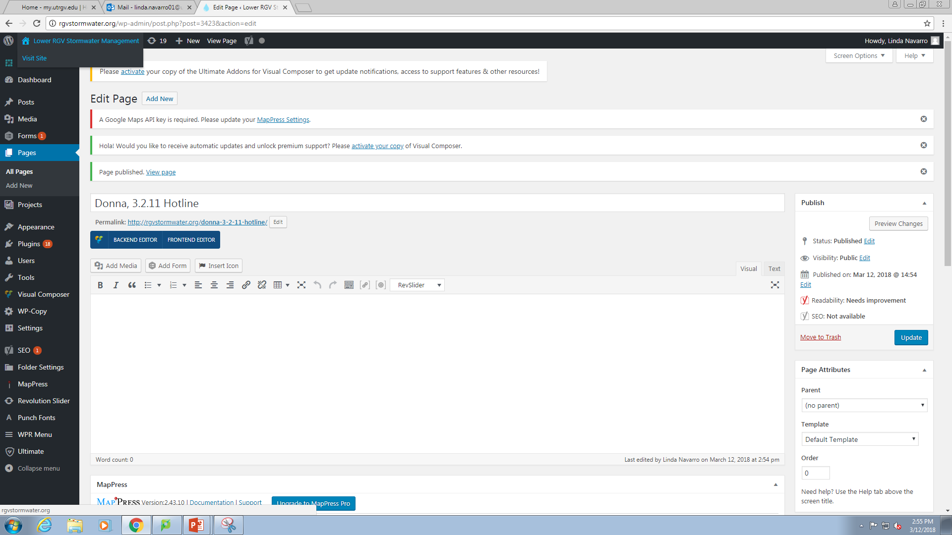
Notes:
Go to “Visit Site”

Slide 7
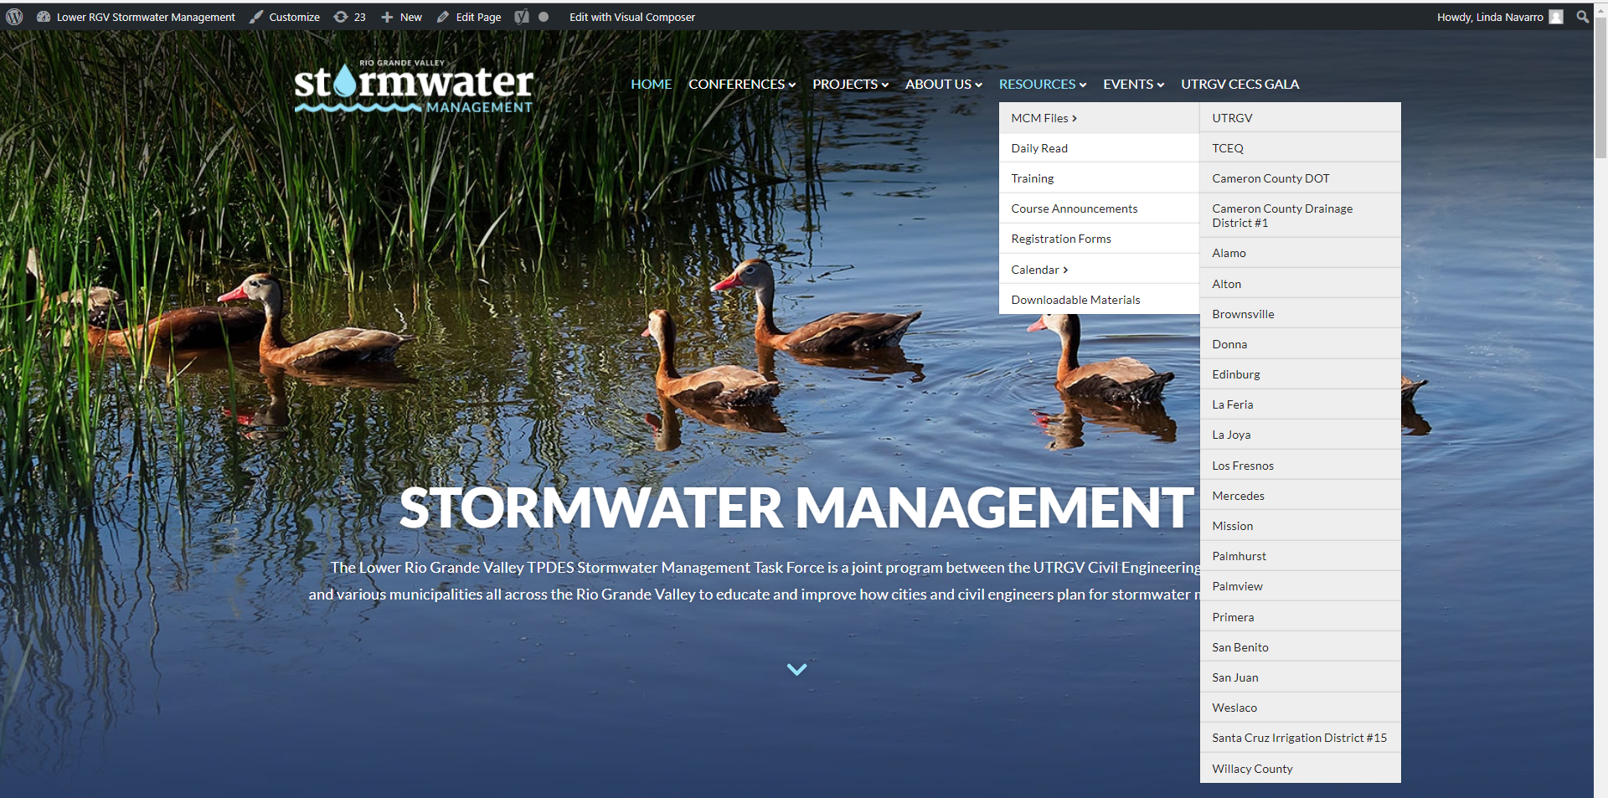
Notes:
Go to Resources and choose your city.

Slide 8
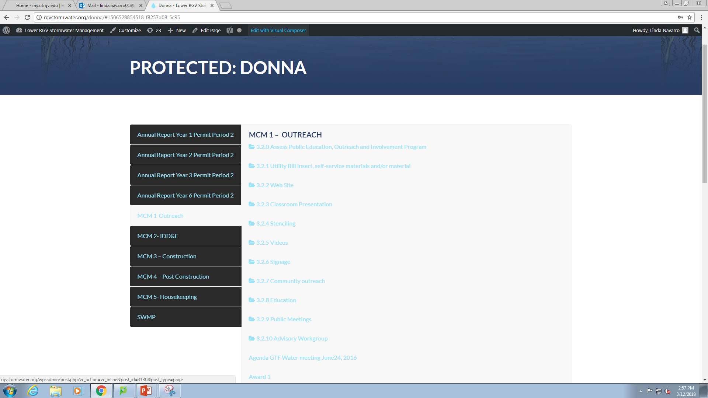

Slide 9
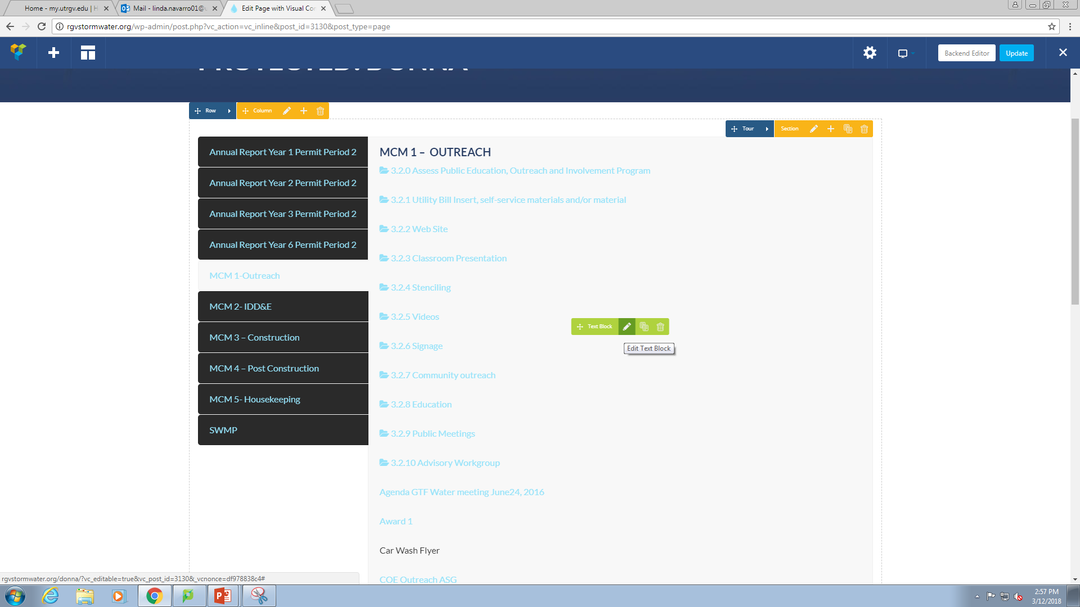

Slide 10
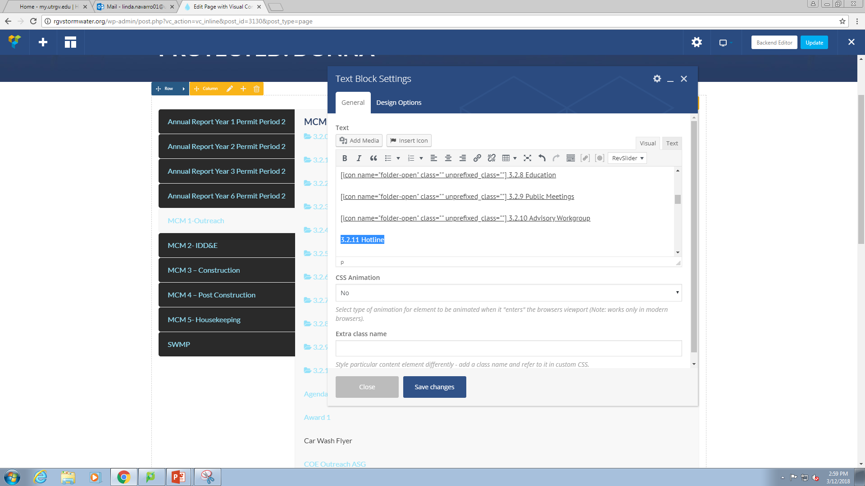

Slide 11
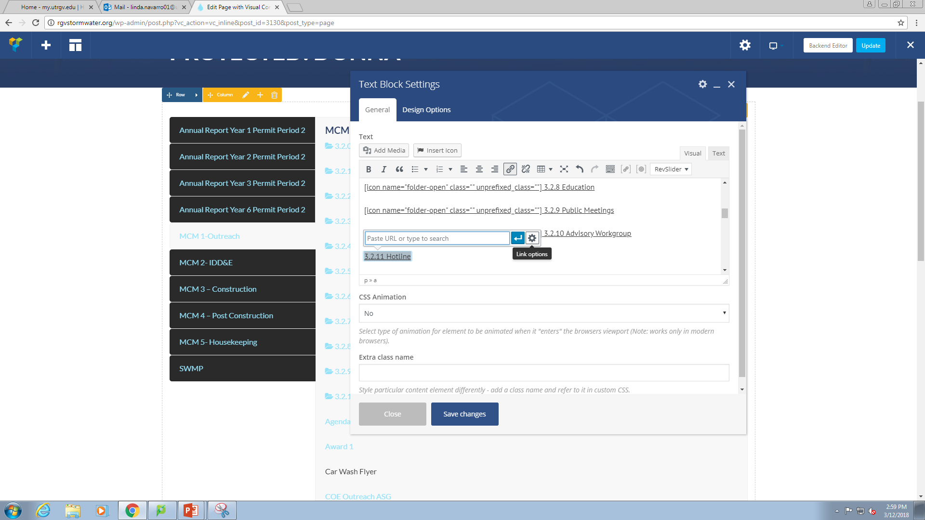

Slide 12
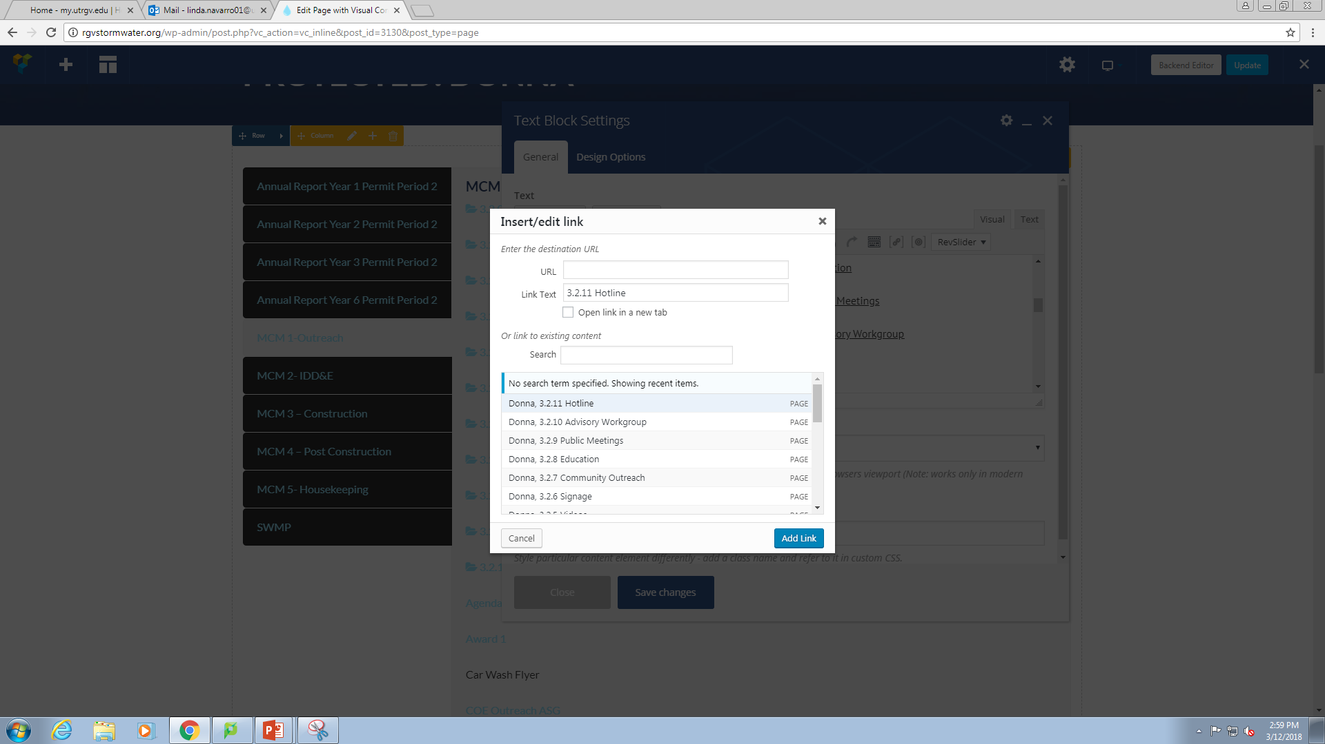

Slide 13
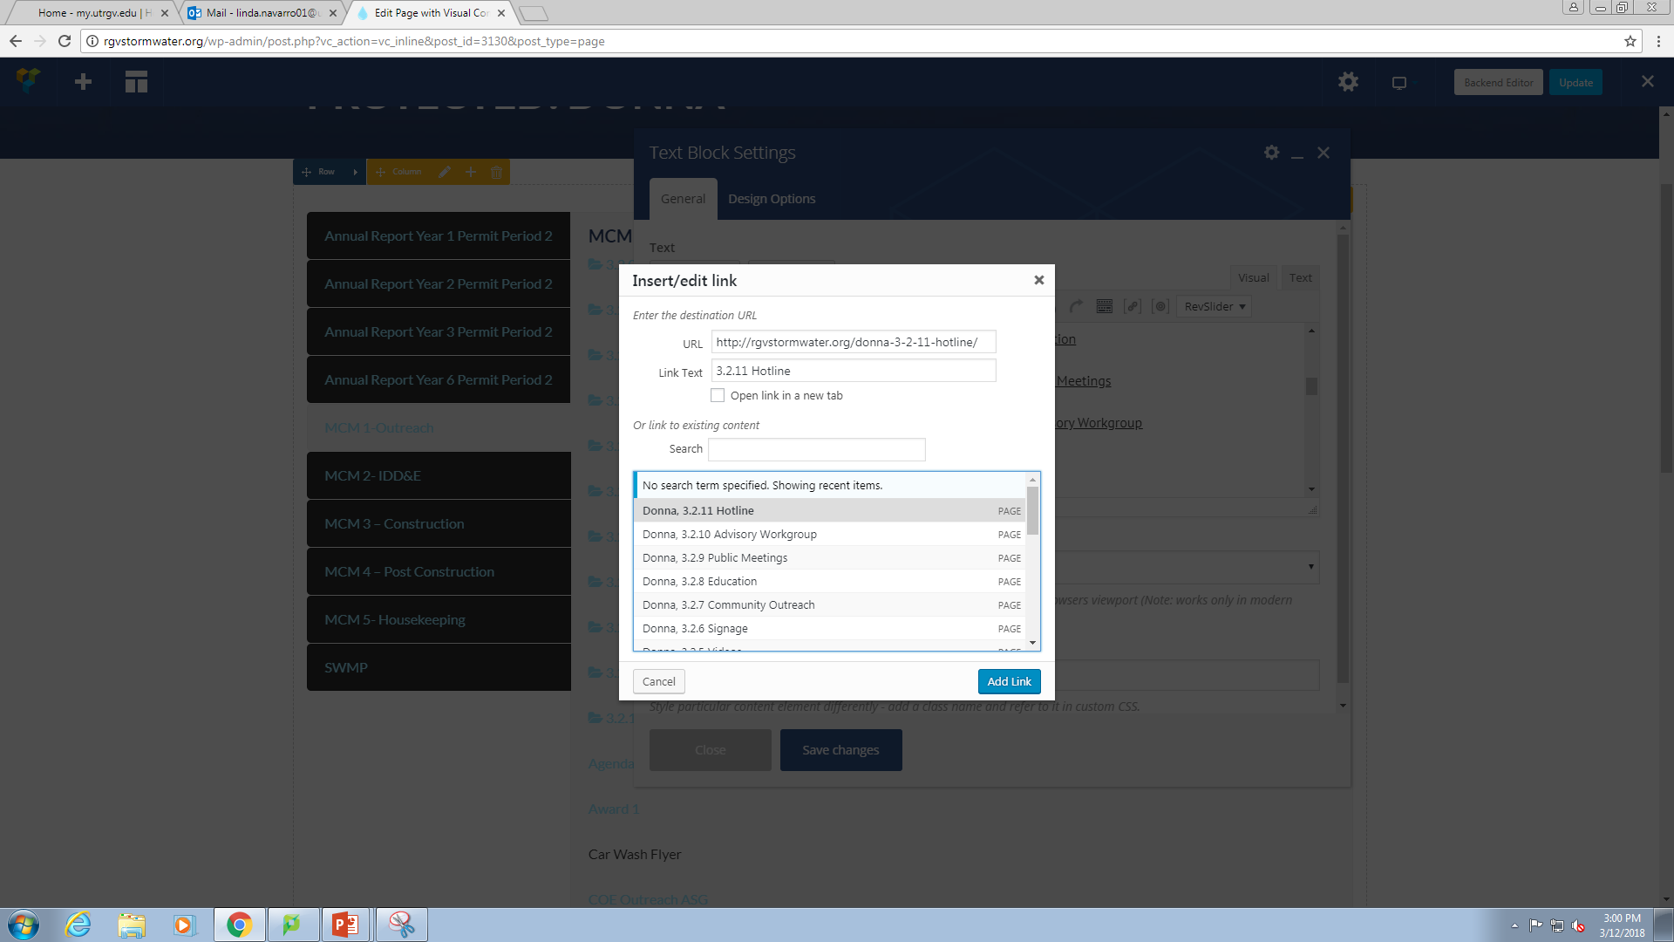

Slide 14

1

Slide 15
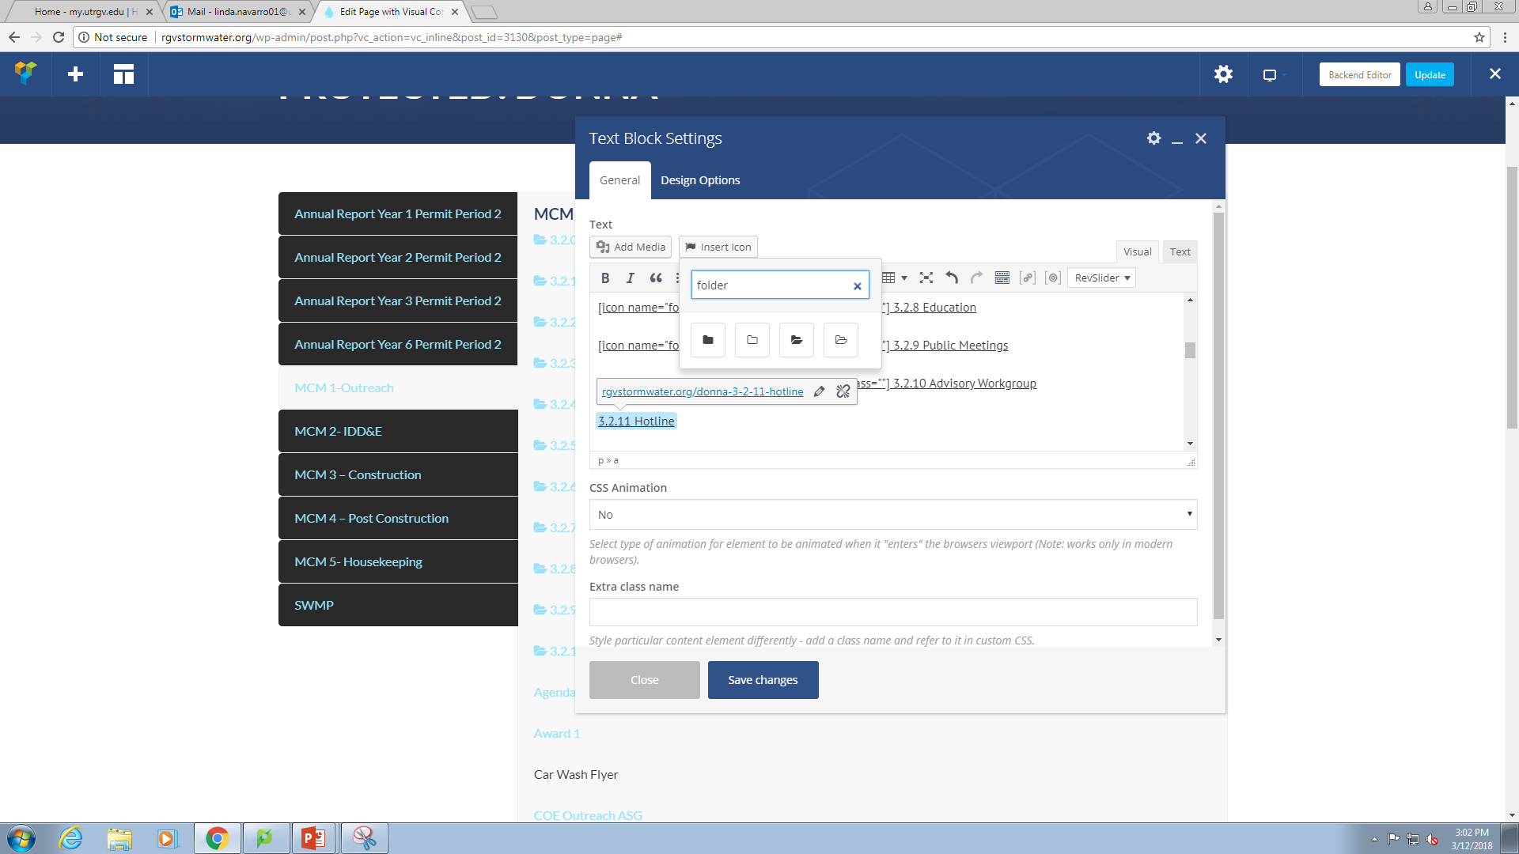
2
3

Slide 16
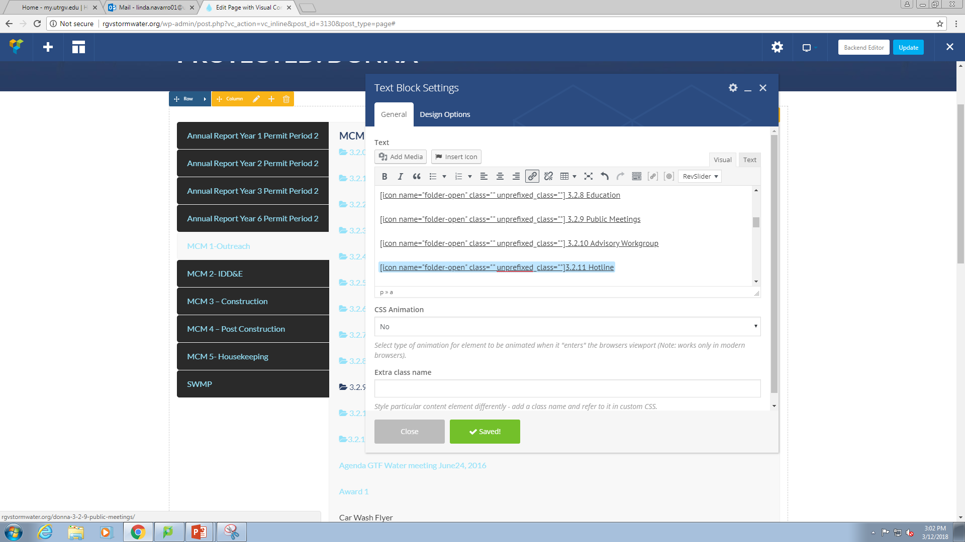

Slide 17


Slide 18
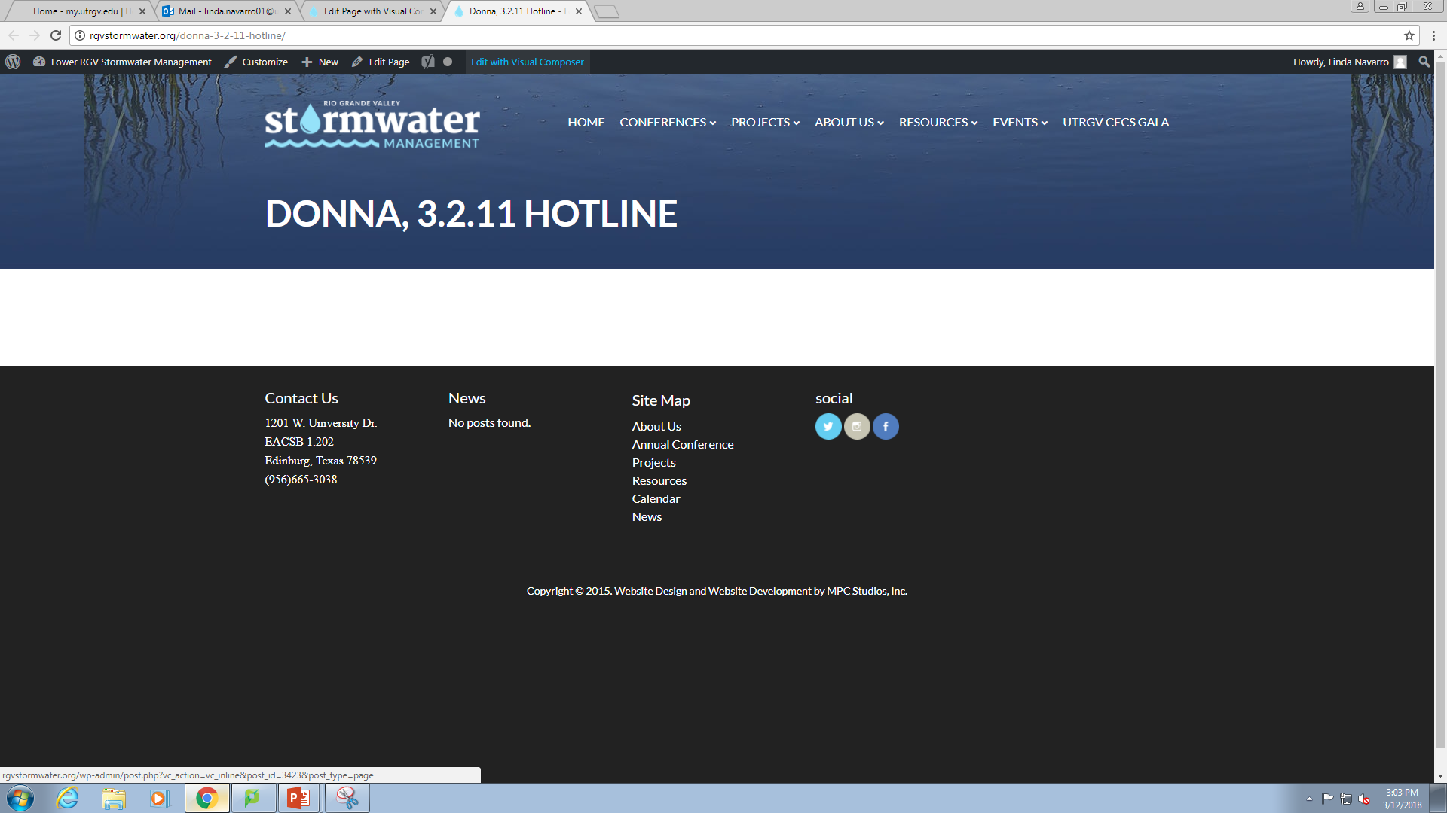

Slide 19
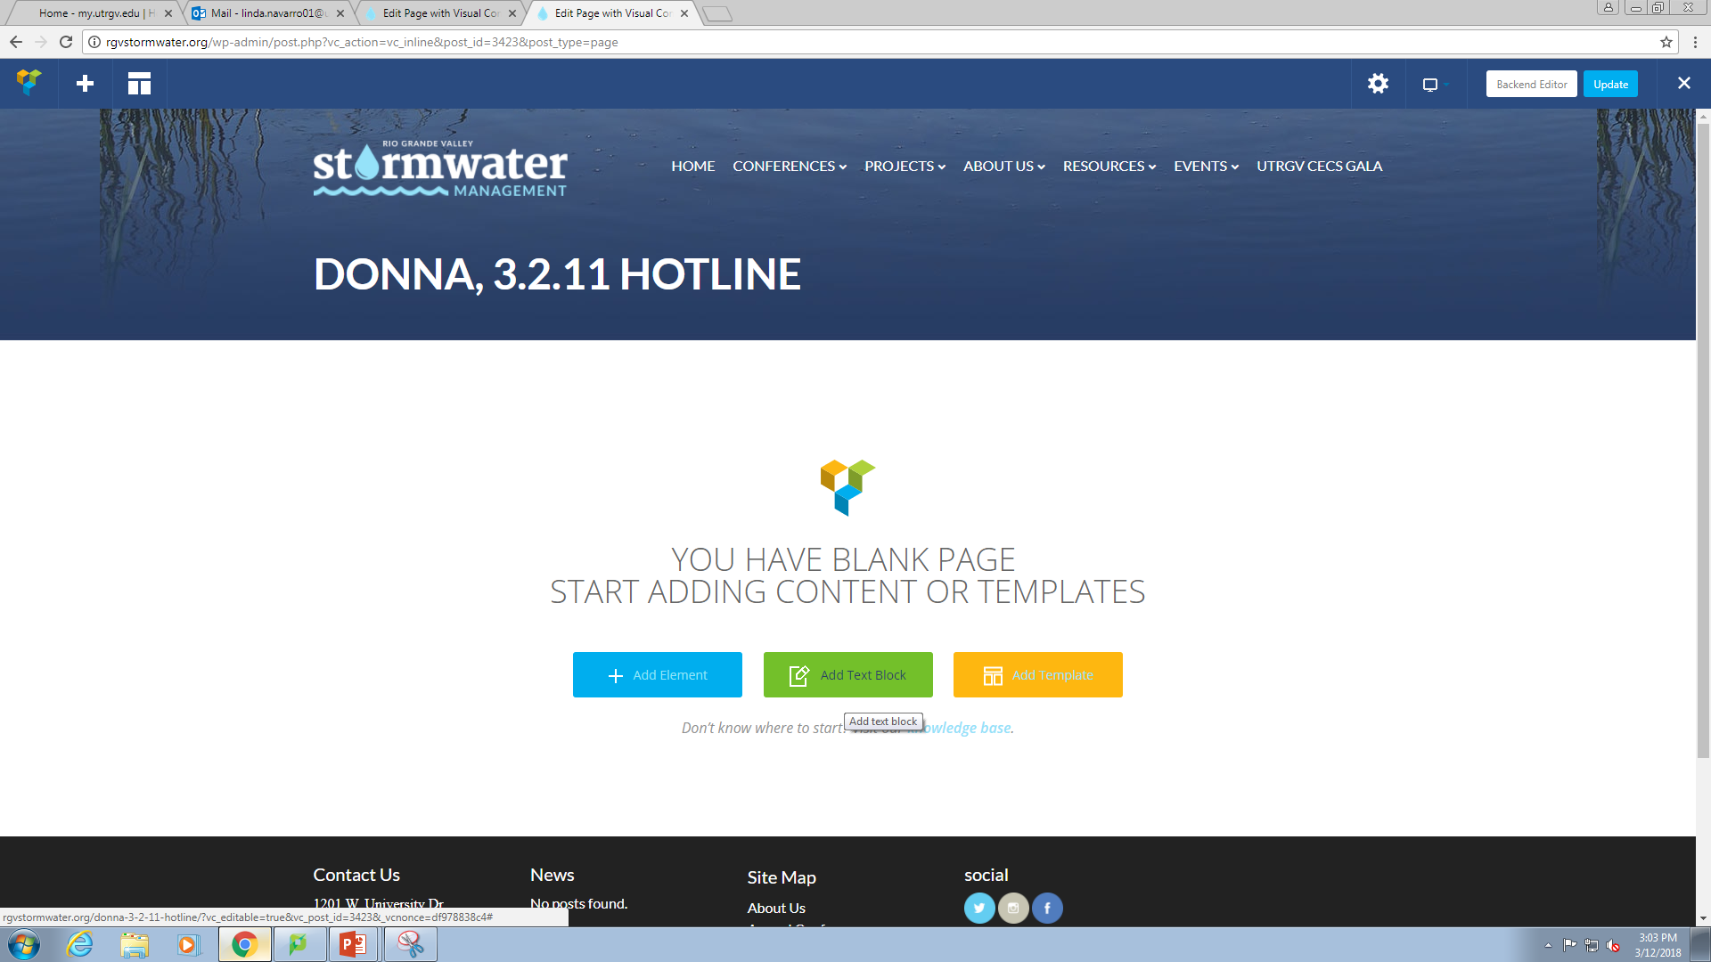

Slide 20
