Slide 1

WordPress Training

Slide 2
Agenda
How to Login
How to Add Sections
How to Add Media/pdfs
Q & A

Slide 3
How to Login
To start editing pages, type login or admin at the end of the URL address in a browser:
http://rgvstormwater.org/login
http://rgvstormwater.org/admin
(On the new template, the login link is no longer available
at the bottom of the page.
Also you have to be on the main site URL, not a subpage )
At the login screen, enter your username and password

Slide 4
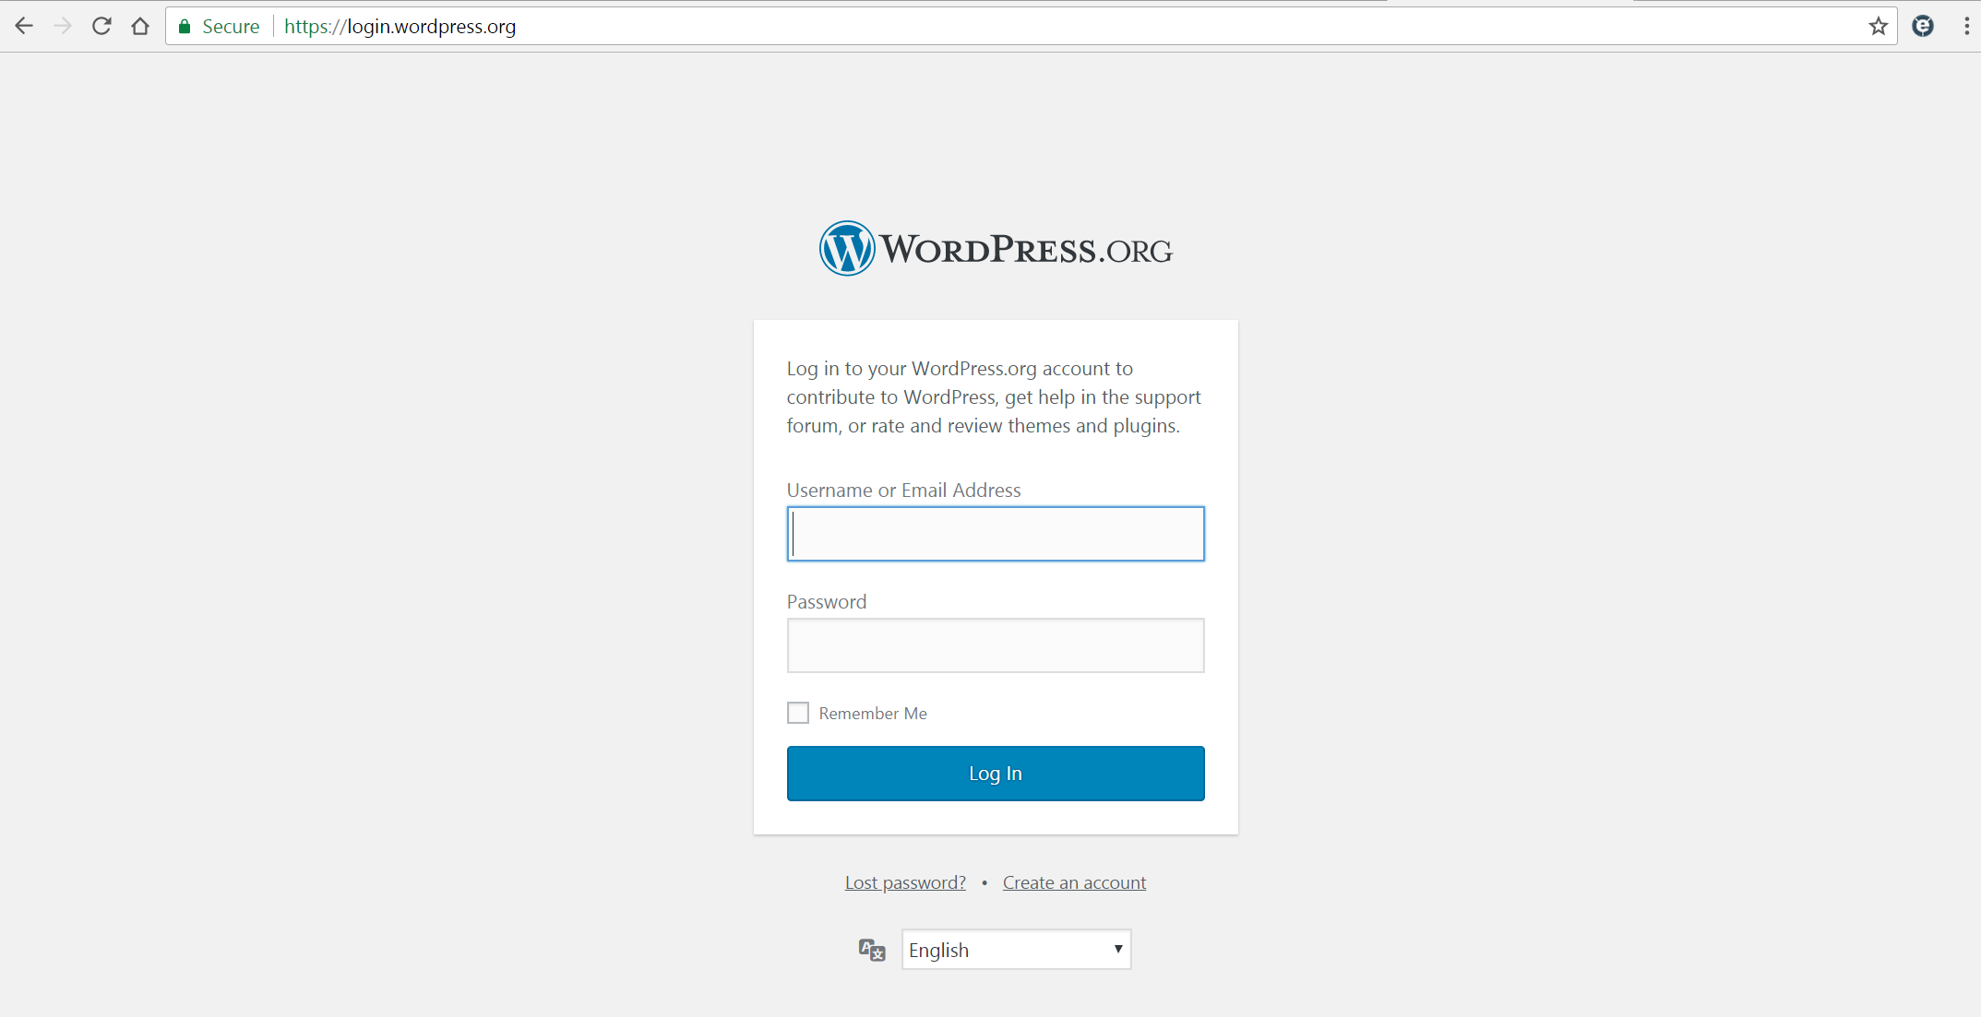
Notes:
Once you enter the website page, this page will appear. Enter you credentials which will be for your username(work email) and for the password will be vaqueros2018

Slide 5
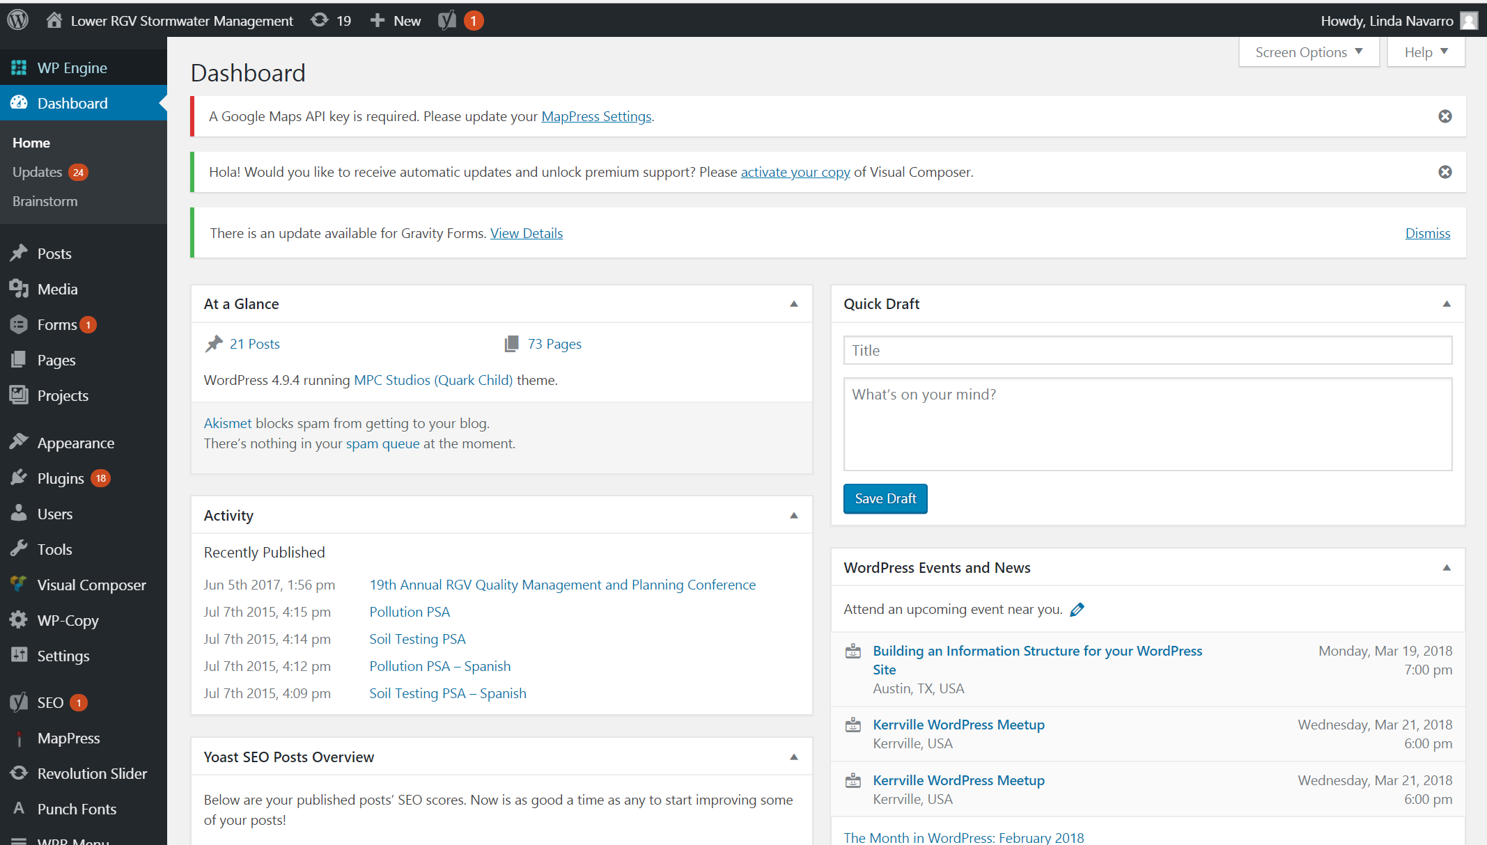
Notes:
This page will appear right after login in.

Slide 6
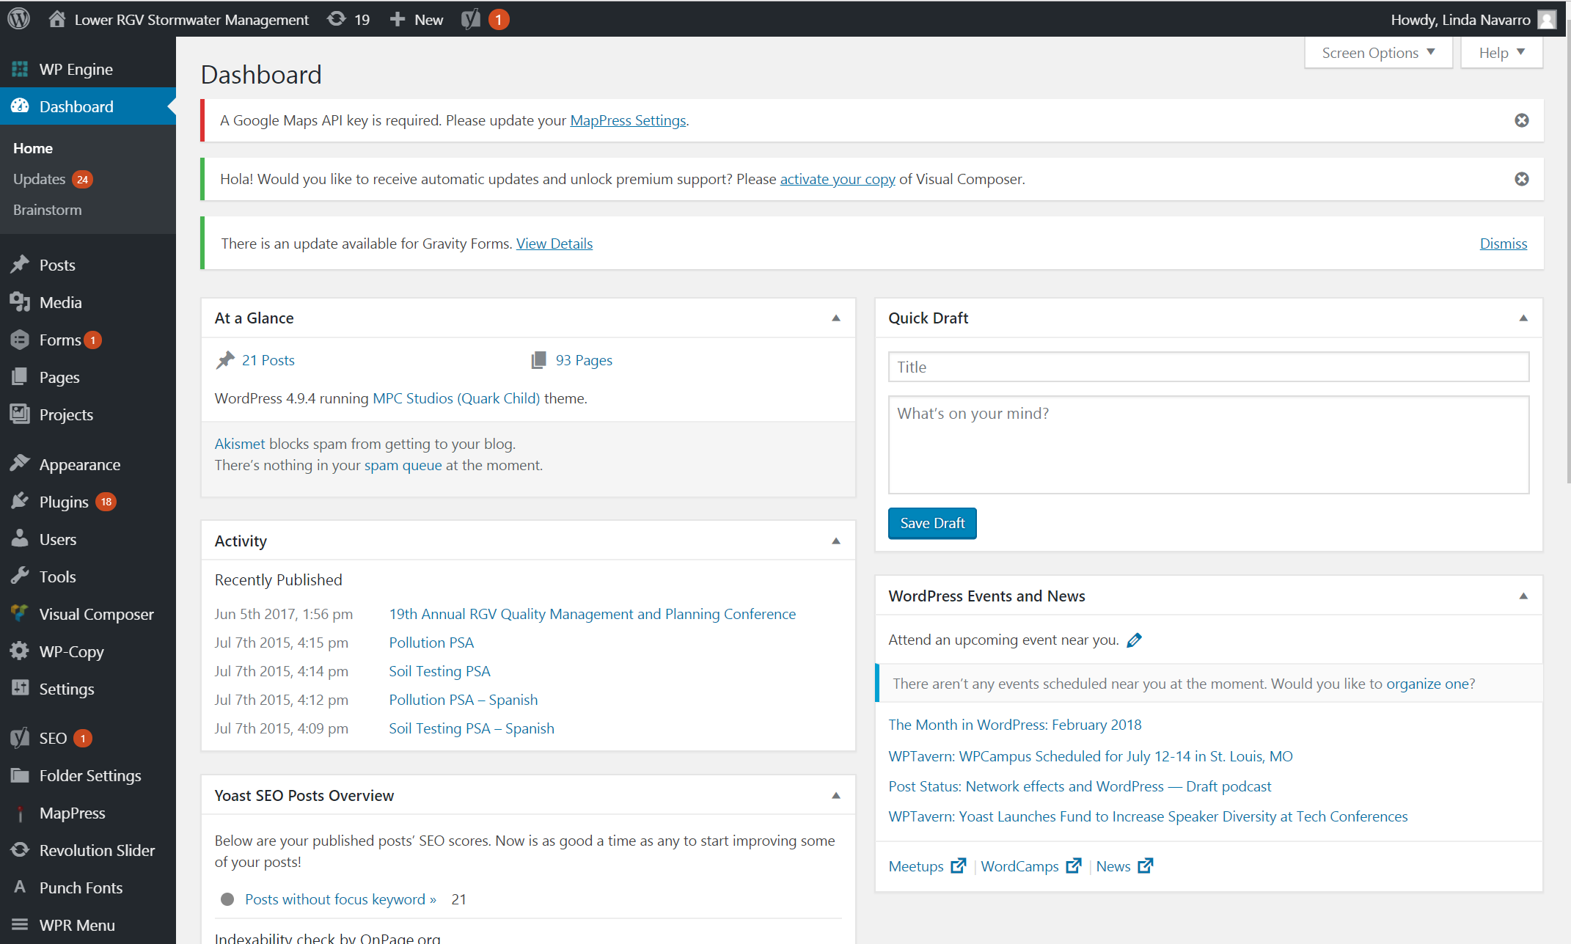
Notes:
Go to users to change your password

Slide 7
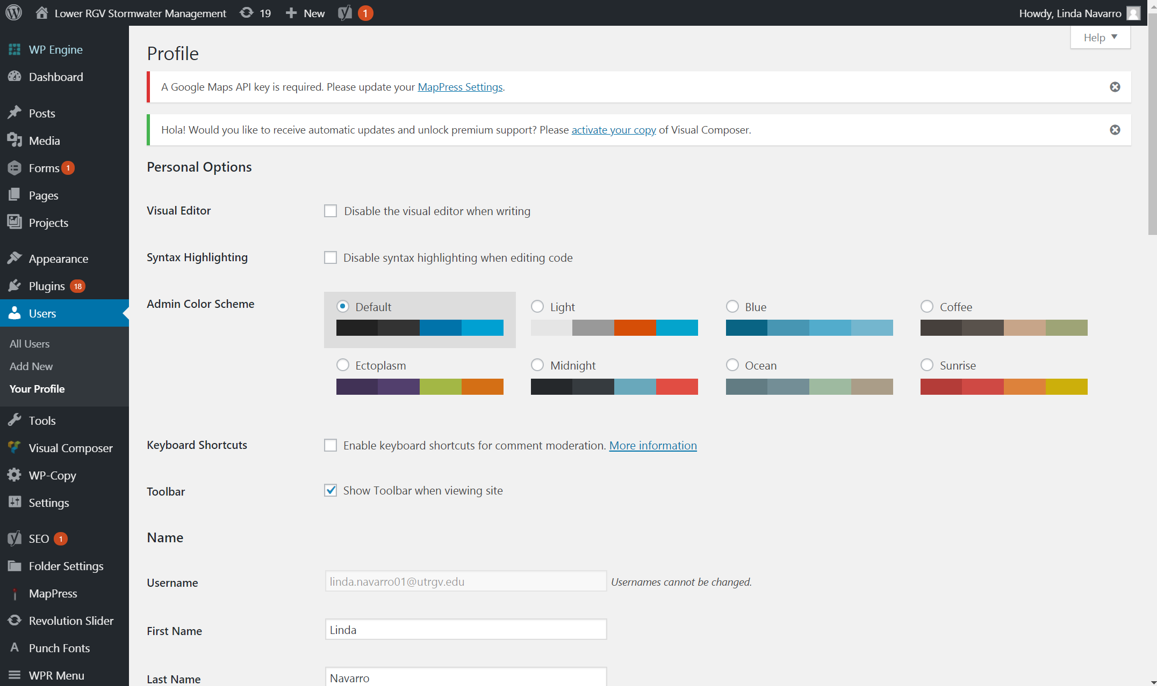
Notes:
Scroll down to

Slide 8
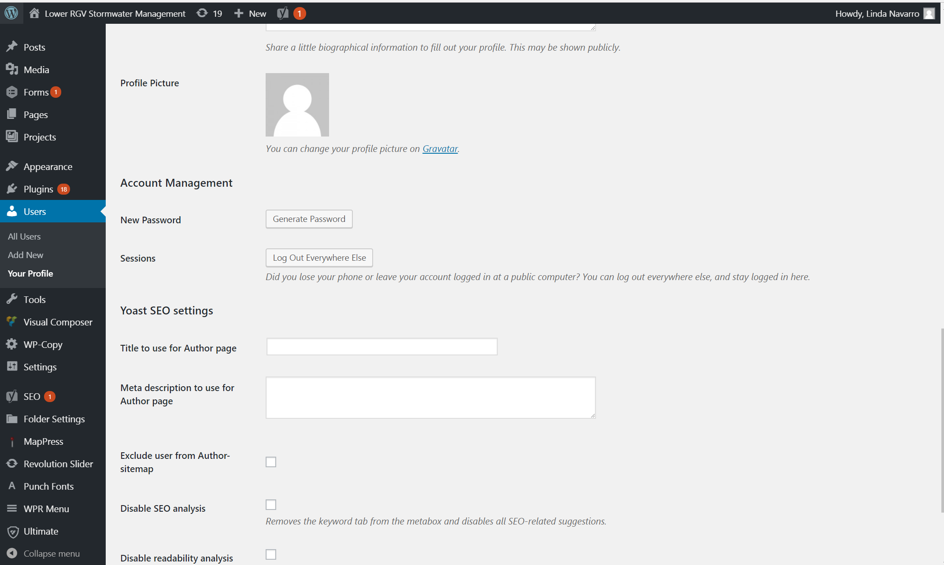
Notes:
Under Account Management and click to “Generate Password”

Slide 9
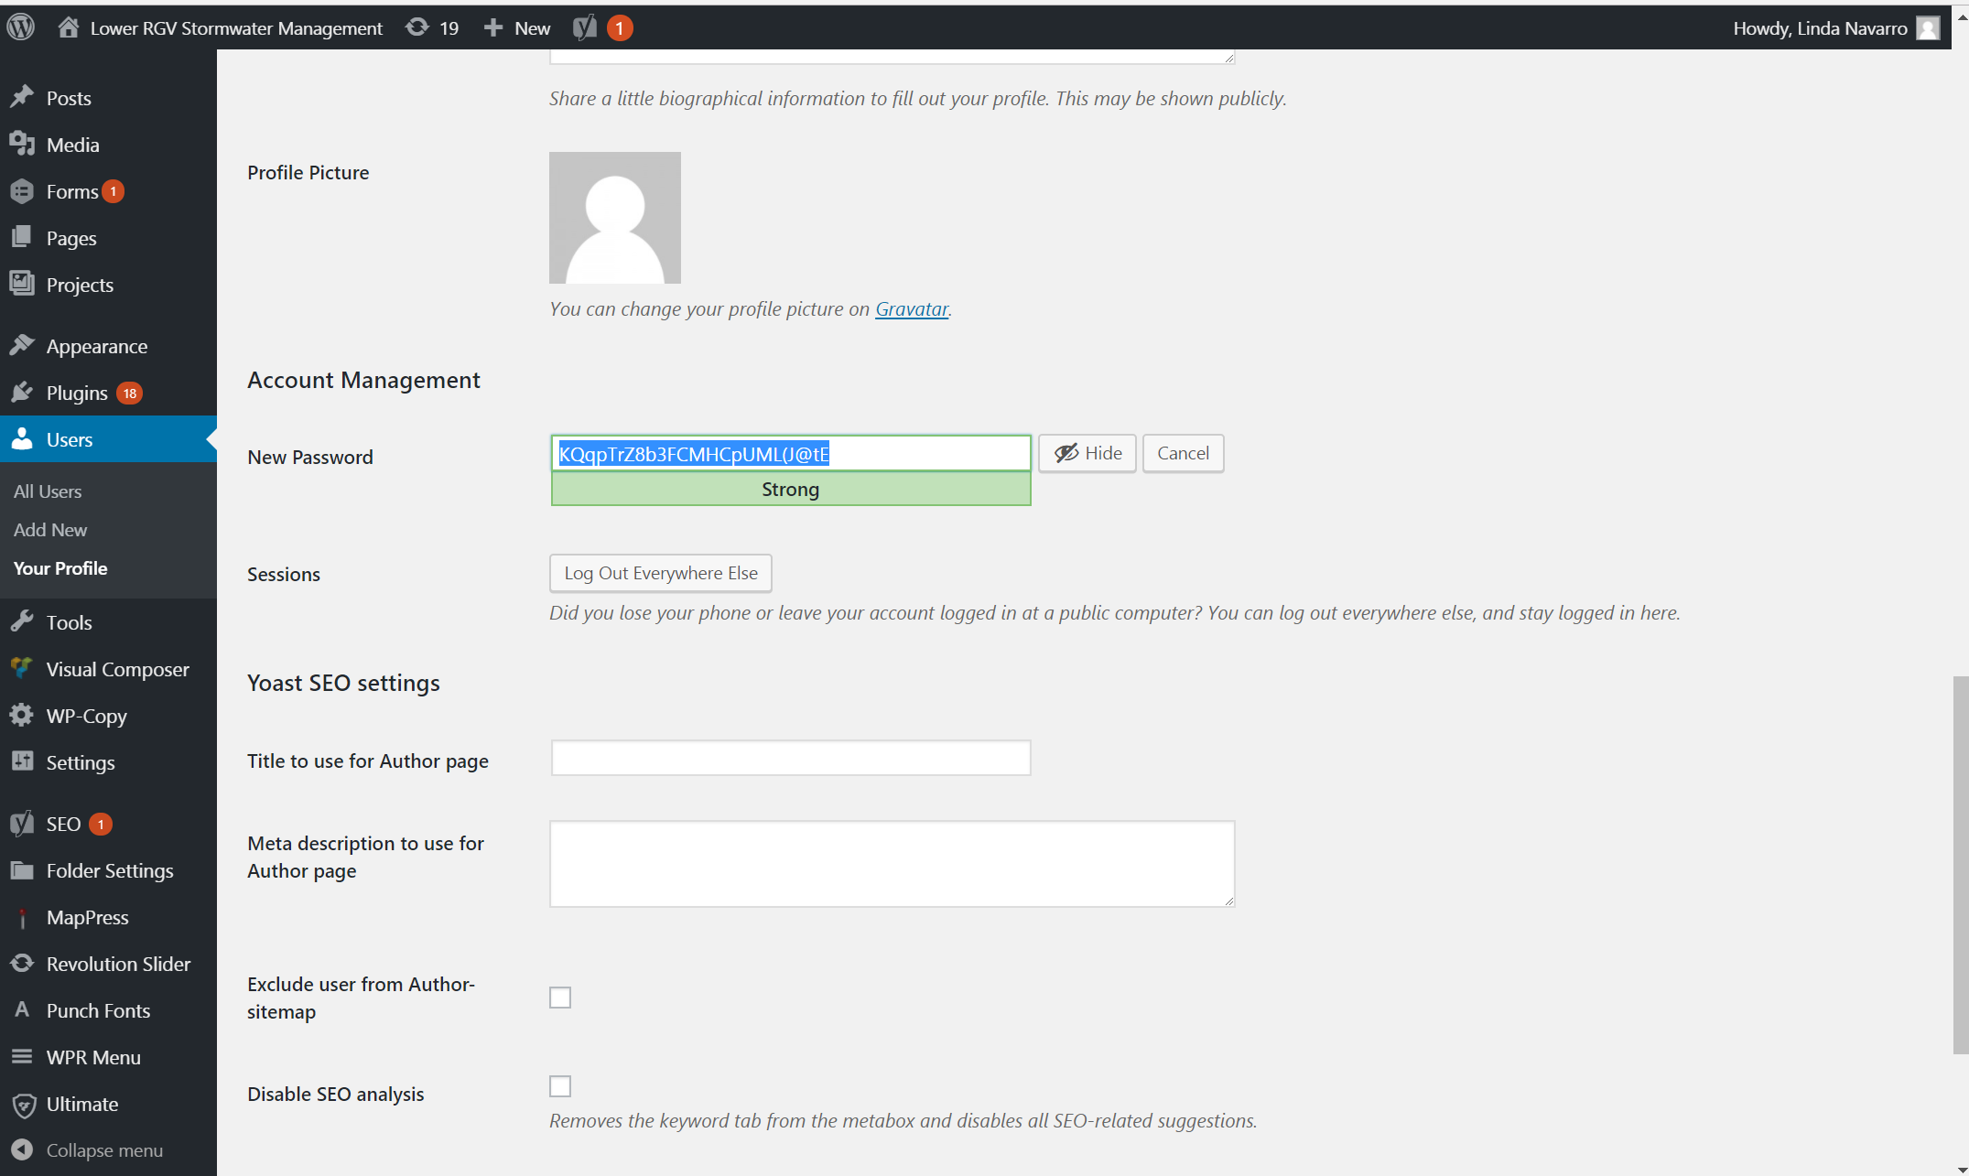

Slide 10
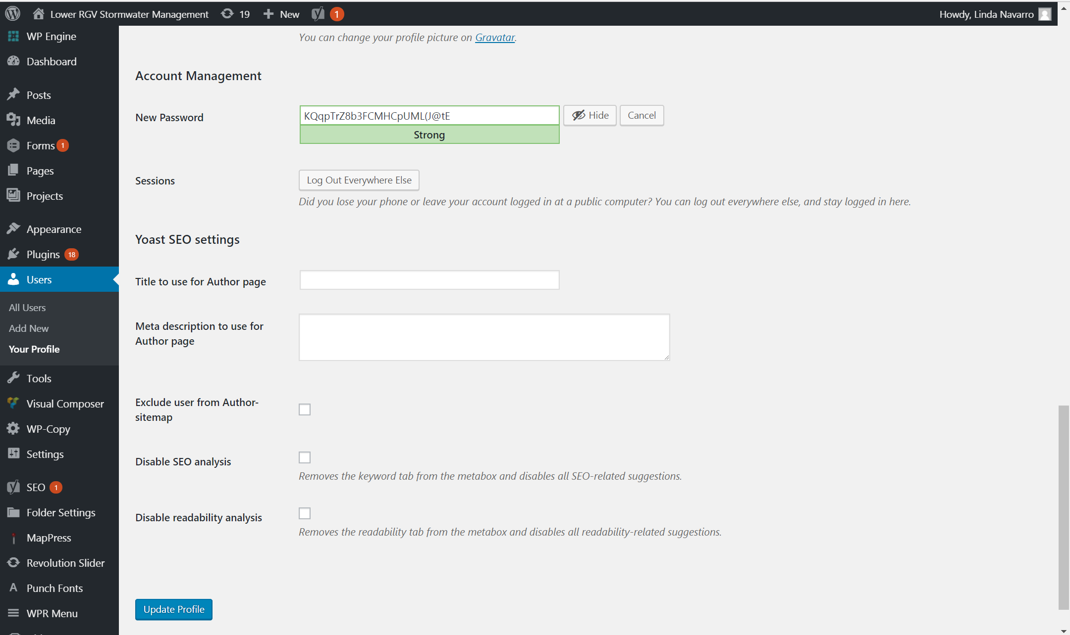
Notes:
Change the password and then click to “Update Profile”

Slide 11
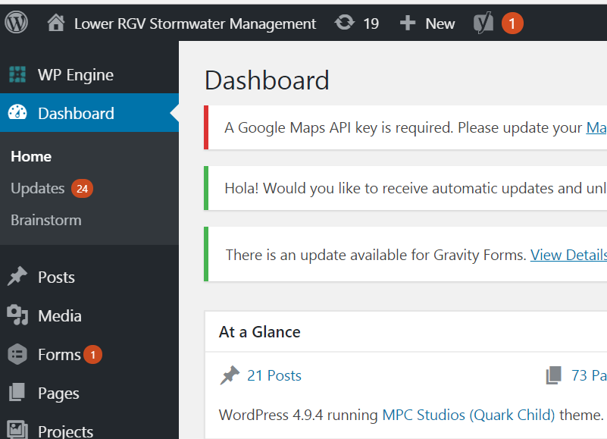
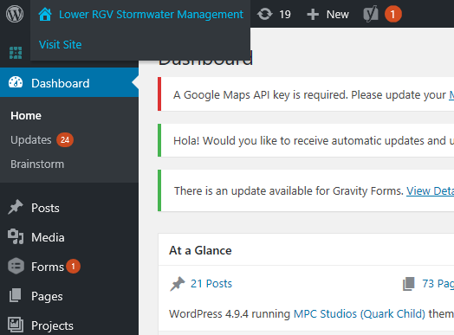
Notes:
Go to the upper left corner to the “Lower RGV Stormwater Management” icon and go to the “Visit Site” icon

Slide 12
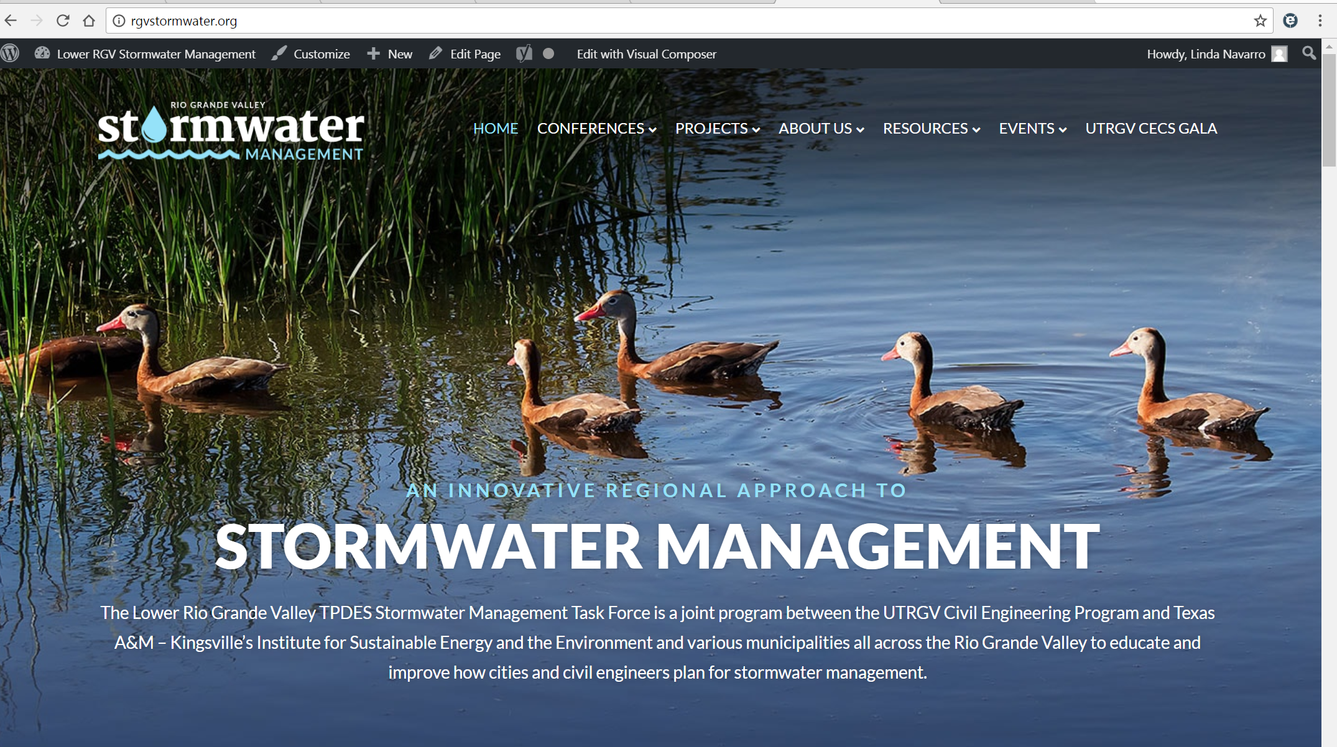
Notes:
This page should appear

Slide 13
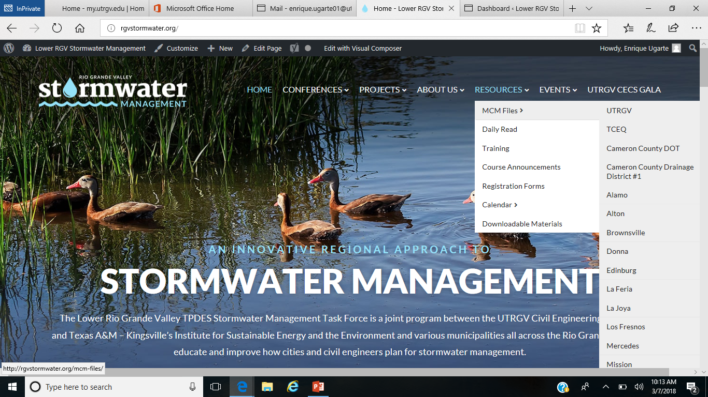
Notes:
Then go to the resources tab, under MCM files select your city

Slide 14
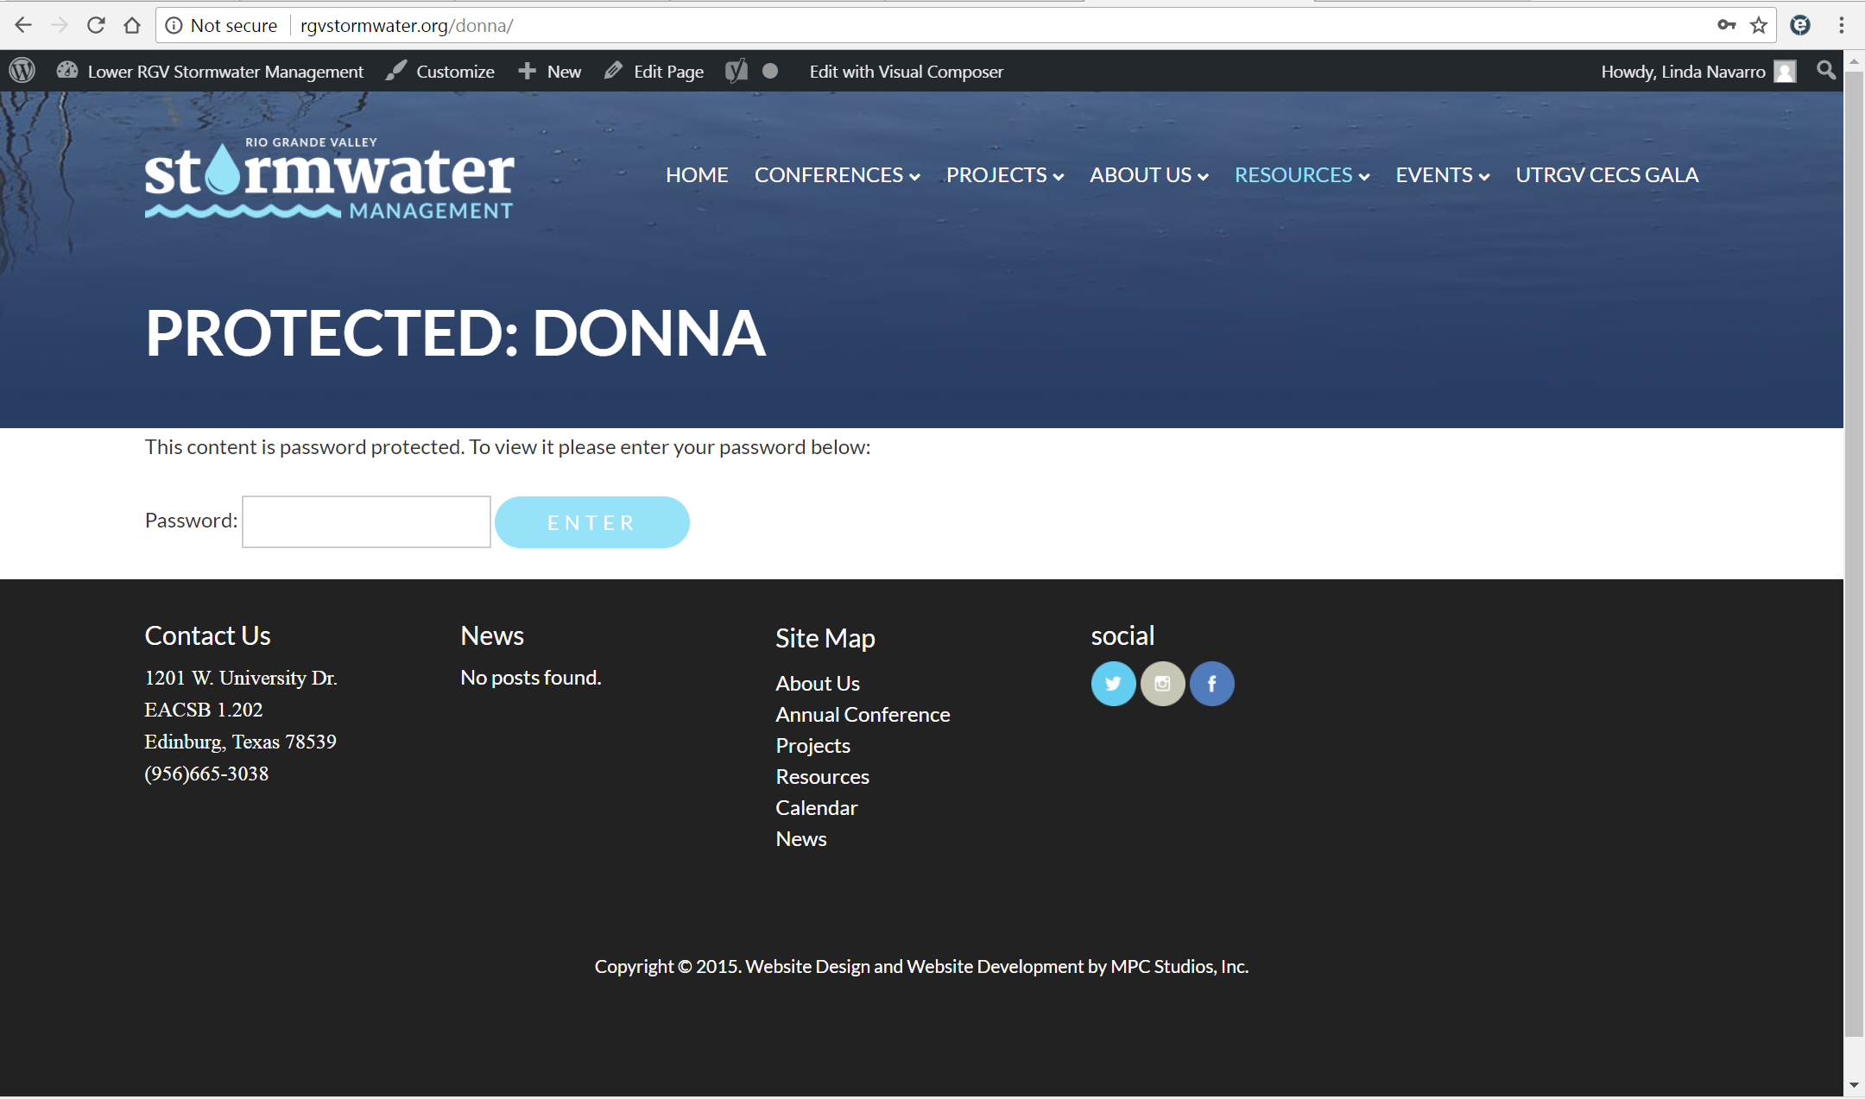
Notes:
For example: City of Donna should enter their password. Every city will be provided with their own password

Slide 15
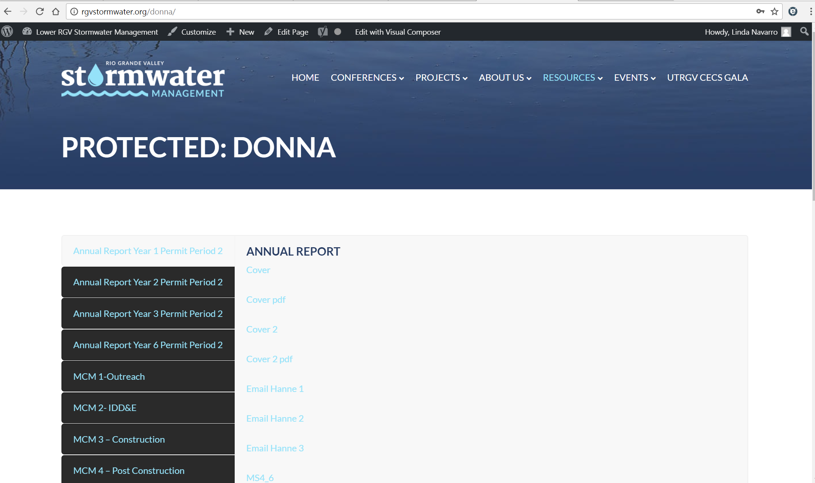

To edit the page go to edit with visual composer.
Notes:
Once entering your password, you will be able to edit the page, go to “Edit with Visual Composer”

Slide 16
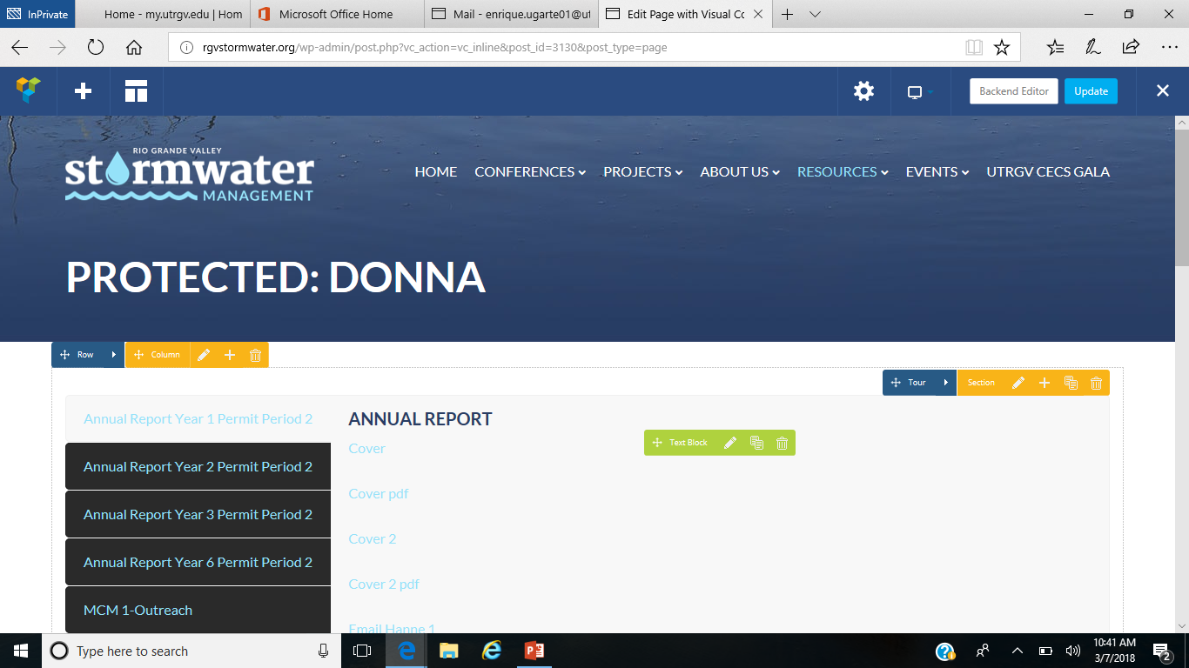
Notes:
This page should appear once you start editing

Slide 17
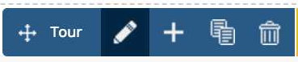
To add a folder/tab
Notes:
Go to right box and select the arrow and the box will expand. Then select the plus icon so you can add a tab.

Slide 18
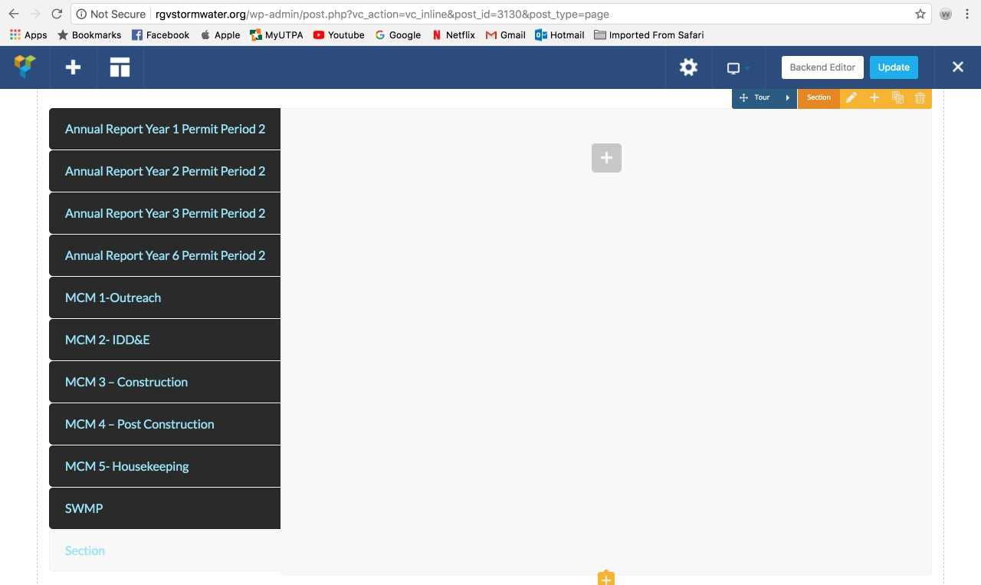
A section will be added
Notes:
Once you add a section it will appear below your other tabs and the tour box will have the option to edit the section. Select the pencil icon to edit the name of the section.

Slide 19
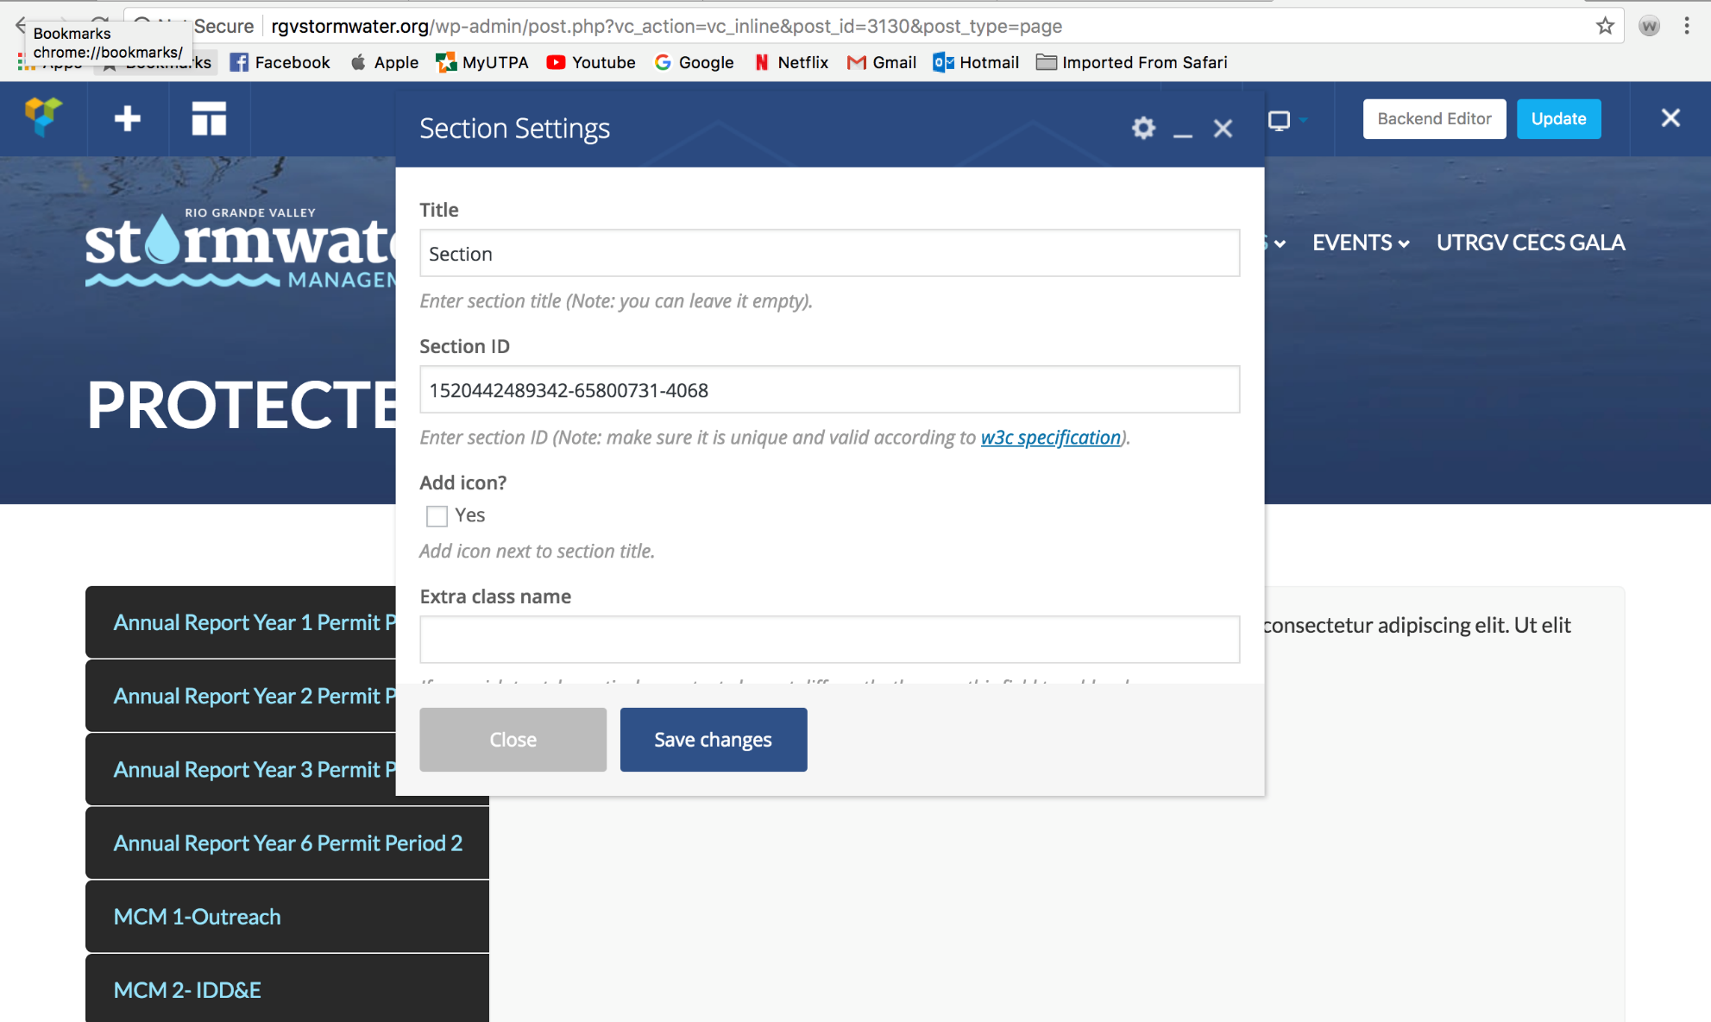
Notes:
This window will show the title of the section and you can change it as well. Don’t forget to save changes.

Slide 20
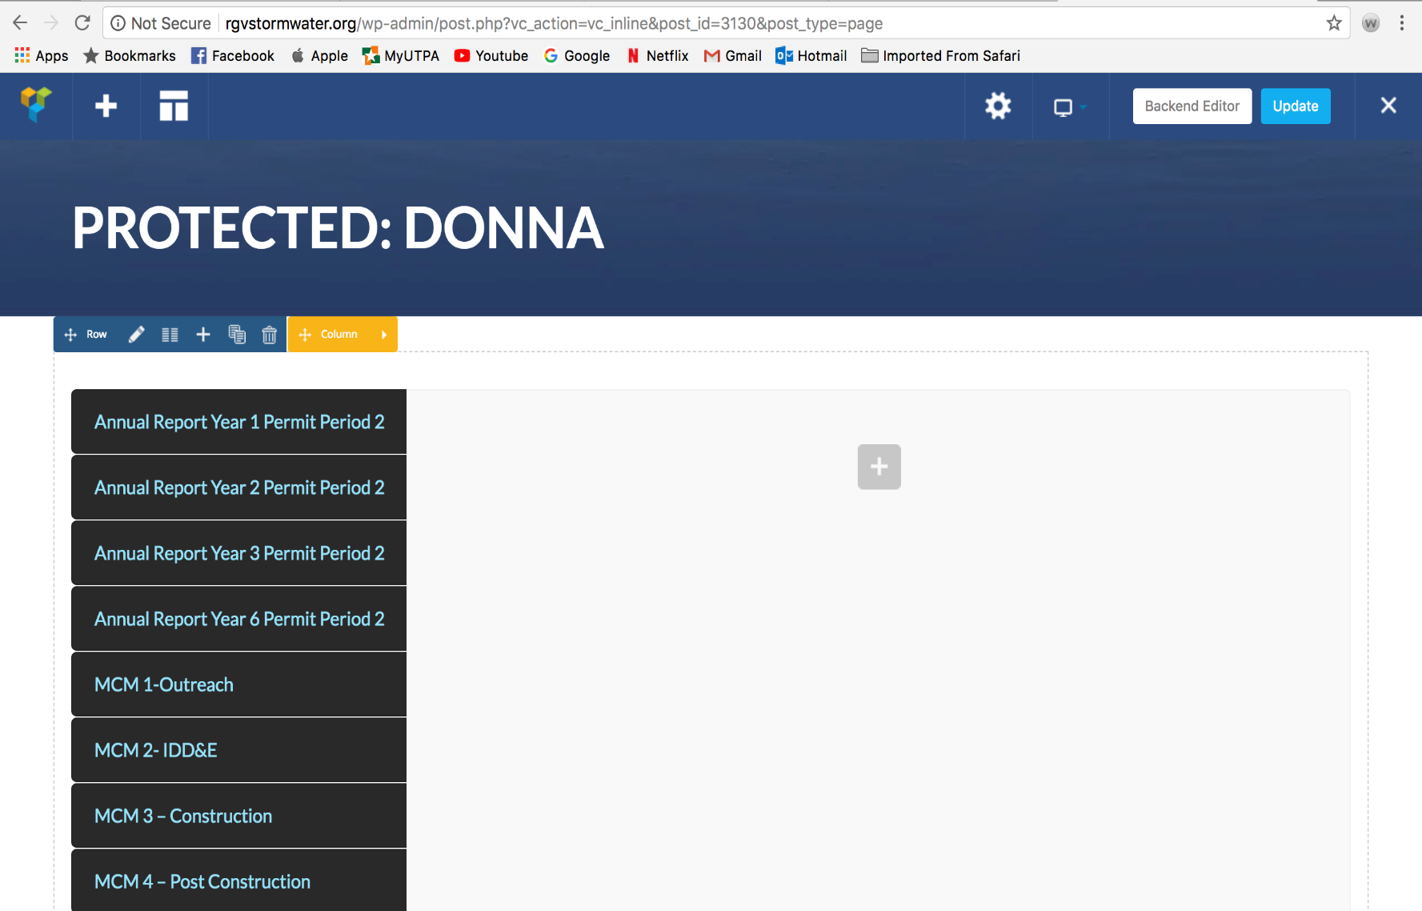
Notes:
Once saving the title, select the plus icon so you can add a file either a picture or a pdf.

Slide 21
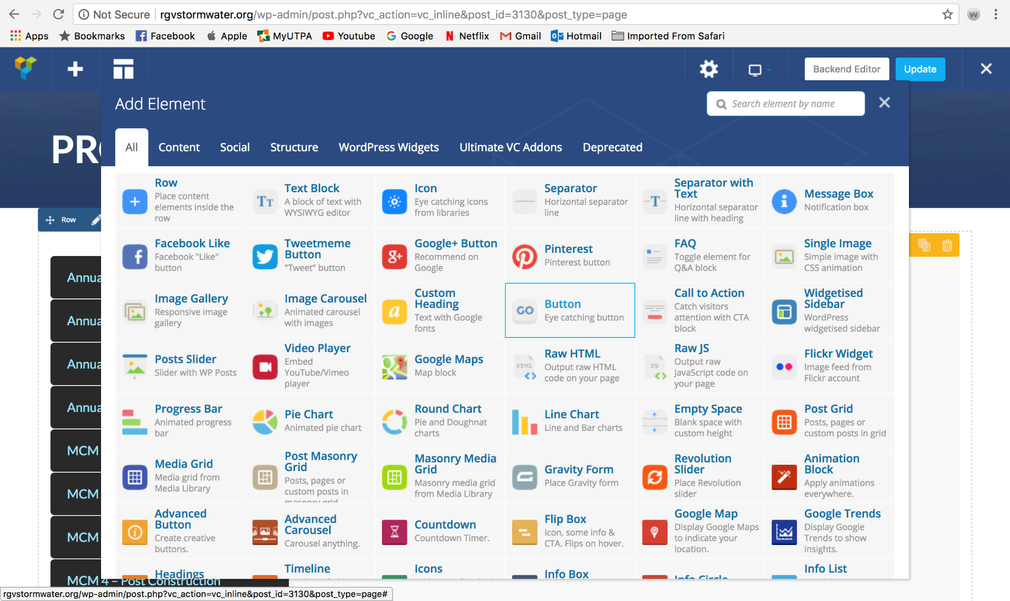
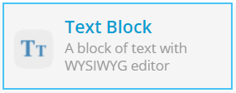
Text Block will allow the addition of pdf, picture and documents
Notes:
This window will show. Now you can add a “Text Block” which will allow to upload a picture or a pdf.

Slide 22
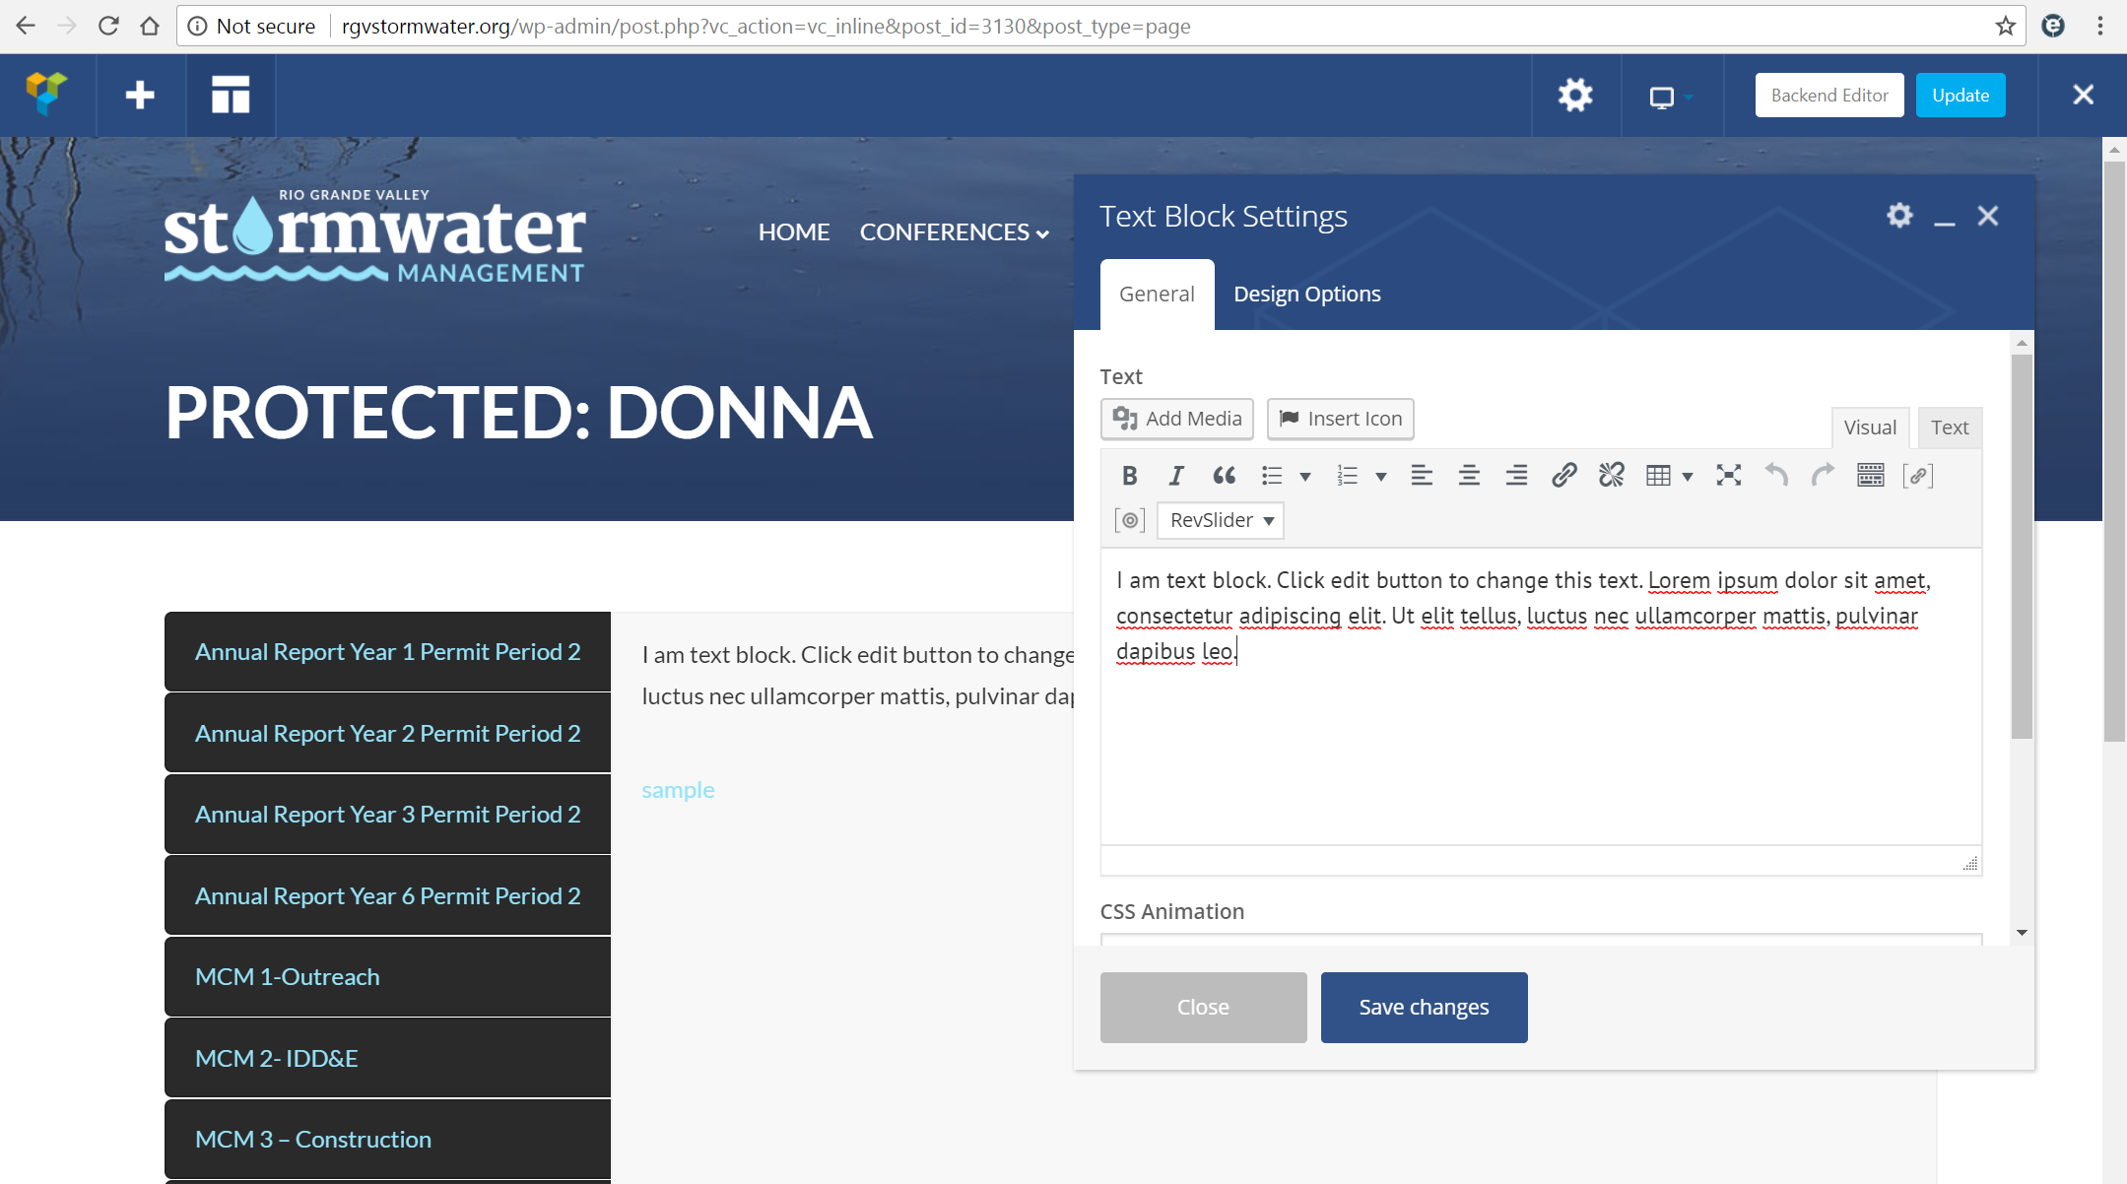
Example of inserting a picture to a folder
Write the title of the picture for example: Sample 2
Notes:
This window will open once you select “Text Block”. For inserting a picture, delete all the text that appears in the box and write the title of the picture you want to upload.

Slide 23
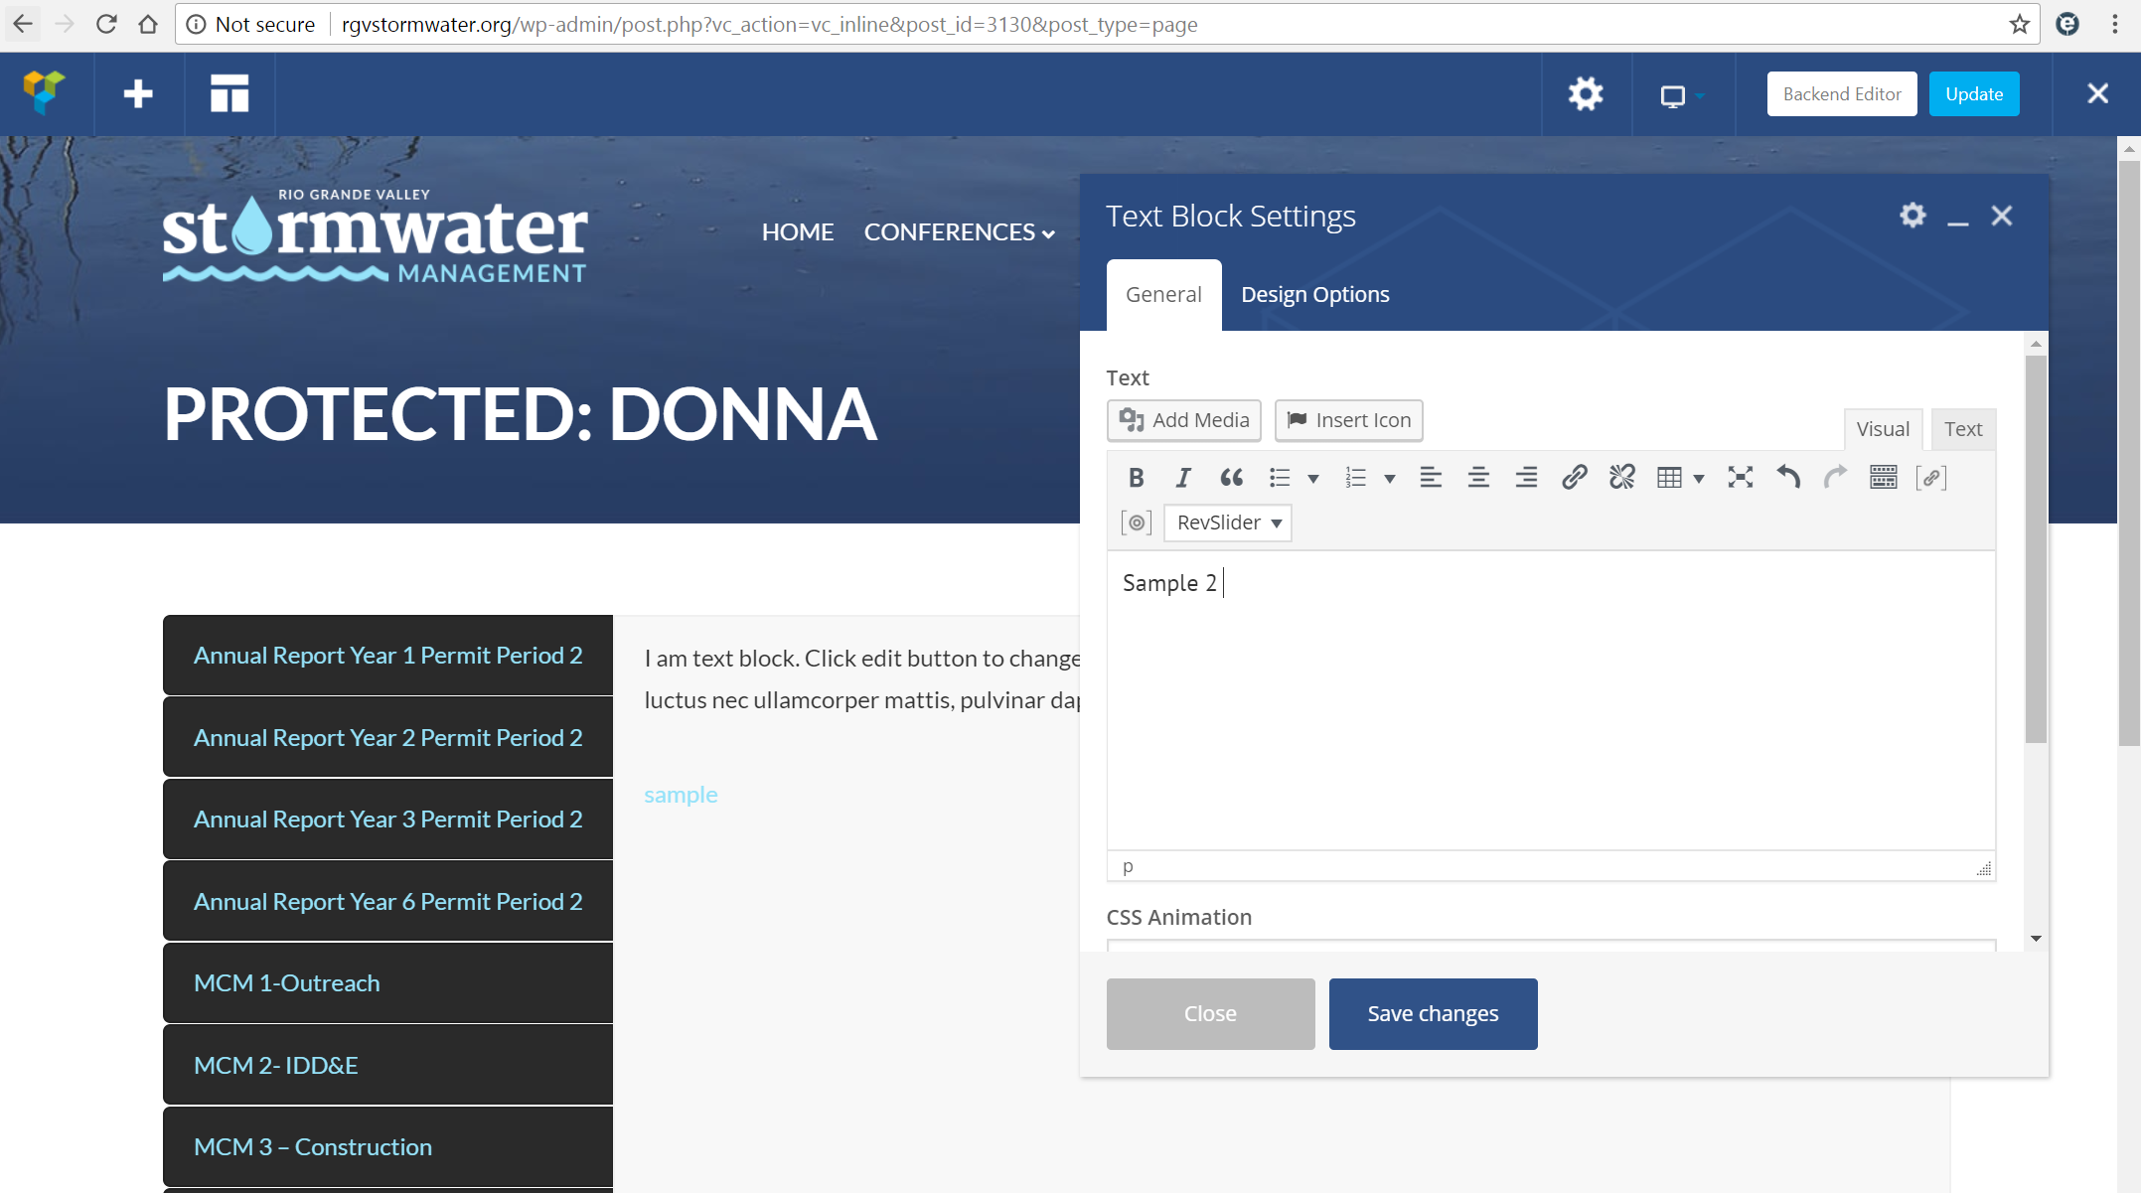
Select add media button
Notes:
Select “Add Media” icon to insert the desire picture.

Slide 24
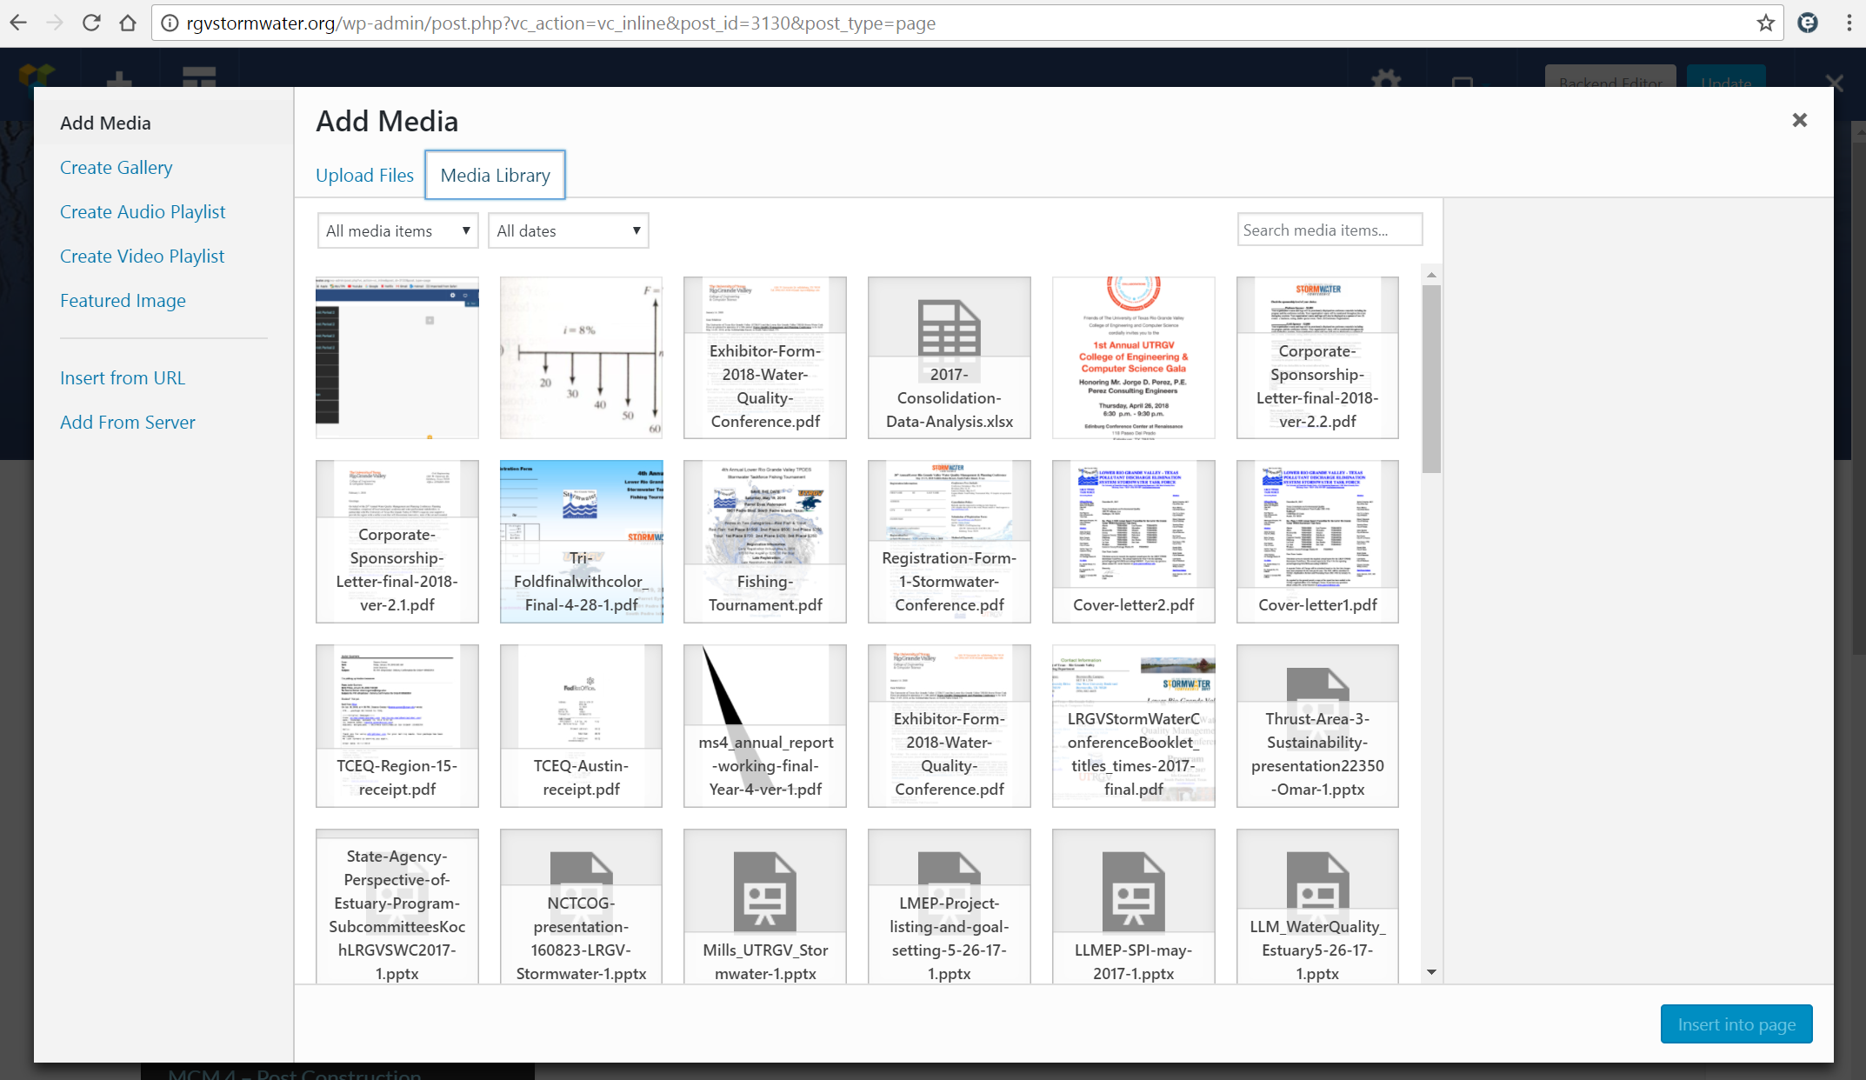
Go to Media Library icon
Notes:
Then go to “Media Library” which will show all the files uploaded to the page. If you wish to upload a picture that is saved in your desktop go to the “Upload Files” link.

Slide 25
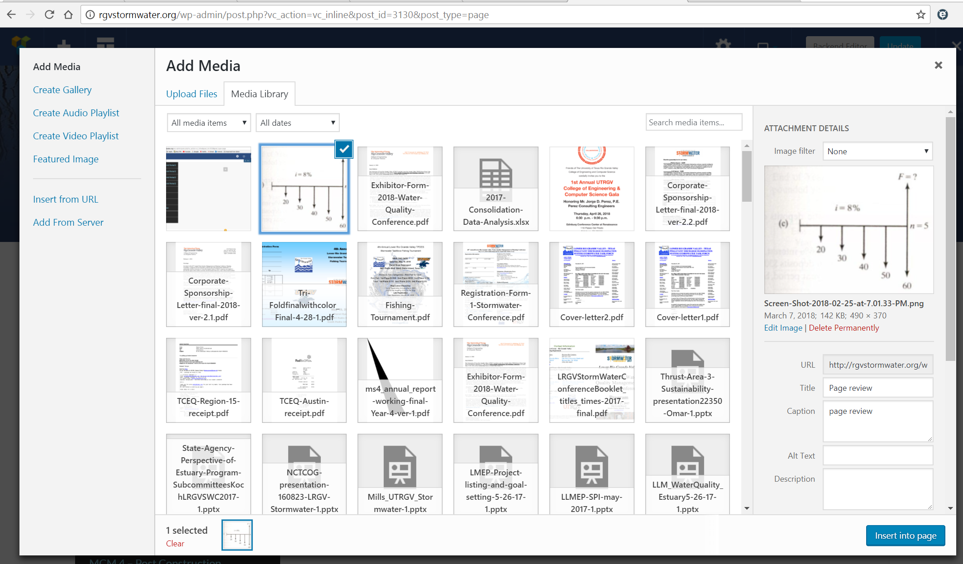
Select the image
Notes:
Select the picture you want to upload.

Slide 26
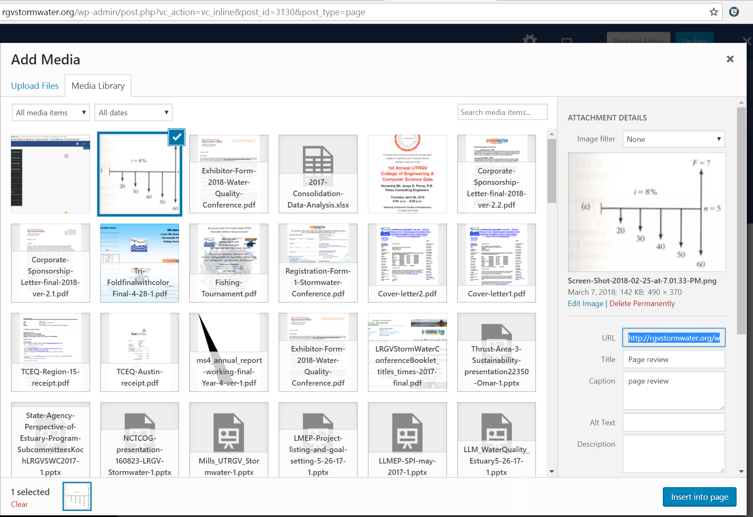
Copy the URL
2
1
Notes:
Then copy the URL which appear on the right side of the page (you can do “ctrl c” to copy). Once you copy close the window.

Slide 27
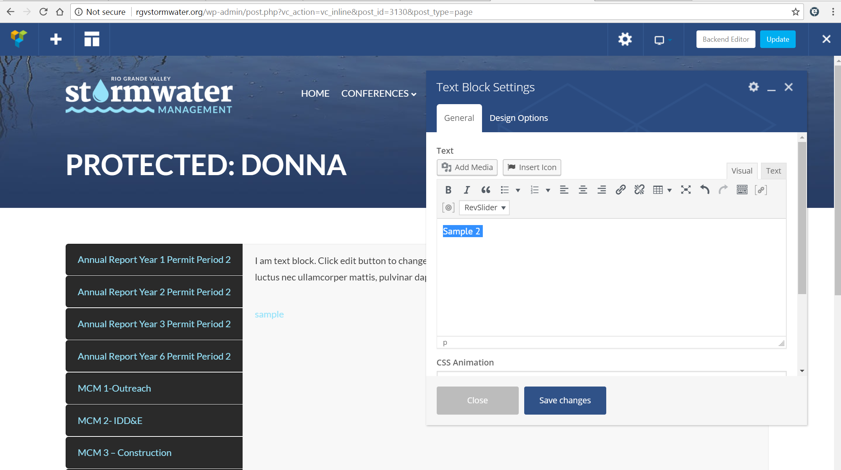
Notes:
This box will show once you close the media window. Select the title and then select the hyperlink icon.

Slide 28
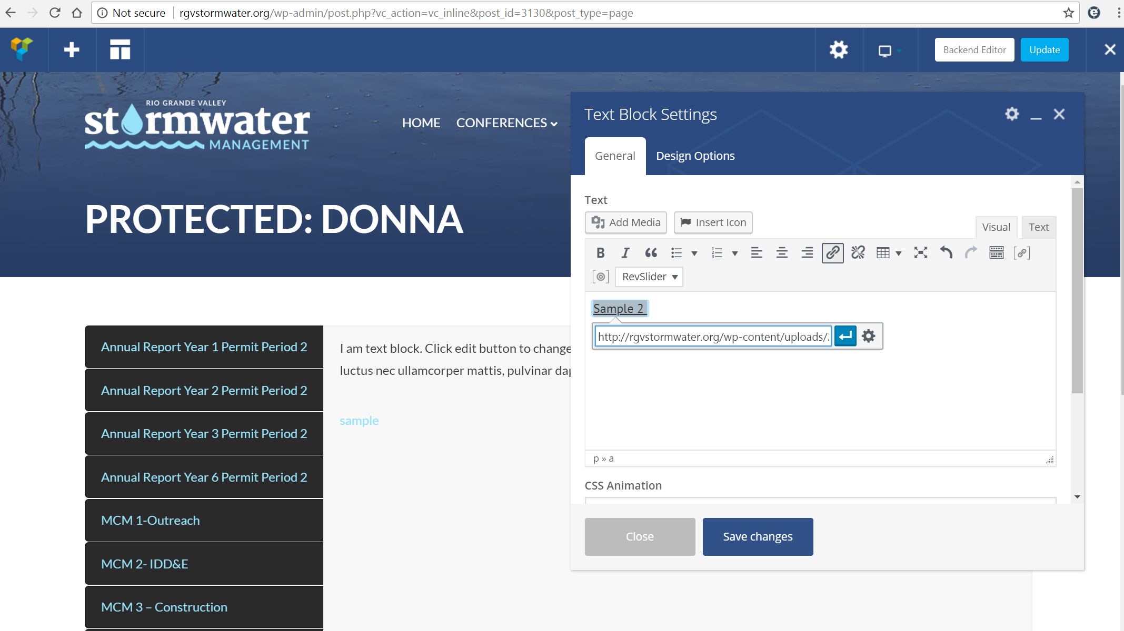
Notes:
A box below the title will appear then paste the URL you just copied (you can use “ctrl v” command)

Slide 29
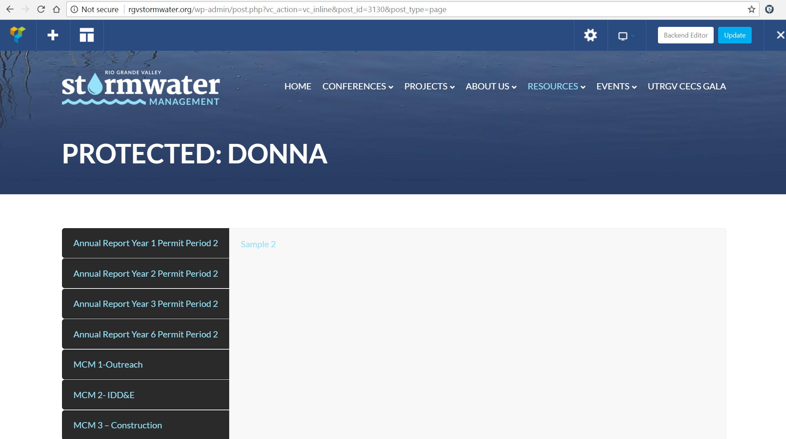
Notes:
Sample 2 will appear like this.

Slide 30
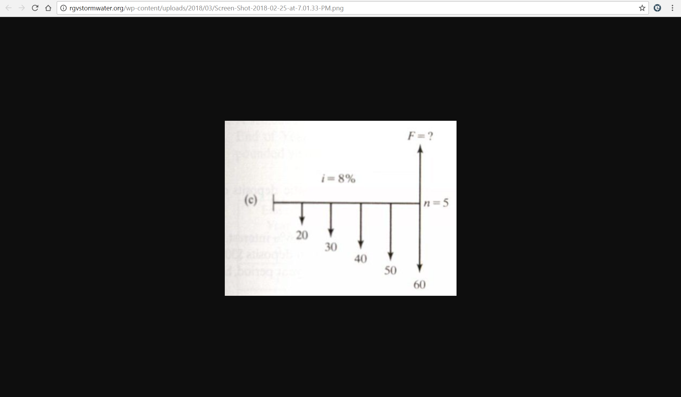
Notes:
When clicking to the link the picture will appear.

Slide 31
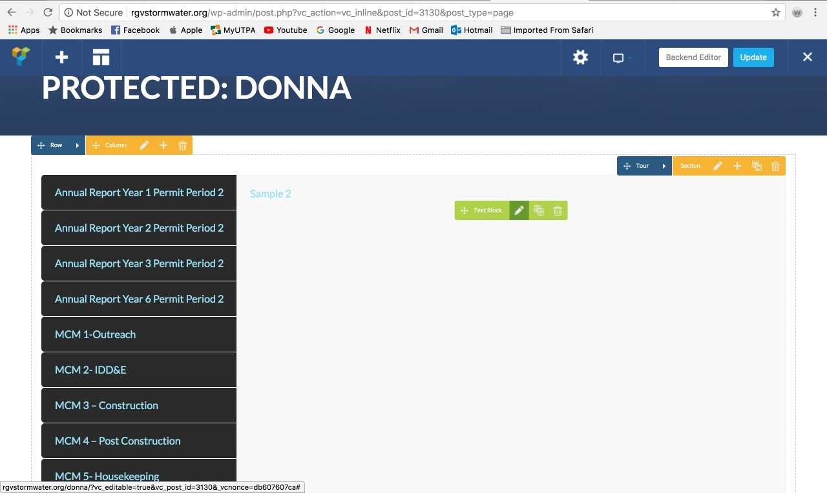
Insert a PDF
Notes:
To continue adding files, this green box will appear. Select the pencil icon.

Slide 32
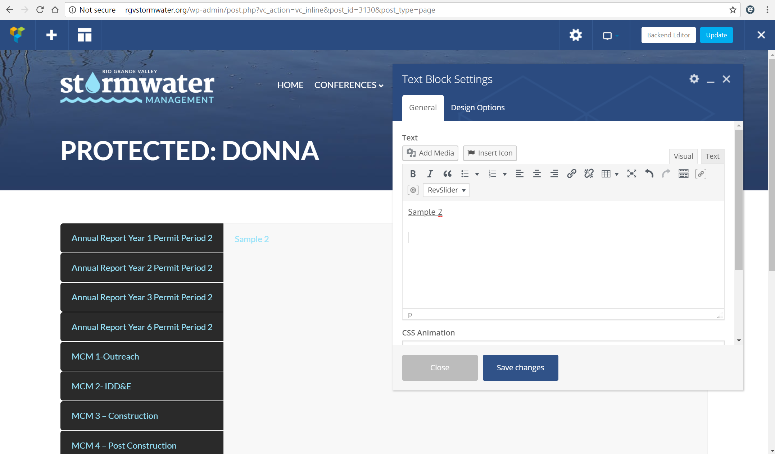
2
1
Notes:
To insert a PDF you must enter the title of the picture that is already added to continue adding files. Then select “Add Media”.

Slide 33
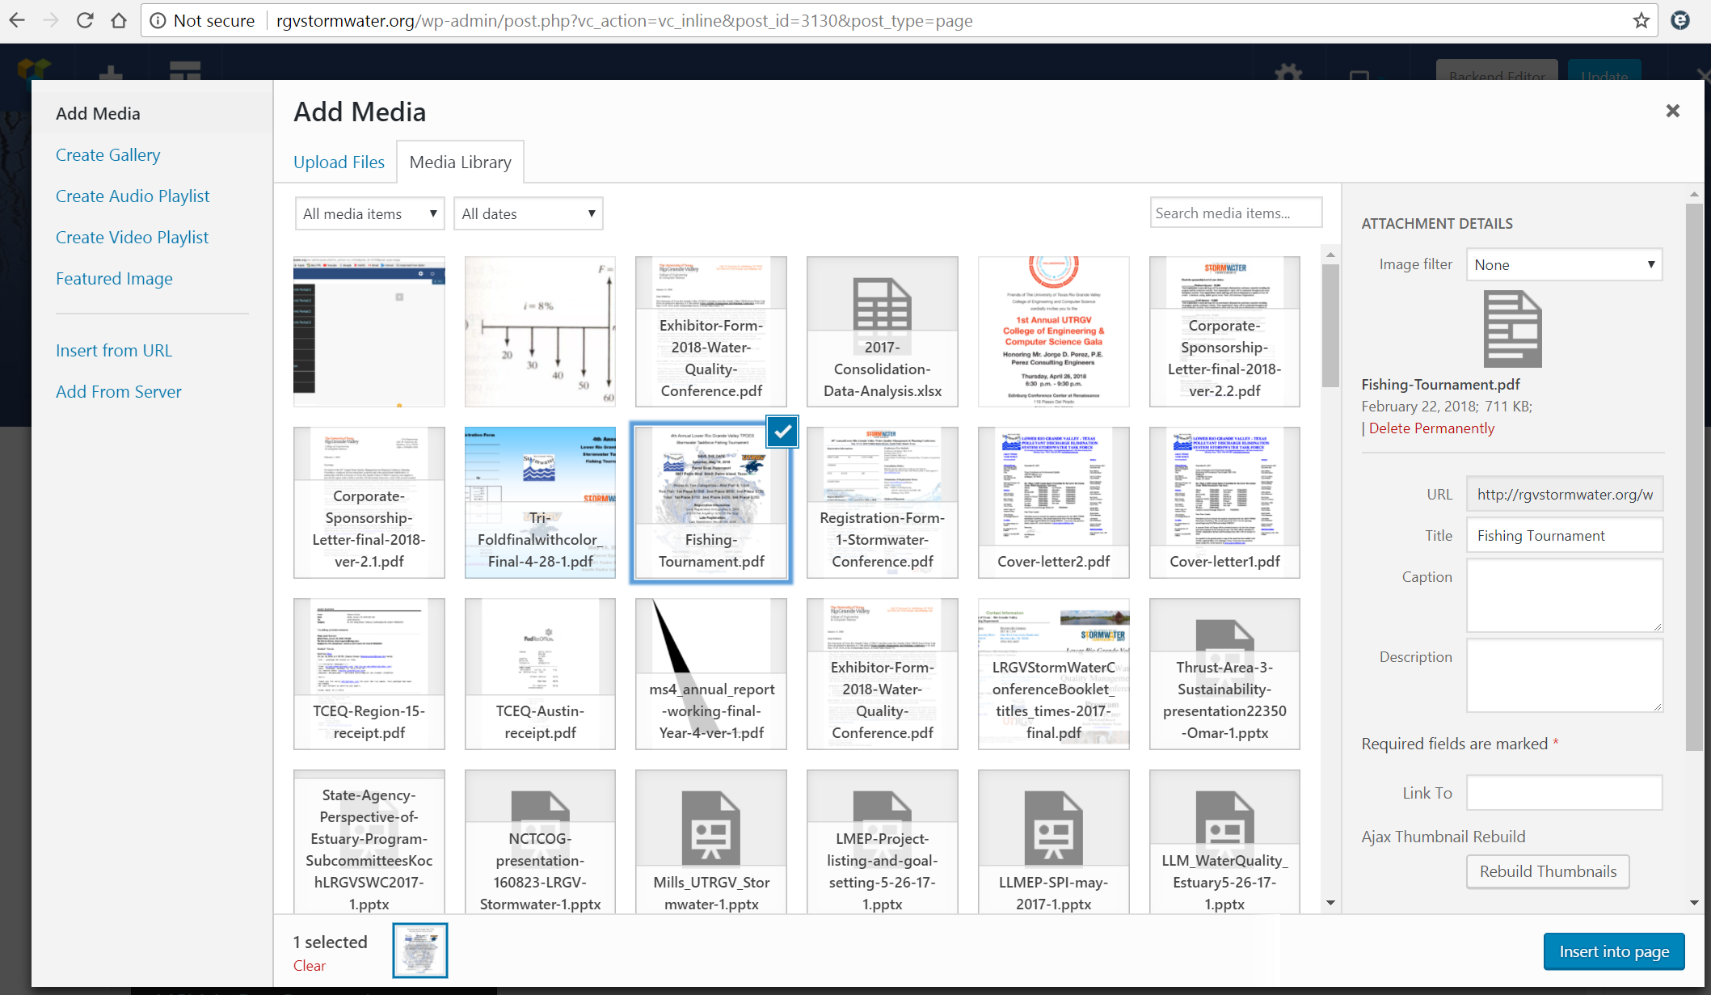
1
2
Notes:
This window will show once you select “Add Media”. Select the desire PDF file and change the name of the file as you wish since the link will appear as the name of the file. Then click “Insert into page” icon to add it.

Slide 34
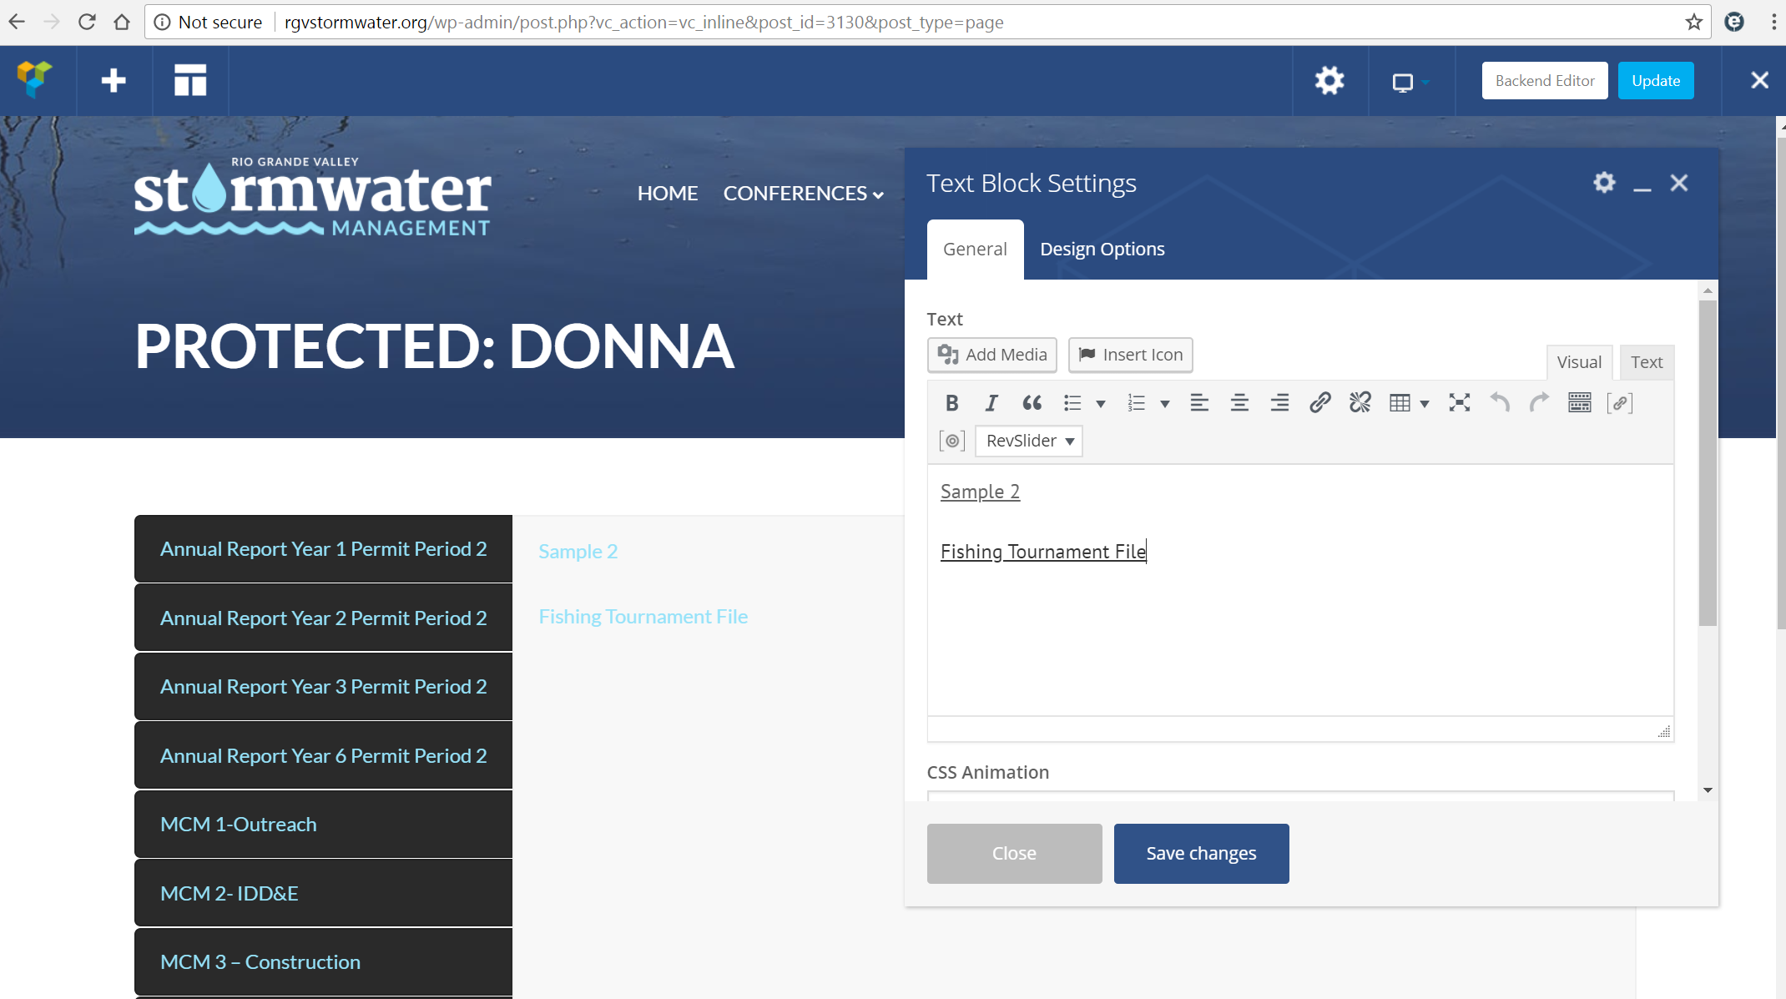
Notes:
The link of the PDF will appear. Save changes.

Slide 35
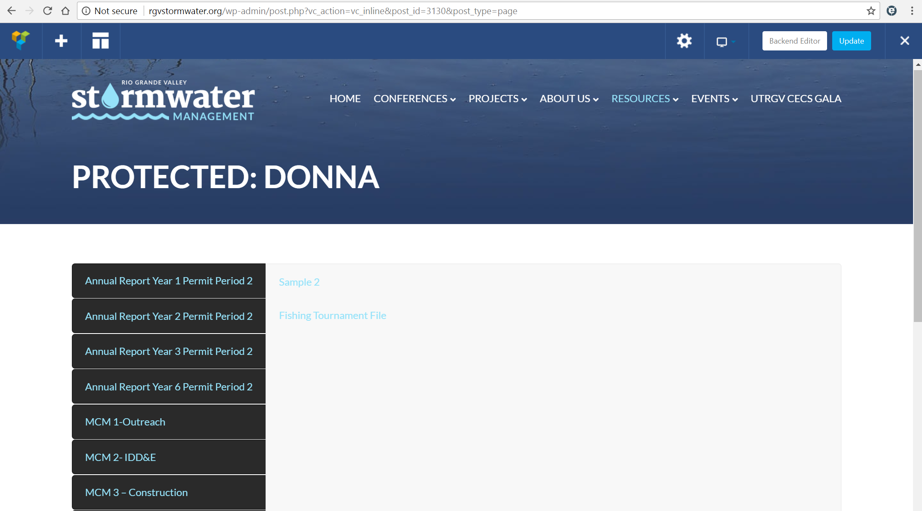
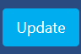
Click the update icon to publish the work done
Notes:
This will look like once you save changes. Don’t forget to click the “Update” icon to publish.

Slide 36
?
?
?
?
?
Questions
?
?
?
?

