Slide 1
2018 Stormwater Construction General Permit (CGP) Renewal TXR150000
TCEQ Environmental Trade Fair May 2018
Lindsay Garza
Stormwater Team
Water Quality Division

Slide 2
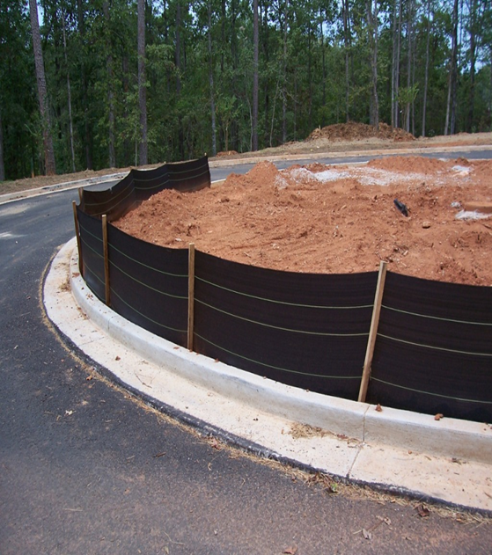
Construction General Permit TPDES Permit No. TXR150000
Effective March 5, 2018
The CGP and all issued authorizations expire at midnight on March 4, 2023
Authorizations:
26,136 NOIs
5 Waivers

Slide 3
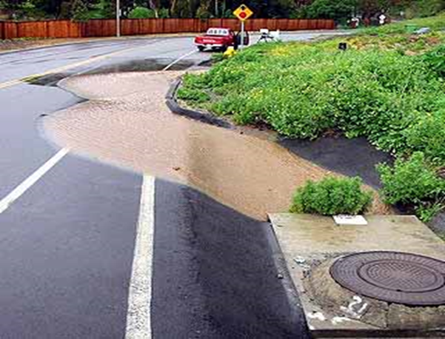
CGP Authorized Discharges
Certain non-stormwater discharges
Stormwater associated with construction and support activities

Slide 4
Primary Operators
Large Construction Sites
Have on-site operational control over construction plans and specifications, including the ability to make changes
Have day-to-day operational control activities at a site to ensure compliance with a stormwater pollution prevention plan (SWP3) and CGP permit

Slide 5
Secondary Operator – Large Construction Sites
Operational Control is Limited to:
The employment of other operators OR
The ability to approve or disapprove changes to the plans and specifications
No day-to-day operational control over construction activities at the site

Slide 6
Primary Operator Requirements Large Site Construction Activities
SWP3:
develop, implement, and maintain a copy on-site (update as necessary)
Notice of Intent (NOI):
complete, submit, and pay application fee to TCEQ
Copy of signed NOI:
send to MS4 operator prior to starting construction activity
Primary Operator Site Notice:
post at site entrance
Final stabilization requirements: must be met prior to termination of authorization
Notice of Termination (NOT):
send to TCEQ and a copy to the MS4

Slide 7
Secondary Operators Requirements Large Site Construction Activities
SWP3:
participate in the development (according to the permit requirements) and sign
Secondary Operator Site Notice:
complete and post at site entrance
Notification to the local MS4 submit a copy of the site notice or alternative notification
NOI, NOT ARE NOT REQUIRED

Slide 8
Requirements for Small Site Construction Activities
Prepare and implement SWP3
Adhere to requirements of permit
Post Small Site Notice
Notify MS4, if applicable
NOI, NOT ARE NOT REQUIRED

Slide 9
Requirements for Construction Activities for Sites Less than 1 Acre
Implement and maintain BMPs
Notify MS4, if applicable
SWP3, NOI, NOT are not required
NOTE: Poor management of unpermitted sites may
result in a violation or citation for unauthorized discharges or nuisance conditions.

Slide 10
General Permit Authorization Applications
By Mail-Paper NOI
Fee: $325
Online through *STEERS- e-NOI
Fee: $225
Provisional coverage begins 7 days after postmarked date
Immediate coverage once fee is paid and application is submitted
*State of Texas Environmental Electronic Reporting System (STEERS)

Slide 11
Electronic Submittal
Starting September 1, 2018, all application forms will be required to be submitted via STEERS/ePermits system
- NOI
- NOC
- NOT
LREW
Application Fee - $225
Waiver from electronic submittal available
Religious beliefs
No internet service
Training needed (1 year only)

Slide 12
2018 CGP Renewal
Permit effective March 5, 2018
Expires March 4, 2023, at midnight
90 day renewal grace period ends June 3, 2018

Slide 13
2018 CGP Changes
Incorporated the 2014 and 2015 amendments to federal the effluent limitations guidelines for construction and development discharges located in 40 CFR Part 450.
Add definitions of Infeasible and Low Rainfall Erosivity Waiver (LREW) form.
Clarified the definitions of Construction Activity and Impaired Water.
Added E-Reporting Rule language for applications

Slide 14
2018 CGP Changes
Add requirements for implementing controls to minimize the exposure of building materials containing polychlorinated biphenyls (PCBs) to precipitation and stormwater during demolition.
Add requirements for implementing controls at construction sites that will discharge to an impaired waterbody or a waterbody with an approved TMDL PCBs.
Add requirements for minimizing the exposure of waste materials by keeping waste container lids closed when not in use.
Add footnote to the benchmark monitoring table for Concrete Batch plants to clarify that that analytical results for certain pollutants must to be obtained from a NELAP certified laboratory.

Slide 15
2018 CGP Changes
Revise the limitations for permit coverage for construction activities related to oil and gas production.
Revise the benchmark monitoring level for Total Suspended Solids (TSS) from 100 milligrams per Liter (mg/L) to 50 mg/l.
Revise to clarify that an applicant who owns or operates a facility classified as an “unsatisfactory performer” is entitled to a hearing before the Commission prior to denial or suspension of authorization.

Slide 16
2018 CGP Changes
Add clarifications for posting site notices for operators of small construction and secondary operators of large construction.
Add clarification that posted small construction site notices may have a redacted signature if there is an original signed and certified copy of a site located at the site.
Additional clarification in the impaired waterbodies section of permit that references the CWA 303 (d) List and the Texas Integrated Report.
Other small revisions and clarifications.

Slide 17
Changes to NOI
Estimated Start Date
Estimated End Date
Concrete Truck Washout

Slide 18
CGP Resources
TCEQ SWP3 template:
Assistance Tools for Construction Stormwater General Permits
EPA SWP3 Guidance:
EPA SWP3
EPA National Menu of (BMPs) for Stormwater
EPA NPDES BMPs

Slide 19
TCEQ Stormwater Program Contacts
For questions regarding your STEERS account and technical difficulties with e-NOI:
(512) 239-6925
For questions about the application process, contact the Stormwater Processing Center
(512) 239-3700
Other questions including technical, contact the Small Business and Local Government (SBLGA) Hotline
1-800-447-2827

Slide 20
TCEQ Stormwater Team Members
Rebecca L. Villalba, Team Leader
Lindsay Garza, Work Leader
Hanne Lehman Nielsen
Gordon Cooper
Dan Siebeneicher
Kent Trede
Austin Office (512) 239-4671
SWGP@tceq.texas.gov

