Slide 1
Engineering for a sustainable future
UTRGV – LRGV Water Quality Management and Planning Conference
Notes:
Good morning! My name is Marianella Franklin and on behalf of UTRGV’s Office for Sustainability, I want to thank you for the opportunity to share a little on what sustainability means to UTRGV.
The Valley’s explosive growth, coupled with its unique ecological situation, presents challenges as well as opportunities with regard to sustainability.
The university is dedicated to being a transformative force for the Rio Grande Valley through education and service, while contributing to the economic growth, environmental stewardship, health, and cultural richness of the region.

Slide 2
HOW IS SUSTAINABILITY DEFINED
“Development that meets the needs of the present without compromising the ability of future generations to meet their own needs."Brundtland Commission (formally known as the World Commission on Environment and Development) of the United Nations General Assembly on March 20, 1987
“The ability to sustain QUALITY OF LIFE!”
UTRGV – LRGV Water Quality Management and Planning Conference
Notes:
In recent years, we have begun to understand how much we can, and must, do as individuals to protect our natural resources.
Sustainability at times has been widely misused and arbitrarily misinterpreted. Used properly, it describes practices through which the global economy can grow without creating a fatal drain on resources.
The most popularly sourced definition of sustainability came out of the Brundtland Commission (formally known as the World Commission on Environment and Development) of the United Nations General Assembly on March 20, 1987, when it was stated in their Our Common Future report,
“Sustainable development is development that meets the needs of the present without compromising the ability of future generations to meet their own needs.”
THE SIMPLER TERM WE PREFER IS:
The ability to sustain Quality of Life

Slide 3
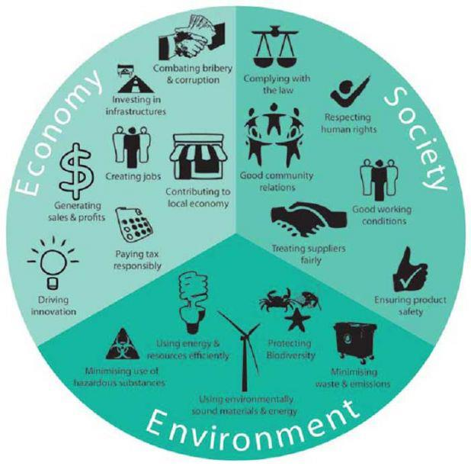
GUIDING PRINCIPLES
PROTECT
The Quality of Life on Earth
Efficient Use of the Earth’s Materials
The Protection of our Global Commons
The Management of Human Settlements
Chemicals and Management of Waste
Sustainable Economic Growth
UTRGV – LRGV Water Quality Management and Planning Conference
Notes:
The concept of sustainability is based on the premise that people and their communities are made up of Social, Economic, and Environmental SYSTEMS that are in CONSTANT INTERACTION and that must be kept in HARMONY or BALANCE if a community or nation is to continue to function to the benefit of its inhabitants— now and in the future..

Slide 4
POSITIVE IMPACT
SYSTEMS THINKING | BALANCE
SUSTAINABILITY
ENVIRONMENT
SOCIETY
ECONOMY
UTRGV – LRGV Water Quality Management and Planning Conference
Notes:
Systems thinking is an approach to integration. Systems thinking sets out to view systems in a holistic manner.
When you encounter situations which are complex and messy, then systems thinking can help you understand the situation systemically.
This helps us to see THE BIG PICTURE- from which we may identify multiple leverage points that can be addressed to support constructive change.
It also helps us see the connectivity between elements in the situation, so as to support joined-up actions.
Sustainability is an ideal toward which to strive and weigh proposed actions, plans, expenditures, and decisions.
The catch is to balance, and strive for POSITIVE IMPACT in all three systems while considering actions to our current and future activities or concerns.
When our focus is strictly within one or two of the systems the solution/s do not provide long term quality…they do not sustain.

Slide 5
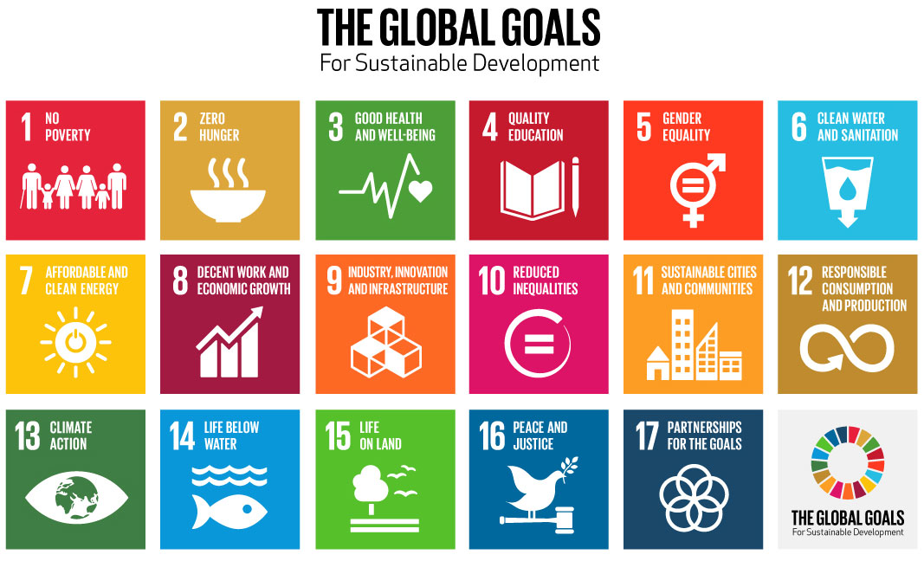
United Nations Global Goals for Sustainable Development
sustainabledevelopment.un.org
Notes:
Voices around the world are demanding leadership on poverty, inequality and climate change.
To turn these demands into actions, world leaders from 193 countries gathered on 25 September 2015, at the United Nations in New York to adopt the 2030 ambitious Agenda for Sustainable Development.
The concept of the SDGs was born at the United Nations Conference on Sustainable Development, Rio+20, in 2012.
The objective was to produce a set of universally applicable goals that balances the three dimensions of sustainable development: environmental, social, and economic. An end to poverty, hunger and inequality worldwide.

Slide 6
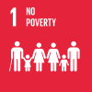
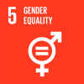
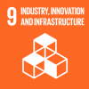
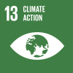
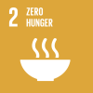
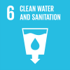
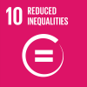
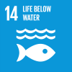
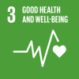
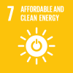
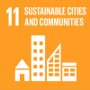
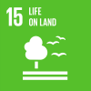
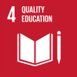
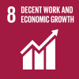
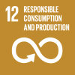
EDUCATION FOR SUSTAINABLE DEVELOPMENT
College of Liberal Arts
Political Science Programs
Center for Rural Advancement
Gender & Women Studies
Veterans Business Outreach Center
Diversity & Intercultural Program
College of Engineering & Computer Sciences
Research Innovation & Economic Development
Center for Excellence in STEM
College of Engineering & Computer Sciences
Civil Engineering
Electrical Engineering
Disaster Studies Program
Environmental Studies
Environmental Science
Agro-Ecology Program
Sustainable Food Systems
Center for Rural Advancement
College of Engineering & Computer Sciences
Civil Engineering Program
Biology Program
College of Liberal Arts
Political Science Programs
Public Affairs
Sociology
College of Sciences
Center for Subtropical Studies
Coastal Studies Lab
Marine Biology Program
College of Health Affairs
South Texas Border Health Disparities Center
Health Affairs Research Academy
College of Engineering
Electrical Engineering
Mechanical Engineering
Center for Excellence in STEM
College of Engineering & Computer Sciences
Civil Engineering
Electrical Engineering
Disaster Studies Program
Environmental Science
Agro-Ecology Program
Sustainable Food Systems
Center for Rural Advancement
College of Education & P-16 Integration
Educational Technology Program
Center for Teaching Excellence
College of Business & Entrepreneurship
Center for Business Development
Entrepreneurship & Commercialization Center
Manufacturing & Industrial Engineering
Texas Manufacturing Assistance Center
Rapid Response Manufacturing Center
College of Liberal Arts
Political Science
Public Affairs
Criminal Justice
Notes:
Unless stakeholders, policy-makers, legislators, businesses, agencies, NGOs, the media and civil society are involved in learning processes, the proposed SDGs will not be achieved….such change cannot happen without learning.
Sustainable development is embedded at the heart of UTRGV education and learning. There is mutual benefit and accelerated positive effect, sufficient to win breakthrough towards an economically secure, ecologically stable and socially just world, way into the future!
With Education for Sustainable Development UTRGV’s Colleges, Programs prepare students that directly serve the community.
These career paths contribute to the economic growth, environmental stewardship, health, and cultural richness of our region while multidisciplinary research provides new business models, data for habitat preservation, and opportunities for entrepreneurship.

Slide 7
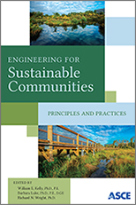
WHY SUSTAINABLE ENGINEERING
Environmental operating conditions are changing radically, overconsumption of resources and excessive pollution, particularly greenhouse gas emissions, have degraded significantly the Earth’s natural resources and systems, resulting in significant changes in resource availability and in the environmental conditions (e.g., ambient temperatures, sea level rise, storm intensity, extent of droughts, heat waves, and flooding) under which infrastructure systems are expected to operate.
UTRGV – LRGV Water Quality Management and Planning Conference

Slide 8
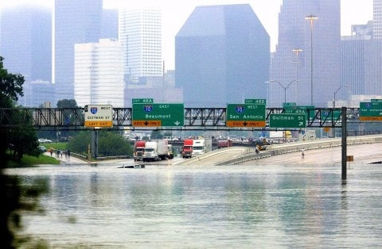
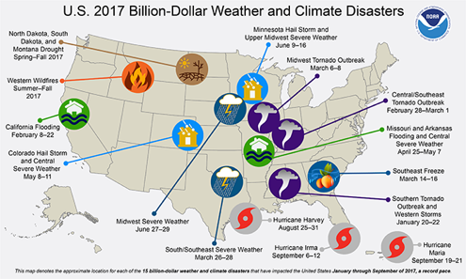
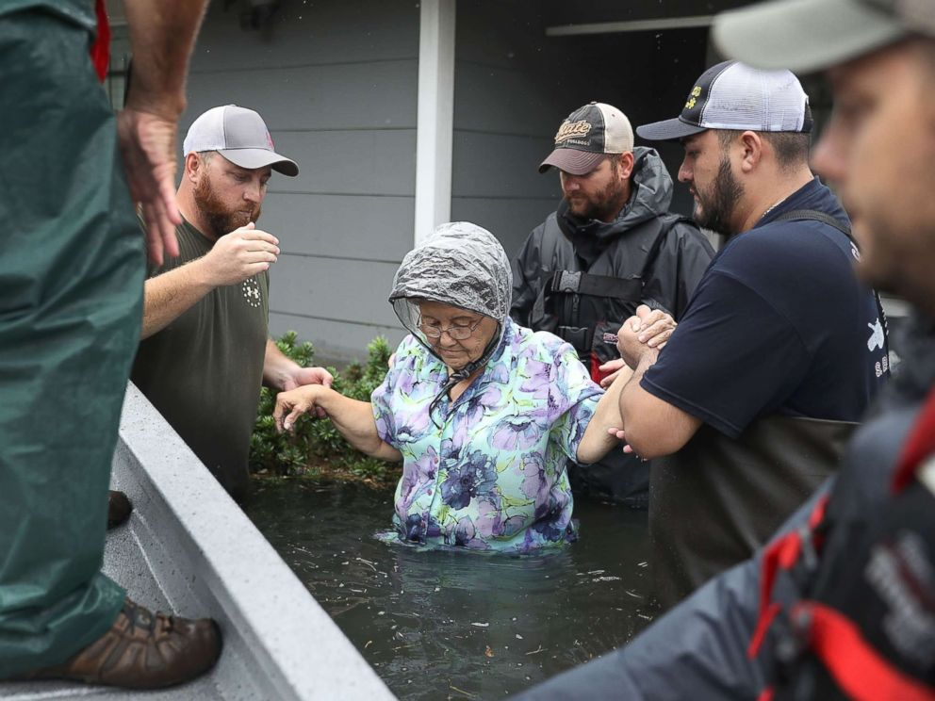
SOCIAL ENVIRONMENTAL & ECONOMIC
IMPACT

Slide 9
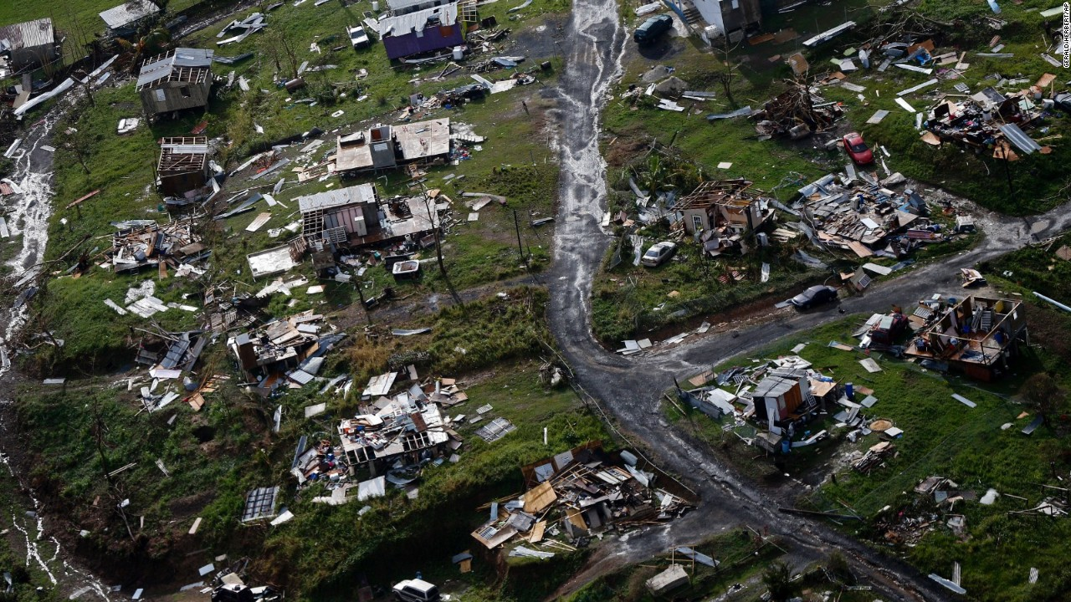
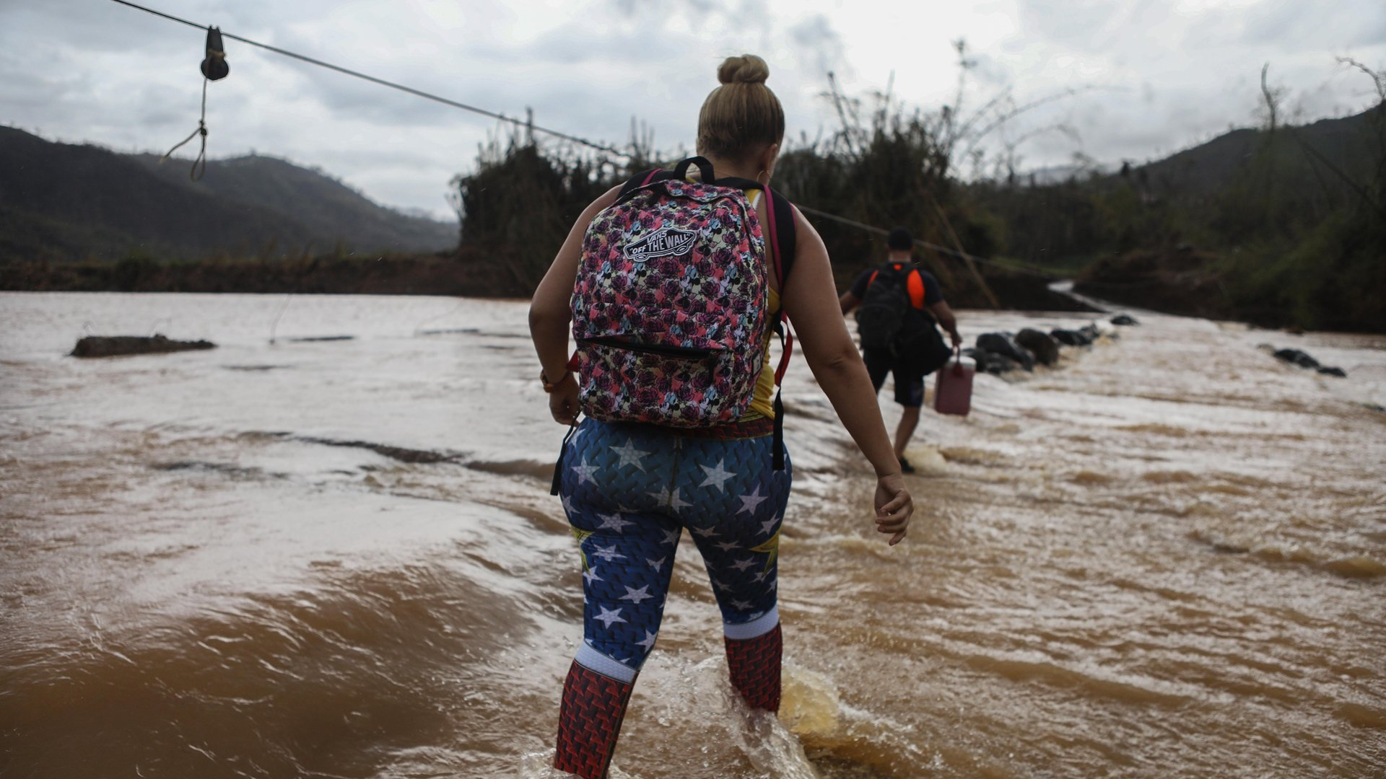
SOCIAL ENVIRONMENTAL & ECONOMIC
“Puerto Rico's Weak Infrastructure Creates Big Challenges For Recovery”
NO ROADS - NO ACCESS
NO ACCESS :
NO POWER
NO COMMUNICATION
NO WATER
NO FOOD
NO HOSPITALS
NO MEDICINE
NO CLOTHING
NO SHELTERS
IMPACT

Slide 10
Sustainable Infrastructure
Infrastructure is the backbone of the U.S. economy and a necessary input to every economic output. It is critical to the nation’s prosperity and the public’s health and welfare.
Infrastructure’s condition has a cascading impact on our nation’s economy, impacting business productivity, gross domestic product (GDP), employment, personal income, and international competitiveness.
ECONOMIC IMPACT
Notes:
As an institution, UTRGV is in a position to inspire, engage and prepare countless students to be socially conscious citizens. By addressing university goals through the wide scope of sustainability, and in accordance with our local tradition and global movements, UTRGV works to maintain a high standard of environmental, social and economic responsibility. This commitment will allow the institution to grow and prosper well into the future, to the benefit of our entire region.
Establishing organizational mission, vision, and/or goals
x Establishing new policies, programs, or initiatives
x Strategic and long-term planning
x Existing or prospective physical resources
x Budgeting, staffing and financial planning
x Communications processes and transparency practices
x Prioritization of programs and projects

Slide 11
PREPARE FOR THE FUTURE
Utilize new approaches, materials, and technologies to ensure our infrastructure is more resilient – to more quickly recover from significant weather and other hazard events – and sustainable – improving the “triple bottom line” with clear economic, social, and environmental benefits.
UTRGV – LRGV Water Quality Management and Planning Conference
Notes:
In recent years, we have begun to understand how much we can, and must, do as individuals to protect our natural resources.
Sustainability at times has been widely misused and arbitrarily misinterpreted. Used properly, it describes practices through which the global economy can grow without creating a fatal drain on resources.

Slide 12
Develop active community resilience programs for severe weather and seismic events to establish communications systems and recovery plans to reduce impacts on the local economy, quality of life, and environment.
Consider emerging technologies and shifting social and economic trends – such as autonomous vehicles, distributed power generation and storage, and larger ships – when building new infrastructure, to assure long-term utility
Improve land use planning at the local level to consider the function of existing and new infrastructure, the balance between the built and natural environments, and population trends in communities of all sizes, now and into the future.
Sustainable Infrastructure
TOOLS & TECNIQUES
Notes:
Establishing organizational mission, vision, and/or goals
x Establishing new policies, programs, or initiatives
x Strategic and long-term planning
x Existing or prospective physical resources
x Budgeting, staffing and financial planning
x Communications processes and transparency practices
x Prioritization of programs and projects

Slide 13
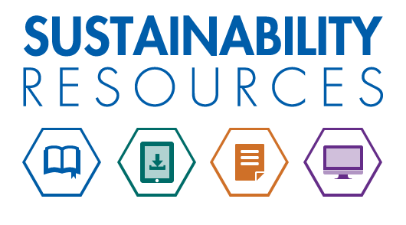
SUSTAINABLE | DEVELOPMENT
RESEARCH
DEVELOPMENT
Support Research and Development into innovative new materials, technologies, and processes to modernize and extend the life of infrastructure, expedite repairs or replacement, and promote cost savings.
Develop a Sustainability Checklist on projects; Recommend sustainable solutions to clients; Adhere to sustainability principles in your work and use Sustainability Resources…
UTRGV – LRGV Water Quality Management and Planning Conference

Slide 14
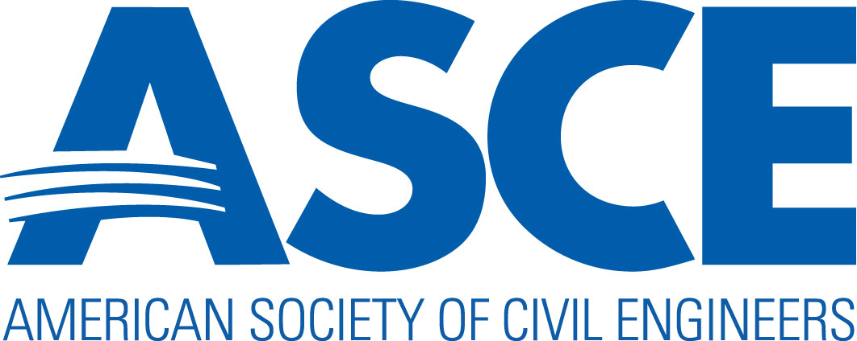
SUSTAINABILITY AT ASCE
ASCE defines sustainability as…
a set of environmental, economic, and social conditions - the "Triple Bottom Line" - in which all of society has the capacity and opportunity to maintain and improve its quality of life indefinitely, without degrading the quantity, quality or the availability of natural, economic, and social resources.
UTRGV – LRGV Water Quality Management and Planning Conference

Slide 15
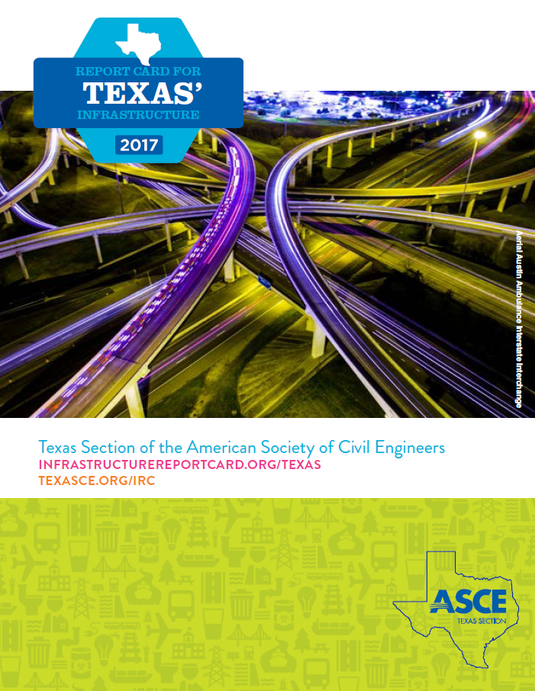
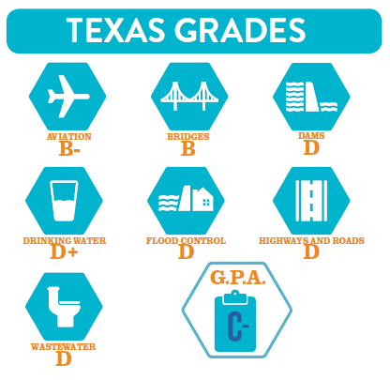
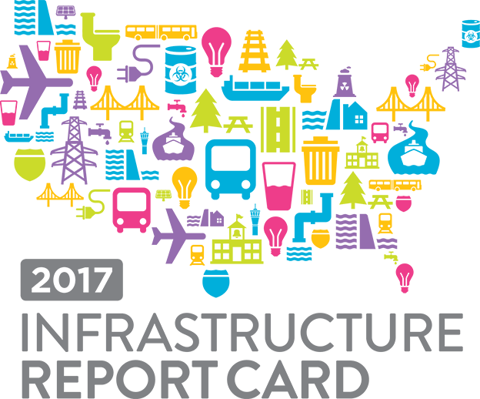
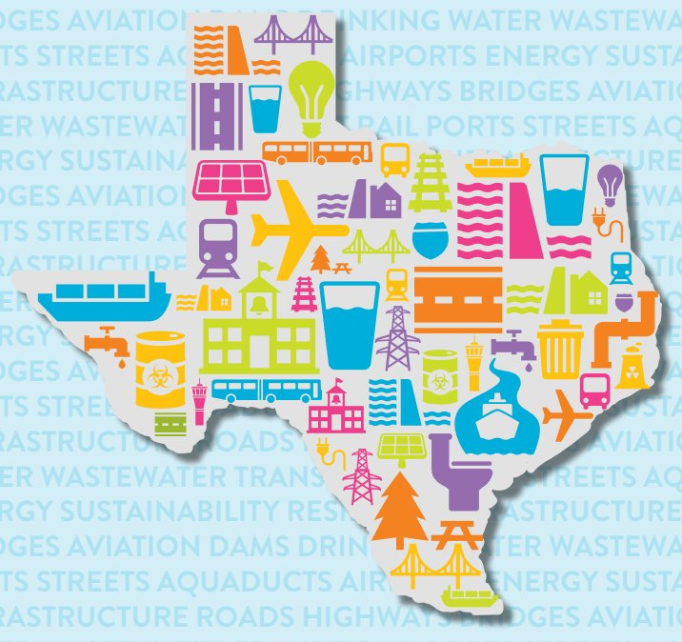
ASCE | REPORTCARDS
UTRGV – LRGV Water Quality Management and Planning Conference
Notes:
ASCE’s Report Card for America’s Infrastructure, which depicts the condition and performance of the nation’s infrastructure and sees the solution in terms of leadership, sustainability, resiliency, maintenance, and prioritized investment.
State and Regional Infrastructure Report Cards, which raise awareness about state and local infrastructure needs.
ASCE infrastructure policy reports, which highlight national infrastructure trends, innovations, and solutions to infrastructure challenges.

Slide 16
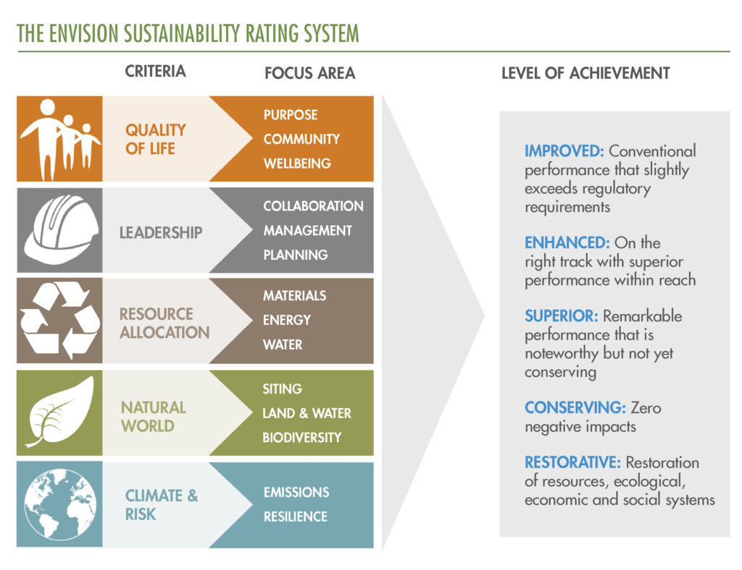
ACSE|ISI – ENVISION RATING SYSTEM
UTRGV – LRGV Water Quality Management and Planning Conference
Notes:
The Institute for Sustainable Infrastructure and its rating tool—
Envision—that incorporates economic, social, environmental criteria in the design, construction, operation and maintenance of infrastructure.

Slide 17
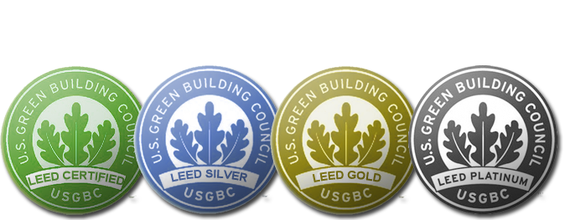
LEED
LEED stands for Leadership in Energy and Environmental Design.
LEED is a national certification system developed by the U.S. Green Building Council (USGBC) to encourage the construction of energy and resource-efficient buildings that are healthy to live in.
UTRGV – LRGV Water Quality Management and Planning Conference
Notes:
Leadership in Energy and Environmental Design (LEED) is one of the most popular green building certification programs used worldwide.

Slide 18
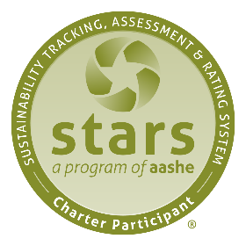
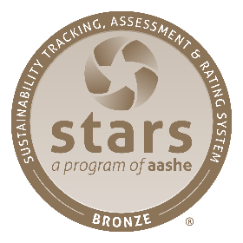
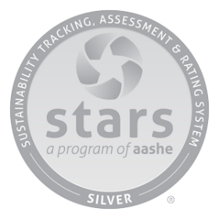
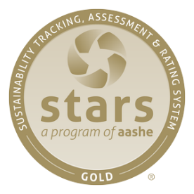
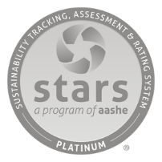
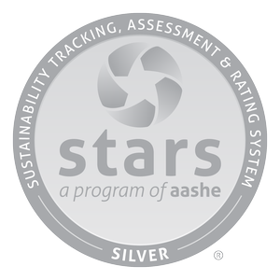
THE ASSOCIATION FOR ADVANCEMENT OF SUSTAINABILITY IN HIGHER EDUCATION Sustainability Tracking, Assessment & Rating System (STARS)
AASHE
AASHE’s mission is to inspire and catalyze higher education to lead the global sustainability transformation.
GOVERNANCE & PLANNING
OPERATIONS
ACADEMICS
ENGAGEMENT
UTRGV – LRGV Water Quality Management and Planning Conference
Notes:
The AASHE STARS is a reporting tool that helps measure a campus’ progress in advancing sustainability goals. It has parameters that include ACADEMICS, ENGAGEMENT, OPERATIONS, PLANNING & ADMINISTRATION.
The Office for Sustainability recently completed the 2015 assessment, which has resulted in a classification of silver for our campus. The following slides will provide an overview of UTRGV’s progress in these four broad areas.

Slide 19
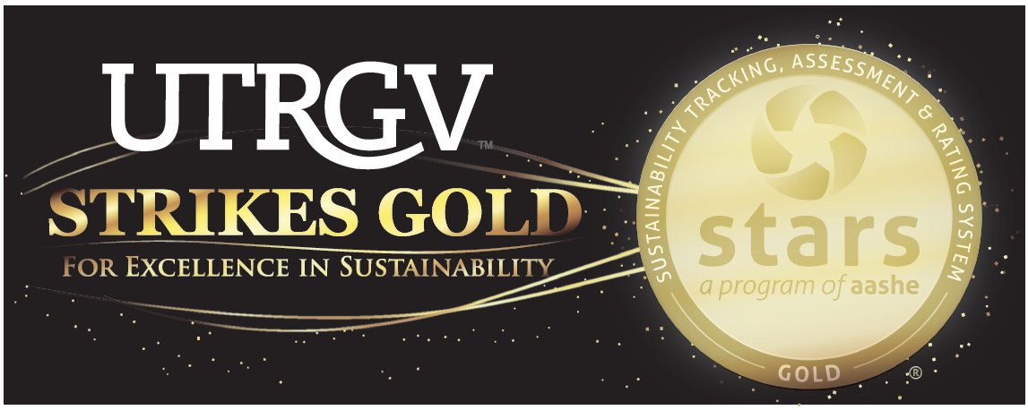
UTRGV COMMITMENT
UTRGV – LRGV Water Quality Management and Planning Conference

Slide 20
RE-CONNECTING
“The Blind application of technology might have led to the unsustainable predicament of the present world,
But one thing is for certain...
Engineers will play a key role in partnership with others in developing a sustainable future!”
-Paul Jowitt
PARTNERSHIPS
FULLFILL THE
ULTIMATE GOAL
UTRGV – LRGV Water Quality Management and Planning Conference
Notes:
A significant part of our current sustainability crisis stems from our inability to understand the complex interconnections between the causes and effects of our actions over time.
Systems Thinking makes us aware of the HIDDEN CONNECTIONS, interdependence, feedback flows, and networks of relationships that we impact on and are impacted by.

Slide 21
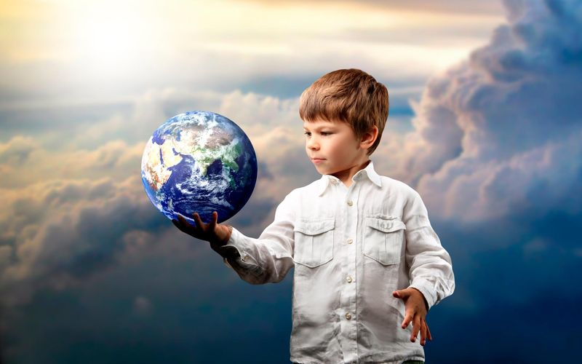
INTENT | OUR FUTURE QUALITY OF LIFE
“If you want to awaken all of humanity, then awaken all of yourself.
If you want to eliminate the suffering in the world then eliminate all that is dark and negative in yourself.
Truly the greatest gift you have to give is that of your own Self-transformation.”
-Lao Tzu
“EDUCATION is the most powerful weapon we can use TO CHANGE THE WORLD” -Nelson Mandela
UTRGV – LRGV Water Quality Management and Planning Conference
Notes:
The Intent of this holistic ideal is not so much as to save the planet as it is to Save Humanity from its own extinction.
The planet has been around for many, many years and has been through some very catastrophic events where many species have gone extinct.
We need this Planet…The Planet does not need us!
“If you want to awaken all of humanity, then awaken all of yourself.
If you want to eliminate the suffering in the world then eliminate all that is dark and negative in yourself. Truly the greatest gift you have to give is that of your own Self-transformation.” -Lao Tzu Philosopher & Poet of ancient china

Slide 22
THANK YOU!
MARIANELLA Q. FRANKLIN
UTRGV Chief Sustainability Officer
marianella.franklin@utrgv.edu
www.facebook.com/UTRGVSustainability
www.utrgv.edu/sustainability/
UTRGV – LRGV Water Quality Management and Planning Conference

