Slide 1

OUR ETHICAL RESPONSIBILITY IN
THE PUBLIC INFRASTRUCTURE INDUSTRY
Partners for a Better Quality of Life
LAMBERTO “BOBBY” BALLI, PE, PWLF
TEXAS BOARD OF PROFESSIONAL ENGINEERS
BOARD MEMBER 2011-PRESENT
LICENSE COMMITTEE CHAIR 2013-PRESENT

Slide 2
AGENDA
WHY ARE WE HERE ??
RESPONSIBILITIES TO THE PUBLIC!
  HEALTH, SAFETY AND WELFARE
DIFFERENCE BETWEEN RIGHT AND WRONG

Slide 3
AGENDA
WHY ARE WE HERE ??
RESPONSIBILITIES TO THE PUBLIC!
  HEALTH, SAFETY AND WELFARE
DIFFERENCE BETWEEN RIGHT AND WRONG

Slide 4
WHY ARE YOU HERE ??
WHY AM I HERE ??
PUBLIC INFRASTRUCTURE IS A PASSION OF OURS!
  -Maintenance and Operation, Planning and Permitting, Design and Construction
IT’S IN OUR BLOOD!

Slide 5
QUALITIES OF A PUBLIC WORKS PROFESSIONAL
Genuine concern for our community
Not generally concerned about monetary gain
End result is important
Multi-Tasker
Plate spinner
Chain saw juggler
Disciplined and Responsible!

Slide 6
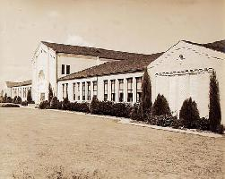
1937
Notes:
5/16/2018
6

Slide 7
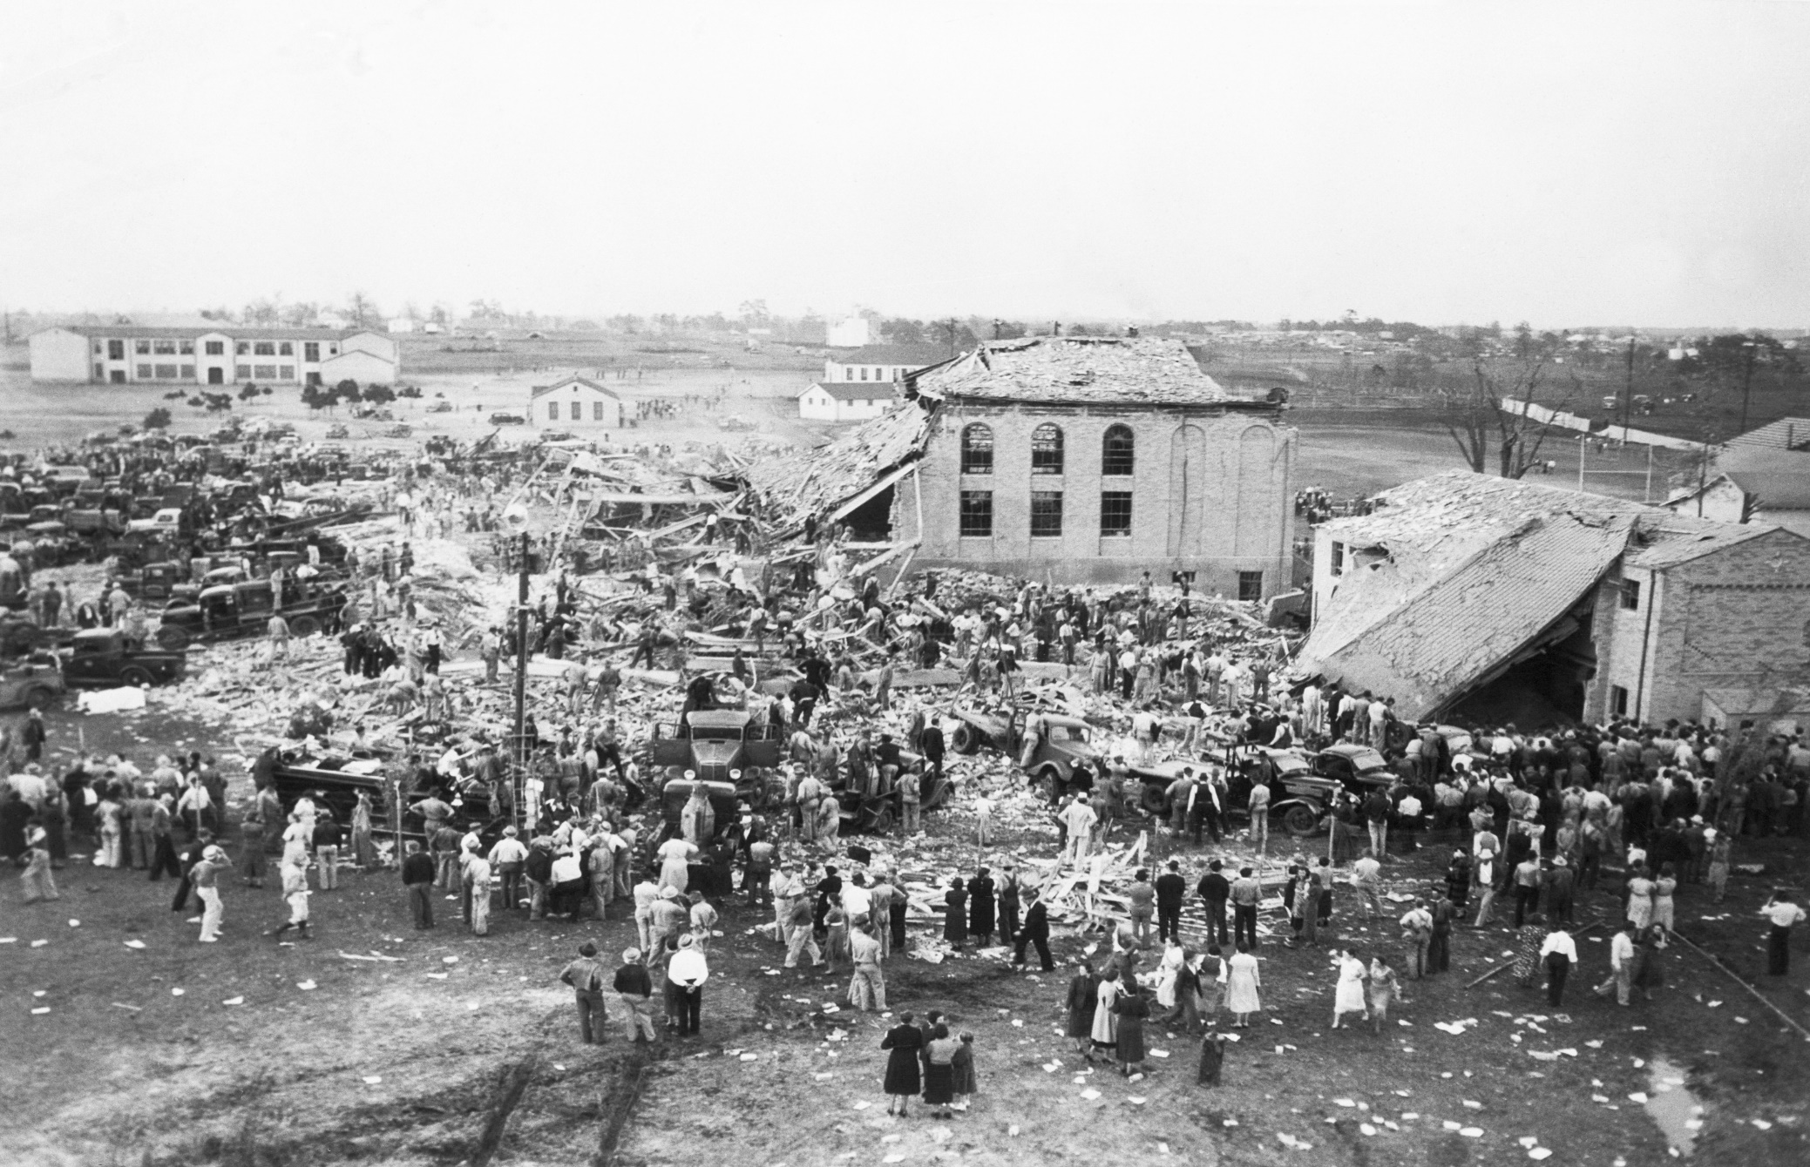
Notes:
5/16/2018
7

Slide 8
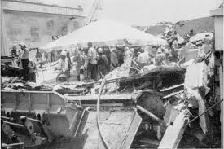
La Tienda Amigo Collapse, Brownsville Texas 1988

Slide 9
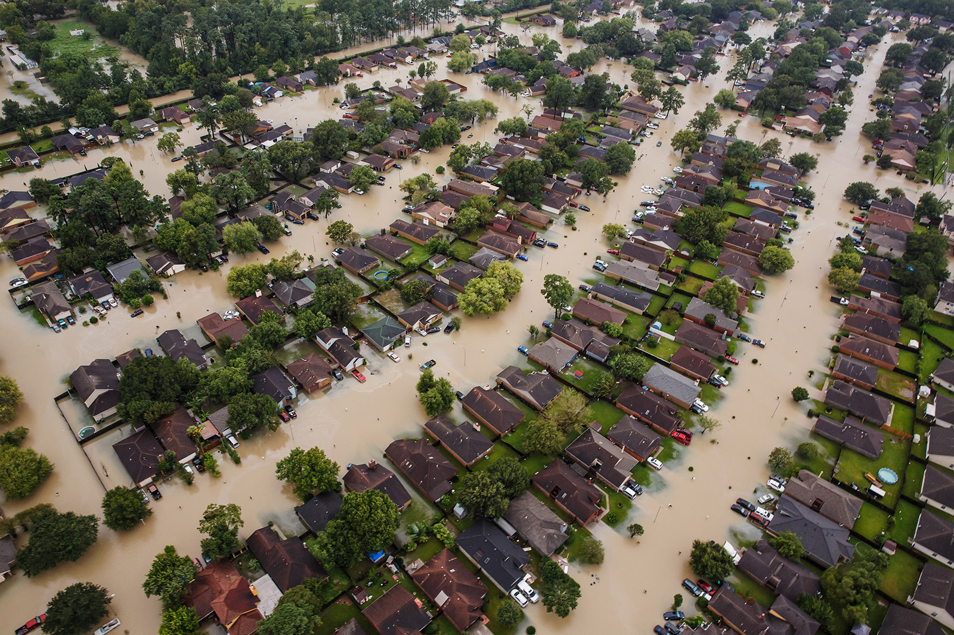
Hurricane Harvey, TEXAS 2017

Slide 10
AGENDA
WHY ARE WE HERE ??
RESPONSIBILITIES TO THE PUBLIC!
  HEALTH, SAFETY AND WELFARE
DIFFERENCE BETWEEN RIGHT AND WRONG

Slide 11
RESPONSIBILITIES TO THE PUBLIC!
UNDERSTANDING OF LAWS AND RULES
TECHNICAL COMPETENCE
PROFESSIONALISM
COMMON SENSE/STREET SMART
ETHICAL RESPONSIBILITY

Slide 12
UNDERSTANDING LAWS AND RULES!
TEXAS LOCAL GOVERNMENT CODE
TEXAS ENGINEERING PRACTICES ACT
PROFESSIONAL SERVICES PROCUREMENT ACT
OTHER ENVIRONMENTAL and HEALTH/SAFETY

Slide 13
TEXAS LOCAL GOVERNMENT CODE
http://www.statutes.legis.state.tx.us/
FOR BOTH MUNICIPALITIES AND COUNTIES
  CHAPTERS 1 - 99
    BOUNDAIRES, TYPES/FORMS OF GOVERNMENT
    POWERS AND ENFORCEMENT
  CHAPTERS 101 – 150 +/-
    MUNICIPALITY AND COUNTY FINANCES AND BUDGET
  CHAPTERS 200 AND ON!!!
    ZONING, PURCHASING AND CONTRACTING
    FUN STUFF

Slide 14
TEXAS ENGINEERING PRACTICES ACT

Slide 15
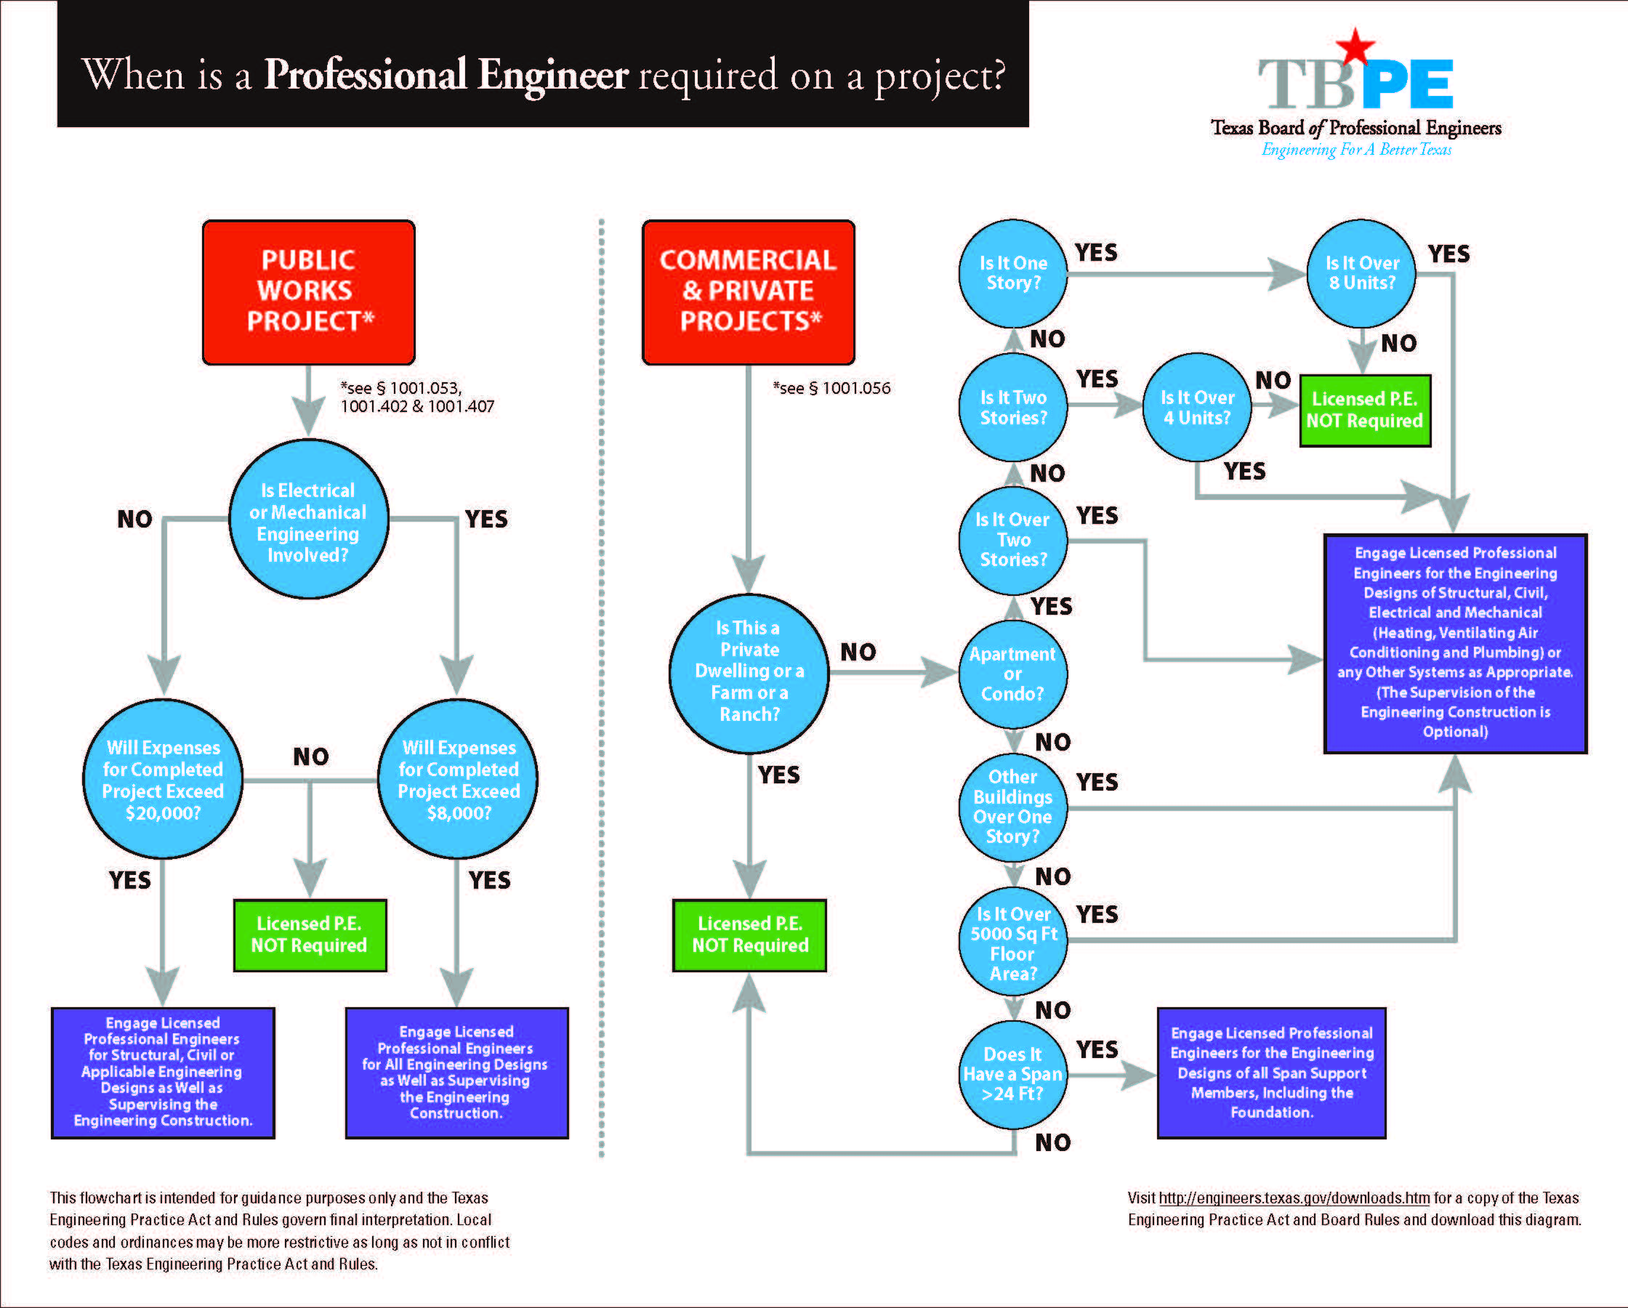

Slide 16
PROFESSIONAL SERVICES PROCUREMENT ACT

Slide 17
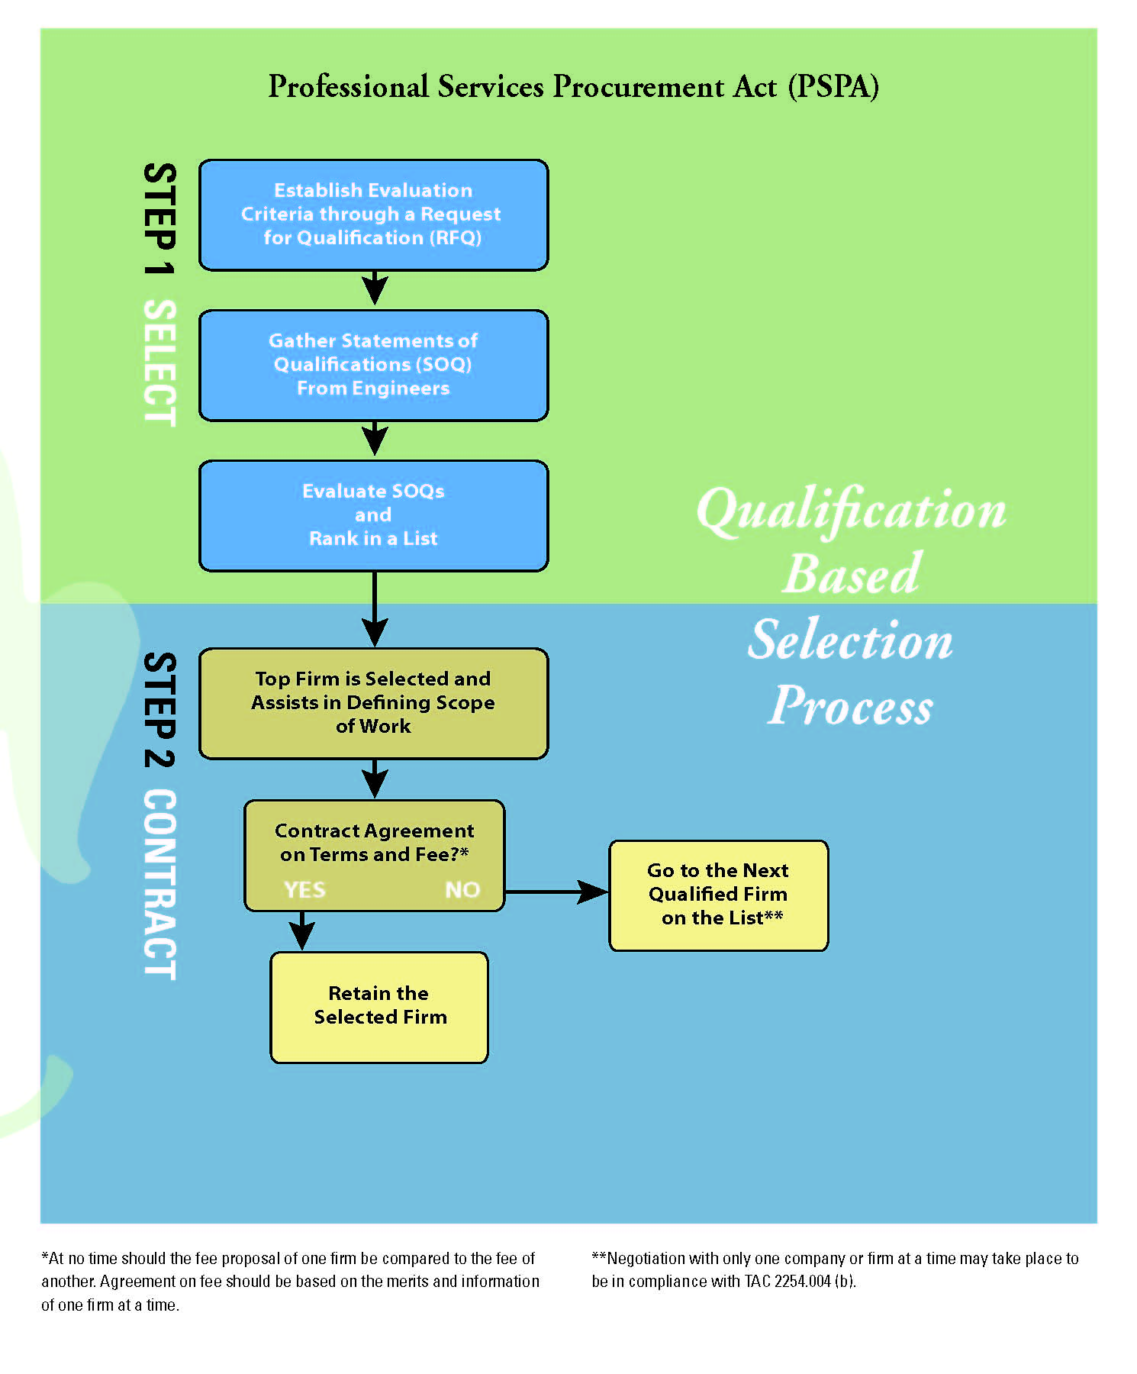

Slide 18
OTHER LAWS AND REGS
Texas Transportation Code
Texas Utilities Code
Texas Water Code
Texas Commission on Environmental Quality
  Water, Wastewater, Solid Waste etc
EPA, FEMA, HUD, USACE
EXAMPLES?

Slide 19
RESPONSIBILITIES
TECHNICAL COMPETENCE
  Engineering, Architecture, Utilities, even Operations
  Credentials – licenses and permits
PROFESSIONALISM
  INTEGRITY
  ETHICAL STANDARDS!
COMMON SENSE = STREET SMARTS

Slide 20
RESPONSIBILITIES TO THE PUBLIC!
UNDERSTANDING OF LAWS AND RULES
TECHNICAL COMPETENCE
PROFESSIONALISM
COMMON SENSE/STREET SMART
ETHICAL RESPONSIBILITY!!!

Slide 21
PERCEPTION = EXPECTATIONS
Perception of Competence
Perception of Professionalism
Perception of Ethics
WHAT DOES THE PUBLIC THINK OF OUR ROLE?
  99% OF OUR JOB IS BASED
    ON PERCEPTION!!

Slide 22
AGENDA
WHY ARE WE HERE ??
RESPONSIBILITIES TO THE PUBLIC!
  HEALTH, SAFETY AND WELFARE
DIFFERENCE BETWEEN RIGHT AND WRONG

Slide 23
Difference between RIGHT and WRONG
SOMETIMES QUITE OBVIOUS!
SOMETIMES IT IS INTERPRETTED (PERCEPTION!)
SOMETIMES IT’S JUST COMMON SENSE!!
    STREET SMARTS!!!???!!!

Slide 24
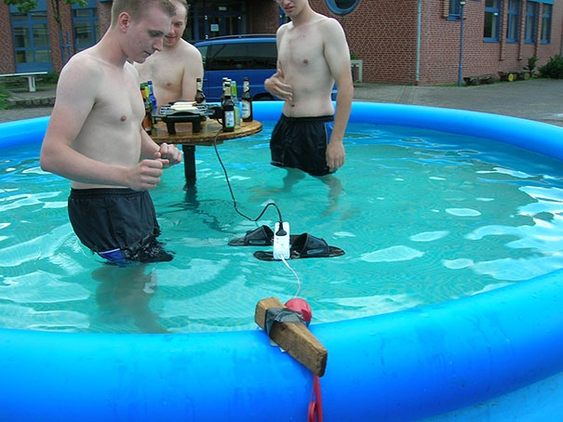
Difference between RIGHT and WRONG

Slide 25
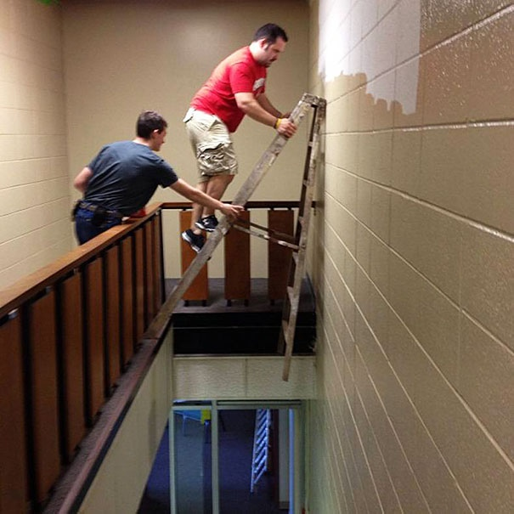
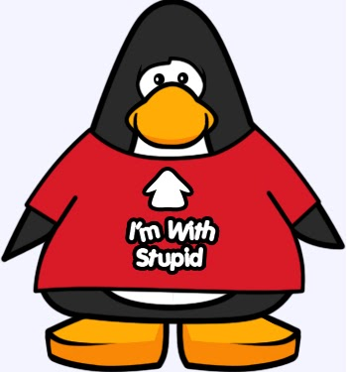
Difference between RIGHT and WRONG

Slide 26
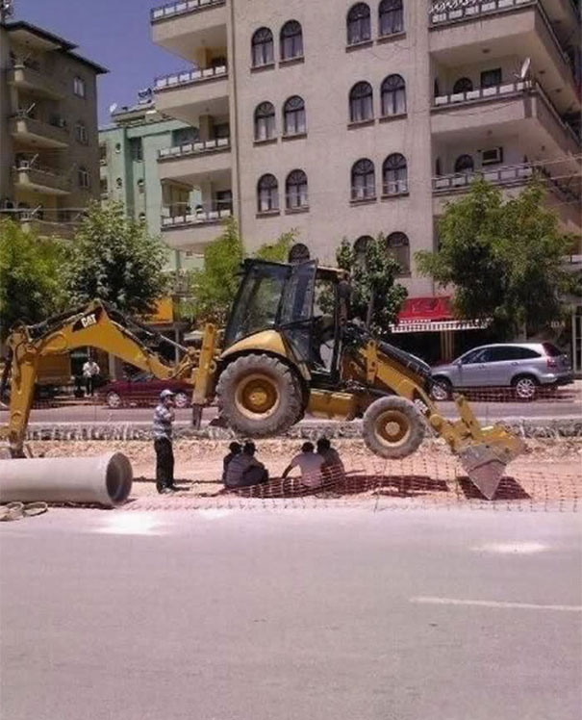

STREET SMARTS?

Slide 27
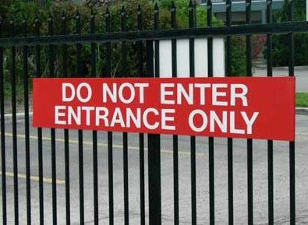
…and some NOT so very obvious!!!!

Slide 28
THE EIGHT ETHICAL TESTS!
The Golden Rule Test
The Truth Test
The What-If-Everybody-Did-This Test:
The Parents Test
The Religion Test
The Conscience Test
The Consequences Test
The Front Page Test
— Dr. Tom Lickona, Character Matters (www.Amazon.com)

Slide 29
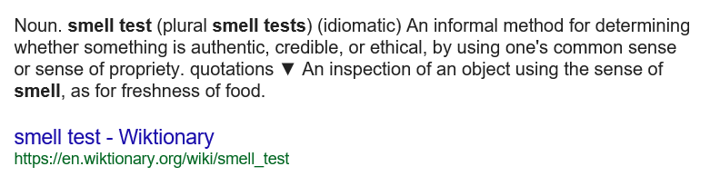
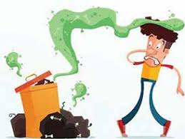
THE SMELL TEST!

Slide 30

THE SMELL TEST!

Slide 31
How do I define ETHICS?

Slide 32
How do I define ETHICS?

Slide 33
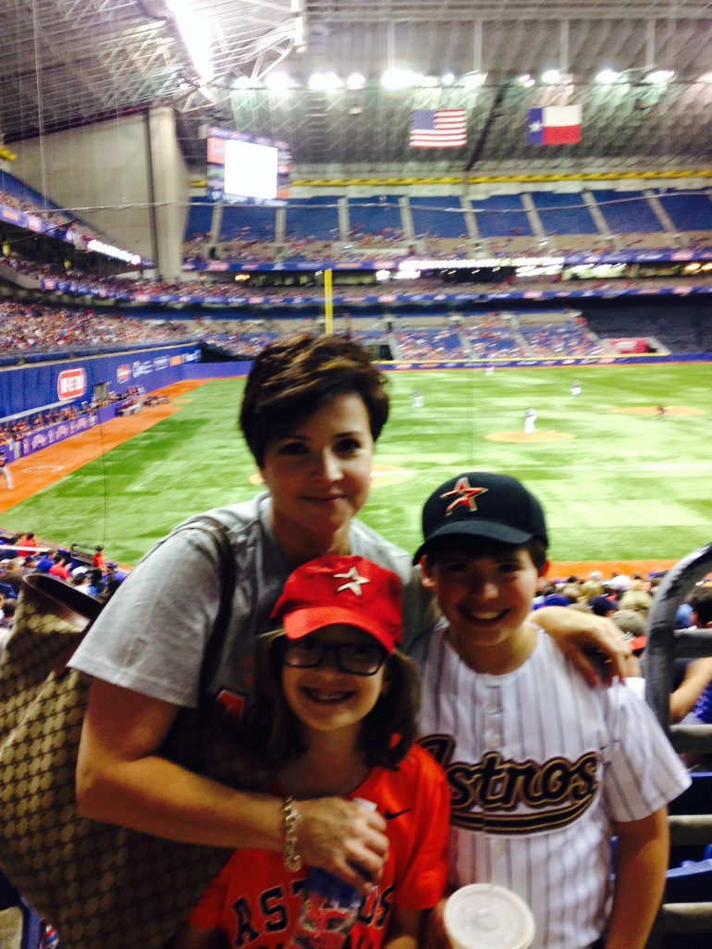
How do I define ETHICS?

Slide 34
ETHICS is not about a Corporate Policy
ETHICS is not about just getting your CEU every year!!!
ETHICS IS ABOUT A LIFESTYLE!!

Slide 35
“WALK THE LINE”
Clear and Concise Communication
Clear and Concise Communication
Clear and Concise Communication
Communicate!
Communicate again!
Communicate again some more!

Slide 36
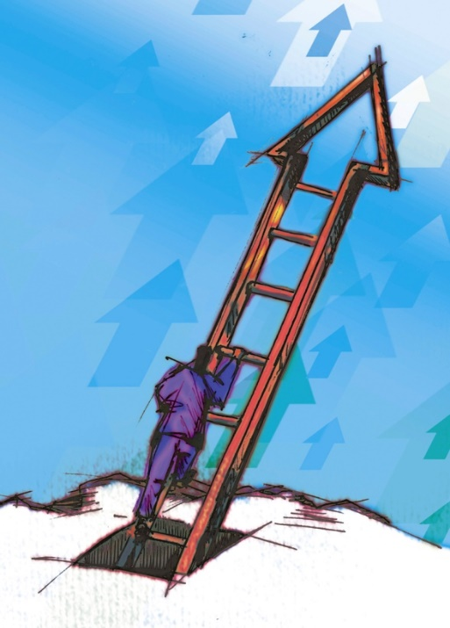
RESPONSIBILITIES TO YOURSELF!
Keep track of the expectations of your profession (Training, etc)
Utilize a Mentor
Manage well
  Management Courses
  Leadership Course
Social Media

Slide 37
RESPONSIBILITIES TO OTHERS
Have a protégé
Lead by example
Serve your community
  Civic organizations
  Religious organizations
  Professional organizations

Slide 38
RESPONSIBILITIES TO YOUR PROFESSION!!
Understand your role in your industry
Hold each other to SAME standards
Respect one another’s profession
Understand the threats to your profession

Slide 39
“WALK THE LINE”
  I keep a close watch on this heart of mine!
  I keep my eyes wide open all the time!
  I keep the ends out for the tie that binds!
  Because you're mine, I walk the line!

Slide 40
Thank you
Lamberto “Bobby” Ballí, PE, PWLF
  (210) 846-1097

