Slide 1

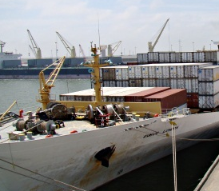

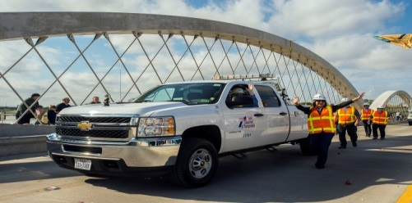



Texas FREIGHT AND INTERNATIONAL TRADE: FREIGHT MOBILITY & border master planS
1st Annual Sustainable Civil Infrastructure Management & Planning Conference
November 16, 2017

Slide 2
Two Plans – One Transportation System

Slide 3
Freight Plan 2017
  Comprehensive multimodal plan identifying freight assets, policies, challenges, strategies, and implementation
  23 stakeholder workshops including 6 in border regions
    El Paso, Laredo, and Rio Grande Valley
    Participation from U.S. and Mexico
    Identified challenges at border crossings
  TxDOT identified the Texas Multimodal Freight Network
    Includes all border crossings - commercial vehicle and rail
Notes:
Skeleton view of the Texas Freight Plan
Highlight implementation and projects

Slide 4
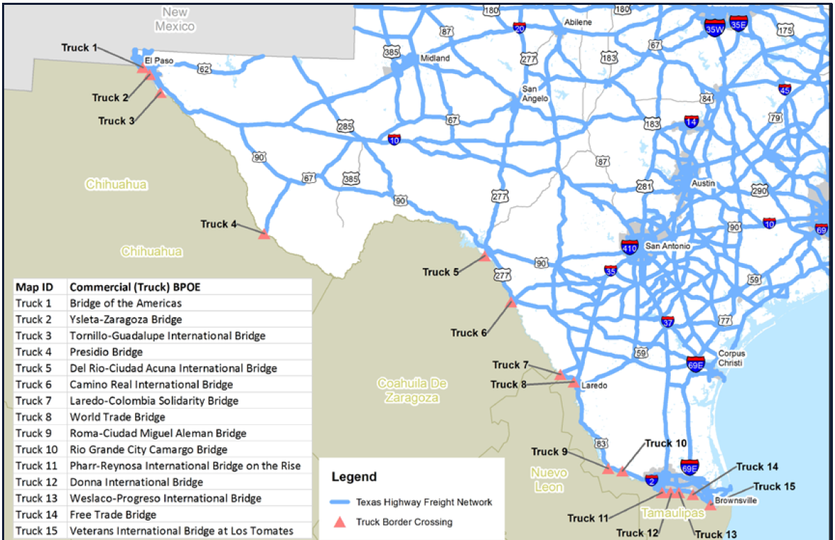
Freight Plan 2017
Notes:
Skeleton view of the Texas Freight Plan
Highlight implementation and projects

Slide 5
Border Crossings in the Freight Plan
  Border Strengths
    Freight and economic asset for Texas and U.S.
    Volume and value of trade highlights integration of key industrial sectors in both countries (computers, electronics, machinery, appliances, vehicles)
    Texas-Mexico border tonnage (Highway + Rail):
      2016 – 73 million tons
      2045 – 211 million tons
Notes:
Skeleton view of the Texas Freight Plan
Highlight implementation and projects

Slide 6
Border Crossings in the Freight Plan
  Border Weaknesses
    Congestion and wait times
    Customs staffing shortage and processing time
    Limited standardization and implementation of cross-border tech
    Permitting regulations are inefficient
    Lack of sufficient funding for infrastructure improvements
    Inadequate data for planning investments and improvements needed to enhance freight processing
    Insufficient dialogue between US and Mexico public and private sectors to address border crossing needs
Notes:
Skeleton view of the Texas Freight Plan
Highlight implementation and projects

Slide 7
TxDOT Freight Policy Improvements
  International Border Crossings
    Coordination between federal, state, regional, and local agencies and stakeholders on border management
    Improve communication between public agencies
    Integrated border crossing technology and operational strategies
    Integrated cargo security measures
    Expedite delivery of border crossing projects
Notes:
MM Ntwrk / Planning must align with gov’s vision for econ growth
NHFP funds have a wide array of eligible project types, including: truck parking, truck-only lanes, traffic information systems, rail/highway grade separation, rail improvements, port enhancements,
Flexible solutions might include being open to shifting funds from unscheduled or longer term low and medium priority projects to high priority projects
In Texas, the number of crashes involving a CMV has exceeded 22,000 the last 2 years. We must identify commercial vehicle management strategies that reduce crash rates and fatalities. In addition to educating the public on freight impacts and how to interact with commercial vehicles, options may include physical separation of passenger vehicles from commercial vehicles by truck-only lanes or even truck-only routes. We are also recommending partnering with railroads to develop solutions to increase highway safety and ease traffic congestion.
Energy industry trends and needs will greatly impact truck routes to pipeline access. TxDOT needs help identifying critical highway-to-pipeline connections to ensure maximum access to domestic and foreign markets.

Slide 8
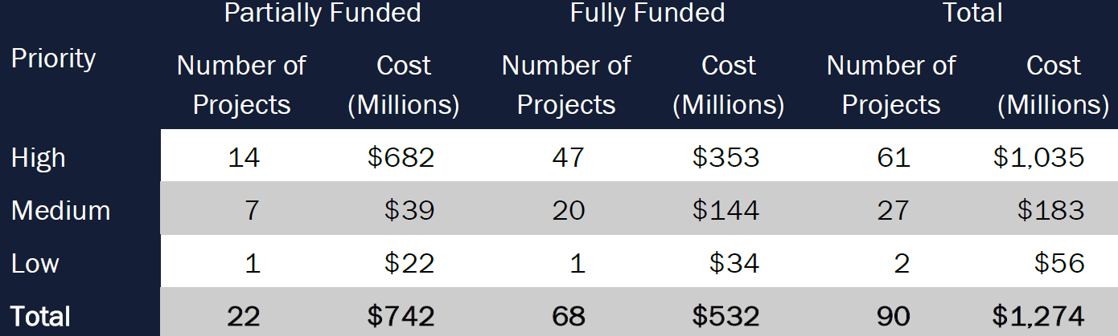
TxDOT Freight Program Improvements
  Border Trade Advisory Committee
    Enhance international coordination
    Improve freight safety, mobility, and efficiency
    Facilitate trade without compromising security
  Texas as a Global Trade and Logistics Hub and Gateway
  90 border crossing projects totaling over $1.2 billion
Notes:
MM Ntwrk / Planning must align with gov’s vision for econ growth
NHFP funds have a wide array of eligible project types, including: truck parking, truck-only lanes, traffic information systems, rail/highway grade separation, rail improvements, port enhancements,
Flexible solutions might include being open to shifting funds from unscheduled or longer term low and medium priority projects to high priority projects
In Texas, the number of crashes involving a CMV has exceeded 22,000 the last 2 years. We must identify commercial vehicle management strategies that reduce crash rates and fatalities. In addition to educating the public on freight impacts and how to interact with commercial vehicles, options may include physical separation of passenger vehicles from commercial vehicles by truck-only lanes or even truck-only routes. We are also recommending partnering with railroads to develop solutions to increase highway safety and ease traffic congestion.
Energy industry trends and needs will greatly impact truck routes to pipeline access. TxDOT needs help identifying critical highway-to-pipeline connections to ensure maximum access to domestic and foreign markets.

Slide 9
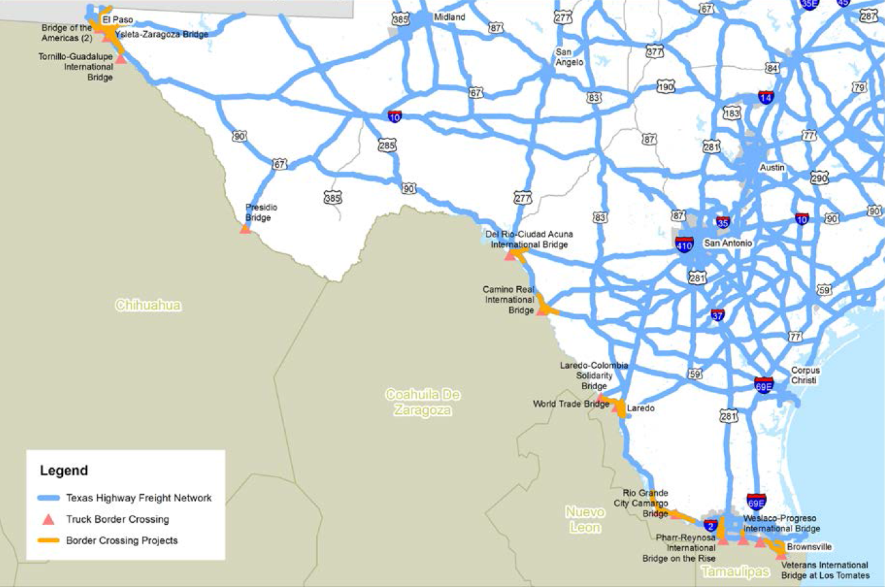
Freight Border Crossing Projects
Notes:
MM Ntwrk / Planning must align with gov’s vision for econ growth
NHFP funds have a wide array of eligible project types, including: truck parking, truck-only lanes, traffic information systems, rail/highway grade separation, rail improvements, port enhancements,
Flexible solutions might include being open to shifting funds from unscheduled or longer term low and medium priority projects to high priority projects
In Texas, the number of crashes involving a CMV has exceeded 22,000 the last 2 years. We must identify commercial vehicle management strategies that reduce crash rates and fatalities. In addition to educating the public on freight impacts and how to interact with commercial vehicles, options may include physical separation of passenger vehicles from commercial vehicles by truck-only lanes or even truck-only routes. We are also recommending partnering with railroads to develop solutions to increase highway safety and ease traffic congestion.
Energy industry trends and needs will greatly impact truck routes to pipeline access. TxDOT needs help identifying critical highway-to-pipeline connections to ensure maximum access to domestic and foreign markets.

Slide 10
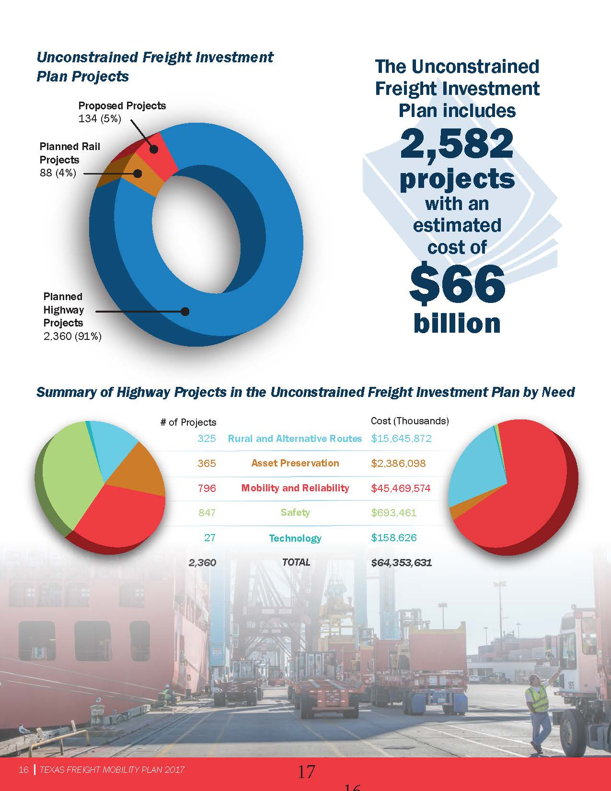
Freight Projects

Slide 11
Freight Projects

Slide 12
Freight Program Summary –Next Steps
  Freight Plan to Commission – November 16
  Freight Plan to FHWA – November 17
  Freight Plan Implementation
    Truck parking study – December 2017
      Inventory parking
      Impacts of Hours of Service Regulations
      Strategies for improvement
    Freight Centric Design Standards – 2018
    Statewide Commercial Vehicle Traffic Center and Incident Management Program
    Off-Peak / 24-Hour Freight Border Crossing Program
Notes:
Border master plan is underway
Bridge reconstruction policies were updated following the 2016 Freight Plan. When reconstructing bridges on the Tx Highway Freight Network, the design must include a vertical clearance of 18 feet 6 inches with few exceptions.
Truck parking and rest area study will start in December with development of the Scope of Work. This study will include a statewide inventory of truck parking, impacts of Hours of Service regulations on the trucking industry and truck parking, as well as community and safety impacts of both the Hours of Service and truck parking needs. How many additional spaces are needed and where are they needed? These and other questions will help identify strategies for improvement.
Freight centric design standards
Statewide traffic and incident management
Off peak / 24 hr delivery program
Robust MM transportation program to include partnerships and strategies with border crossing locations, pipeline companies, energy companies, railroad companies, ports, and airports.

Slide 13
Border Master Plan - Background Information
  U.S. – Mexico Joint Working Committee (JWC)
  Previous border master plans (2012 / 2013)
  Primarily focused on Border Crossings only
    El Paso/Santa Teresa – Chihuahua Border Master Plan
    Laredo – Coahuila/Nuevo Laredo Border Master Plan
    Lower Rio Grande Valley – Tamaulipas Border Master Plan
Notes:
.

Slide 14
TX – MX Transportation Border Master Plan Update
  One single specific deliverable procurement
  Reassesses the Border Crossings and corridors
  Requires a true Needs Assessment
  Includes a pro-active Public Involvement Process
  Specific outcome expectations

Slide 15
TX – MX Transportation Border Master Plan Update
  Builds from the previous plans
  Utilizes participant agencies
  Committees will be established to lead the effort
    Regularly scheduled meetings
    Provide feedback and guidance
    Assist with stakeholder outreach
    Lead development of the plan
    Lead implementation of the plan
Notes:
.

Slide 16
Scope of Work: Texas – Mexico Transportation Border Master Plan Update
Administration and Management of the BMP
  Task 1: Project Management, Administration, and Quality Assurance
  Task 2: Stakeholder Engagement Plan
  Task 3: Goals and Objectives of the Plan

Slide 17
Scope of Work: Texas – Mexico Transportation Border Master Plan Update
Data Collection, Corridor Identification & Analysis
  Task 4: Multimodal Data Collection and Inventory
  Task 5: Multimodal Corridor identification and designation
  Task 6: Needs Assessment
  Task 7: Forecasting – Twenty (20) year
  Task 8: Economic Analysis

Slide 18
Scope of Work: Texas – Mexico Transportation Border Master Plan Update
Recommendations, Implementation &
Final Report
  Task 9: Recommendations and Investment Plan
  Task 10: Implementation Plan
  Task 11: Final Report, Executive Summary, Brochure

Slide 19
Anticipated Selection Timeframe
Selection Milestone | Target Dates (are subject to change)
Pre-RFQ Meeting | April 13, 2017
Request for Qualifications (RFQ) Posting | August 21, 2017
Statement of Qualifications (SOQ) Due | September 11, 2017
Notification of Short List | October 2, 2017
Interviews | Week of October 16, 2017
Selection Complete | October 2017
Negotiations Complete | December 2017
Contract Execution | February 2018

Slide 20
Contact Information
  Casey Wells
  Planner V
  casey.wells@txdot.gov
  (512) 936-0950
  Timoteo “Tim” Juarez, Jr.
  International Trade & Border Coordinator
  tim.juarez@txdot.gov
  512-305-8588

Slide 21
Discussion
www.MoveTexasFreight.com

