Slide 1
Grants.gov Demonstration
UW San Antonio Federal - Grant 101 Workshop
Location: Isla Grande Resort SPI
2nd Floor Paradise Rm
Tuesday May 23, 2017 at 8:00 am to 3:30 pm
Leah B. Yasenchak, PhD AICP/PP, CEcD/EDP
leah@brsinc.com
Adele Cardenas Malott, P.E.
Senior Policy Advisor EPA

Slide 2
Register as Applicant

Slide 3
Link to DUNS Number

Slide 4
Create Username/Password

Slide 5
Use New Login Information

Slide 6
Check Role

Slide 7
Check Role

Slide 8
Assigning Roles in Grants.gov

Slide 9
Log in with MPIN (Marketing Partner Identification Number)

Slide 10
Search by “All” or a Specific Name

Slide 11
Highlight Name You Wish To Assign Roles

Slide 12
Move to “Current Roles”

Slide 13
Funding Opportunity
Example Search:
FY16 ENVIRONMENTAL WORKFORCE DEVELOPMENT AND JOB TRAINING (EWDJT) GRANTS
EPA-OSWER-OBLR-16-01

Slide 14
Funding Opportunity

Slide 15
Funding Opportunity

Slide 16
Funding Opportunity

Slide 17
Funding Opportunity

Slide 18
Funding Opportunity

Slide 19
Funding Opportunity

Slide 20
Funding Opportunity

Slide 21
Funding Opportunity

Slide 22
Funding Opportunity

Slide 23
Funding Opportunity

Slide 24
Two Paths

Slide 25
Application Package

Slide 26
Create a Workspace with Application

Slide 27
Invite Participants

Slide 28
Application Elements

Slide 29
Editing Application

Slide 30
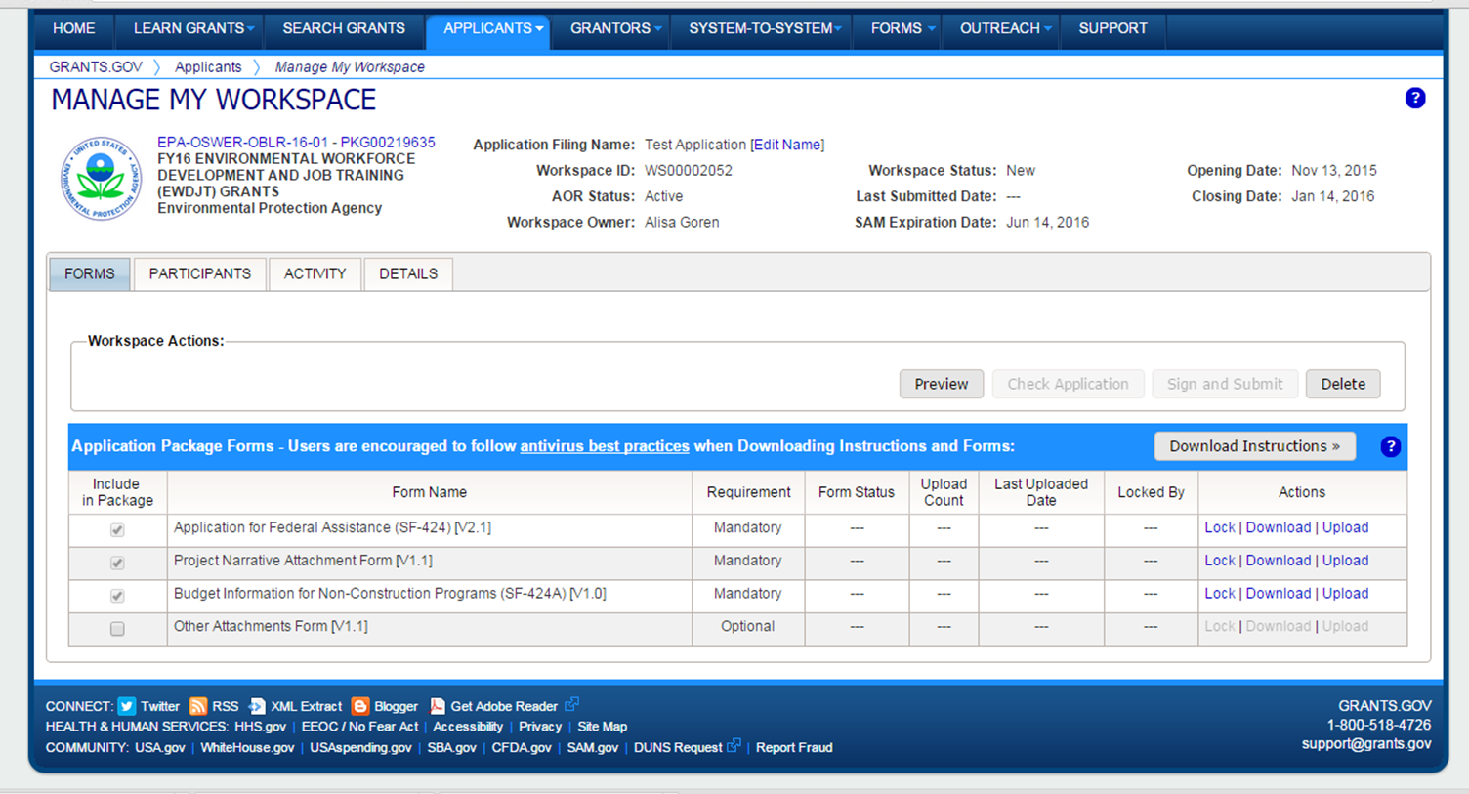
Submittal

Slide 31
Workspaces

Slide 32
Questions?
Thank you
Leah B. Yasenchak, PhD AICP/PP, CEcD/EDP
leah@brsinc.com
ww.brsinc.com
Adele Cardenas Malott, P.E.
Cardenas.Adele@epa.gov
(214) 665-7210

