Slide 1
Developing a Decision Making Tool for Determining LID Stormwater Detention Requirements for the LRGV
Javier Guerrero
Civil Engineering, University of Texas Rio Grande Valley
Kim Jones, Taufiq Alam
Institute of Sustainable Energy and the Environment
Texas A&M University-Kingsville
19th Annual Water Quality Management and Planning Conference
May 26, 2017

Slide 2
DMT for LRGV LID stormwater management and planning
Project Partners
  Border Environmental Cooperation Council
  US EPA Border 2020 program
  Texas A&M University Kingsville
  LRGV TPDES Stormwater Task Force
  University of Texas Rio Grande Valley
  Cameron County and Cities of Edinburg, Weslaco, Donna
  South Texas College
  Regional EDC

Slide 3
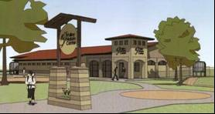
Project Objectives
Develop a user friendly design tool (DMT) to reduce reliance on traditional detention pond solutions and promote innovative LID/GI technologies to reduce BMP footprints, conserve land resources and improve water quality by incorporating subsurface and LID storage and runoff reduction calculations into the design process for the LRGV
Incorporate outreach and education into workshops and seminars to facilitate training and implementation of the DMT into design and construction

Slide 4
Methodology and Modeling
DMT will incorporate extensive LID runoff and pollutant reduction data collected over several years from LID implementation program led by TAMUK and LRGV SW TF supported by TCEQ NPS 319 Program
WinSLAMM model for SW BMP modeling peer reviewed and accepted by scientists, engineers and agencies
Model calibration and validation achievable for unique BMPs in the LRGV such as pervious pavements, bioswales, biodetention cells, others

Slide 5
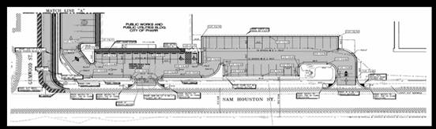
Methodology and Modeling
Extensive modeling runs of various combinations and connection of BMPs to be developed
Outputs coalesced into user friendly approaches such as Excel spreadsheets and tables (DMT) for use by cities, counties, planners, and stakeholders
DMT training and workshops implemented and enhanced for additional BMPs and connections

Slide 6
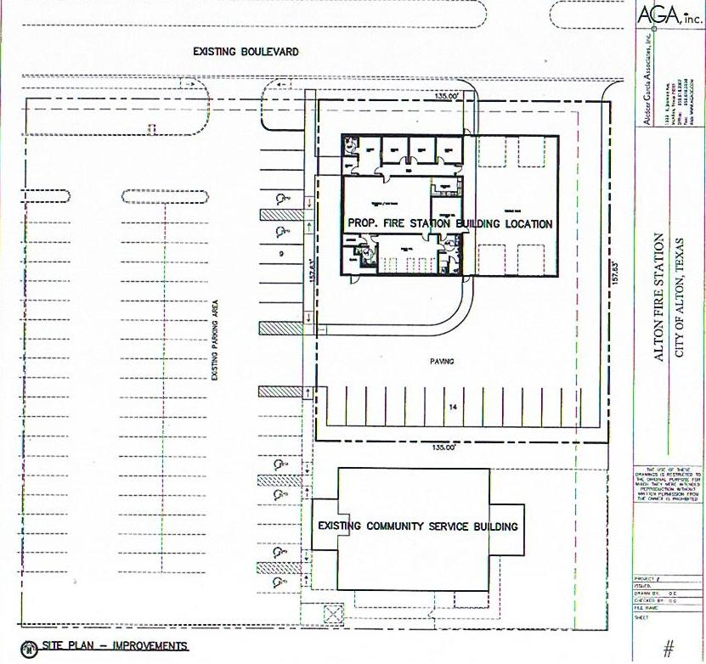
Milestones and Updates
Modeling QAP developed
Example prototypes for typical LRGV mixed use communities and development scenarios in development
Several initial meetings with DMT workgroup implemented
Modeling QAP developed
DMT WQ Conference roll out and engagement
Modeling scenarios and post processing completed October 2017

Slide 7
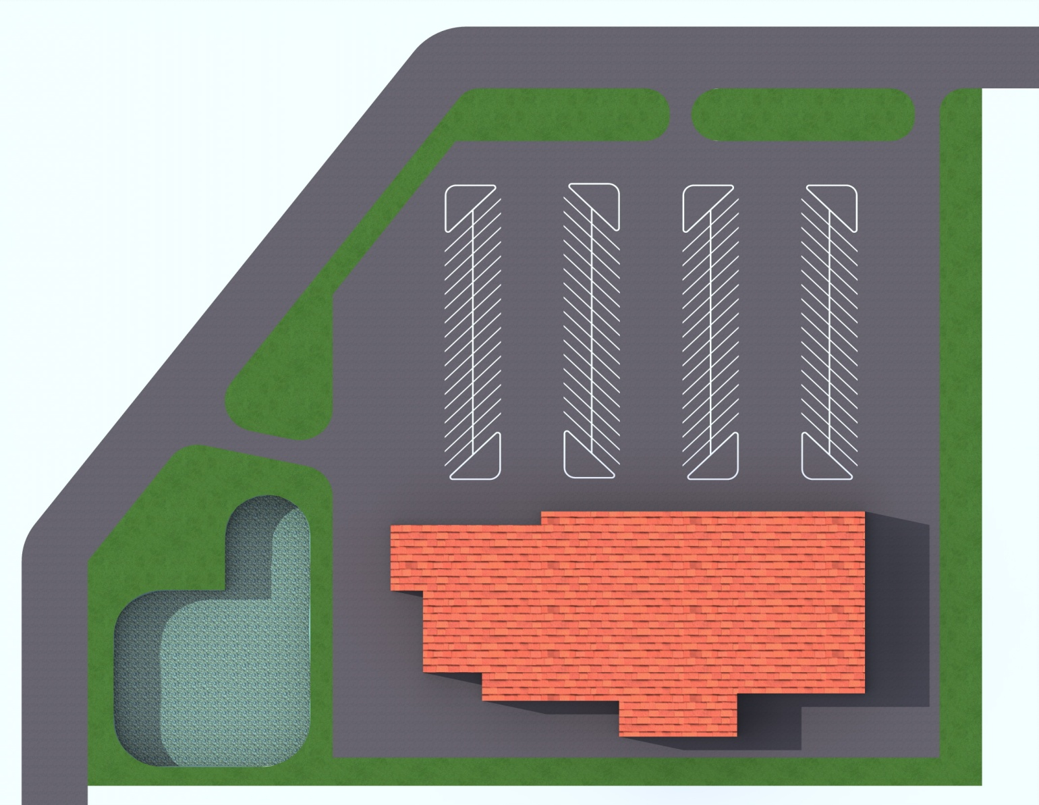
Example development
Traditional detention basin
Olusola Fasae, TAMUK

Slide 8
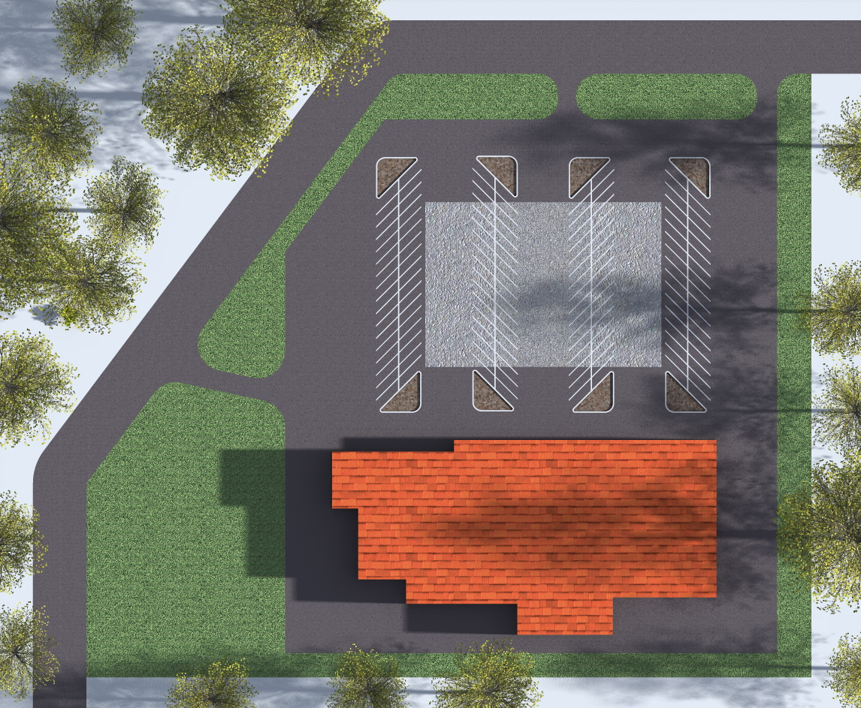
Example development
Connections of pervious pavement and
bio-detention cells
Olusola Fasae, TAMUK

Slide 9
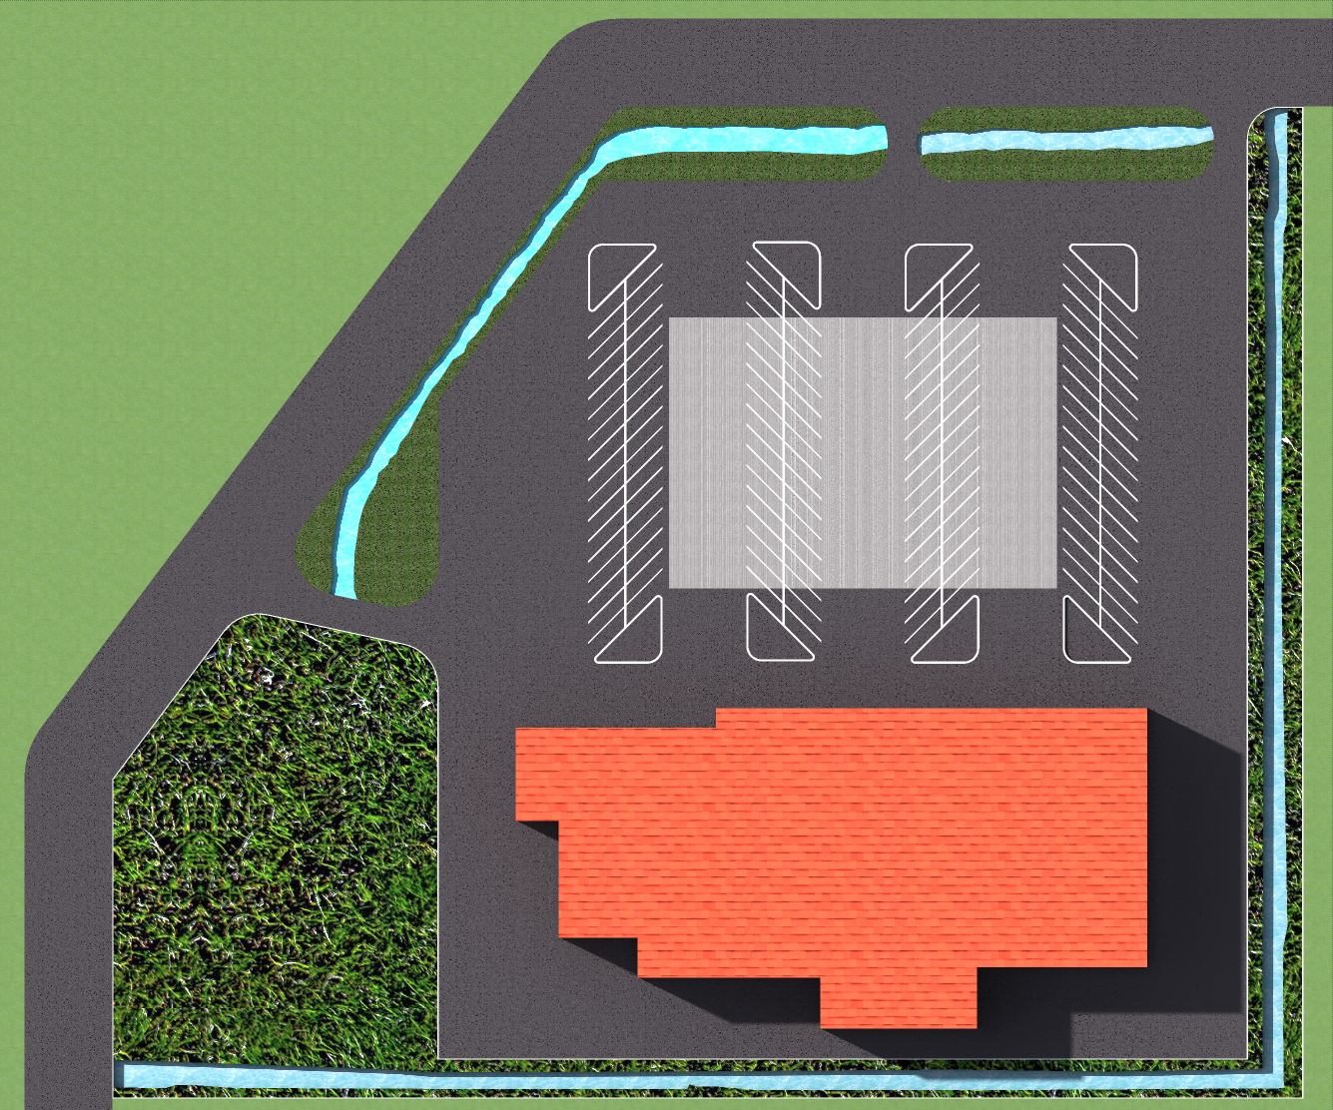
Example development
Connections of pervious pavement and bioswales
Olusola Fasae, TAMUK

Slide 10
Acknowlegements
Border Environmental Cooperation Council
U.S. EPA Border 2020 Contract SOLTA-15-010
LRGV SW Task Force Partners
University of Texas Rio Grande Valley

