Slide 1

Strategic Direction of the College of Engineering and Computer Science
By Alex Domijan

Slide 2
Mission
The College provides a path to a better life through a comprehensive education for student-success delivered by accomplished and passionate scholars supported by professional and caring staff. We will transform the Rio Grande Valley through innovative academic programs integrated with research that has global impact.
Our Roadmap
Providing multi-national learning innovations with a personal touch
Conducting research that has global impact
Providing opportunities for student engagement in scholarly activities
Creating an ecosystem that attracts and develops new industries

Slide 3
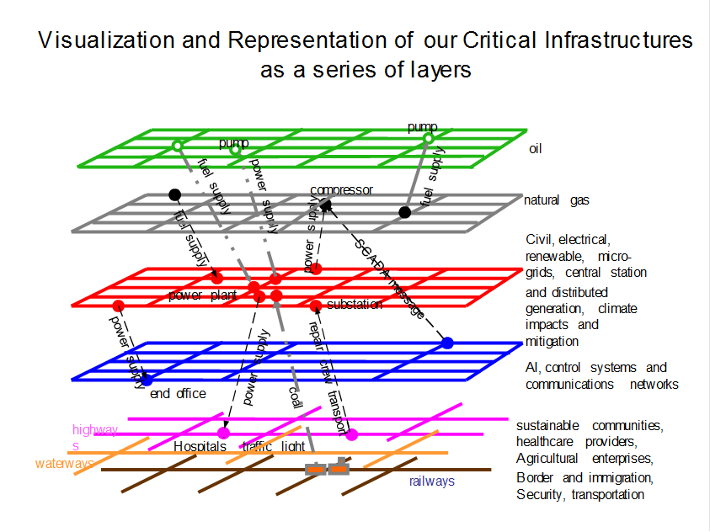

Slide 4
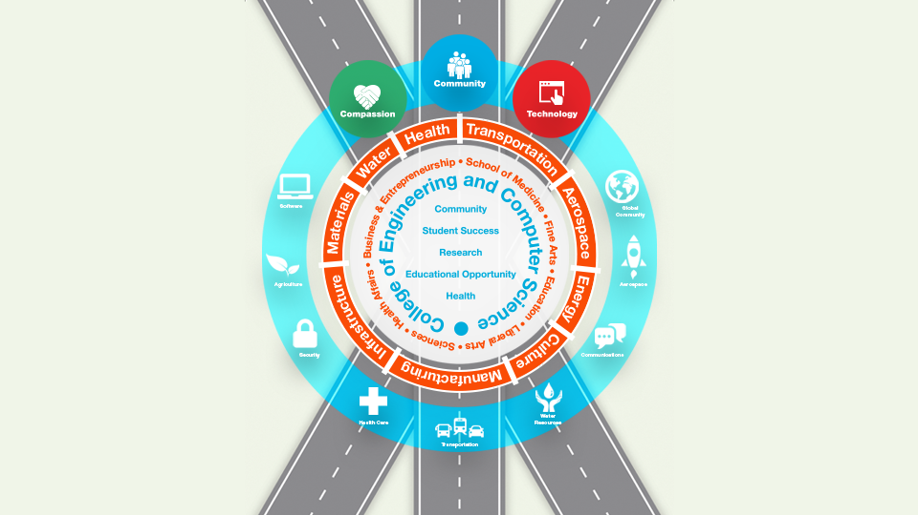

Slide 5
The Heartbeat of the CECS: Practical Sustainable Approach to Student-Success Centered Learning, Employment and Applied Innovation

