Slide 1

Framework For A Tool For Contract Time Determination System
UNIVERSITY OF TEXAS RIO GRANDE VALLEY
COLLEGE OF ENGINEERING AND COMPUTER SCIENCE
CIVIL ENGINEERING DEPARTMENT
Cuauhtemoc Torres Cantu
Graduate Student – Civil Engineering Department.
University of Texas Rio Grande Valley.
PI: Mohamed Abdel-Raheem,
PhD, PMP, LEED GA, LSSGB, CM-BIM, CM-Lean
Assistant Professor – Civil Engineering Dept.
Co-PI: Sophie Wang, PhD
Associate Professor – Math and Statistical Science Dept.

Slide 2

1- Introduction
Estimating the duration time of a project is one of the most important stages in project management.
Estimated quantities and productivity rates are used to find the maximum total duration of a project.
Quantities can change once the project is in progress.
Factors that can affect productivity rates: Project Location, Size, Complexity of Work, Weather, Worker Skills, Equipment.
$$Activity Duration=\frac{Quantity}{Production Rate}$$

Slide 3
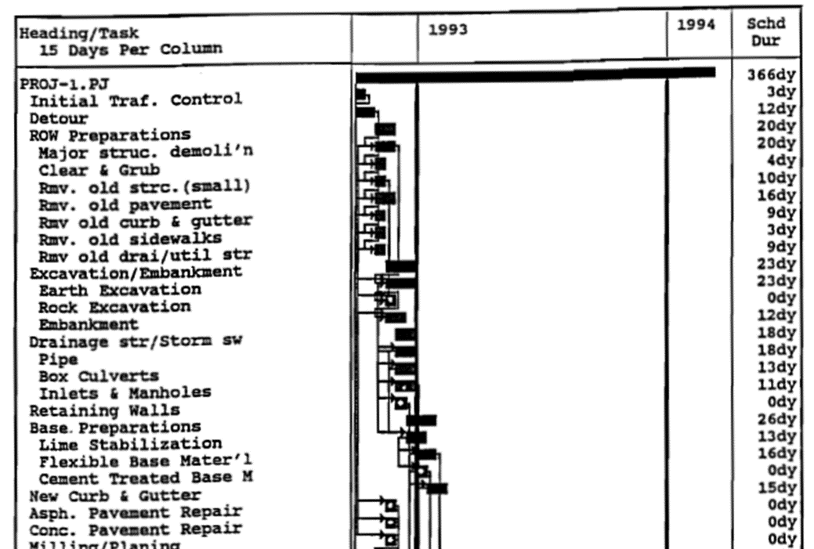
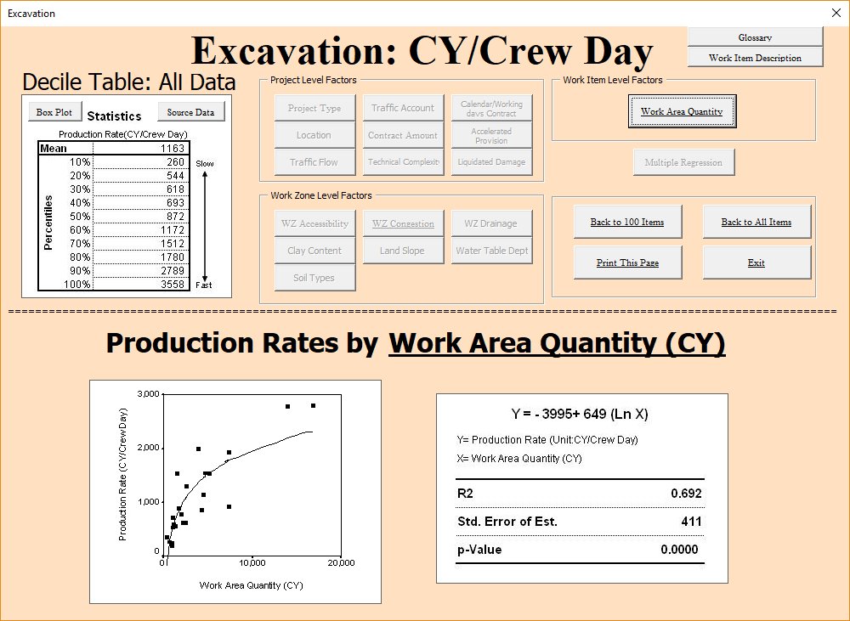
1- Introduction
TxDOT have being experiencing problems estimating contract time durations.
A survey conducted by UTRGV implies that TxDOT uses a combination of Engineering Experience and :
Contract Time Determination System (CTDS)
Created in 1992 by the Texas Transportation Institute and TxDOT.
Authors: Hancher, McFarland, and Alabay.
Production rate database resulted from survey inputs. It is composed of 3 values for production rates and adjustment factors (low, average, high).
Highway Production Rate Information System (HyPRIS)
Created in 2004 by UT Austin in cooperation with U.S DOT, FHWA, and TxDOT
Authors: O’Connor, Chong, Huh, and Kuo.
Database established lower and higher averages for production rates, for 26 items.
HyPRIS is meant to be used as a support database rather as a scheduling tool.

Slide 4
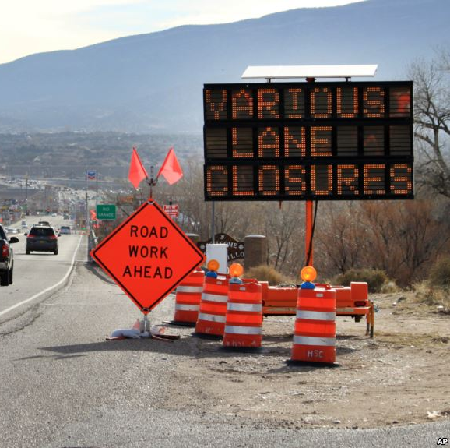
2- Project Problem Statement
  Problem Summary:
TxDOT projects get delayed; this delay costs a lot of money
Two Scheduling Tools:
  Contract Time Determination System (CTDS)
  Highway Production Rate Information System (HyPRIS)
The current CTDS is not accurate enough to produce reliable schedule – provides default values
HyPRIS is not a comprehensive production rate estimating system. It cannot be used alone
https://www.voanews.com/a/trump-healthcare-tax-reform-infrastructure/3798638.html

Slide 5
3- Project Objective
  Objective : Develop a preliminary contract time determination tool (scheduling tool) based on probabilistic production rates.
Collect Data: collect data sets (previous and current projects) needed for tool development: a) work items/activities list, b) production rates, c) activities durations, and d) quantities of work from TxDOT
Create probability distributions for the different work items involved in a project using the provided data sets , work items should include, but not limited to : Row Preparations , Subgrade preparations , Hot mix asphalt surface , and Concrete paving.
Develop a spreadsheet-based scheduling tool implementing PERT and Monte-Carlo simulation , for the selected TxDOT Districts: Pharr , Lubbock , Bryan , Houston , and Corpus Christi.
Evaluate the performance of the developed tool in determining the project contract time: a survey soliciting feedback of engineers from the selected district offices.

Slide 6
4- Methodology
4.1- Project Scope
The project scope is to develop a friendly excel based contract time determination tool for each of the district mentioned before. The project can be divided into two parts:
The Scheduling Tool: Development of tool using Visual Basic Application (VBA)
Development of a database for production rates based on historical data.

Slide 7
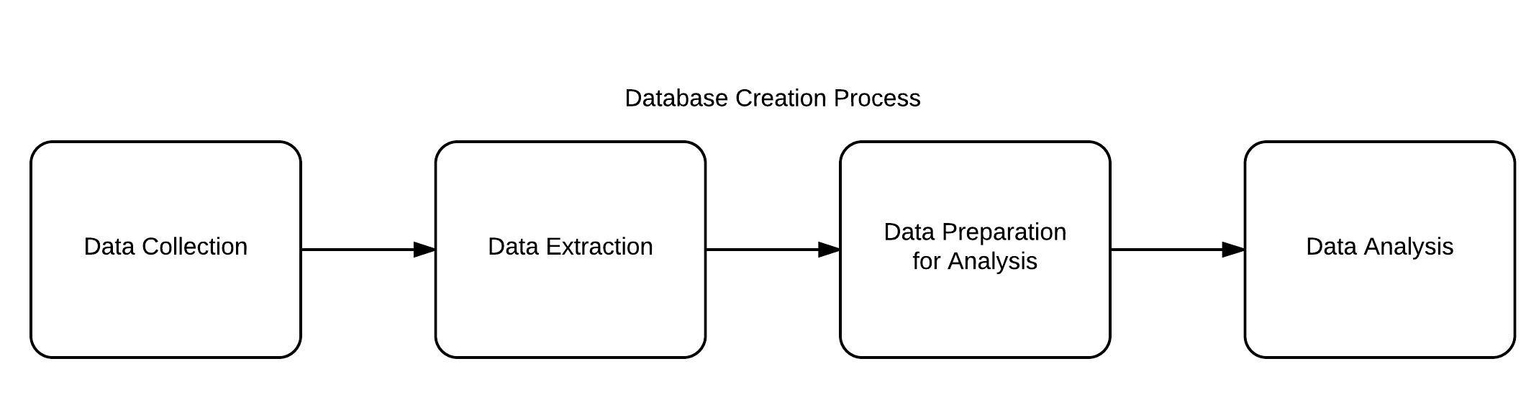
4- Methodology
4.2 – Creating the Database
The accuracy of the contract time determination tool to predict the total duration of the project relies on the accuracy of the production rate database.

Slide 8
4- Methodology
4.2.1 – Data Collection
At least 30 different projects of the same type of work (for example Overlay Projects) are needed.
The collected data is received in report forms which include :
Contract Report Bundles (excel files)
Daily Work Summary Reports (DWR) (PDF files)
Original TxDOT timeline (when available) (PDF or Excel Files)

Slide 9
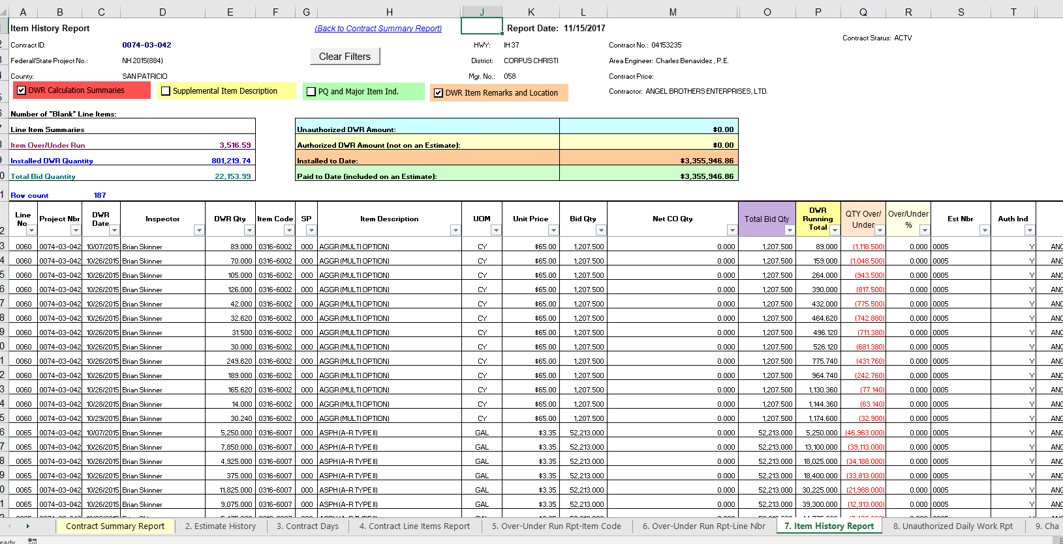
1. Contract Report Bundle

Slide 10
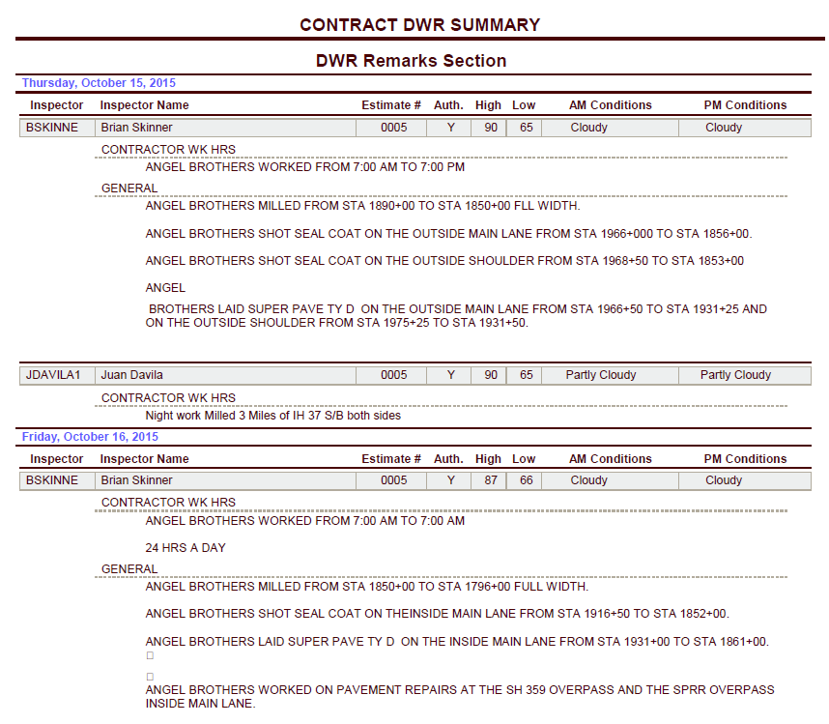
2. Daily Work Summary Reports (DWR)

Slide 11
3. TxDOT Timeline

Slide 12
4- Methodology
4.2.2 – Data Extraction
Data needed to be extracted include: Item Codes & Descriptions, Estimated & Actual Quantities, Unit of Measurement, Weather & Temperature Conditions, Daily Work Reported Quantity (daily production date).
Early stages performed manually; Semi automated system was developed to facilitate and save time in the data extraction process.
Data Extraction
Data Preparation

Slide 13
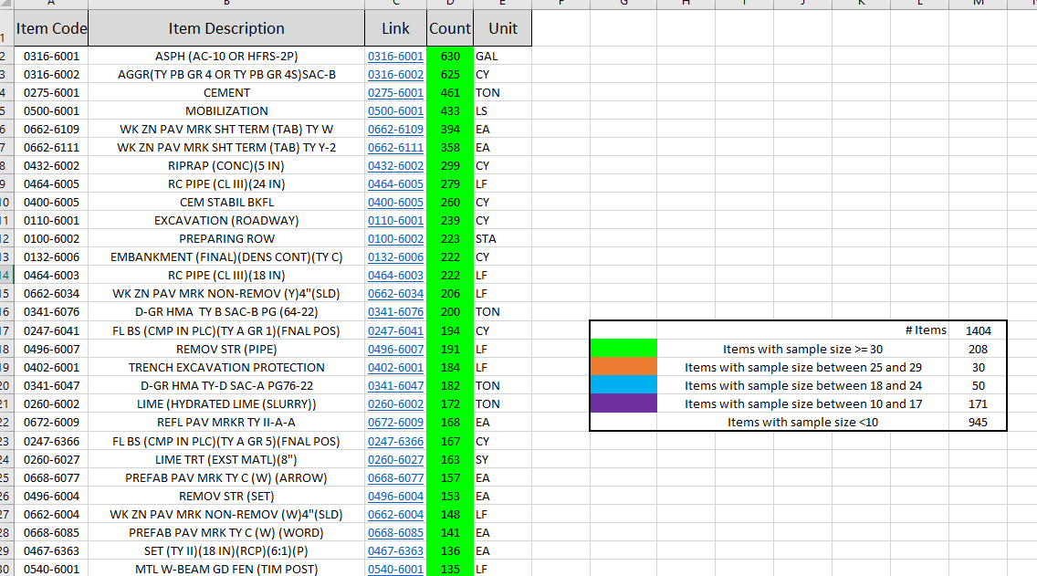
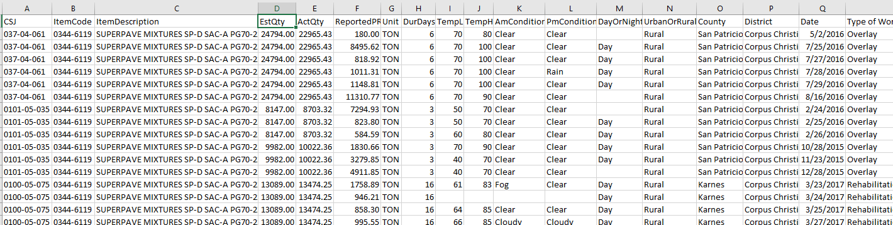
Example of Data Ready for Analysis

Slide 14
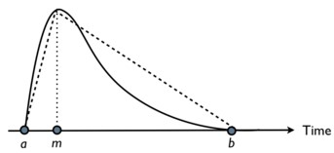
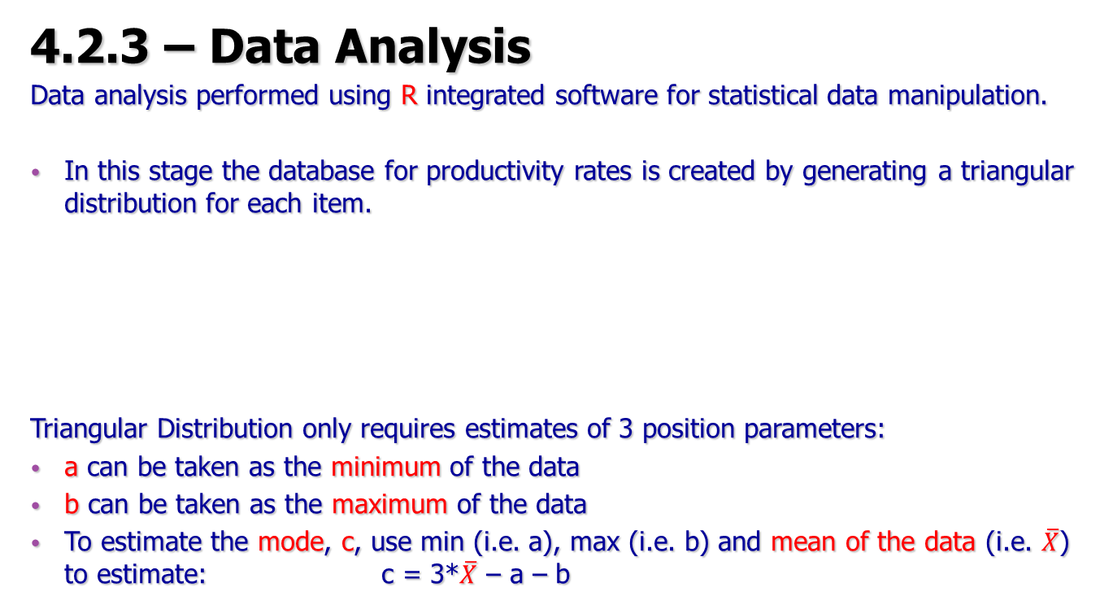
4- Methodology
4.2.3 – Data Analysis
Data analysis performed using R integrated software for statistical data manipulation.
In this stage the database for productivity rates is created by generating a triangular distribution for each item.
Triangular Distribution only requires estimates of 3 position parameters:
a can be taken as the minimum of the data
b can be taken as the maximum of the data
To estimate the mode, c, use min (i.e. a), max (i.e. b) and mean of the data (i.e. $\overline{X}$) to estimate: c = 3*$\overline{X}$ – a – b

Slide 15
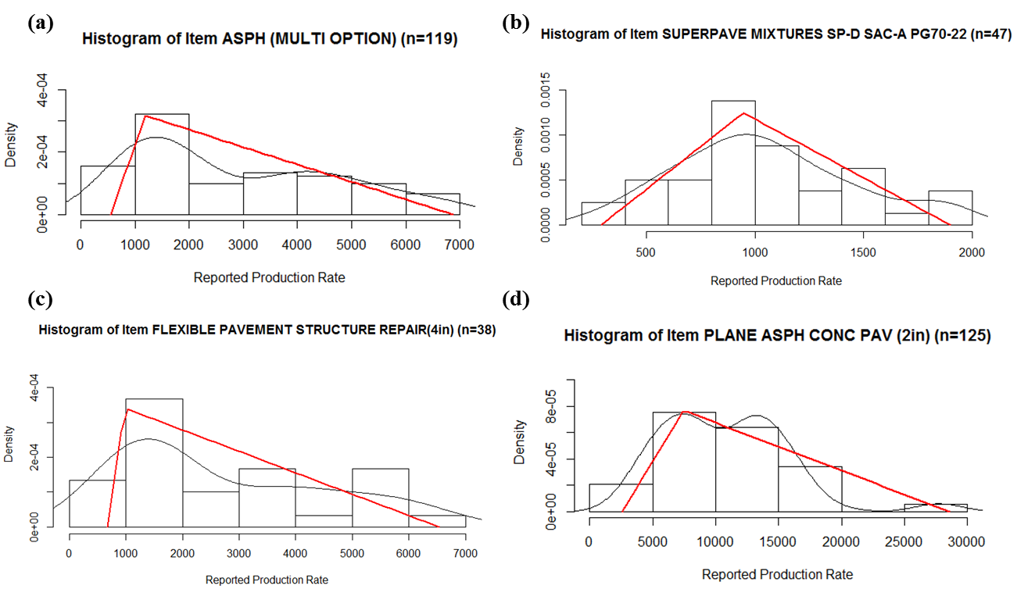
Results of Triangular Distribution:
Item : 316-6001 ASPH (MULTI OPTION)
The production rates (GAL/day):
Minimum (pessimistic) = 550
Mode (most likely) = 1191.8
Maximum (optimistic)=6680
Item : 344-6119 SUPERPAVE MIXTURES SP-D SAC-A PG70-22
The production rates (TON/day):
Minimum (pessimistic) = 290.63
Mode (most likely) = 946.22
Maximum (optimistic)=1899.19

Slide 16
5- Contract Time Determination Tool Framework Development
User-friendly tool, developed using Microsoft Excel as a base program, and Visual Basic Application (VBA) as the coding language.
The software implements different scheduling techniques:
Critical Path Method (CPM) : uses deterministic durations.
Program Evaluation and Review Technique (PERT): uses probabilistic durations

Slide 17

PERT
Takes into consideration the variability in activity duration. And this variability is defined using three estimates:
Optimistic Duration = Do
Most likely Duration = Dm
Pessimistic Duration = Dp
According to the Central Limit Theorem duration of the project in PERT is represented by a normal distribution.
$${Duration}_{Expected}=\frac{D_{o}+{4D}_{m}+D_{p}}{6}$$

Slide 18
6- Contract Time Determination Tool
Items (activities)
Quantities
Relationships between activities
Activity Predecessor &lag
User Input
CPM / PERT
Output
User decides whether to schedule using CPM or PERT
Report of :
Total Duration
Critical Path
Gantt Chart
Precedence diagram

Slide 19
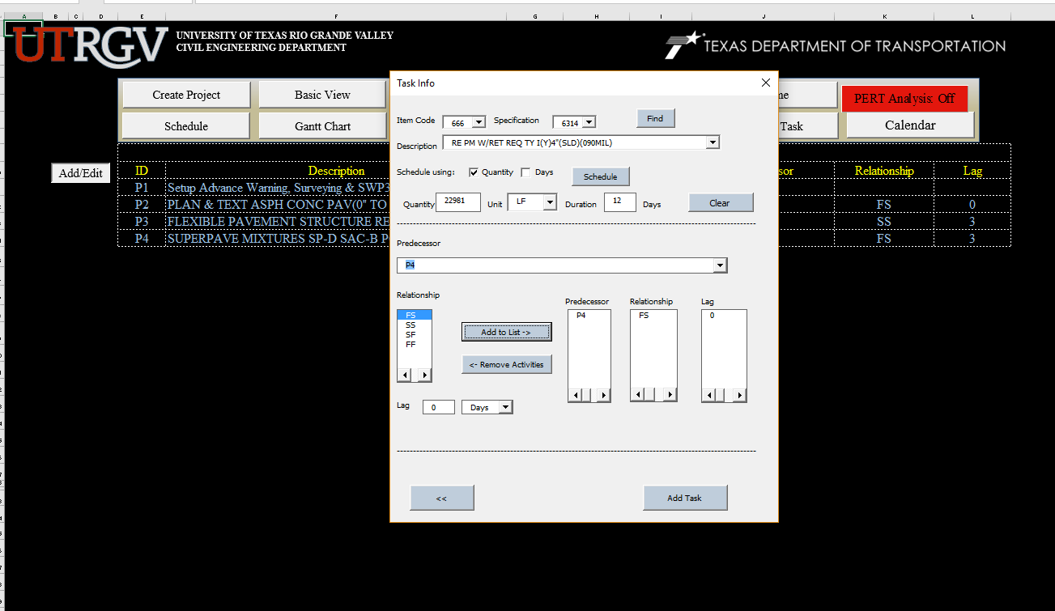
User Input

Slide 20
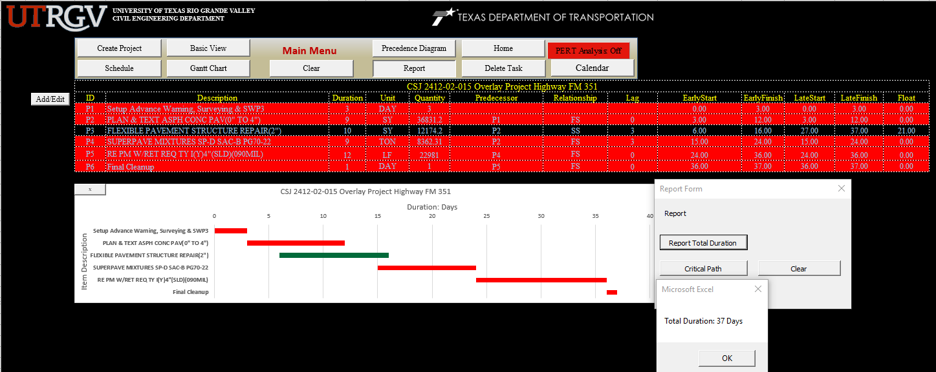
CPM

Slide 21
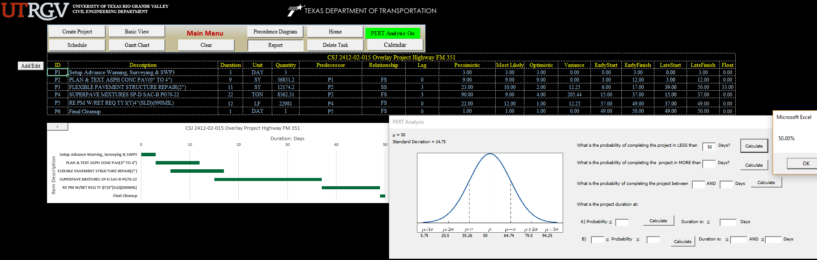
PERT

Slide 22
7.1- Precedence Diagram
7- Work in Progress
Implementation of the Precedence Diagram in order to give the user a comprehensive figure of the project being scheduled.
Each activity will have ES,EF,LS,LF, Duration and relationship with other activities.
Critical Path will be marked in red color.

Slide 23
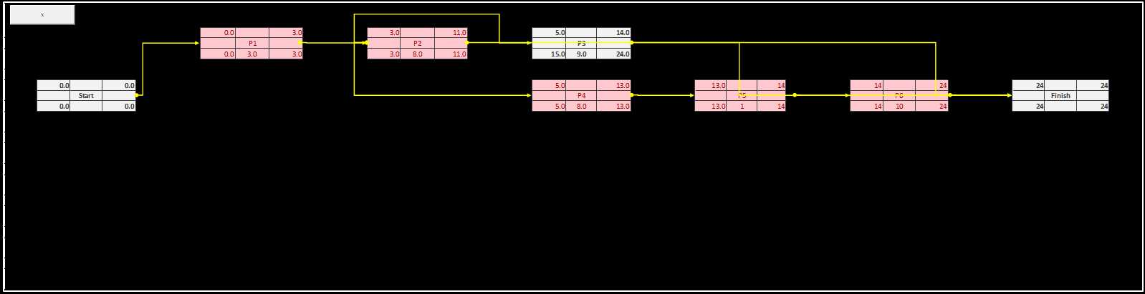
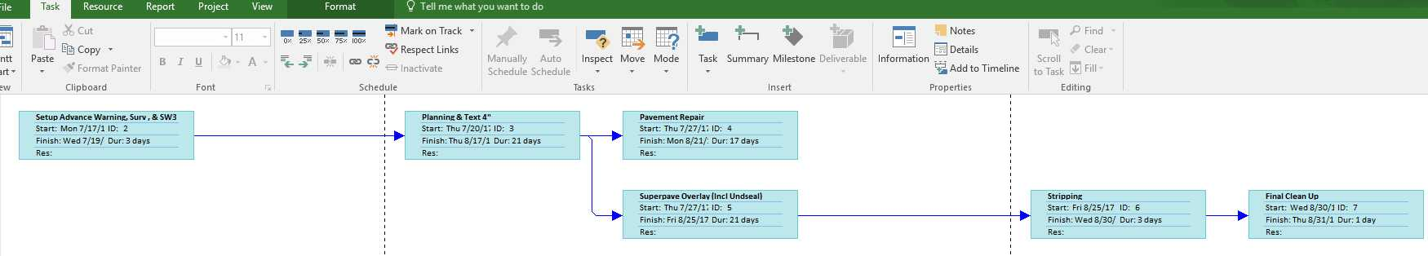
Our software
MS Project (network diagram)

Slide 24
7.2- Calendar
7- Work in Progress
The Calendar will allow the user to set the working schedule manually.
Local and National Holidays will be also implemented as non working days and the user can change that.
The user will set the starting date of the project and the software will calculate the ending date of the project.

Slide 25
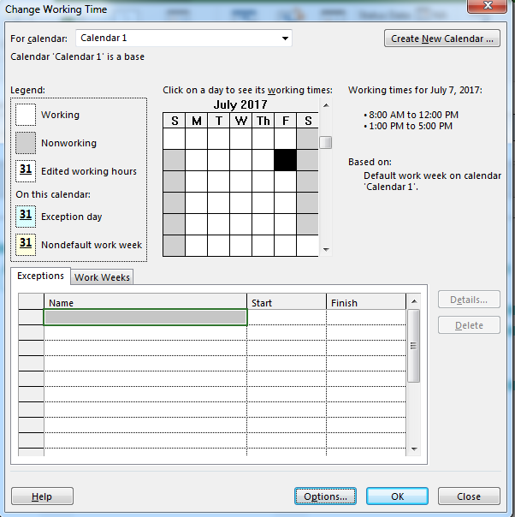
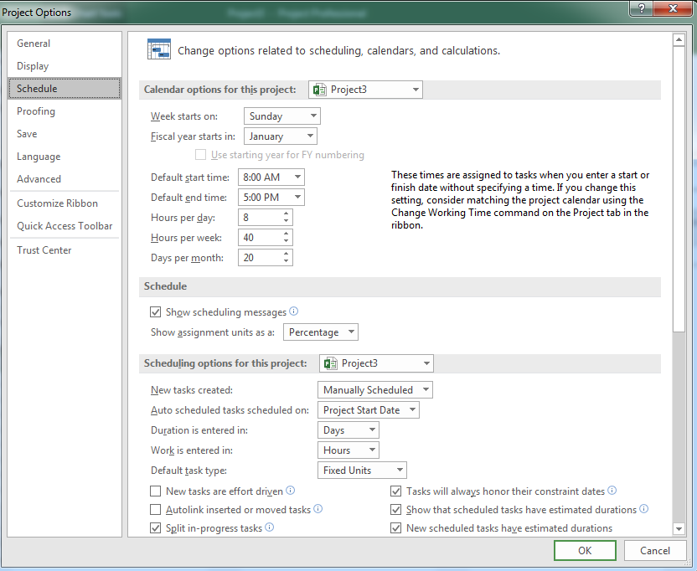
Calendars from MS Project

Slide 26
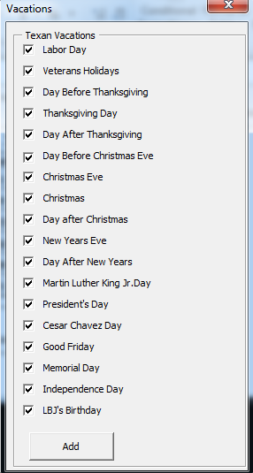
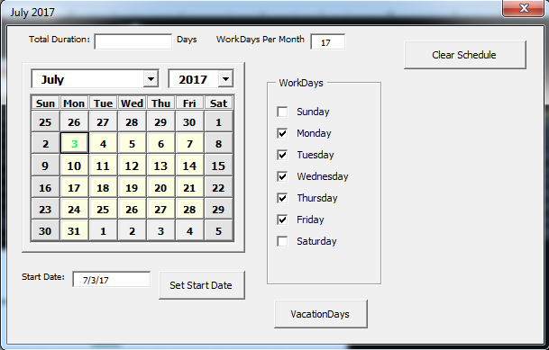
Our software calendar

Slide 27
8- Future Work
Continue testing using Corpus Christi database.
Perfecting the database.
Perfecting Precedence Diagram
Perfecting the implementation of the Calendar.
Implementing Monte Carlo Simulation
Creation and implementation of database for the rest of the districts.

Slide 28
Acknowledgements
I would like to show my gratitude to:
My advisors Dr. Mohamed Abdel-Raheem and Dr. Sophie Wang.
The project manager Darrin Jensen and Anette Trevino for their help in obtaining historical data from the different TxDOT Districts.
Corpus Christi and Pharr districts for their time and attentions given to this research, especially Tomas Trevino, David Chapa and Sergio L. Cantu.

