Slide 1
LOWER LAGUNA MADRE
ESTUARY PROGRAM
GLO CMP Grant (Cycle 21)
Cameron County
UTRGV-Department of Civil Engineering
TAMUK- Institute for Sustainable Energy and the Environment

Slide 2
GLO CMP Grant Objectives
To identify existing pertinent information, locate data gaps, seek other stakeholders (landowners, agricultural organizations, non-profit groups, NGOs, and other local governments), and expand the collaborative team of professionals to enhance the project’s capability to successfully achieve the ultimate goal of establishing a NEP for the LLM:
To promote community resilience.
Examine critical issues prevalent in the region.
Assign a priority.
Provide an economic analysis (cost).
Develop objectives and action items.

Slide 3
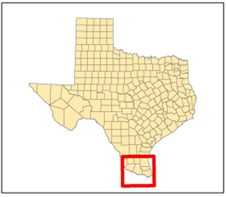
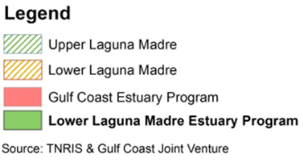
Proposed Estuary Program Map

Slide 4
Scope of the strategic plan
The development of a comprehensive strategic plan targets:
Natural coastal waters.
Multi-use management.
Flood hazard mitigation.
Water quality strategies.
Protection of ecosystems.
Outreach and educational
Economic development.

Slide 5
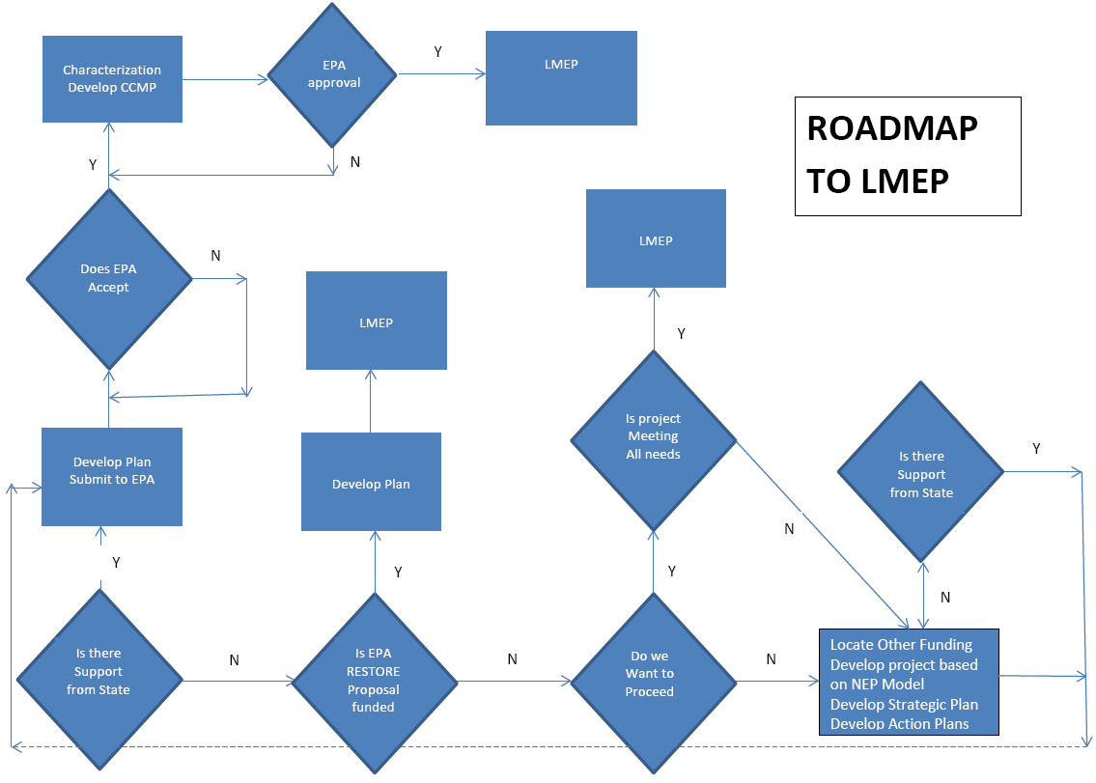

Slide 6
Partners
Cameron County
UTRGV
TAMUK
LRGV TPDES Stormwater task force (17 local governments)
Coastal Cities Taskforce (14 local governments)
Texas General Land Office
EPA
NOAA

Slide 7
Emerging Issues
Sea Level Rise
Loss of Land/Dune Erosion
Extreme Weather Events
Community/Habitat Resiliency
Economic Development

Slide 8
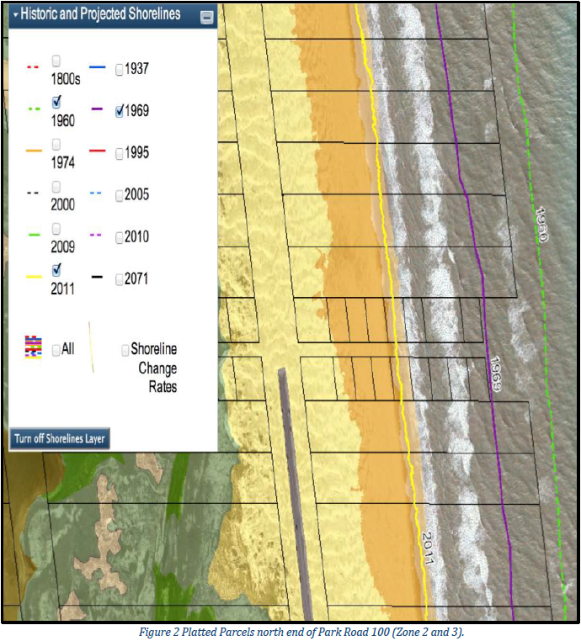
Erosion Response Plan

Slide 9
Participatory Feedback Loop

Slide 10
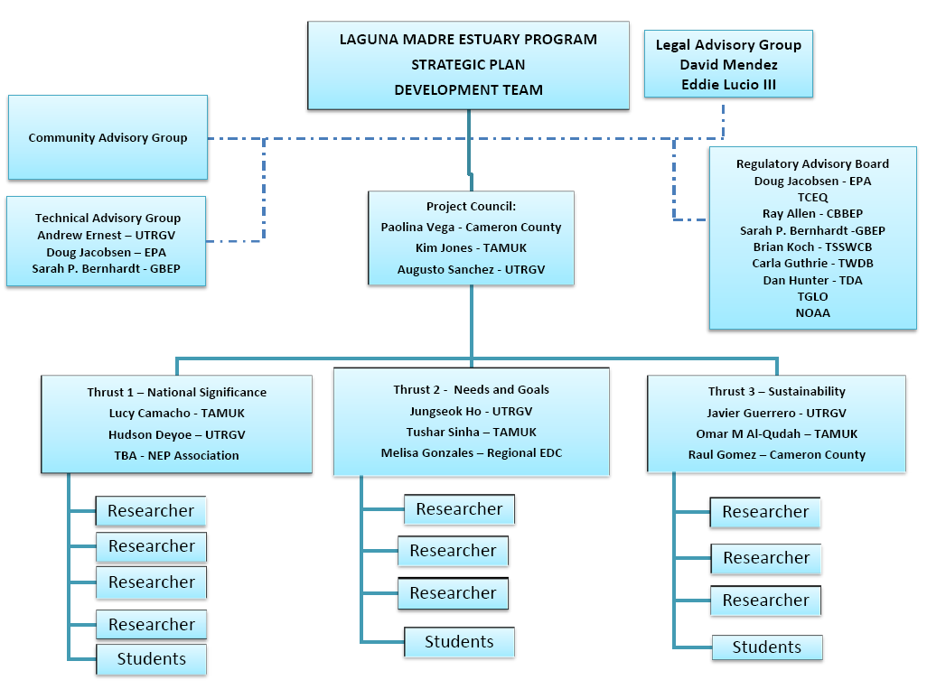
Institutional Structure: Strategic Plan Development Team

Slide 11
Thrust PMs Contact Info
Thrust 1 – “National Significance”
Lucy Camacho, Ph.D. (TAMUK)
Lucy.Camacho@tamuk.ed
Hudson Deyoe Ph.D (UTRGV)
hudson.deyoe@utrgv.edu
Thrust 2 – “Important Needs and Goals of the LLM EP”
Jungseok Ho Ph.D. (UTRGV)
jungseok.ho@utrgv.edu Tushar Singha, Ph.D (TAMUK)
Tushar.Sinha@tamuk.edu
Thrust 3 – “Implementation Planning and Sustainability”
Javier Guerrero M.S., (UTRGV)
javier.guerrero@utrgv.edu
Omar Al-Qudah, Ph.D. (TAMUK)
Omar.Al-Qudah@tamuk.edu
Project Council
Paolina Vega, P.E. (Cameron County)
Paolina.Vega@co.cameron.tx.us
Kim D. Jones, Ph.D., P.E. (TAMUK)
Kim.Jones@tamuk.edu
Augusto Sanchez Gonzalez, M.S.
augusto.sanchezgonzalez@utrgv.edu

Slide 12
Kick-off Workshop – Nov 17 2016 Participants
David Garza (Commissioner Cameron County, Pct. 3)
Christopher Moore (PhD., CDR Associate)
Andrew Ernest (UTRGV)
Adele Cardenas (EPA Region 6)
Hudson Deyoe (UTRGV)
Kim Jones (TAMUK)
Doug Jacobson (EPA Region 6)
Matt Ruszczak (Rio South Texas Economic Council)
Tony Reisinger (Texas Sea Grant)
Stephanie Bilodeau (CBBEP)
Willy Cupit (TPWD)
Brian Koch (TSSWCB)
C. Simpson (TAMUK)
Tim Anderson (USFW)
Jaime Salazar (HCDD#1)
Juan de la Garza (Mission)
Javier Coronado (San Benito)
Erika Rodrigez
Celina Gonzales (Los Fresnos)
Sonia Najera (Texas Nature Conservancy)
Tushar Sinha (TAMUK)
Lucy Camacho (TAMUK)
Omar Al-Qudah (TAMUK)
Christopher Caudle (TCEQ)
Joe Fox (TAMUCC)
Owen Fitzsimmons (CBBEP)
Joe Hinojosa (LRGV SWTF/ SCID#15)
Jungseok Ho (UTRGV)
Rosarro Martinez CBBEP)
George Machuca (San Benito)
Wesley Cant
Cory Horan (TCEQ)
Tom McLemore (HID#1)

Slide 13
Workgroup Series (2017)
January
12th - Mission
20th - San Benito
27th – Raymondville
February
6th - Brownsville
24th – Edinburg
March
10th - Starr County Courthouse
31st - SPI Community Center
April
April 5th- Kingsville
Trust leaders general meeting May 10,
Stormwater Conference 2017
General status update and strategic plan draft presentation

Slide 14
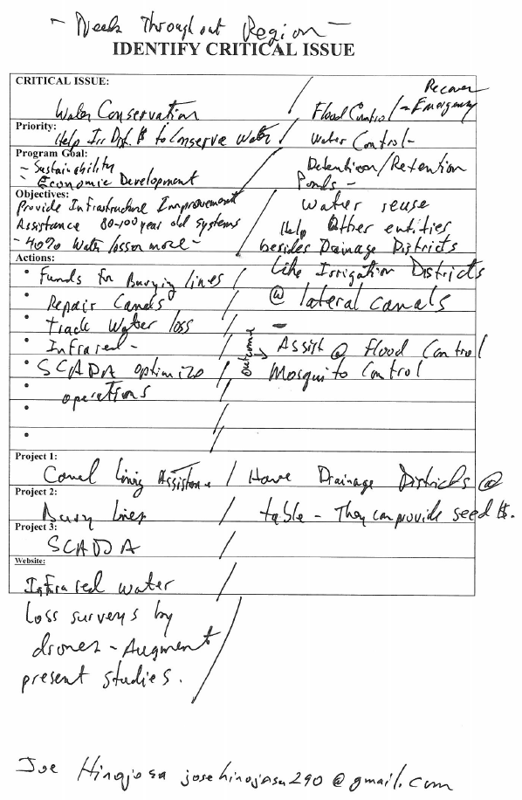
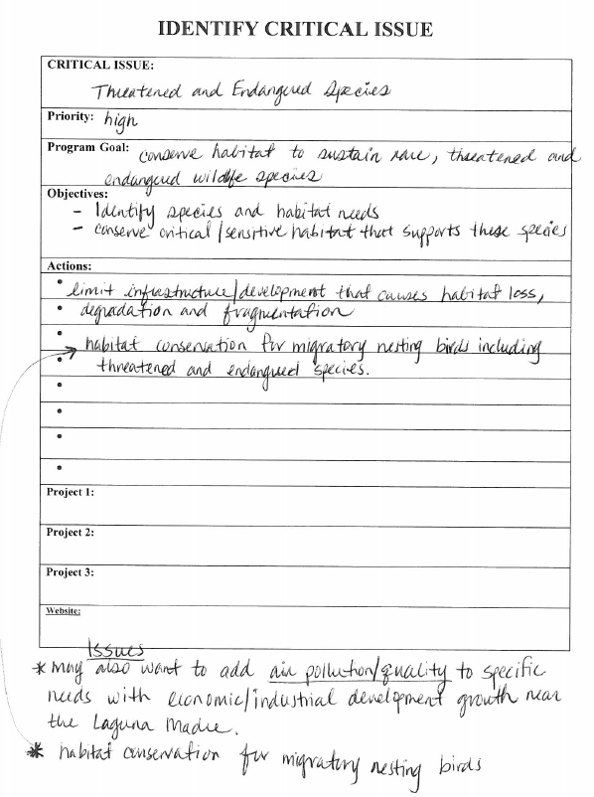
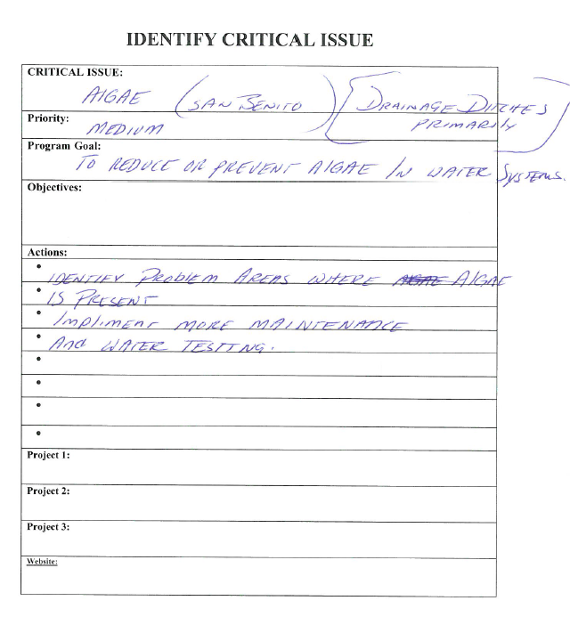
Report Outline

Slide 15
llmep@listserv.utrgv.edu
http://www.lagunamadreestuary.com/

