Slide 1
QUEEN ISABELLA MEMORIAL CAUSEWAY
TxDOT’s Plan Moving Forward

Slide 2
Table of contents
1
Pharr District Facts
4-6
2
QIC Facts
7
3
QIC Bridge Elements
8-26
4
QIC Maintenance History
27
5
QIC Service Life Assessment
28-35
6
QIC 2013 Repairs
36-52
7
2017 Inspection Findings
53-56

Slide 3
Table of contents
8
Fracture Critical Inspection
57-59
9
Reasons for QIC in Good Condition
60-61
10
TxDOT’s Plan Moving Forward
62
Questions
11
63

Slide 4
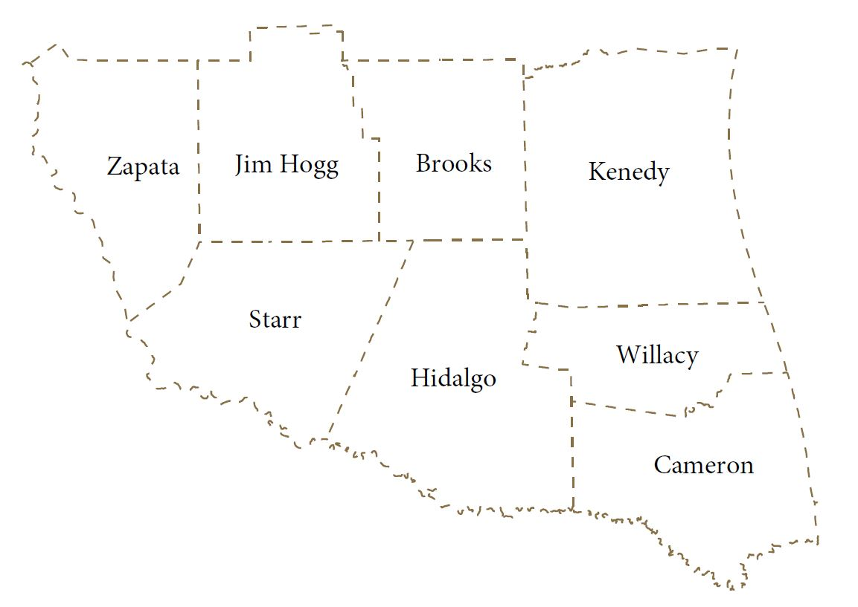
Pharr District Facts
The Pharr District plans, designs, builds, operates, and maintains the state transportation system within its 8 counties. Pharr is a Coastal District with 14 International crossings and serves as a NAFTA corridor. The Pharr District is committed to ensuring the safety of the traveling public.
FY 2017
Population | 1,385,195
Square Miles Area | 8,812
Lane Miles | 6,510 (+102)
Centerline Miles | 2,378
Daily Vehicle Miles | 19,283,619

Slide 5
Pharr District Facts: On-System Bridges
State Bridge Total = 35,489
State Sufficiency Rating = 88%
Pharr District Total = 728
Sufficiency Rating = 92%
On-System inspections occur every two years. These inspections ensure all bridges open to traffic are safe. Reports are developed along with Follow-up Action reports to correct any significant issues to maintain bridge integrity. Currently, none of the Pharr District bridges are load rated. Thanks to ongoing maintenance efforts of our structures.

Slide 6
Pharr District Facts: Off-System Bridges
State Bridge Total = 19,434
State Sufficiency Rating = 82%
Pharr District Total = 355
Sufficiency Rating = 84%
International Bridges = 14
11 Public
3 Private
Off-System bridges are inspected biannually and TxDOT helps by having them inspected for the County and City. There are currently 34 load zoned posted bridges within the Pharr District.

Slide 7
QIC Facts
Connects Port Isabel to South Padre Island
Constructed between 1973 and 1974
2.36 miles long and 67.75’ wide (2 – 12’ lanes with inside and outside shoulders)
150 Pre-stressed Type 54 Concrete Beam Unit Spans (80’)
1 – 750’ Variable Depth Plate Girder three span continuous unit
(220’ – 310’ – 220’)
78’ Vertical clearance and 200’ horizontal clearance over Inter Coastal Waterway
2001 Vessel Impact – 320’ of Bridge removed and replaced
Cathodic Protection placed on sub-structure elements ~ 2011

Slide 8
Bridge Elements

Slide 9
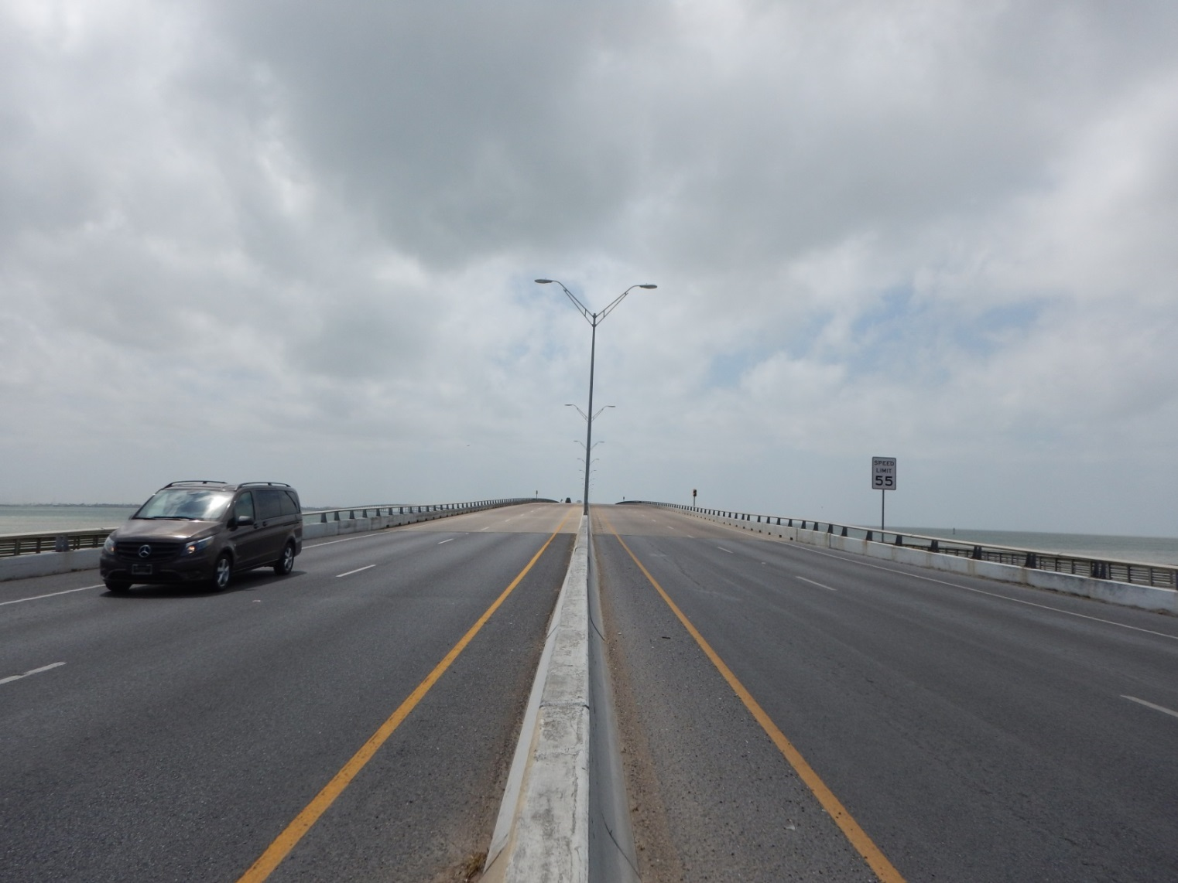
Bridge Elements
Roadway Approach South Padre Island Side

Slide 10
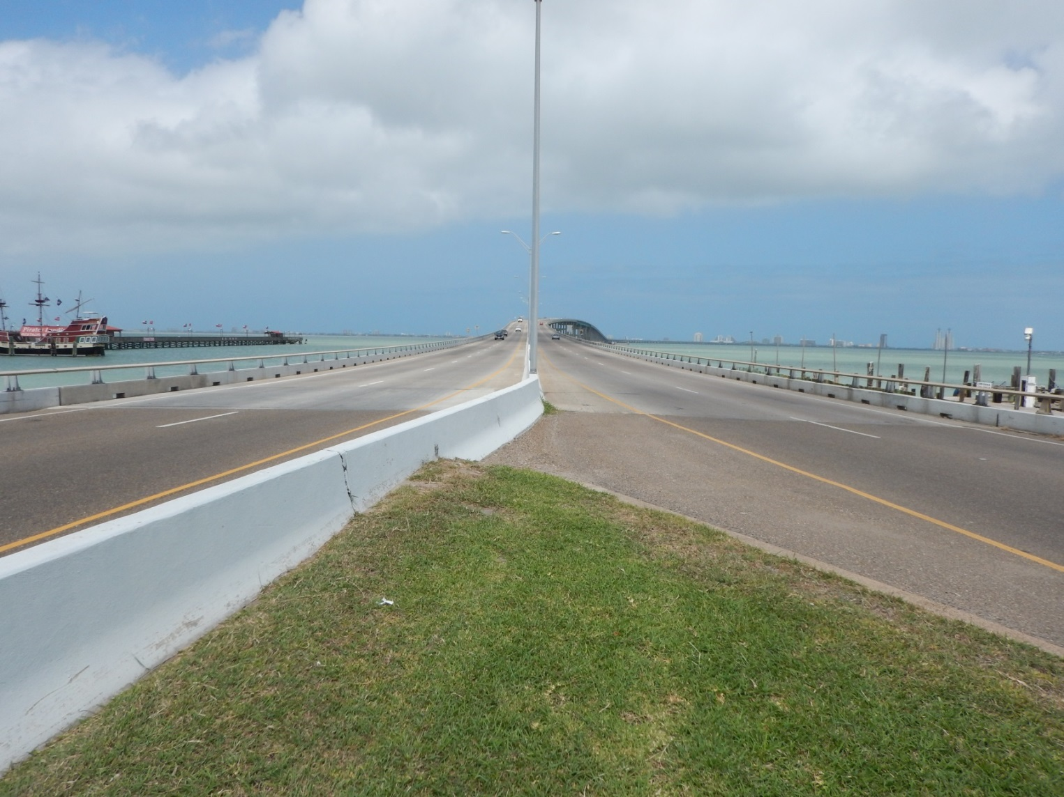
Bridge Elements
Roadway Approach Port Isabel Side

Slide 11
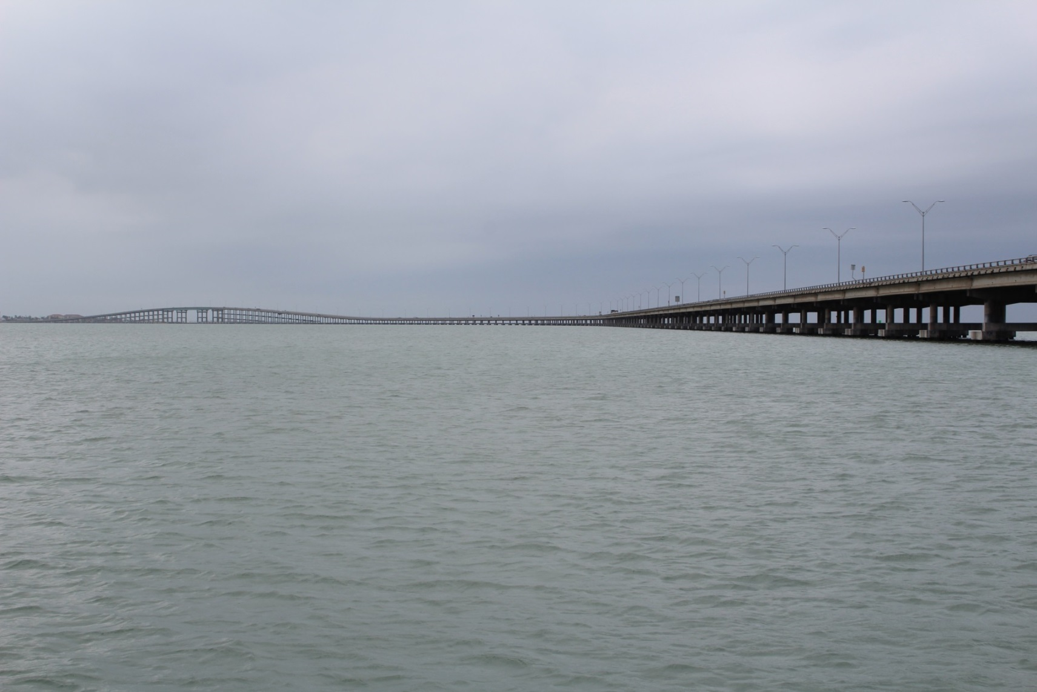
Bridge Elements
Side View

Slide 12
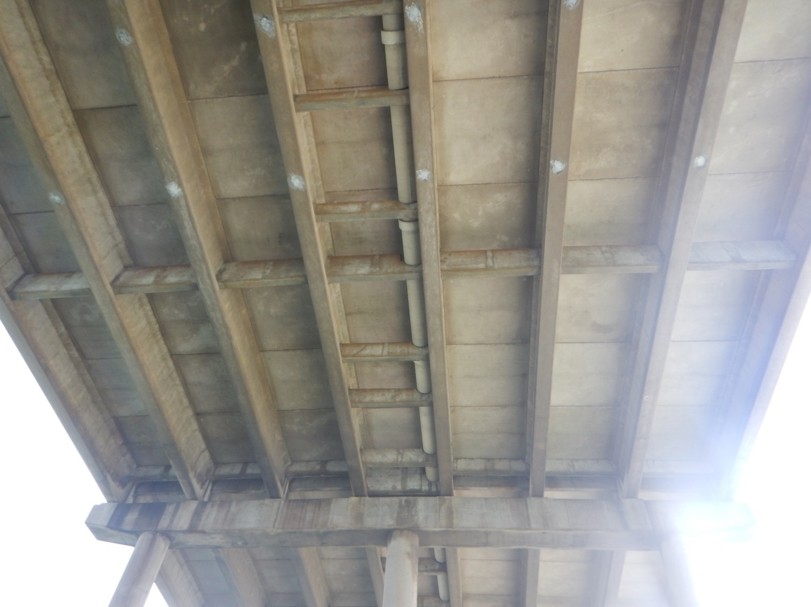
Bridge Elements
Type 54 Girders w/ Internal Concrete Diaphragm

Slide 13
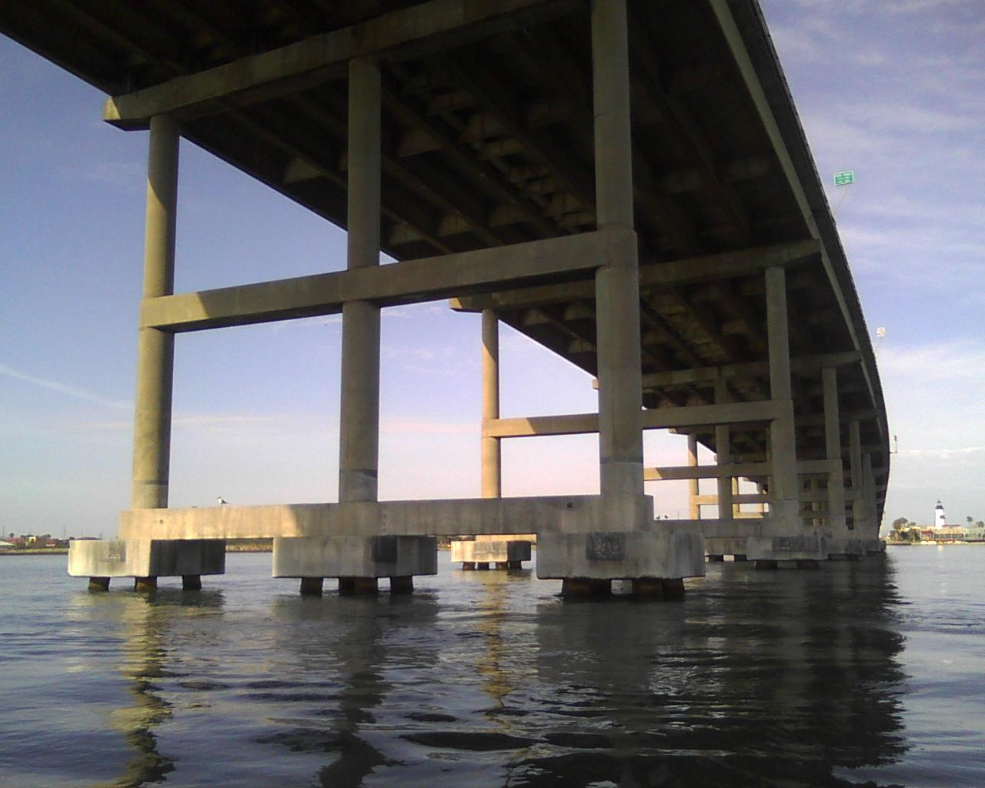
Multi-Column Bent

Slide 14
Bridge Elements
Lower Tie Beam

Slide 15
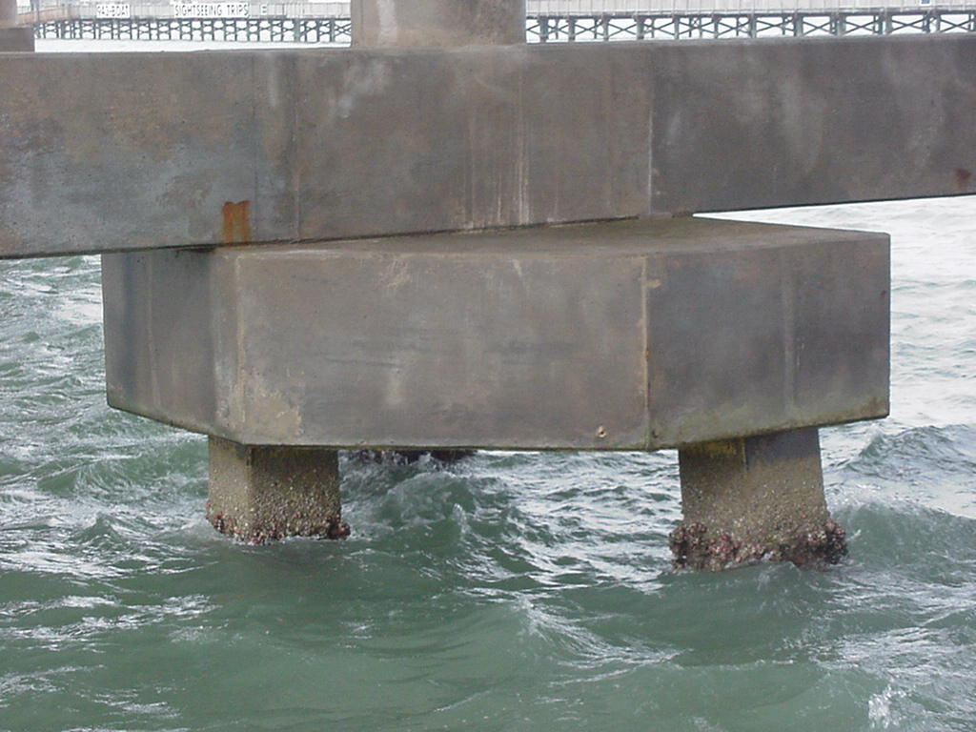
Bridge Elements
Pile Cap Footings

Slide 16
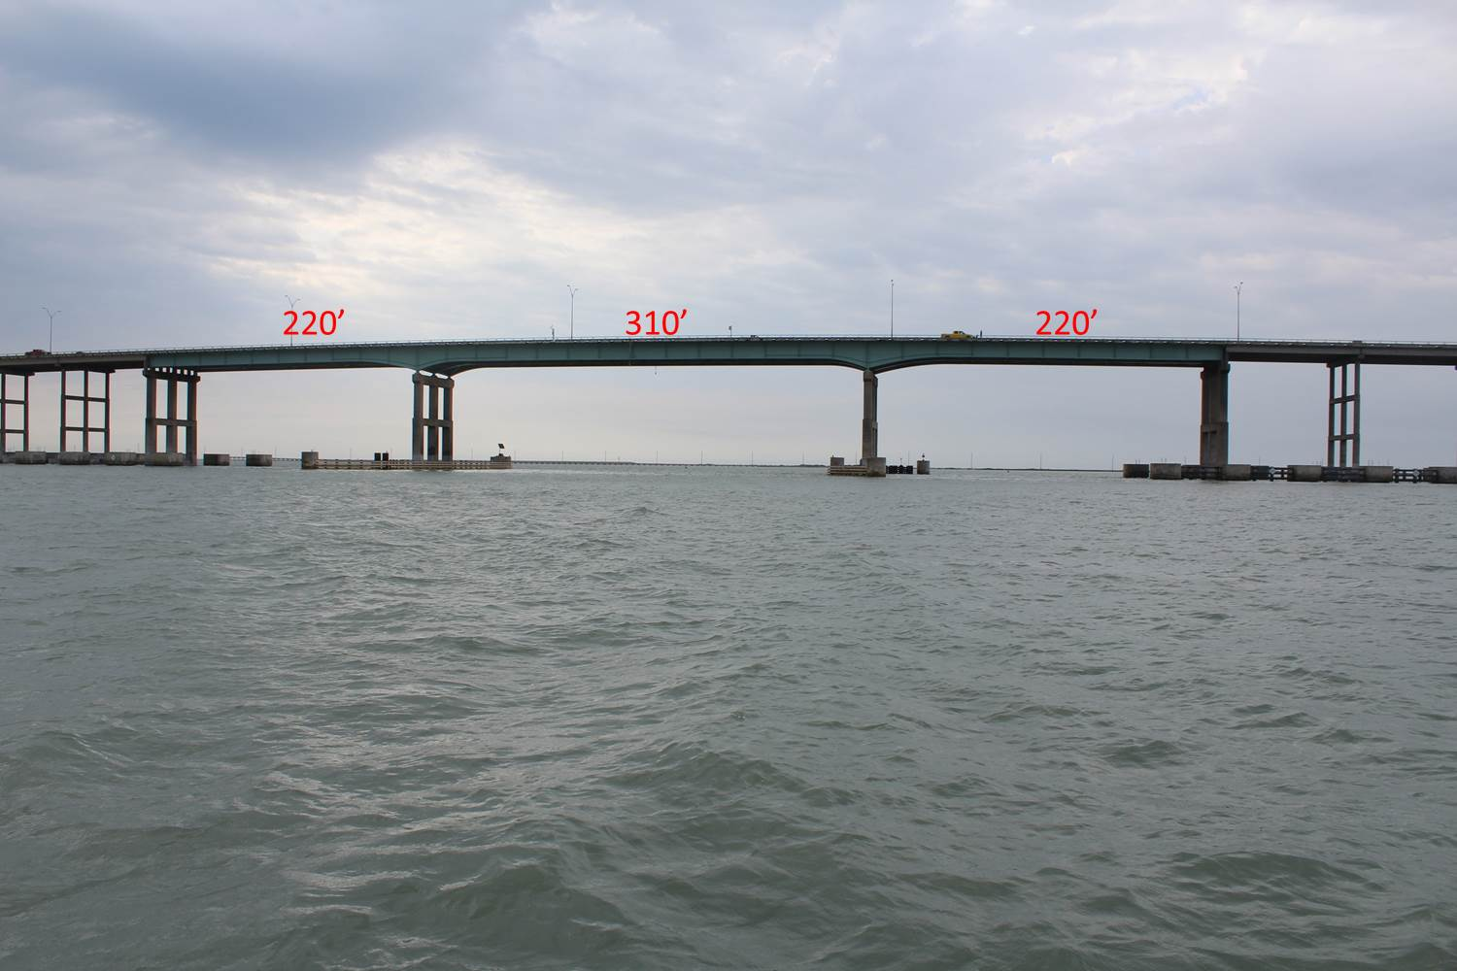
Bridge Elements
750’ Variable Depth Steel Girder – 3 Girders

Slide 17
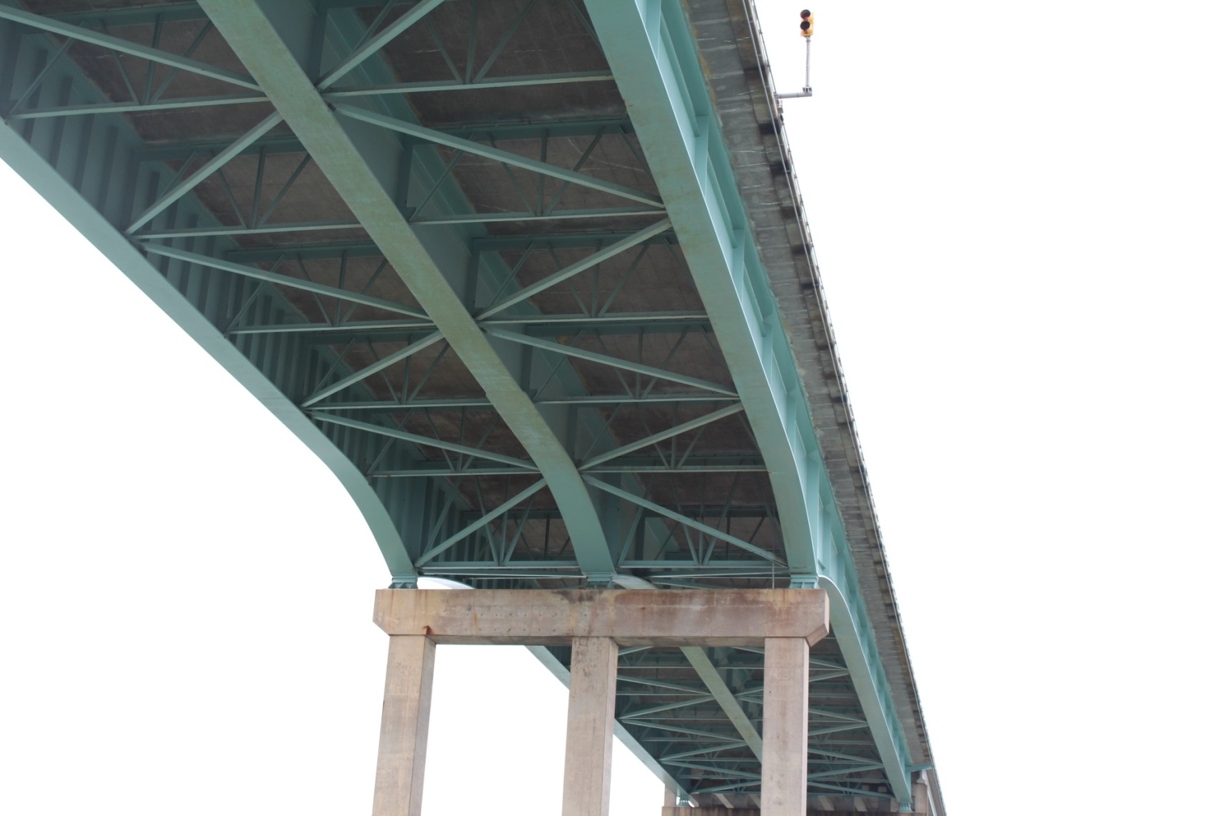
Bridge Elements
Steel Girder with Internal Diaphragms

Slide 18
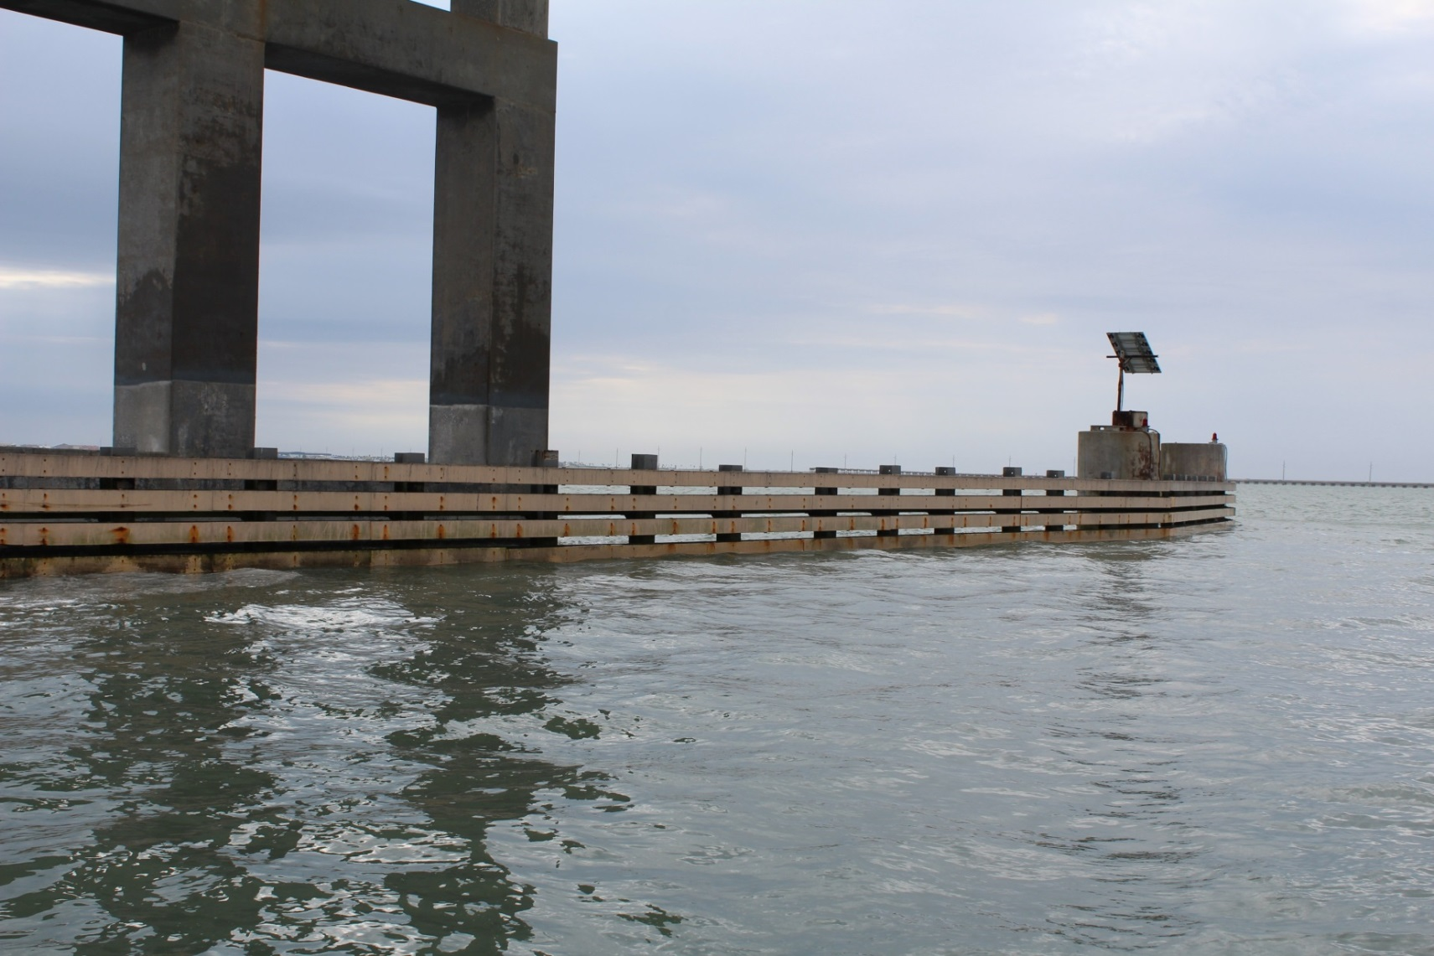
Bridge Elements
Fender System

Slide 19
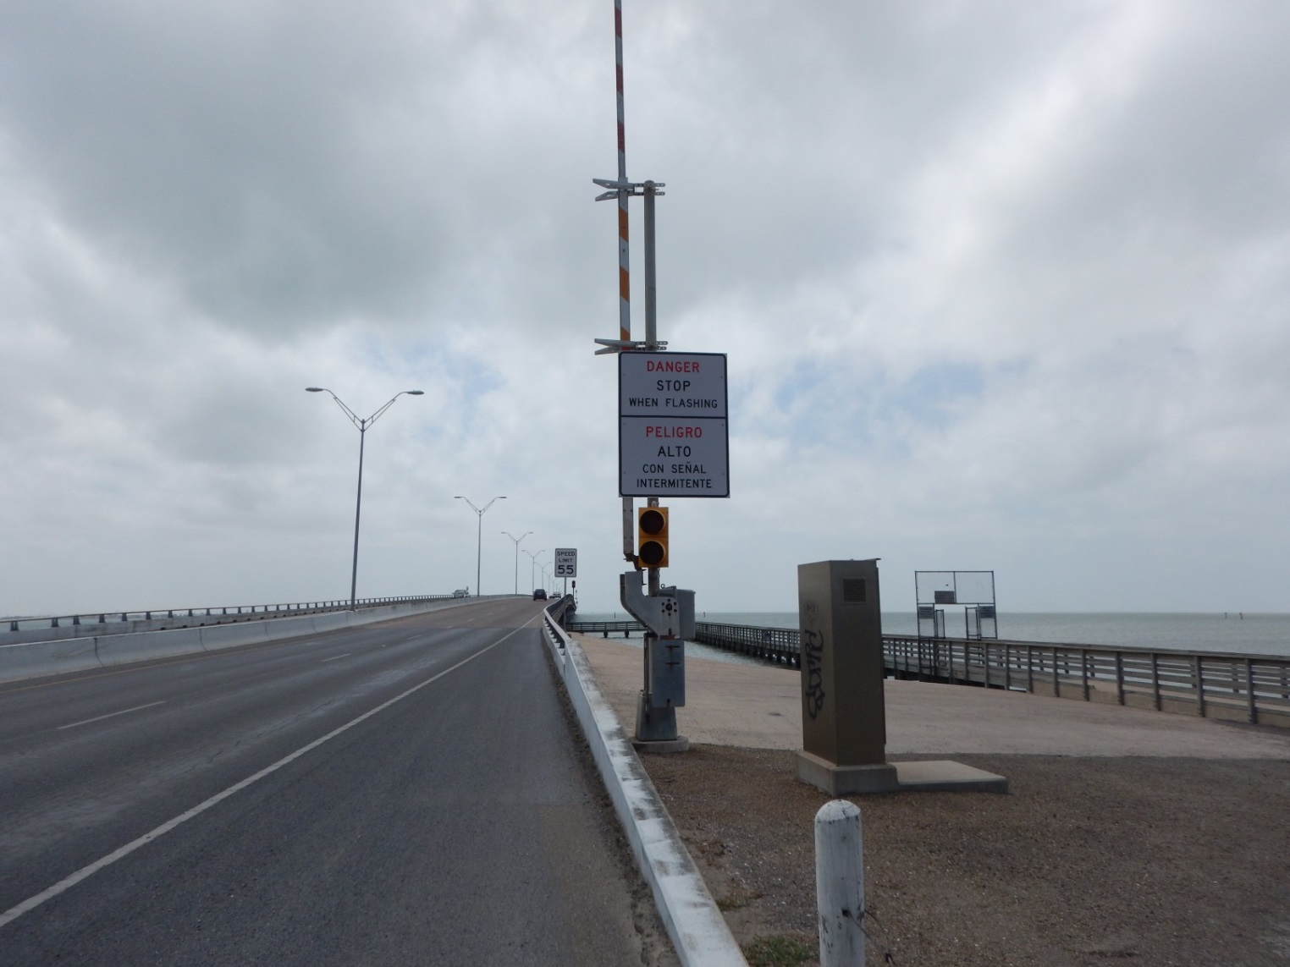
Bridge Elements
Early Warning Collapse Detention

Slide 20
Bridge Elements
Early Warning Collapse Detention

Slide 21
Bridge Elements
Early Warning Collapse Detention

Slide 22
Bridge Elements
Early Warning Collapse Detention

Slide 23
Bridge Elements
Cathodic Protection showing damaged conduit and instrumentation

Slide 24
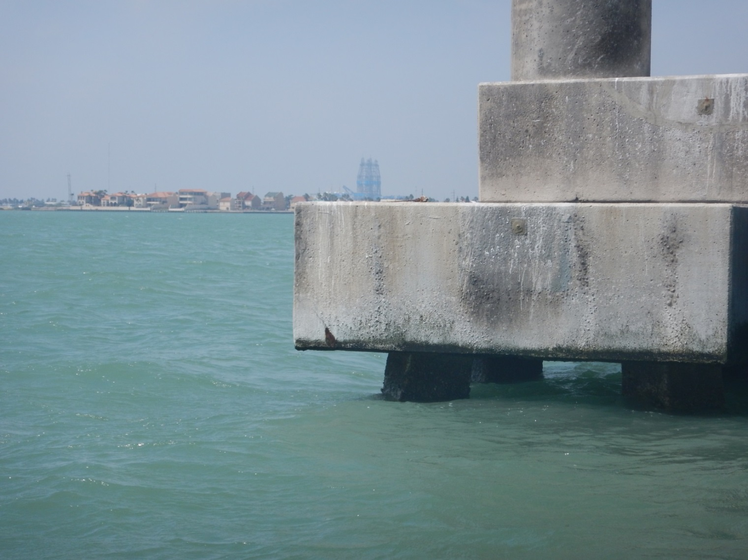
Bridge Elements
Cathodic Protection

Slide 25
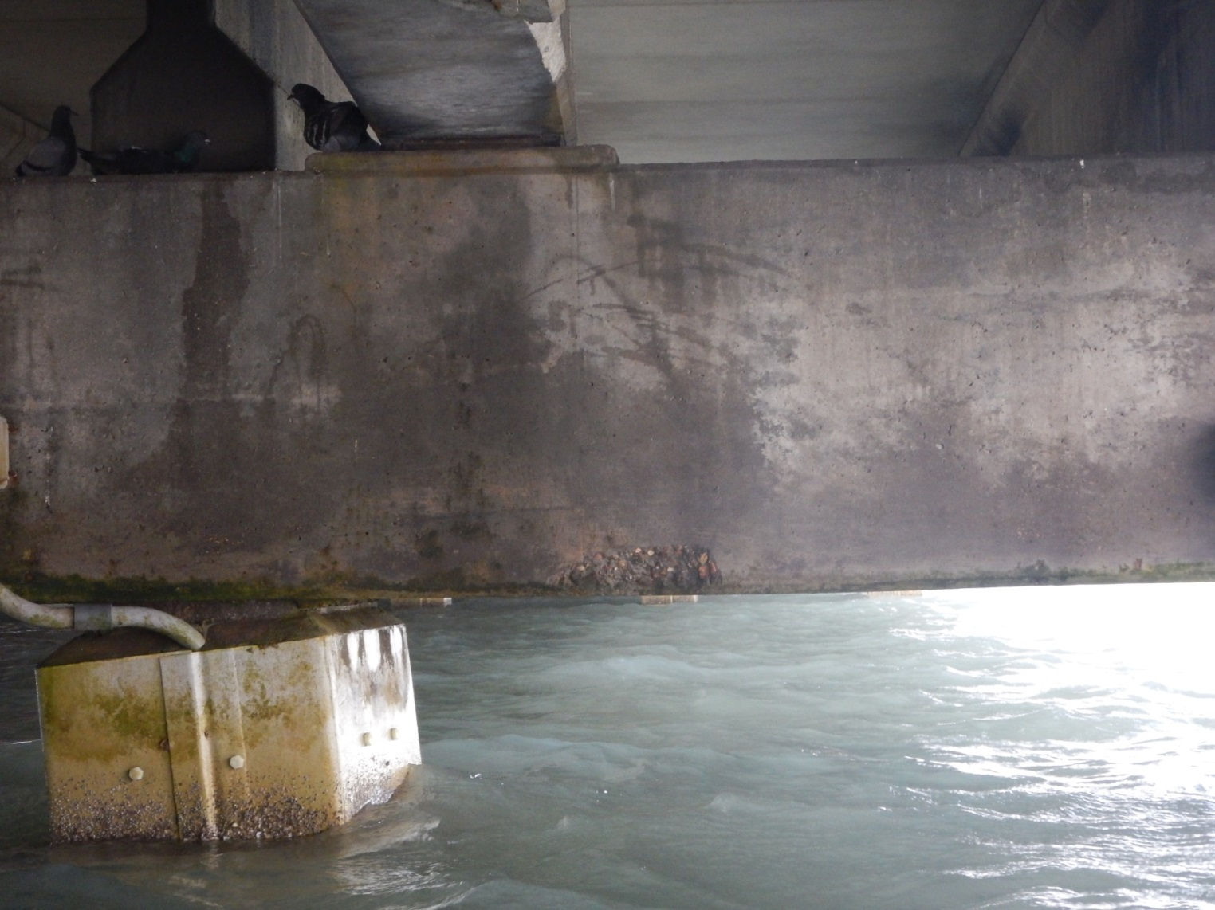
Bridge Elements
Pile Jacket

Slide 26
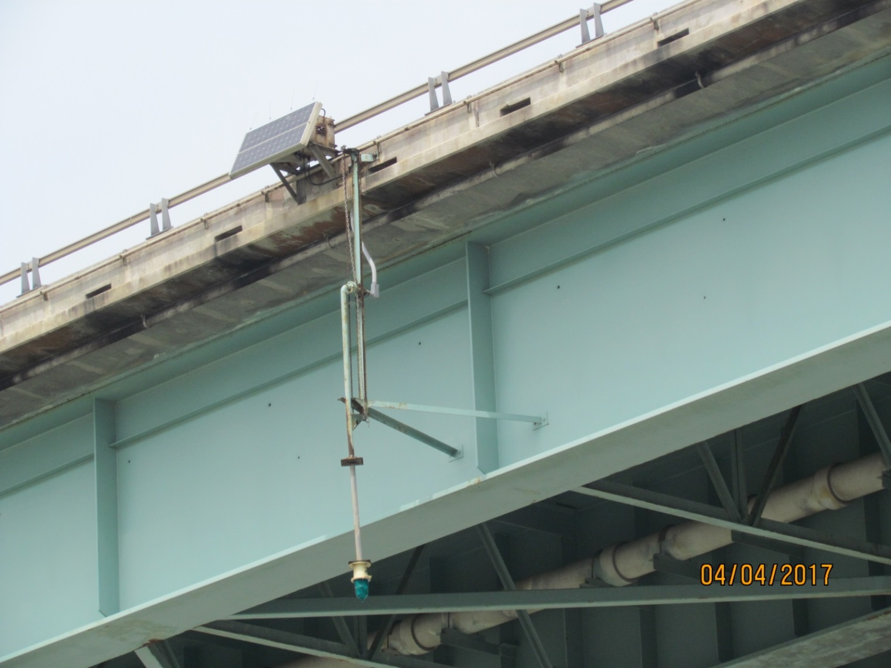
Bridge Elements
Navigation Lights

Slide 27
QIC Maintenance History
FY | PROJECT DESCRIPTION | PROJECT COST
1997 | CATHODIC PROTECTION (BENT 19-24) | $478,000.00
1997 | REHAB/PAINT MAIN SPAN | $618,601.71
2001 | EMERGENCY REPAIRS (SPAN 29-33) | $5,918,012.88
2003 | CATHODIC PROTECTION | $3,117,394.00
 |  | $445,000.00
2003 | EARLY WARNING DETECTION | $842,861.00
2003 | PIER PROTECTION & FENDER SYSTEM | $3,262,255.00
 |  | $2,602,800.00
2003 | PIER PROTECTION & FENDER SYSTEM | $6,589,207.38
2004 | CATHODIC PROTECTION | $1,296,103.06
2007 | DOLPHIN & FENDER REPAIRS | $1,084,750.00
2009 | REPAIRS TO DECK SPAN #3 | $55,482.80
2010 | REHAB/PAINT MAIN SPAN/CATH PROTECTION | $3,940,365.06
2010 | REPLACE ILLUMINATION POLES/FIXT | $410,856.68
2010 | DOLPHIN & FENDER REPAIRS | $13,336.27
2011 | DOLPHIN & FENDER REPAIRS | $17,001.25
2012 | DOLPHIN & FENDER REPAIRS | $263,909.00
2013 | STRUCTURE REPAIRS, RAIL RETROFIT, SILANE | $2,811,843.96
 | TREATMENT, BEAM END REPAIR
 | PROJECTED TOTAL | $33,767,780.05

Slide 28
QIC Service Life Assessment
Condition and Service Life Assessment (08/2009)
Based on the assessment findings, the Causeway is in good condition considering its age and service environment.

Slide 29
QIC Service Life Assessment
Strategies For Extending the Life of the Structure:
Not employing any significant remediation efforts and only continuing with “routine” maintenance.
Employing both remediation and routine maintenance efforts to optimize the service life relative to cost.
Employing comprehensive remediation efforts to extend the service life of the beams and lower substructure elements to approximately that of the other elements.
Present estimated cost for QIC Replacement is ~ $ 125 M. (2009)
Service Life – bridge able to satisfy state legal load of 80,000 pounds. TxDOT’s goal is to avoid load posting of bridge.
No significant maintenance remedies performed for the first 20 years (1974 to 1995).

Slide 30
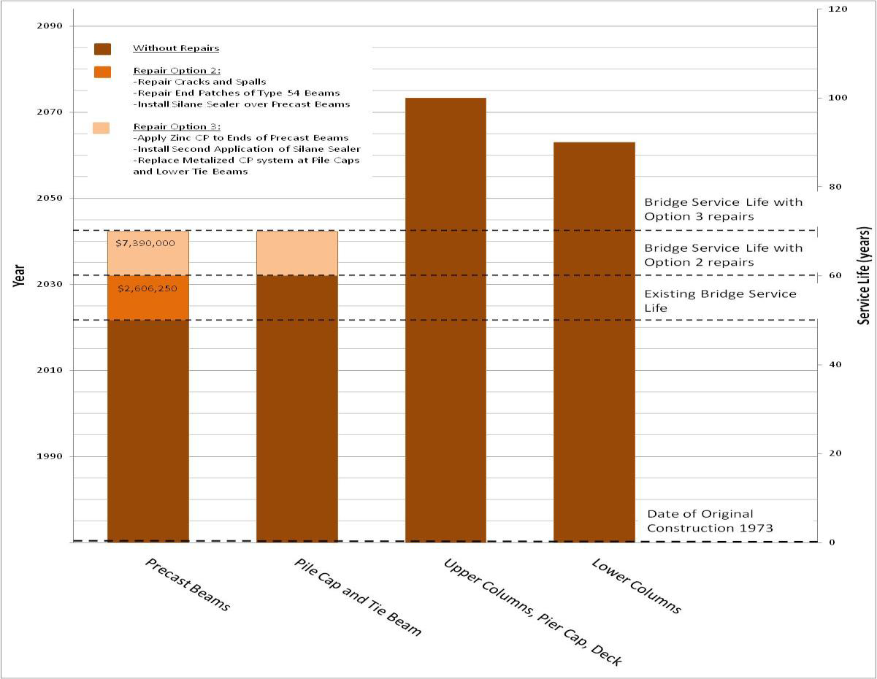
QIC Service Life Assessment

Slide 31
Option 1
Entails only normal maintenance efforts. Pre-stressed beams are the controlling element to yield a service life up to 2023. Total cost for this work is estimate at $6.9M.
Repair and paint steel girders ($4,500,000)
Repair non-functioning CP systems and broken appurtenances ($7,500)
Mill and replace seal coat at Steel Girder Spans 34 through 37 ($20,000)
Replace deteriorated anchor bolts and guard rails with a T-4 three-bolt railing system ($627,500)
Remove and replace deteriorated light standards ($680,000)
Install additional anode connections for thermally sprayed metalized coating at each pile cap ($22,500)
Coat all new and existing exposed anode connections for the thermally sprayed metalized coating with epoxy ($25,500)
Repair and paint exposed end connections for lateral tie roads ($117,000)
Completed VA BPM: 6207-63-00 and CSJ 0331-04-065 (2010 to 2013)

Slide 32
Option 2
Includes all items captured in Option 1 and extends the service life an additional 10 to 15 years (2033). Again the pre-stressed beams are the controlling element. This includes the repair and repainting of the steel unit. This will be the fourth repainting effort (1983, 1995, 2010, 2020+ TBD). Total cost for this work is estimated at $14M.
Perform all items in Option 1 ($6,946,600) COMPLETED
Repair all existing spalls and major cracks elements utilizing conventional repair techniques ($1,203,750)
Repair end patches at all Type 54 beams ($600,000)
Apply a single application of a penetrating silane sealer to all exposed surfaces of the Type 54 beams and diaphragms ($802,500)
Repair blistered/delaminated areas of aluminum metalizing ($28,000)
Completed above work VIA CSJ 0331-04-065 (2010-2013)

Slide 33
Option 3
Includes all items captured in Option 1 and 2 with additional remediation efforts for the beams and the existing cathodic protection system on the lower substructure to yield a service life up to 40 years (2043). Again the pre-stressed beams are the controlling element. Total cost for this work is estimated at $ 21.5 M.
Perform all items in Option 1 and 2, except as noted below, within a one or two year time period ($14,079,850) - COMPLETED
Apply CP system (zinc alloy thermal spray) to all Type 54 beams at ends, sides, and soffits (bottoms) for a distance of 3 feet from each end in approximately six to eight years following the first silane application ($2,000,000)
Apply second application of a penetrating silane sealer to beam and diaphragm surfaces without CP at same time CP system is applied ($802,500)
Replace zinc and aluminum alloy CP systems at lower substructure elements with new zinc alloy CP system at the same time CP system is applied to beams and pile caps ($4,587,500)

Slide 34
Life Assessment Summary
The three options presented provides TxDOT a pathway for the QIC to systematically achieve an estimated service life of an additional 70 years (1973 to 2043).
Controlling bridge elements are the pre-stressed beam and substructure elements.
The QIC is in good condition considering its age and service environment.

Slide 35
Things to Consider
TxDOT has committed to Option 3 to sustain serviceability to year 2043 and beyond.
Steel unit will receive its fourth paint system and a closer investigation with respect to nominal thicknesses need to be evaluated beyond further painting systems.
Re-application of the cathodic protection will need to be done but further investigation needs to be considered for the concrete beams.
A Life Cycle Cost will need to be performed beyond 2043 to evaluate a replacement benefit cost ratio. For now, it makes sense to maintain the QIC.
Routine Maintenance efforts are still required to sustain predicted service life estimate. Routine Maintenance efforts planned in FY 19 ~ $ 750 K.
Pharr District has understood the need for routine maintenance efforts and to address the right treatment at the right time before the treatment scope turns into replacement efforts. TxDOT’s maintenance efforts are reflective in the Service Life Assessment performed in 2009. The report serves as a guide for the QIC to reach and possibly exceed the estimated service life beyond in 2043.

Slide 36
QIC 2013 Repairs

Slide 37
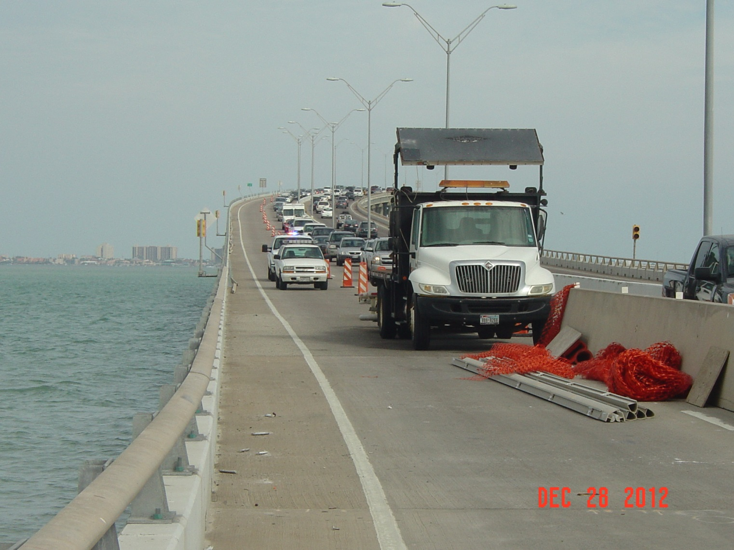
QIC 2013 Repairs
Traffic Control

Slide 38
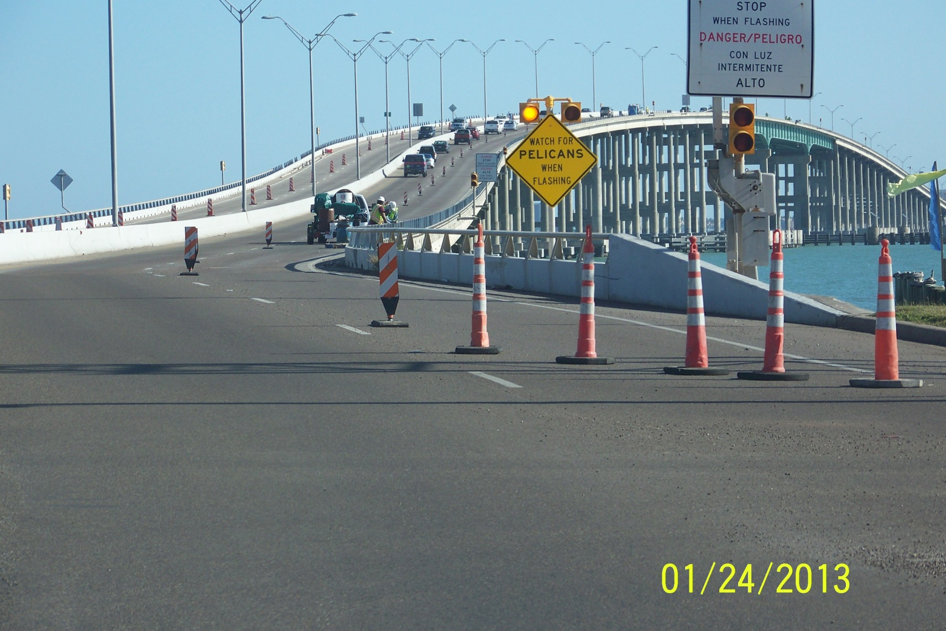
QIC 2013 Repairs
Traffic Control

Slide 39
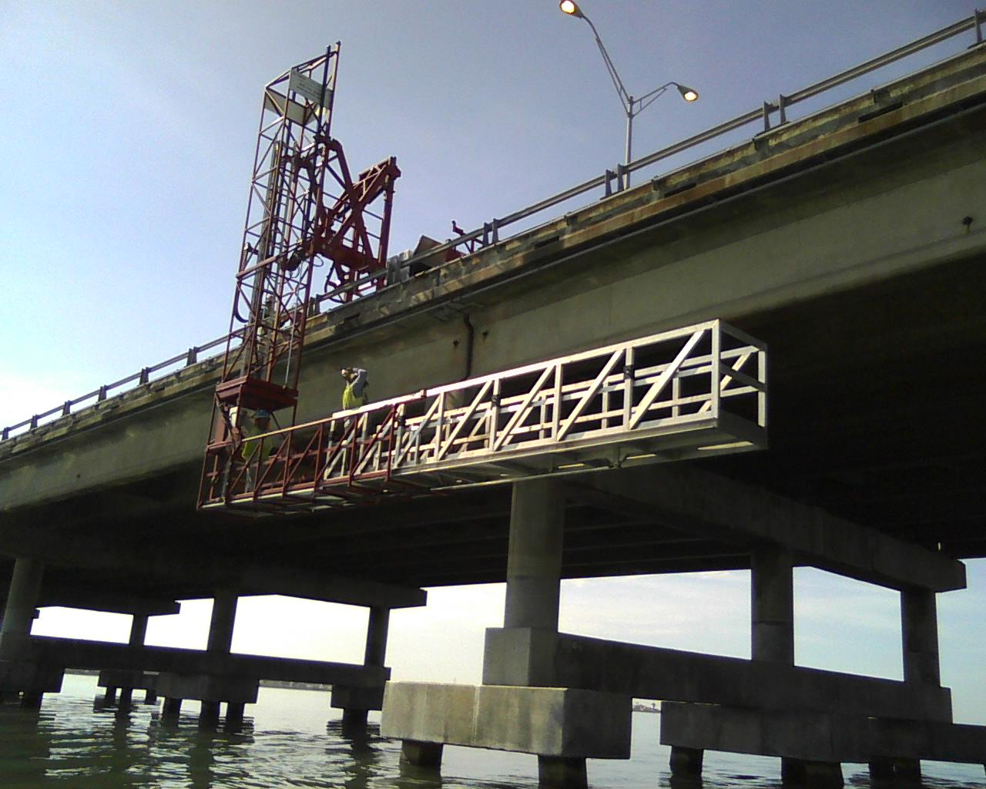
QIC 2013 Repairs
Contractor using a movable working platform

Slide 40
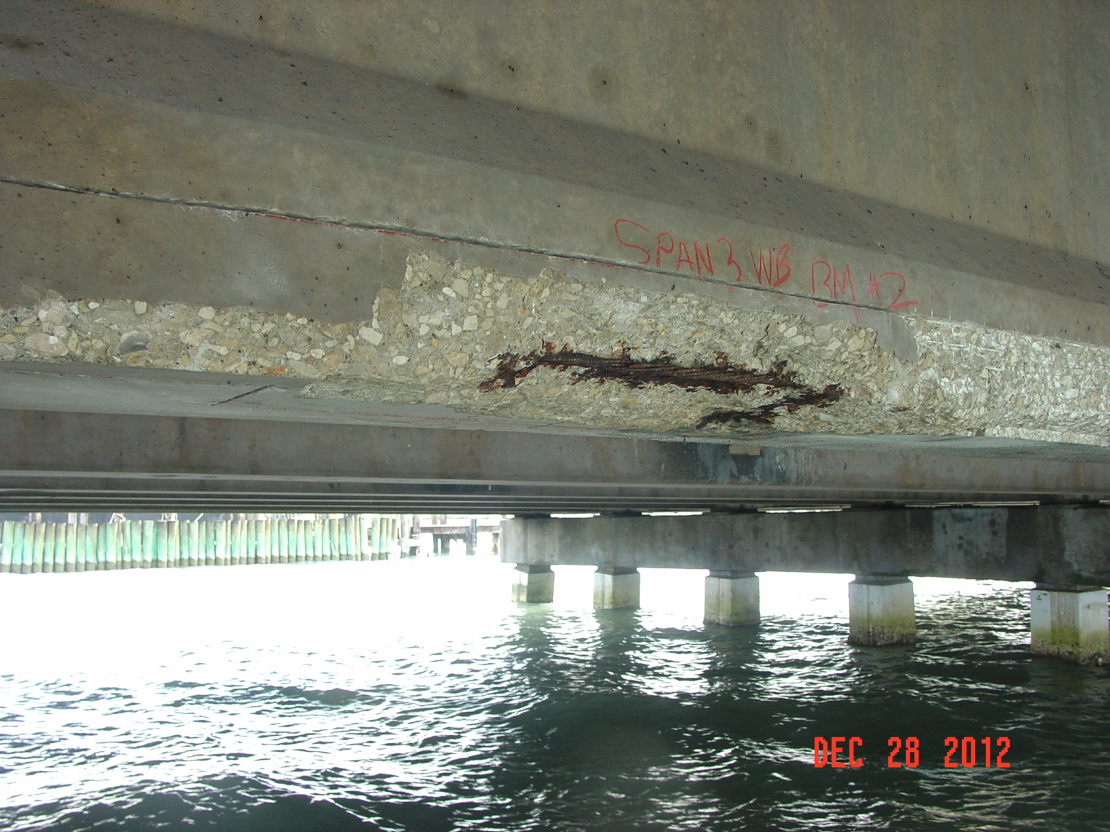
QIC 2013 Repairs
Exposed Pre-Stressed Strand – Corrosion Propagating

Slide 41
QIC 2013 Repairs
Completed Concrete Structure Repairs (Beam)

Slide 42
QIC 2013 Repairs
Span #1 WB Underside Bridge Deck Spalled concrete with exposed reinforcement.

Slide 43
QIC 2013 Repairs
Armor Joint Plate - Deformation

Slide 44
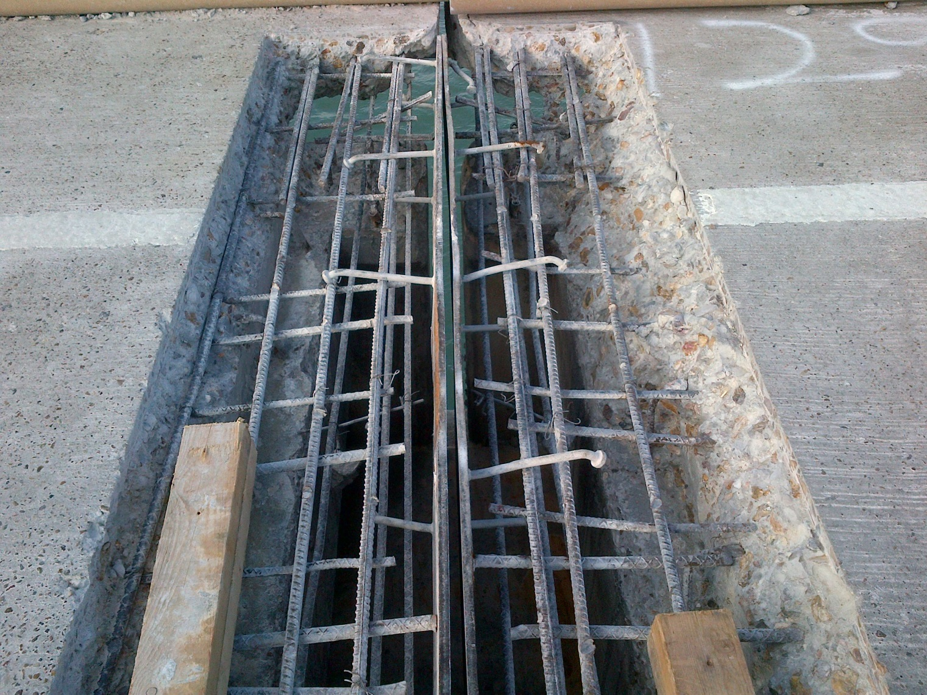
QIC 2013 Repairs
Armor Joint Repair – removal and replacement of armor joint

Slide 45
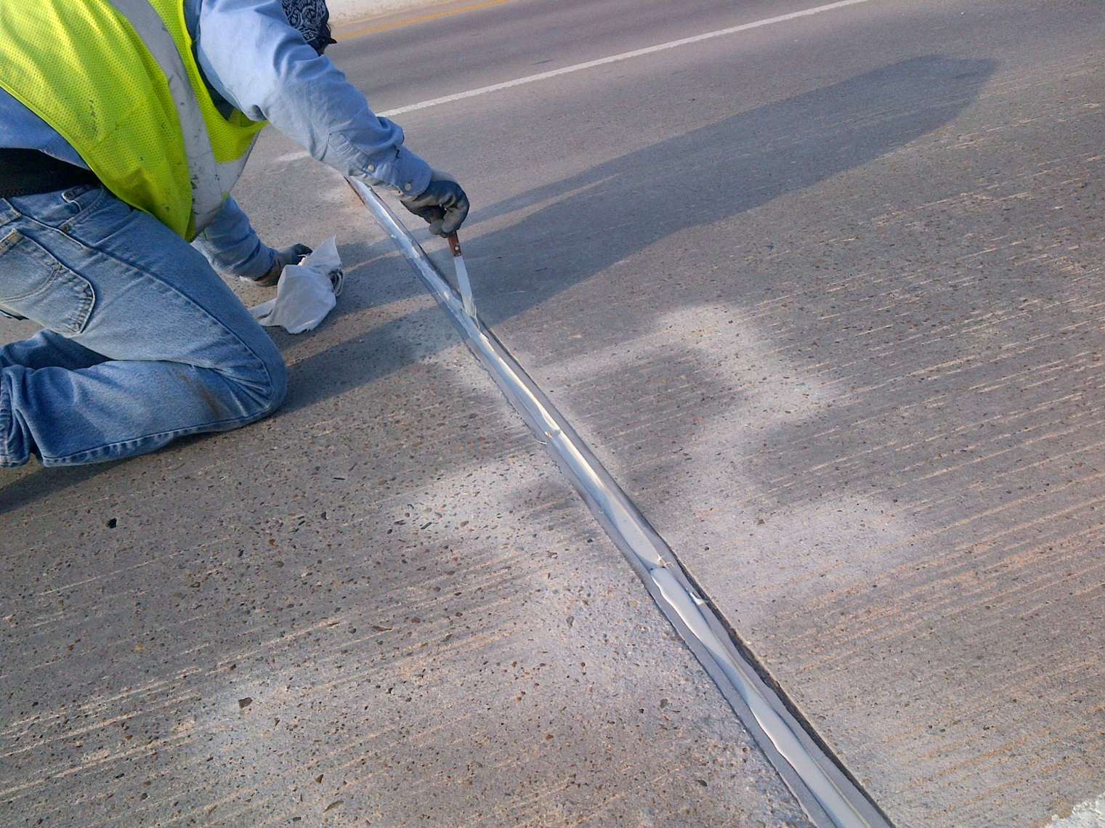
QIC 2013 Repairs
Armor Joint – silicone sealant applied at join opening

Slide 46
QIC 2013 Repairs
Beam End at Various Locations Deteriorated epoxy coating and exposed/corroded strands.

Slide 47
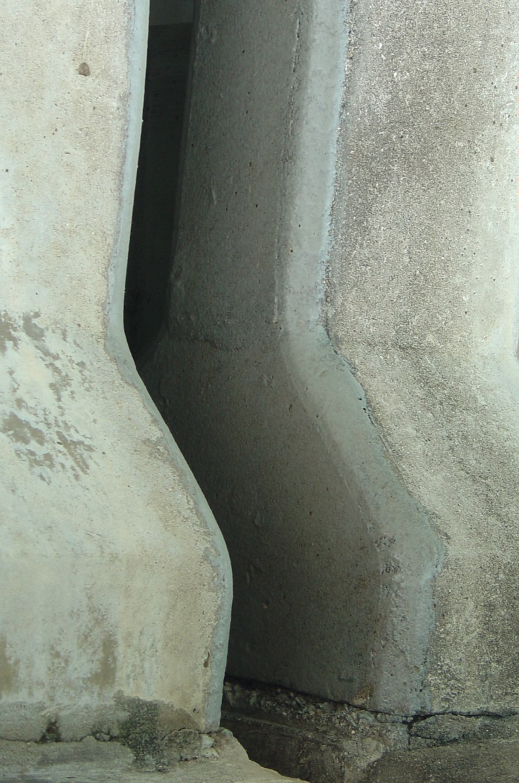
QIC 2013 Repairs
Beam ends w/ Epoxy Coating

Slide 48
QIC 2013 Repairs
Existing Rail Connection ‐ Typical Existing anchor bolts and hardware severely corroded.

Slide 49
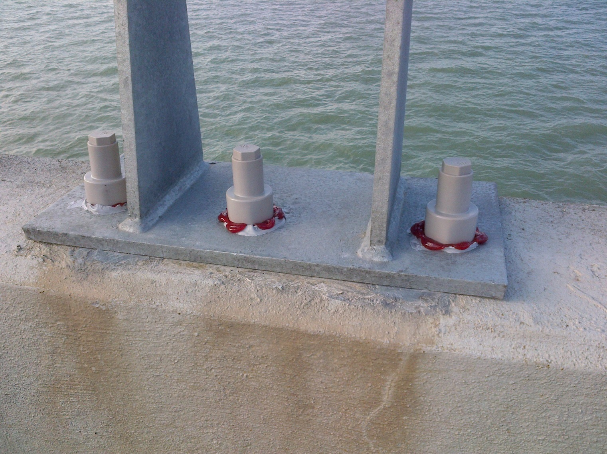
QIC 2013 Repairs
Completed bridge rail retrofit with SAP seal covers

Slide 50
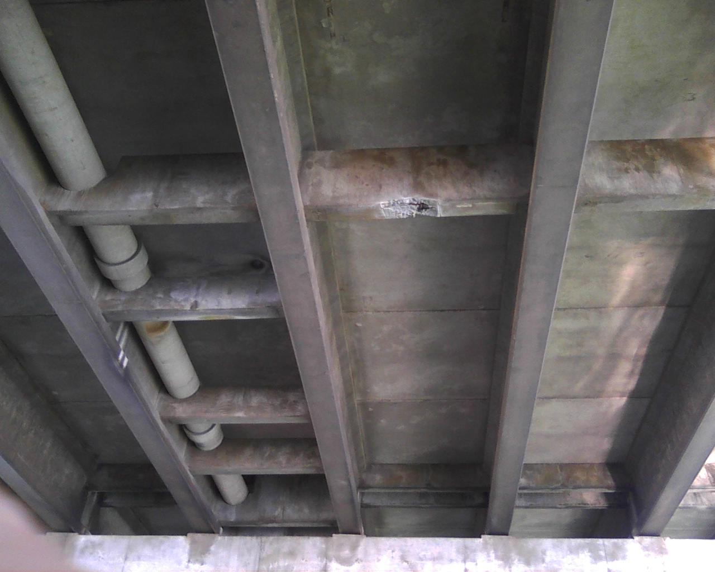
QIC 2013 Repairs
Existing concrete space at concrete diaphragm

Slide 51
QIC 2013 Repairs
Completed Concrete Structure Repairs (Diaphrams)

Slide 52
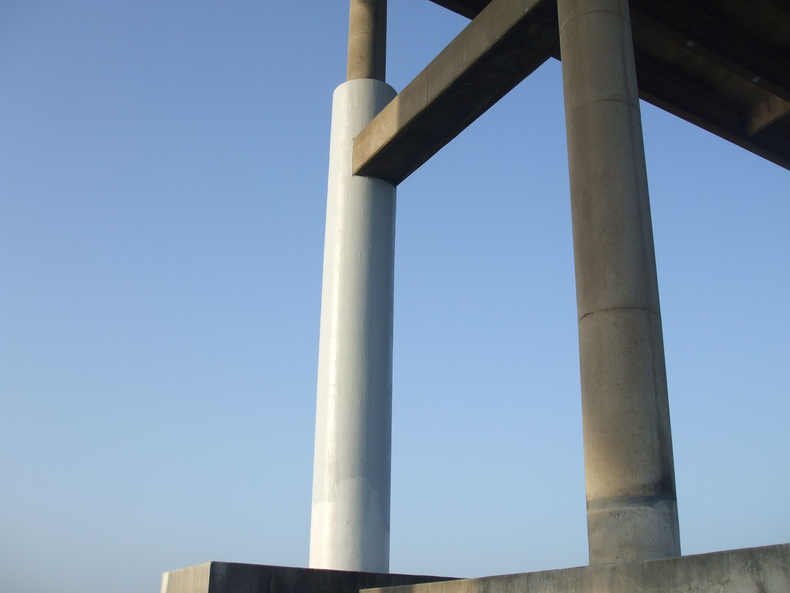
QIC 2013 Repairs
Colum Fiber Wrap – Bent #26 due to excessive cracking

Slide 53
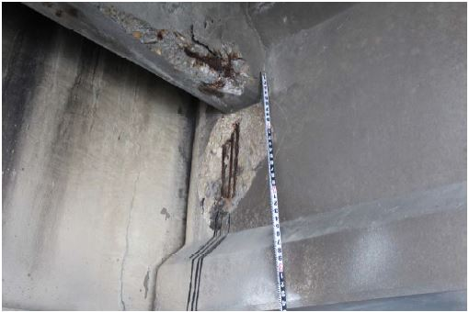
2017 Inspection Findings
Beam Spall

Slide 54
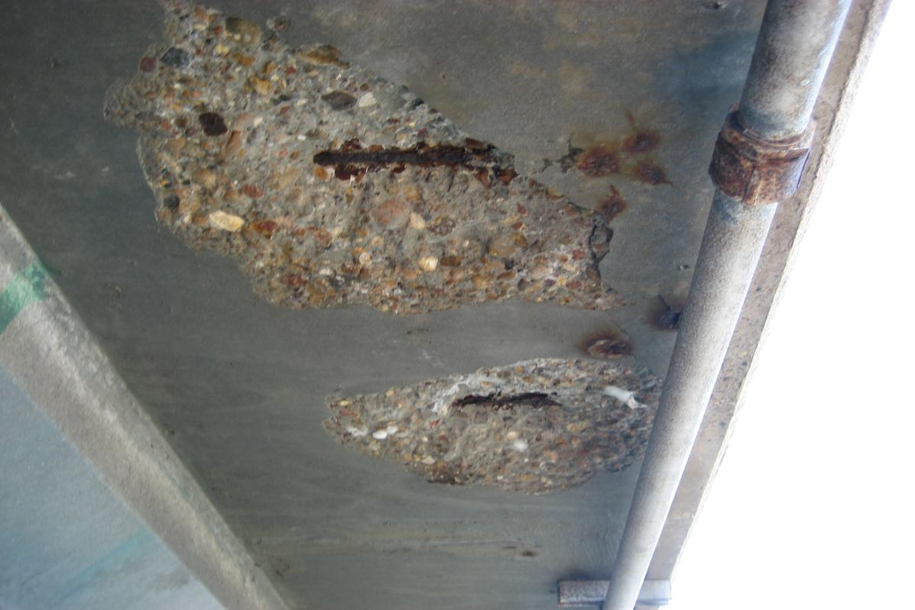
2017 Inspection Findings
Spall

Slide 55
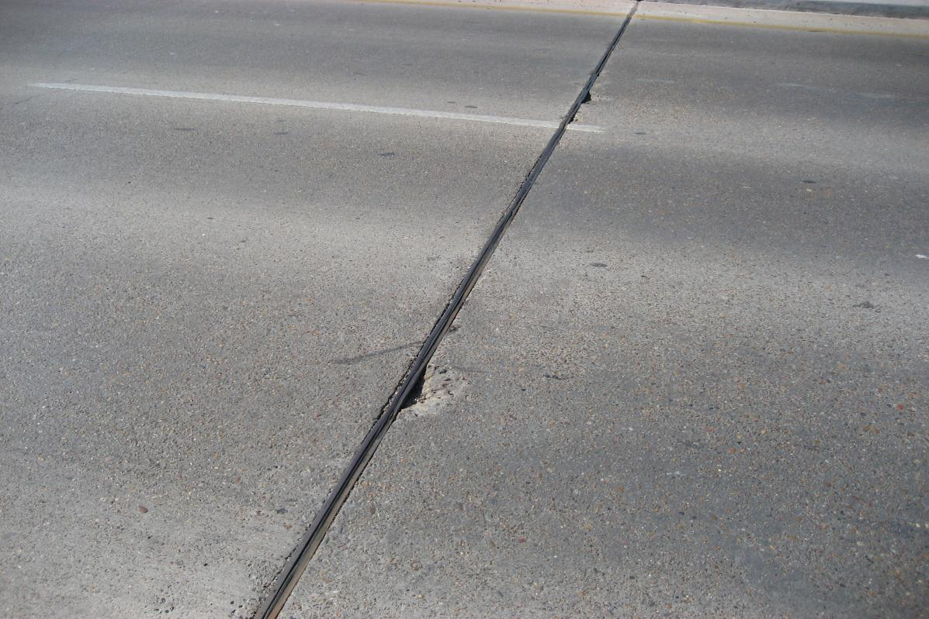
2017 Inspection Findings
Armor Joint

Slide 56
2017 Inspection Findings
As part of TxDOT’s Routine Safety Bi-Annual Inspections, a thorough inspection was performed with spalled concrete and compromised armor joints needing repair.
Concrete Spalls | Square Footage
Top Deck | 24
Underside Deck | 16
Girders | 81
Bent Caps | 11
Diaphragms | 102
Pile Caps | 11
TOTAL | 245
Description | Quantity | Unit | Cost | Subtotal
Traffic Control Barriers | 5 | MO | $20,000 | $100,000
Concrete Repair | 245 | SF | $1,000 | $245,000
Armor Joint Repair | 670 | LF | $600 | $402,000
 |  |  | TOTAL | ~$750,000
Armor Joint Repair | Linear Footage
Armor Joint | 670
TxDOT plans to let a contract in FY 19 to address the above repairs. This project is considered routine maintenance.

Slide 57
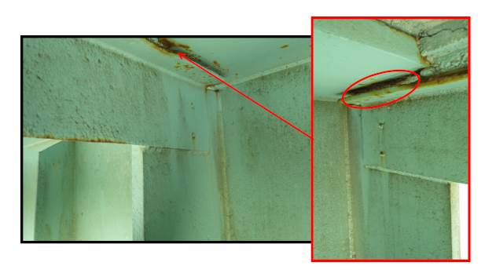
Fracture Critical Inspection
As part of TxDOT’s Routine Safety Bi-Annual Inspections, a thorough inspection was performed for the Steel Girder Unit.
Pack rust accumulation and weld at top flange and interior diaphragm

Slide 58
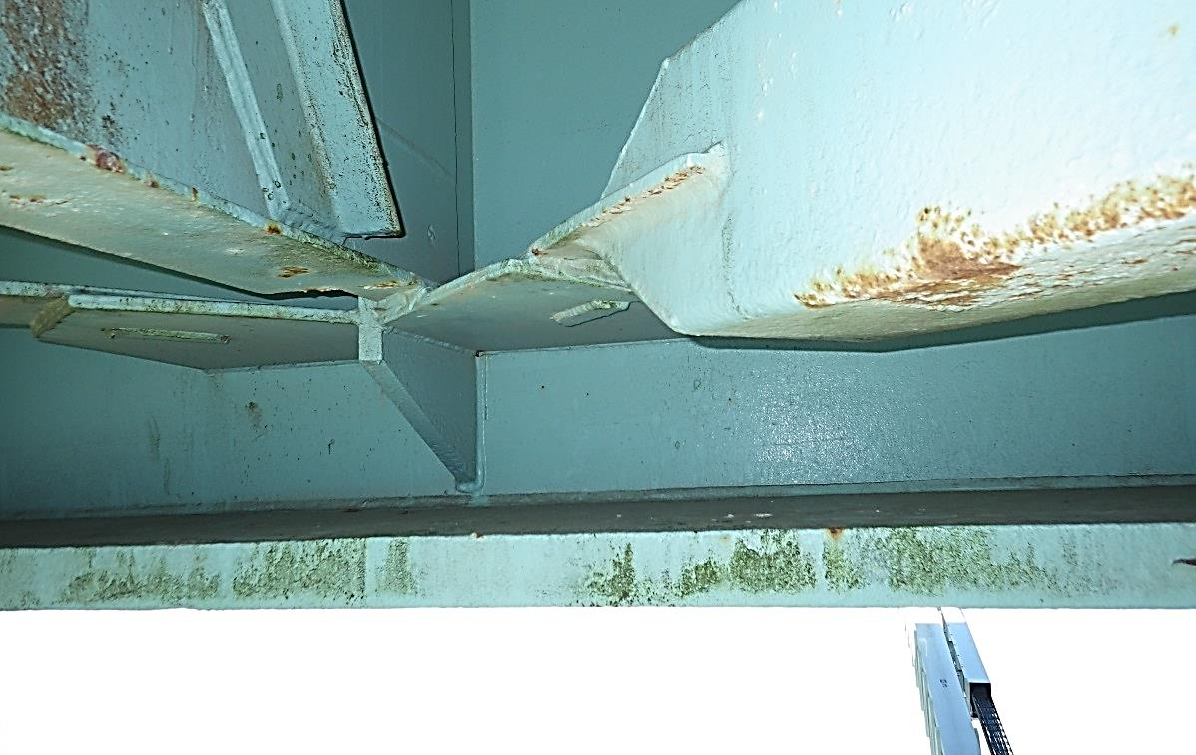
Fracture Critical Inspection
Minor Paint Failure at Bottom Flange

Slide 59
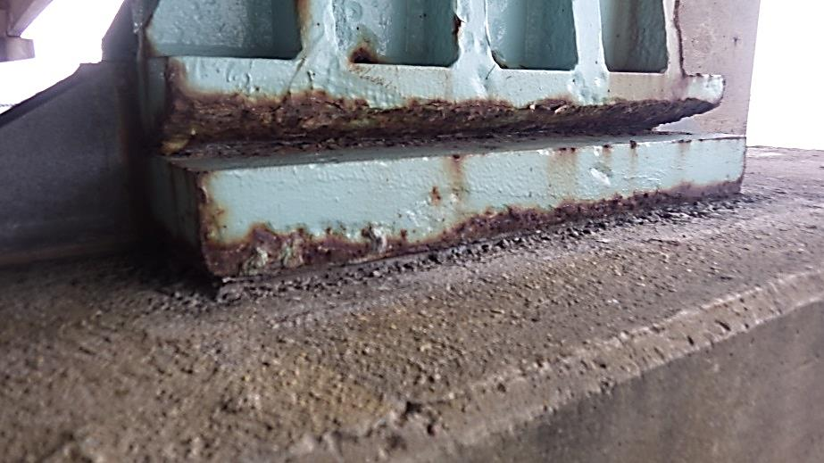
Fracture Critical Inspection
Pack Rust at Bearing Plate

Slide 60
Reasons for QIC in Good Condition
Tribute to our past engineers for having the foresight not to push design limits in a corrosive environment. Such simple implements include the following:
80’ Simple Spans – this is the practical and economical limit for a Type 54 Beam use. The ultimate design limit could reach up to 110’ thus placing more stress and strain on the beams and pre-stressing strands.
Concrete Diaphragms – no longer used in TxDOT bridge design, the internal diaphragms help distribute live and dead loads acting on the beams. Without placement at the quarter points, would place additional stress and strain on the beams.
Pre-stressed Pre-Cast Concrete Panels – a new concept of TxDOT bridge design at that time. The 4” deep concrete panels act as a forming mechanism with the remaining 4” of batch concrete placed to make the 8” deep slab. Little to no chance of corrosive sulfate penetrating into the steel which would lead to deck repair.

Slide 61
Reasons for QIC in Good Condition
Multi-column Bents w/Tie Beams – the use of tie beams at mid height of the column and at the top of the pile footing caps help with load distribution and limiting cracks along the columns.
Cathodic Protection – the implementation of cathodic protection has prevented the substructure elements (steel reinforcement) from being compromised in a corrosive environment. Re-application of the sacrificial layer is needed to sustain the primary function of the bridge element.

Slide 62
TxDOT’s Plan Moving Forward
The steel girder will be stripped and painted a fifth time ~ 2020. Concerns with reducing nominal thicknesses and tears in the welds.
Cathodic protection could be applied to the substructures and girders.
Life cycle cost needs to be investigated for continual maintenance remedies beyond 2043.
TxDOT plans to keep the QIC in good condition with strategic and time based maintenance efforts to prevent load posting and continue to serve as a life line to the traveling public and adjacent stakeholders.

Slide 63
QUESTIONS?
Rex A. Costley, P.E.
Director of Maintenance
Rex.Costley@txdot.gov
956-702-6137

