Slide 1
Welcome to the LRGV
Water Quality Management & Planning Conference
Texas Floodplain Management Association

Slide 2
What is TFMA?
Organization of professionals with a wide range of experience and expertise.
Our Purpose, Mission, and Goals:
Facilitate sound floodplain management in Texas
Educate, Train and Certify local Floodplain Managers
Strive to enhance cooperation and exchange of information among individuals, private sector companies, and public federal, state, and local agencies
Save lives and property from flooding and other natural disasters

Slide 3
What is TFMA?
Non-profit organization
Established in 1988
State Chapter of the Association of State Floodplain Managers (ASFPM)
Largest association/chapter in the nation (outside of ASFPM)
Current Membership - Over 2,000 members
Now in our 29th Year

Slide 4
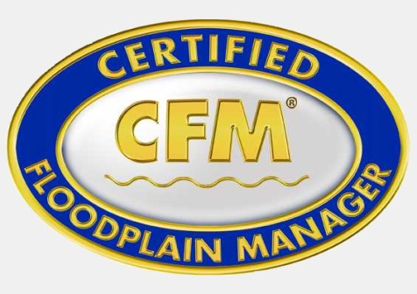
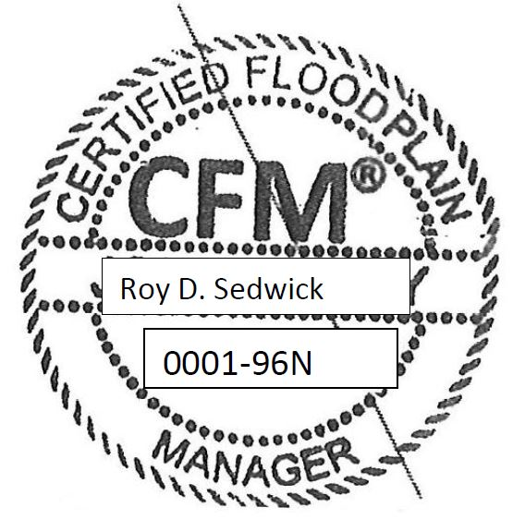
Certified Floodplain Manager
CFM Program is Nationally Accredited certification – Started in 1996 in Texas
Over 6,000 CFMs in US
1/3 in Texas
TFMA administers program for CFMs in Texas
Exam offered throughout the year
8 CECs annually to maintain certification
New stamp available for use by Community Floodplain Administrators

Slide 5
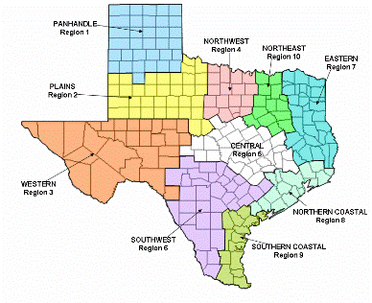
TFMA Regions
Region 9 Director
Martha Viada, CFM

Slide 7
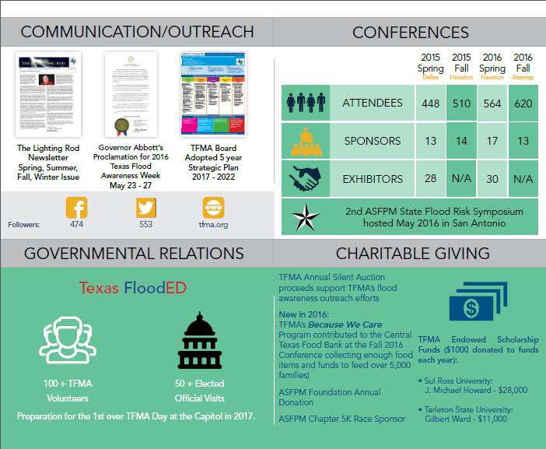
TFMA 2016 Annual Report

Slide 8
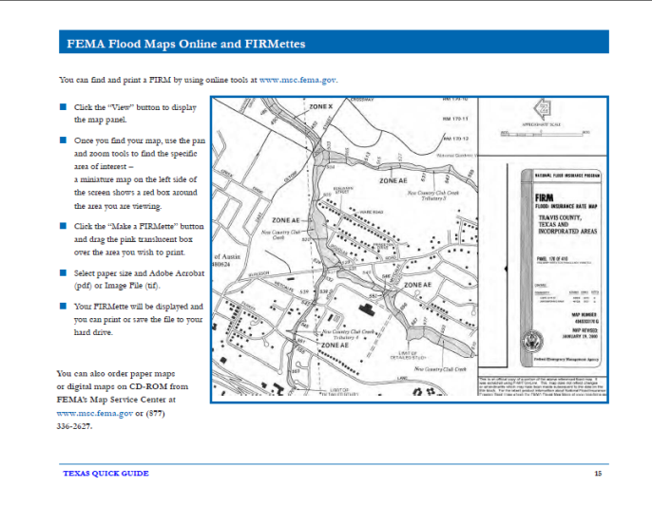
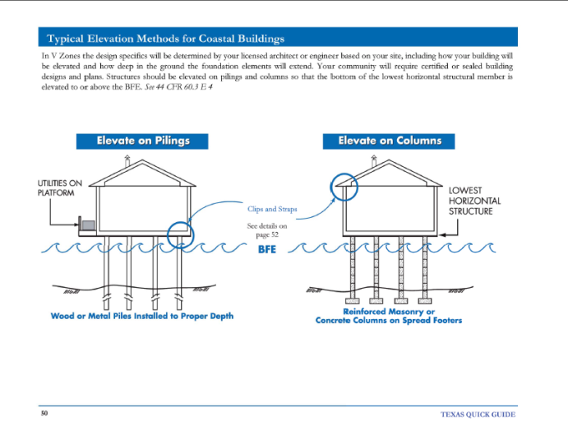

Slide 9
TFMA “Ask an Expert”
Modeling
NFIP Regulations
Coastal Issues
Mapping Sources
DFIRMs & FEMA Mapping
Ethics and Floodplain Management
Map Amendments & Revisions
Elevation Certificates
Local Community Issues
Ordinances & Higher Standards
Floodproofing
Stormwater Management
Stormwater Utilities
Environmental Issues
Wetland Permit Requirements
TCEQ Dam Safety
NFIP & Insurance Issues
Mitigation Grants
NRCS Programs
TWDB Flood Protection Planning
Outreach, Training and Continuing Education
Texas Water Code
FEMA
Substantial Damage
Community Rating System
GIS
Historical Flood Data
CFM Exam

Slide 10
Public Outreach
Teachers
School Children
Calendars
TADD Bumper Stickers
Weather Advisories

Slide 11
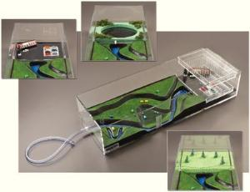
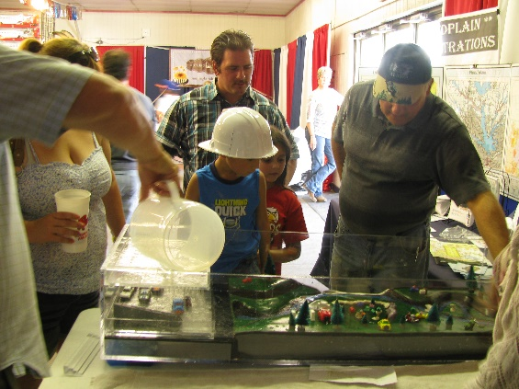
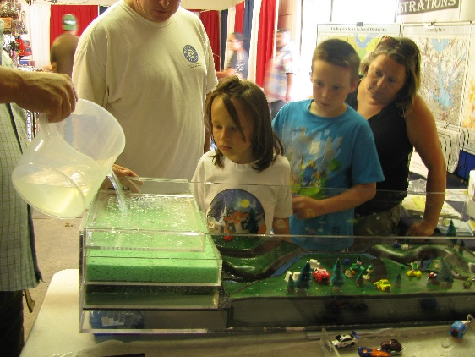
Public Outreach
Physical Flood Model(s)

Slide 12
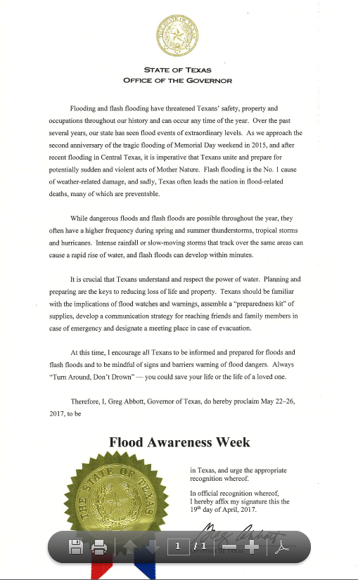

Slide 13
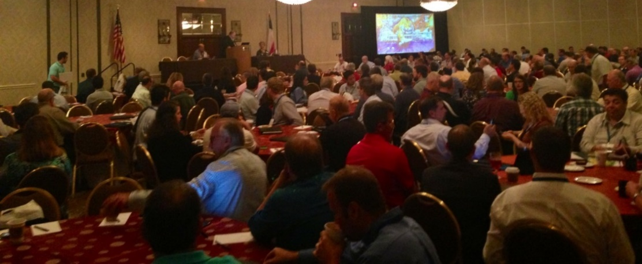
2017 TFMA Technical Summit
August 30 – September 1, 2016
Hyatt Hill Country Resort, San Antonio, Texas
2017 TFMA 30th Annual Spring Conference
March 6-9, 2017
Horseshoe Bay Resort, Marble Falls, Texas
TFMA Regional Training
FEMA/ ASFPM/ TWDB/ TFMA 4-Day & 1-Day Classes

Slide 14
Texas Floodplain Management Association
Like us on Facebook:
TXFMA
Follow us on Twitter:
@TexasCFM
www.TFMA.org 512-260-1366
Thomas Mountz– TFMA Training Committee
Tom.mountz@rpsgroup.com

Slide 16
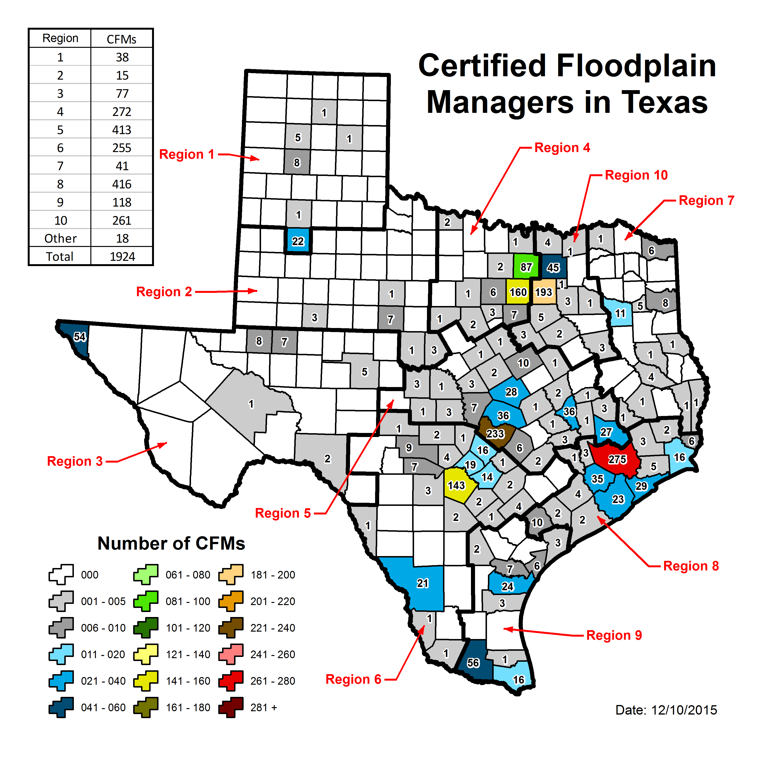
TFMA CFMs

Slide 17
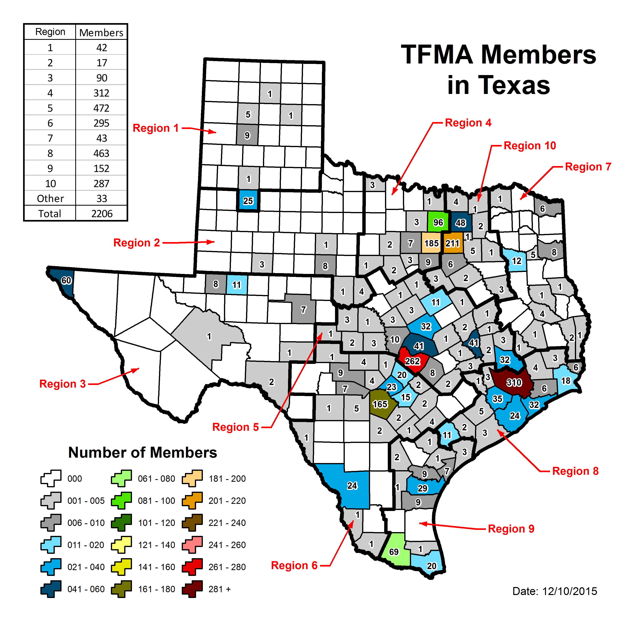
TFMA Members

Slide 18
TFMA’s Stormwater Committee
Urban stormwater issues being addressed by Subcommittee:
2D Modeling
Urban flooding
Alternative Funding
Low Impact Design
Regulatory
Stormwater Utilities
Stream Restoration
Water Quality Certification

Slide 19
TFMA Committees
Certification
Conference
Legislative
Membership
Member Services
Mentor Program
Outreach
Communications
Training
Community Rating System (CRS) Program
Stormwater

Slide 20
TFMA’s Stormwater Committee
Formed in 2013
First meeting held at Fall 2013 Conference in Austin
TFMA / Lower Rio Grande Valley Stormwater Task Force Partnership
Chair: Steve Eubanks, PE, CFM – City of Fort Worth Steven.Eubanks@fortworthtexas.gov

Slide 21
TFMA Purpose
Promote public awareness of proper floodplain management
Promote professional status of floodplain management
Enhance cooperation and exchange information among individuals, private organizations and public agencies
Promote floodplain management education
Inform members of floodplain management legislation

