Slide 1
City of Laredo
TPDES Construction Management at the City of Laredo
Ivan Santoyo
Engineering Associate
Environmental Services Dept.

Slide 2
Environmental Services Department
The City of Laredo has one fulltime environmental construction inspector which randomly inspect BMP’s placed in the construction site.
This Program is a requirement of the city’s own Texas Pollutant Discharge Elimination System (TPDES) Permit.

Slide 3
When the inspector goes to a site for the first time, what will he inspect?
Inspector will schedule a meeting with the construction superintendent.
Inspector will examine the site’s notice of intent (NOI)
Inspector will check the SW3P for all required elements such as certification, inspection reports and site description for erosion and sediment controls.
The SW3P must be available onsite. It must be available at the construction site vehicle.
The SWPPP shall describe and ensure the implementation of best management practices (BMP).
BMP’s are placed to reduce the pollutants in the storm water discharges associated with the construction site.
Notes:
Superintendent will give documented information of the project to city inspector
And the basic BMP’s should be placed.

Slide 4
Components of SW3P package
Site / Project Information (The plan)
The Notice of Intent (NOI) > 5.0 acres
The Construction Site Notice (CSN)
Areas disturbed >1.0 but < 5.0 acres
Controls (Best Management Practices -BMP’s)
Inspections
Maintenance
Record Keeping (3 years)
File The Notice of Termination (NOT)
Notes:
This is the basic components of SW3P
Controls means structural and non structural measures and are using to prevent erosion and discharges of soil, silt , hazardous waste, litter, construction materials and other harmful substances from entering the storm drain system.

Slide 5
City Site Inspections
The City of Laredo inspects construction sites to ensure compliance with the city ordinances (2012-O-101 Chapter 24.59)
The site is subject to inspection from onset of construction until final completion ( 75% soil stabilization followed by NOT Submittal)
Company Construction Superintendent is responsible to conduct self inspections and provide documentation to city inspector

Slide 6
NOI General Permit > 5.0 Acres
City inspector will check site posting of NOI and SW3P near of construction entrance.
The TPDES number for the project or a copy of NOI if a permit number has not yet been assigned.
The name and telephone number of a local contact person
A brief description of the project
The location of the SW3P
Name of Receiving Water
Certification with printed name & signature by developer or his/her representative
Notes:
Is better known as the environmental permit.
Representative means consultant engineer
Contractor should be generated its own NOI to obtain the NOT in project more than one acre

Slide 7
Violations and Fines
City of Laredo Ordinance 2012-O-101 Chapter 24.59
Storm Water Management Ordinance
Temporary erosion and sediment control
General requirements Section 4.1
Fines are applicable in the municipal court
Fines from $500 - $2,000 for non- compliance

Slide 8
City ordinance most common violations
No submittal of NOI
Tracking sediments into streets.
No silt fence barrier on stepped lots
Lack of windblown dust control
Uncontained windblown solid waste at the construction site
Paints and solvents out of designated covered area

Slide 9
Conclusion of the inspection
The inspector explains to the construction site superintendent where the areas need improvement.
Written warning issued to the site superintendent for site compliance.
Follow-up inspection will be conducted within a certain time to be in compliance, generally a week to ten days.
With mayor violations, the inspector may issue a citation which carries a civil fine of $500 per day per violation.

Slide 10
Construction Inspection Flow Chart

Slide 11
Notice of Intent (NOI) Posted
Construction >5 acres
CSN small project

Slide 12
Sample Inspection Forms
Notes:
Left hand the Bi-weekly inspection and left side the after rain events insp. form

Slide 13
City’s Construction Inspection Form
Notes:
Could be considered as an audit inspection
Encapsulated question of BMP’s of any project
On the bottom of this contractor and city inspector sign as a common agree

Slide 14
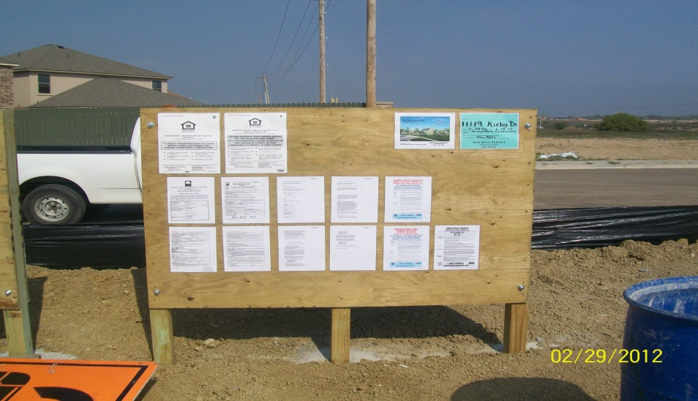
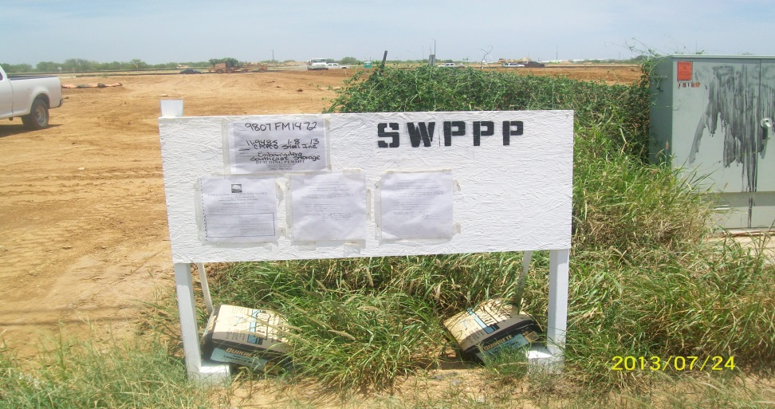
NOI posted at construction entrances

Slide 15
BMP’s Poor Housekeeping?
Ordinance violation # Chapter 14 Art., 2, Sec., 14.24 ( nuisance)

Slide 16
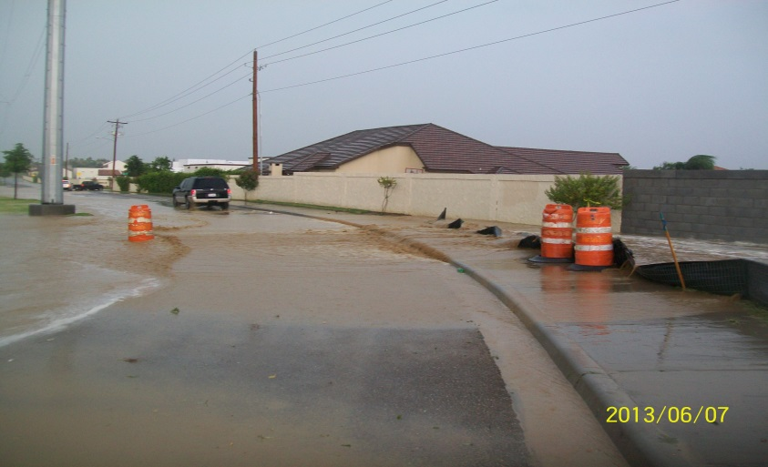
Tracking sediment into streets
Ordinance violation # 99-O-186 Chapter 24.59 Sec., 4.1 ©

Slide 17
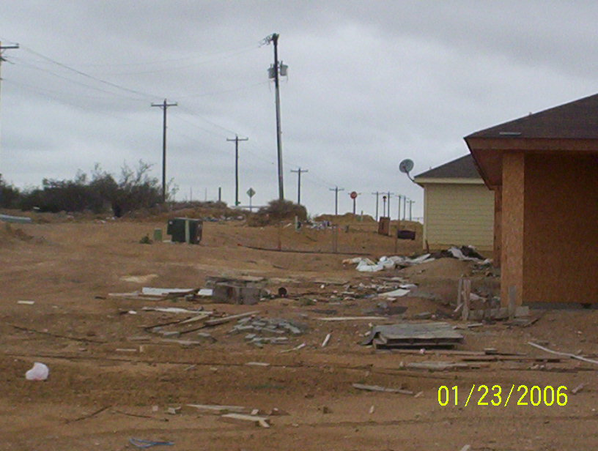
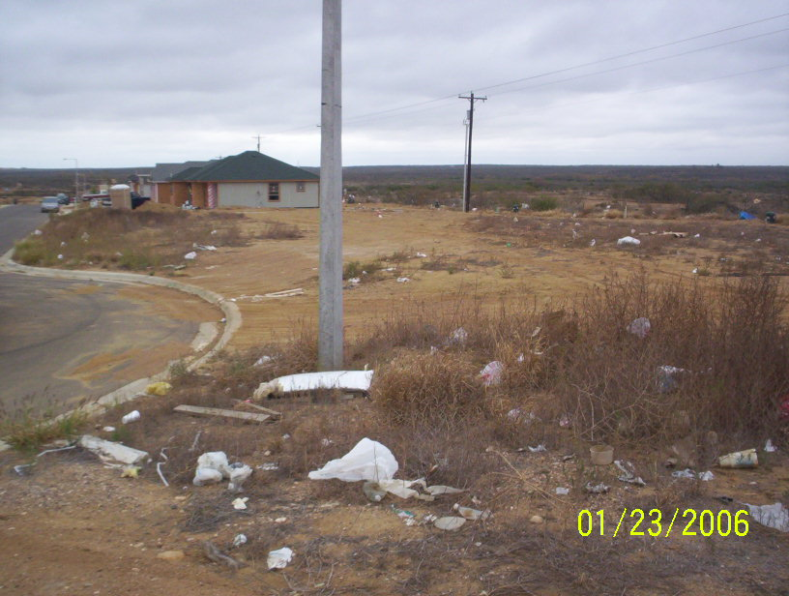
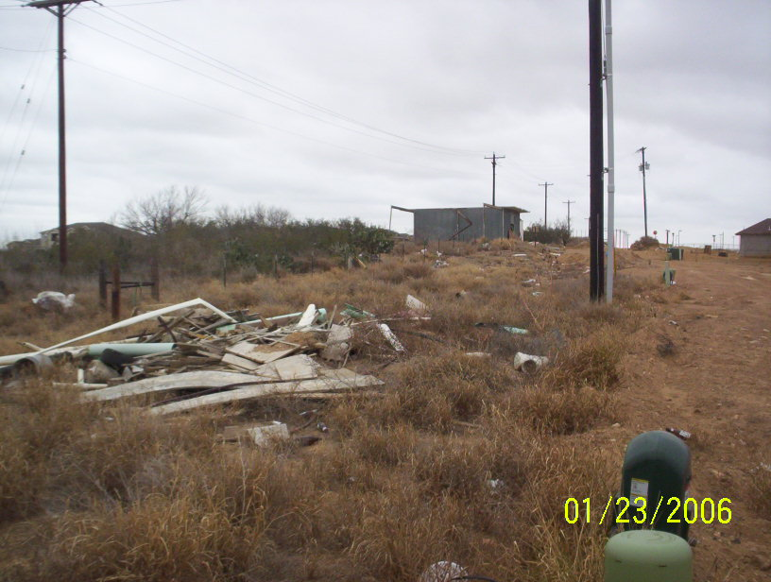
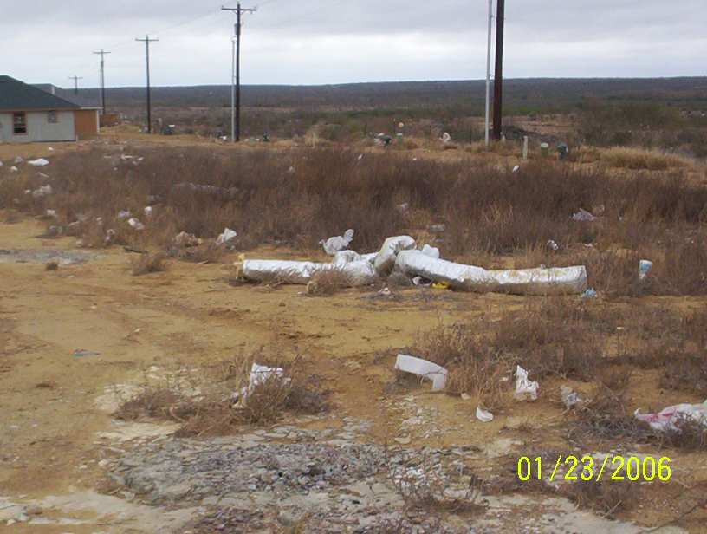
Windblown waste without control
Ordinance violation 99-O-186 Chapter 24.59 Sec., 4.1 (f)

Slide 18
Mixed Concrete and Stone Pebbles draining into MS4
Ordinance violation # 99-O-243 Chapter33, Art., IV, Sec. 33-316

Slide 19
Construction debris on the job site
Ordinance violation # 99-O-3337 Chapter 33, Art., V, Sec., 33-353

Slide 20
Heavy equipment left on job site (Junked Vehicles)
Ordinance violation # Chapter 14 Art., 2 Sec.14.24 (Junk vehicles)

Slide 21
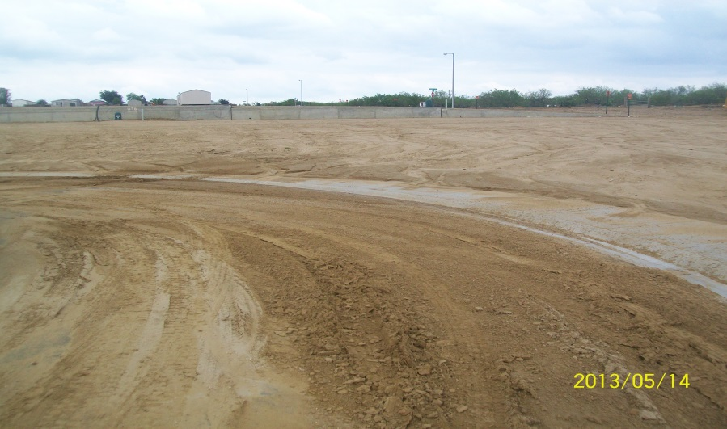
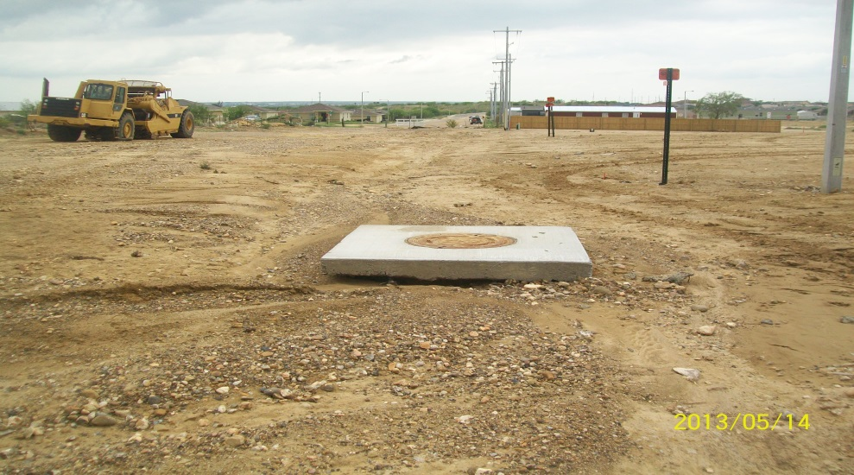
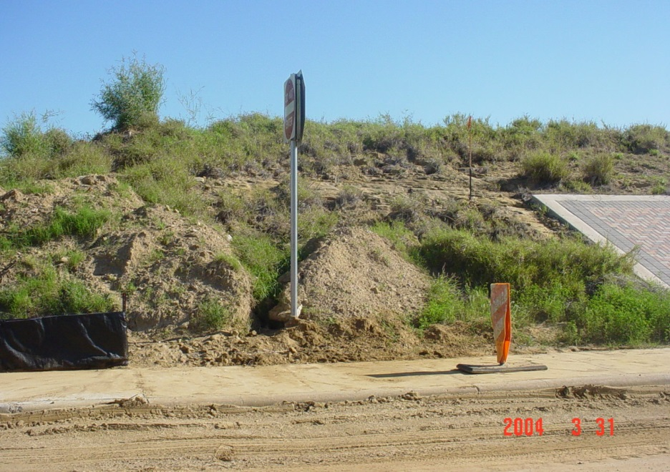
Erosion Problems
City violation # 99-O-186 Chapter 24.59 Sec., 4.1

Slide 22
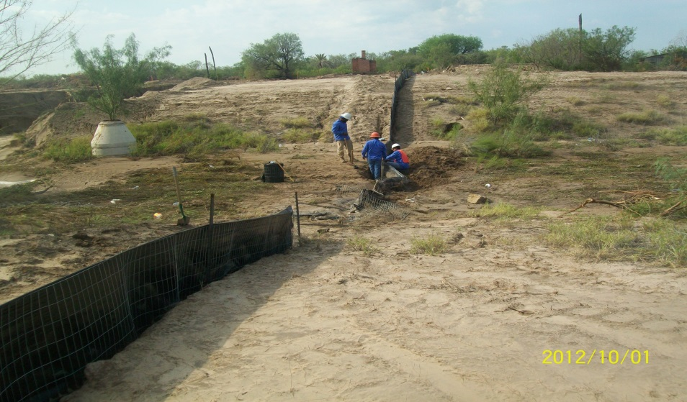
Best Management Practices; silt fence not properly installed.

Slide 23
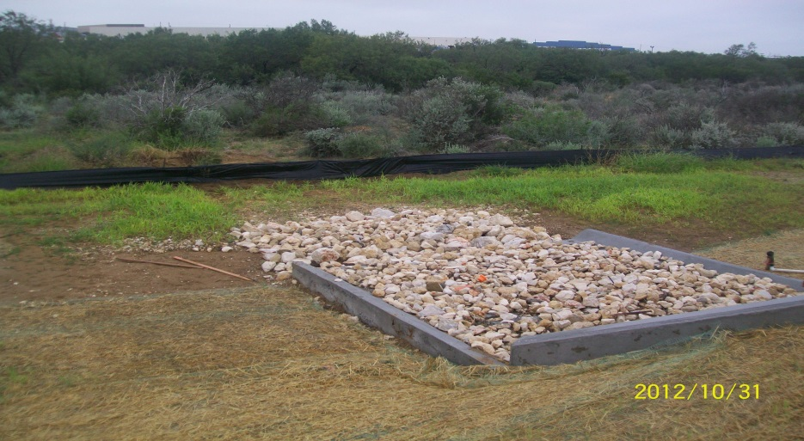
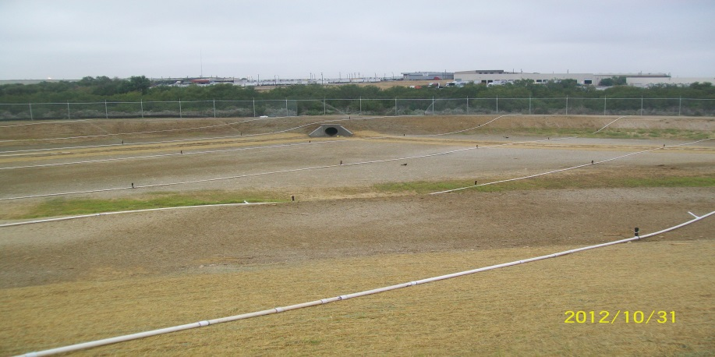
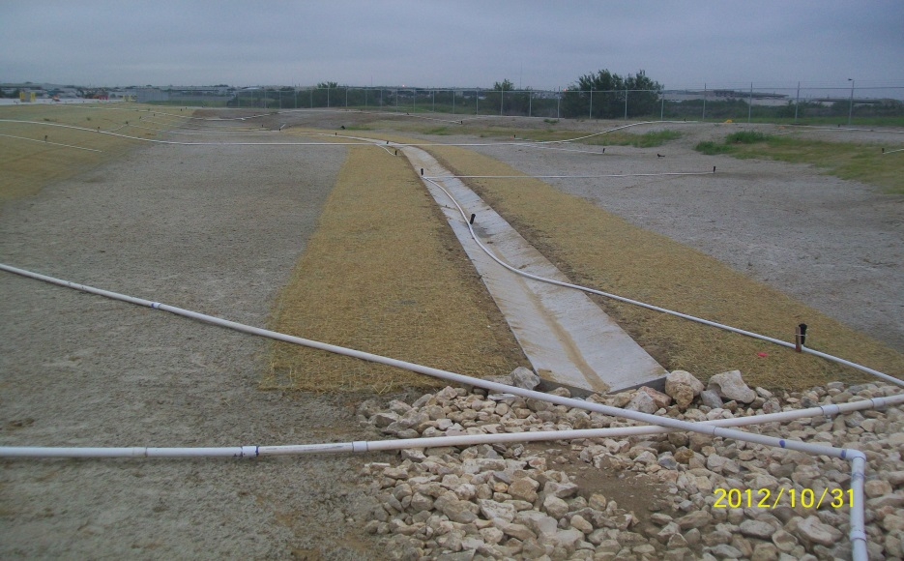
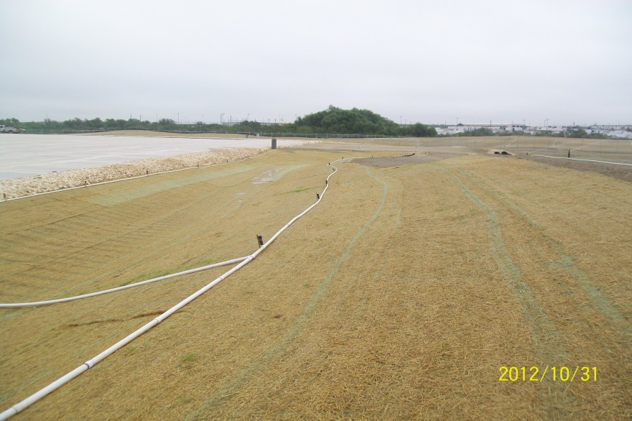
STABILIZING DETENTION POND

Slide 24
Construction in project less than 5.0 acres and more than 1.0 acre
Most of projects are commercial, apartments complex and warehouses.
Projects are reviewed for plan review staff
Environmental issues are considered
The storm water pollution prevention package must be submitted
The Construction Site Notice (CSN) is required
An environmental inspection is conducted to verify if potential pollutants exist, (e.g. const. entrance, dust control, etc.

Slide 25
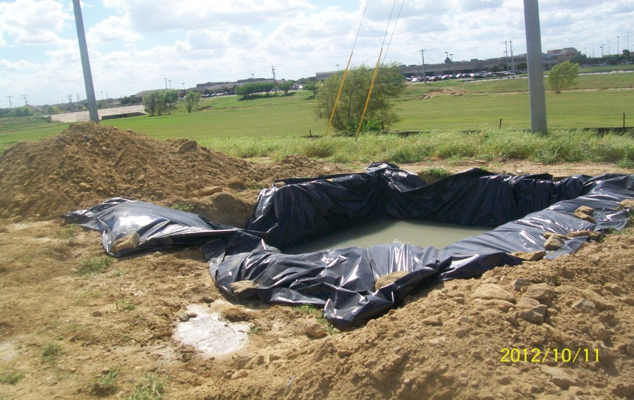
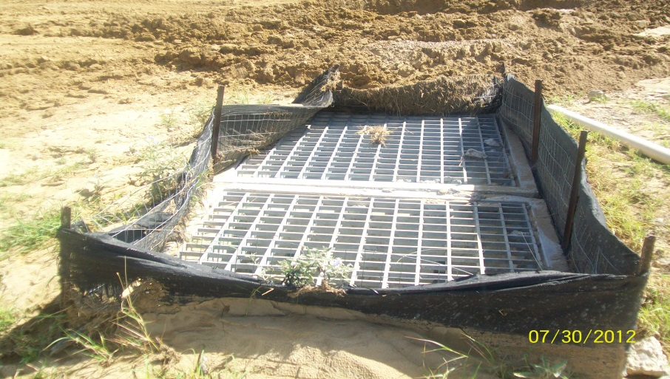
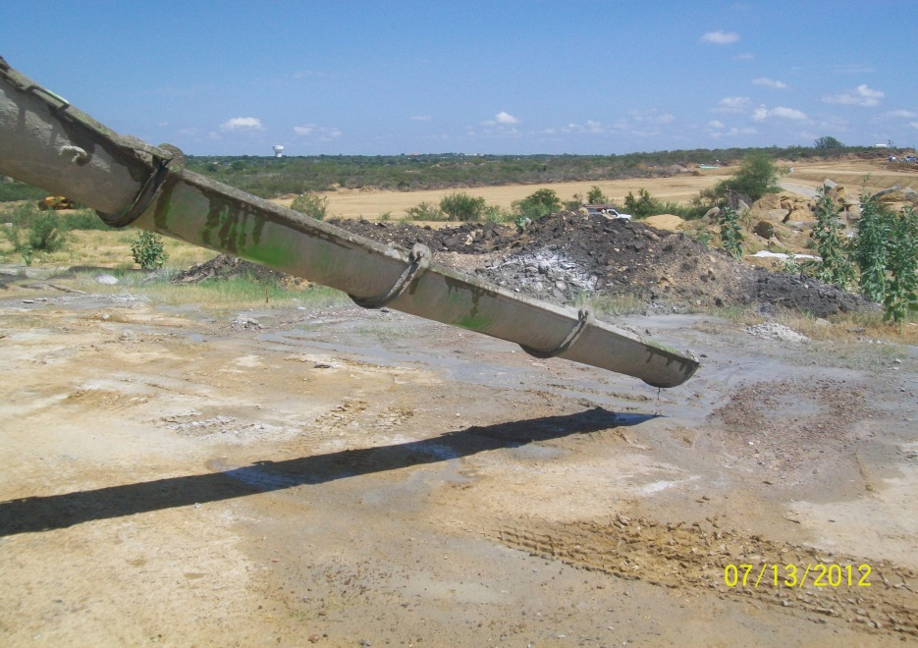
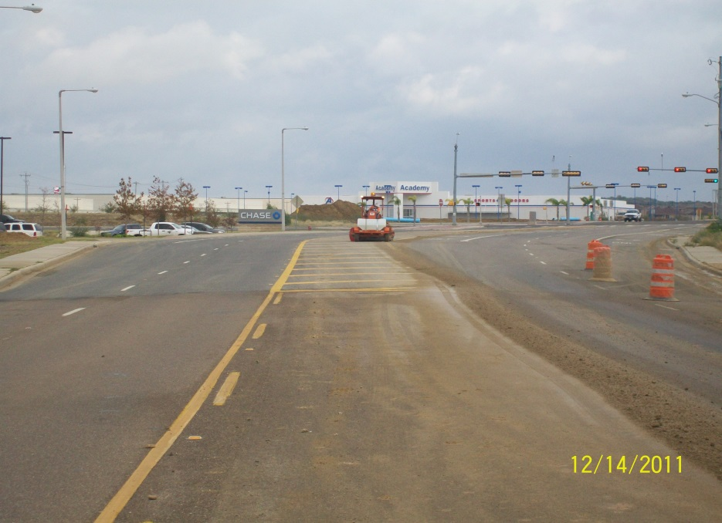
Most common problems in small construction sites

Slide 26
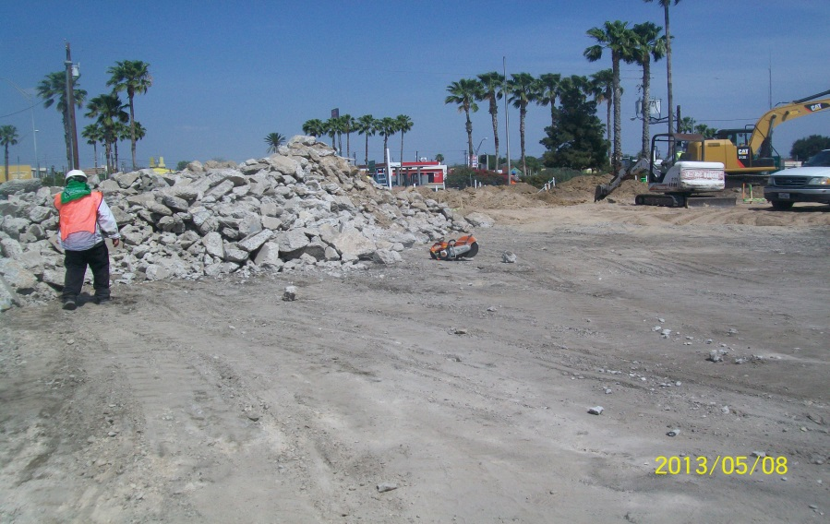
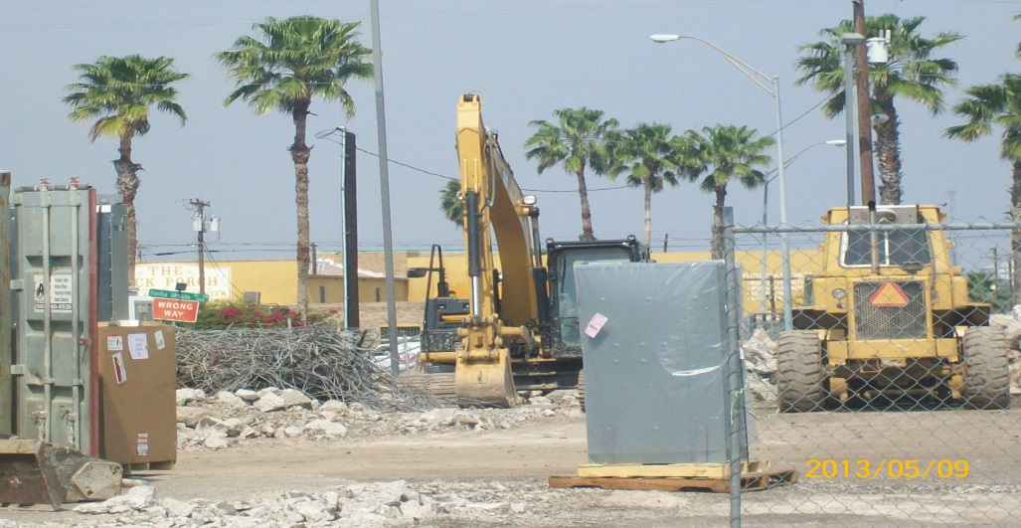
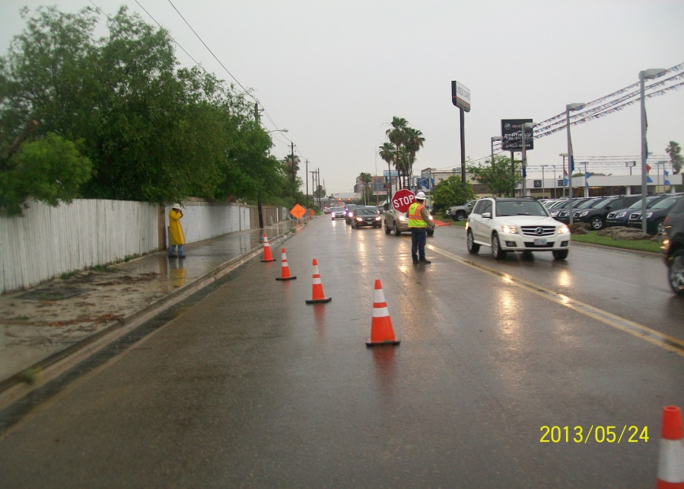
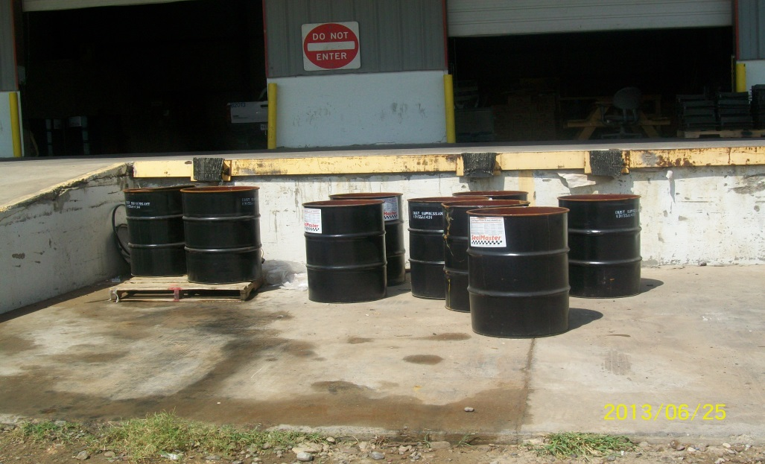
Most common problems in small construction sites

Slide 27
BMP’s in the earthen channel

Slide 28
Questions?
isantoyo@ci.laredo.tx.us

