Slide 1

GREEN INFRASTRUCTURES APPLICABILITY FOR TURKEY
IN THE CONTEXT OF CLIMATE CHANGE AND URBANIZATION
Enda Tolon, M.Sc.
The Robert C. Vackar College of Business & Entrepreneurship,
Department of Management
Mert Tolon, Ph.D.
College of Engineering & Computer Science,
Civil Engineering Department
5/18/2018
Lower Rio Grande Valley 20th Annual
Water Quality Management & Planning Conference

Slide 2

Outline
Motivation
Greener Living
Climate Change
Turkey
  Demographic Information
  Climate Change
  GHG
  Green Buildings
  Natural Disasters
    Floods
    Drought
Suggestions
  Municipality
  Government
Conclusion

Slide 3

RESEARCH QUESTIONS
How to apply green infrastructure application in Turkey as a developing country?
What are the roles of Turkey’s metropolitan city managers in green infrastructure applications?

Slide 4
CONTRIBUTION
By identifying green infrastructure related solutions for a developing country in the context of climate resiliency this study will contribute the literature.
Guide for practitioners by revealing insights about understandable and easily repeatable methods of green infrastructure as a public service.

Slide 5
GREENER LIVING
Living Sustainably
Being Green on the Road
Throw Away Less
Choosing Greener Products
Greening Industrial and Business Processes
Cleaner Energy Choices
EPA
Notes:
https://www.epa.gov/environmental-topics/greener-living
Our actions impact the environment. Each thing we do can help or hurt our planet in many ways. reduce our environmental footprint.
EPA's Sustainability and Pollution Prevention (P2) sites, or in the Greener Living Frequent Questions.
Living Sustainably
Smart Growth
Green Streets, Jobs and Towns Program
Greener Lawn and Garden Care
Green Sports
Household Carbon Footprint Calculator
Watersense: Reduce Water Use
Conservation in School Buildings
Being Green on the Road
Green Vehicle Guide
Fuel Economy
Clean Diesel
School Buses and Healthy Schools
SmartWay
Throw Away Less
Reduce, Reuse, Recycle
How do I Recycle?
Reduce Food Waste
Electronics Management
Sustainable Materials Management (SMM)
Responsible Appliance Disposal (RAD)
Choosing Greener Products
Greener Products and Services
WaterSense Products
Safer Household and Industrial Chemicals
Safer Chemical Ingredients
Energy Star: Energy Efficient Products
Greening Industrial and Business Processes
Green Engineering
Environmental Management Systems
Green Chemistry
Greener Cleanups
WasteWise
Cleaner Energy Choices
Energy and the Environment
E3: Economy, Energy and Environment
RE-Powering America's Land

Slide 6
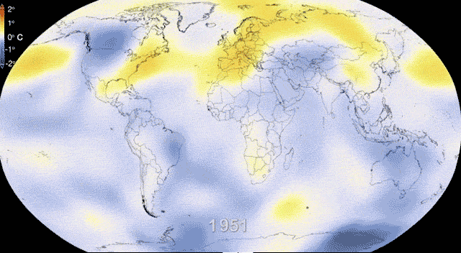
Climate Change
Believe or not climate is changing
Notes:
Communities across the nation already are experiencing the effects of climate change. As different parts of the country become drier, wetter or hotter, community leaders and citizens are looking to green infrastructure to improve their community’s resiliency to the effects of climate change.

Slide 7
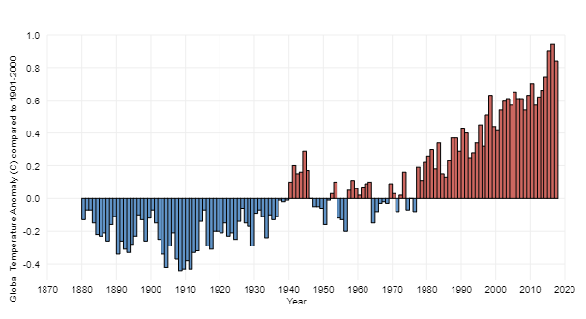
Climate Change
Since 1880, surface temperature has risen at an average pace of 0.07°C every 10 years for a net warming of 0.94°C through 2016.
By 2020, global surface temperature will be more than 0.5°C warmer than the 1986-2005 average
Dahlman, 2017 Climate.gov
Notes:
Change over time - Over this 137-year period
Though warming has not been uniform across the planet, the upward trend in the globally averaged temperature shows that more areas are warming than cooling. Since 1880, surface temperature has risen at an average pace of 0.07°C every 10 years for a net warming of 0.94°C through 2016.,
By 2020, models project that global surface temperature will be more than 0.5°C warmer than the 1986-2005 average, regardless of which carbon dioxide emissions pathway the world follows.

Slide 8
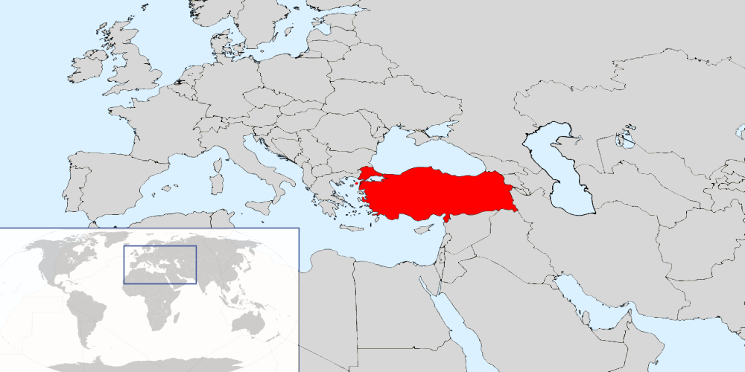
Turkey
A unique geographic position
Area: 302.535 mi² Population: 80.810 .525 (2017)
Notes:
A unique geographic position, lying partly in Asia and partly in Europe
The area : 3 hundred 2 point 5, 35 square miles
80 million 810 thousand 525 people
Turkey is geographically located in the Mediterranean region which is identified as a climate change hot spot by The Intergovernmental Panel on Climate Change.

Slide 9
Population by years, 2000-2017
In past 17 years, population of Turkey increased almost %19.
Notes:
In past 17 years, population of Turkey incresed almost %19.

Slide 10
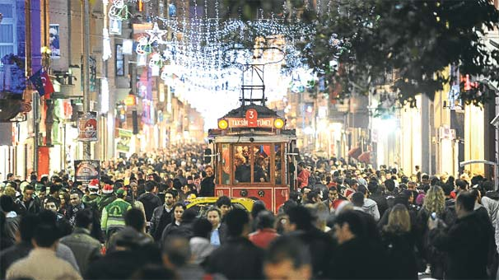
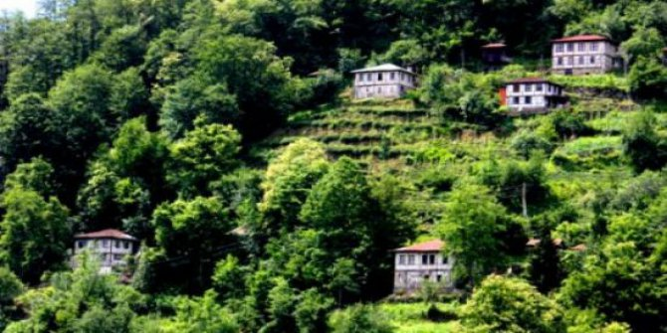
Urbanization vs. Climate Change
İstiklal Street, İstanbul
Arhavi, Artvin
92,5 of residents in urban and district centers
towns and villages is 7.5%
The most important anthropogenic influences on climate are the emission of greenhouse gases and changes in land use, such as urbanization and agriculture
Kalnay & Cai, 2003.

Slide 11
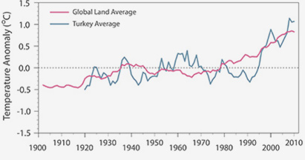
Turkey, Climate Change
Climatechangeinturkey.com
Notes:
The recent increasing trend in temperature in Turkey starts after 1990 while the global warming trend seems to begin earlier, before the 1980s. Despite this delay in the temperature increase in Turkey's climate, the increase is bigger than the global one for the same period.

Slide 12
Greenhouse Gas Emissions (GHG)
135.4%
GHG (CO2 equivalent)
Million tonnes
Year
Turkish Statistical Institute
Notes:
The Greenhouse gas emission inventory includes direct GHGs as carbondioxide (CO₂), methane (CH₄), nitrousoxide (N₂O), F gases, and indirect GHGs as nitrogenoxides (NOx), non-methane volatile organic compounds (NMVOC), carbonmonoxide (CO) and sulphurdioxide (SO₂) emissions originated from energy, industrial processes and product use, agricultural activities and waste.
According to the United Nation, Turkey is considering as a developing country. Within economic developments… total ghg emissions are increasing. Total greenhouse gas emissions as CO₂ equivalent increased by 135.4% in 2016 compared to the emissions in 1990

Slide 13
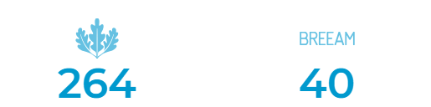
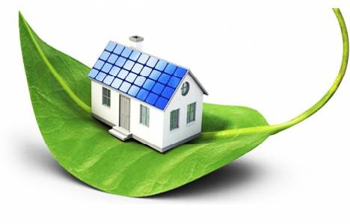
GREEN BUILDINGS
LEED Certificated Project
BREEAM Certificated Project
Buildings are also responsible for about 12% of water use,
65% of waste and 71% of electricity consumption.
Eco-Friendly Green Buildings Association,2018
Notes:
LEED BREEAM farkını yaz
The environmental effects of buildings and settlements are not limited to the CO2 gas they secrete
in this context of green constracturions it is seems that Turkey mostly focus on GB

Slide 14
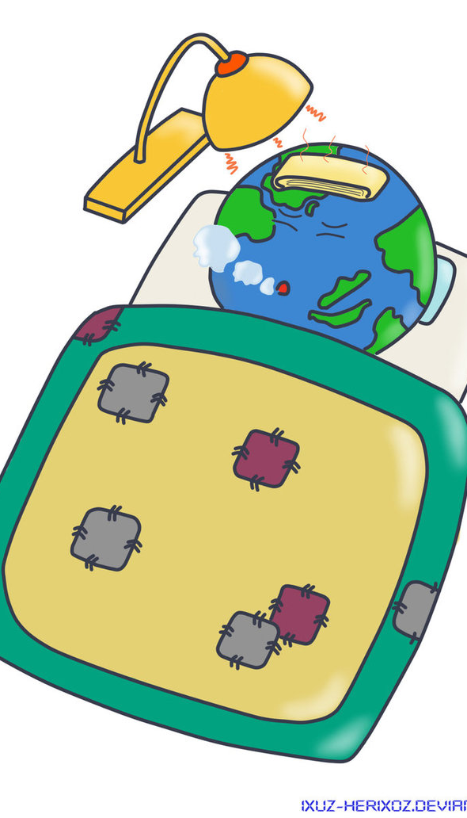
NATURAL DISASTERS OCCURED IN TURKEY
Flood
Drought
Earthquake
Frost
Avalanche
Lightning
Snow
Storm
Forest fires
Landslide
Rock Fall

Slide 15

FLOODS in TURKEY
Flooding caused by heavy rainwater due to the climate change leads to loss of lives and property increasingly every year
Reasons for the rapid and violent increase of flood in the effects of climate change
  increasing population and
  lack of adequate infrastructure for urbanization
Notes:
Drainage Flooding
Coastal Flooding
Sudden Rainfall
River Flood

Slide 16
FLOODS in TURKEY (cont’d)
484, in 15 years
300, in 60 years

Slide 17
FLOODS in TURKEY (cont’d)
15 Province More Than 10 Flood
Turkey Disaster Knowledge Base

Slide 18
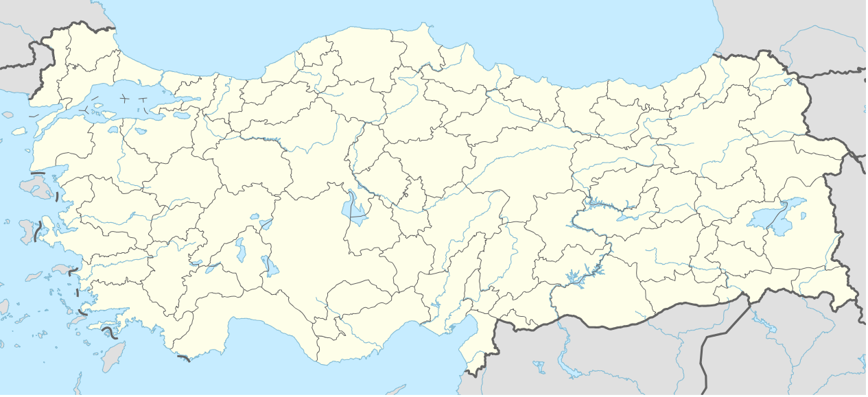
Istanbul

Slide 19
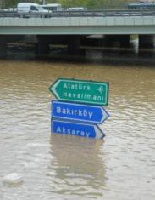
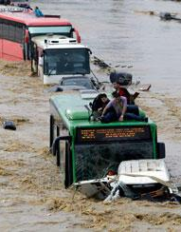
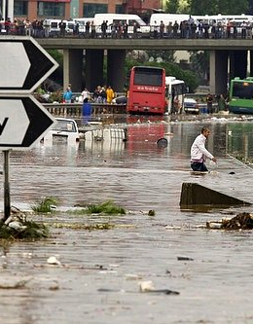
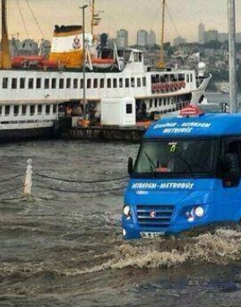
ISTANBUL

Slide 20
Ankara

Slide 21
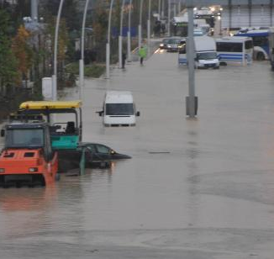
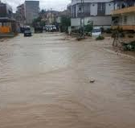
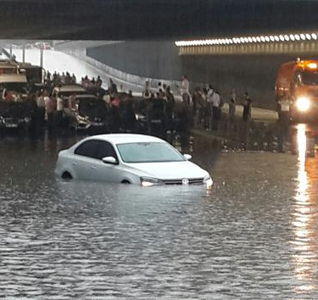
Ankara

Slide 22
Black sea Region
The wettest area
Notes:
The wettest area

Slide 23
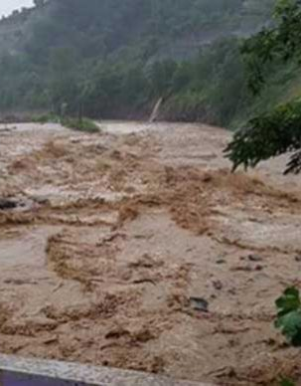
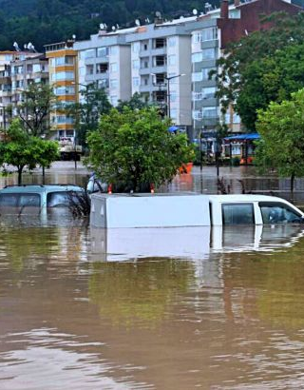
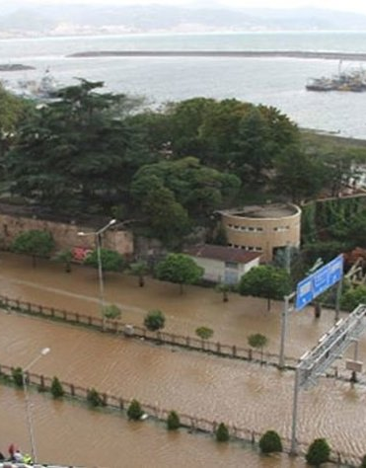
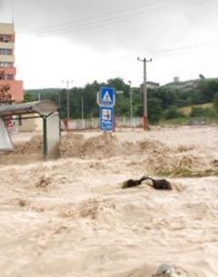
BLACK SEA REGION

Slide 24
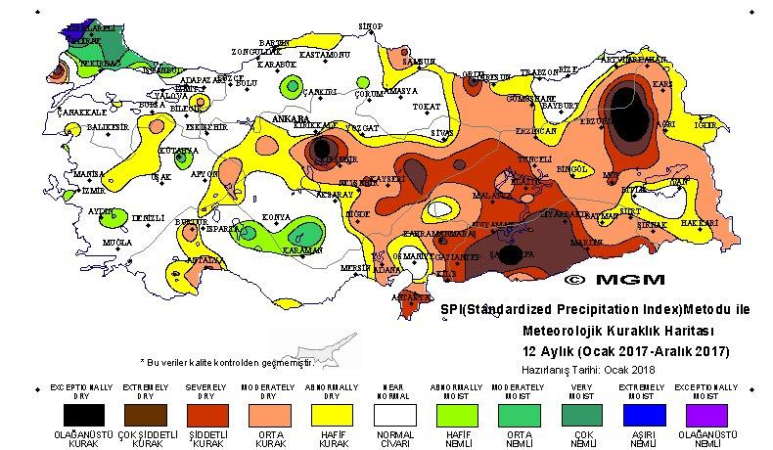
2017 Yearly Drought Assessment
Ministry of Forestry And Water Management
General Directorate of Meteorology
Notes:
Exceptionally dry
Extremely dry
Severely dry

Slide 25
The Number of Droughts by Province, 1964-2014
Turkey Disaster Knowledge Base

Slide 26
Yearly Drought, 1964-2014
Turkey Disaster Knowledge Base

Slide 27

RESEARCH QUESTIONS
Q1- How to apply green infrastructure application in Turkey as a developing country?
Notes:
To give a solution for this question

Slide 28
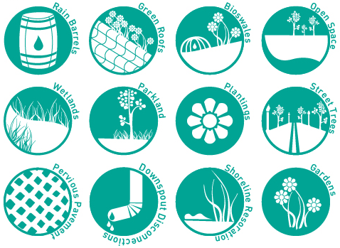
GREEN INFRASTRUCTURE (GI) FOR CLIMATE RESILIENCY
Green infrastructure strategies can help communities prepare for and manage climate change impacts by using vegetation, soils, and natural processeses to manage water.
EPA Report, 832-R-16-004, (2016).

Slide 29
MANAGES FLOOD RISK
High intensity storms are expected to become more frequent and intense as global temperatures continue to rise. As a result, the risk of flooding is likely to increase dramatically.
GI can help manage both localized and riverine floods by absorbing rainfall, preventing water from overwhelming pipe networks and pooling in streets or basements.

Slide 30
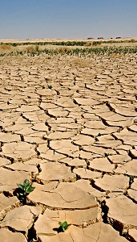
BUILDS RESILIENCY TO DROUGHT
Fragile local water supplies are being stressed by decreased precipitation associated with climate change.
GI can help replenish groundwater reserves, relieving stress on local water supplies and reducing the need to import potable water. Prepare for drought by infiltrating water where it falls.

Slide 31
REDUCES THE URBAN HEAT ISLAND
LOWERS BUILDING ENERGY DEMANDS
Green roofs can greatly reduce the amount of energy needed to keep the temperature of a building comfortable year-round by insulating against extensive heat loss in the winter and heat absorption in the summer.
Trees, green roofs, and vegetation can help reduce urban heat island effects by shading building surfaces, deflecting solar radiation, and releasing moisture into the atmosphere.
Notes:
REDUCES THE URBAN HEAT ISLAND
Urban heat islands occur when cities replace natural land cover with dense concentrations of pavement, buildings, and other surfaces that absorb and retain heat. This effect increases energy costs (e.g., for air conditioning), air pollution, and heat-related illness and mortality. Climate change will likely lead to more frequent, more severe, and longer heat waves during summer months. Extreme heat events often affect our most vulnerable populations first.
LOWERS BUILDING ENERGY DEMANDS
Trees and vegetative cover can lower ambient air temperatures in urban areas through shading, windbreak, and evapotranspiration. The result is lower demand for the energy needed to provide air conditioning in summer months.

Slide 32
REDUCES ENERGY NEEDED TO MANAGE WATER
IMPROVES COASTAL RESILIENCY
Municipal and domestic energy use with green infrastructure practices that will reduce rainwater flows into sewer systems, recharge aquifers, and conserve water.
Living shorelines can be created using plants, reefs, sand, and natural barriers to reduce erosion and flooding. Restoring affected wetlands can reduce wave heights and property damage.
Notes:
IMPROVES COASTAL RESILIENCY
Coastal areas are particularly vulnerable to the effects of climate change. Sea-level rise and heavy storms can cause erosion and flooding of sensitive coastal areas and destroy natural habitat. Climbing global temperatures will result in continued sea level rise, amplified storm surges, and more frequent and intense storms that will continue to erode the shoreline and damage property and infrastructure.
REDUCES ENERGY NEEDED TO MANAGE WATER
Communities and their residents use a lot of energy treating and moving drinking water and wastewater.

Slide 33
RESEARCH QUESTIONS
Q2 - What are the roles of Turkey’s metropolitan city managers in green infrastructure applications?

Slide 34

MUNICIPALITY
The first step in selecting the best potential candidate locations for implementing green infrastructure improvements and solutions
Benchmarking and establishing bilateral cooperation with cities similar to their own conditions in the world that has already implemented green infrastructure projects like Istanbul- New York City
Looking at whether green infrastructure applications has a place in new projects
Supporting and encouraging projects that has GI applications

Slide 35
MUNICIPALITY
Carry out all the infrastructure works while paying attention to green infrastructure applications under the following headings in the content of climate change
    Energy needed to manage water
    Reduces the urban heat island effect
    Builds resiliency to drought
    Manages flood risk
    Lowers building energy demands

Slide 36

GOVERMENT
Case studies should be done with different cities of 7 different region of Turkey.
The Greenspace Network should be established which is an inter-connected system of naturally-vegetated open space linking existing parkland, population centers and key natural resource areas at the regional scale.

Slide 37
CONCLUSION
Climate change will impact on the urban environment. These impacts are felt by both people and the built infrastructure.
To minimize the affects of climate change, cities, regional entities, and countries should adhere green infrastructure applications.
Each city has different issues based on the most pressing climate change impacts they were facing.
The green infrastructure could play an important role in adapting a city to climate change resiliency.

Slide 38

Thank You

Slide 39
References

