Slide 1

Asce Texas Section
Craig B. Thompson, P.E.
Past President, Texas Section 2017 – 2018
Office: 361-814-9900 Mobile: 361-442-5424 cthompson@hanson-inc.com

Slide 2
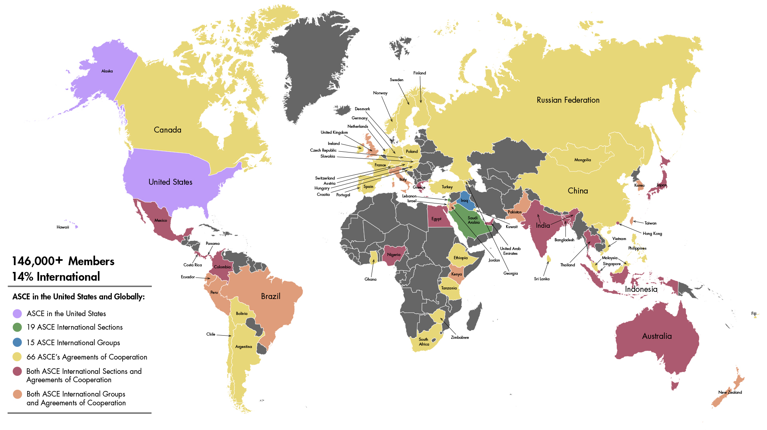

TexASCE.org
Established 1852
Notes:
So just how big is ASCE? We have about 150,000 members globally!

Slide 3
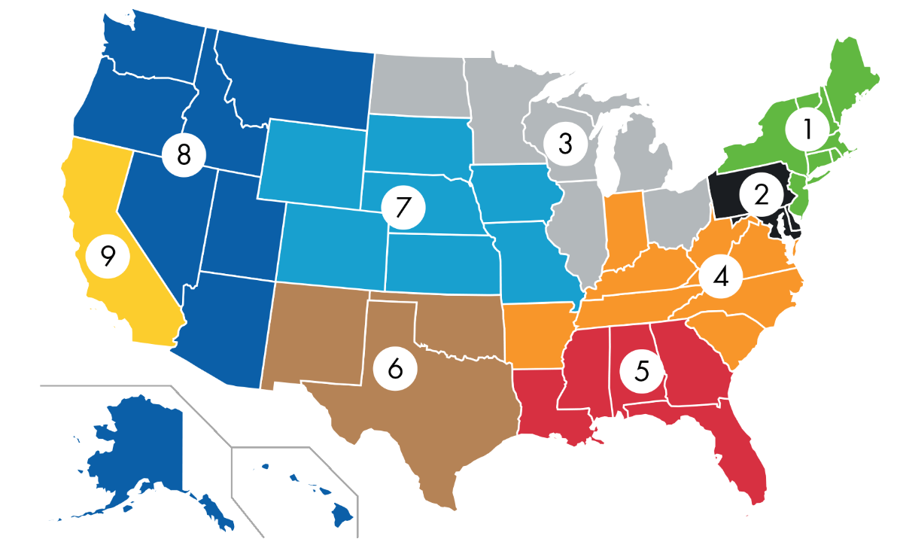

Region 6 includes the MEXICO, Oklahoma, New Mexico, and Texas Sections
Notes:
ASCE is divided into 10 Regions world-wide
Region 6 has three State Sections (Texas, Oklahoma, New Mexico) and now includes the Mexico Section

Slide 4
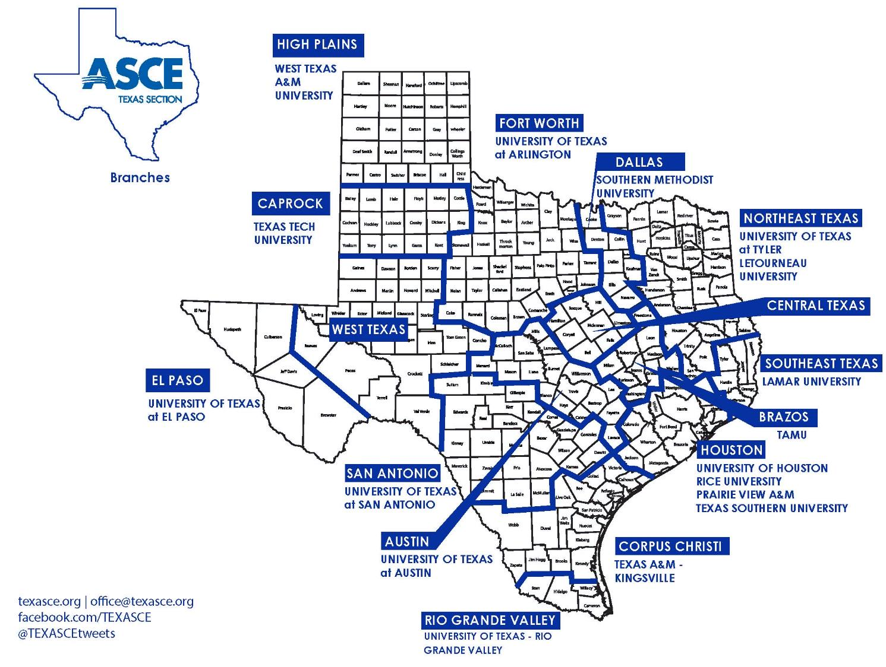






Notes:
The Texas Section of ASCE has 15 Branches that are designed to provide leadership development and networking opportunities on a local level, including committees and an officer rotation.
ASCE Texas Section also has a Board of Direction with 30 volunteers!
In addition to Board members, the Texas Section of ASCE also has more than 20 active committees.

Slide 5
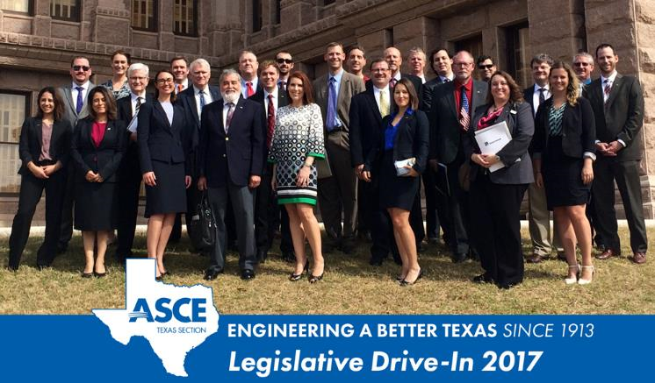
Texas Section Vision
  Texas civil engineers are leaders in their communities building a better quality of life across the street and around the world.
Texas Section Mission
    The ASCE Texas Section advances our communities through the development of civil engineers as leaders who create a legacy of Service through:
        Technical proficiency
        Educational opportunities
        Professional advocacy

Slide 6

ASCE 2017 Infrastructure Report Card

Slide 7
Cumulative
Infrastructure
GPA
As in 2017, America’s cumulative GPA is once again a D+.

Slide 8
America’s
Report Card

Slide 9

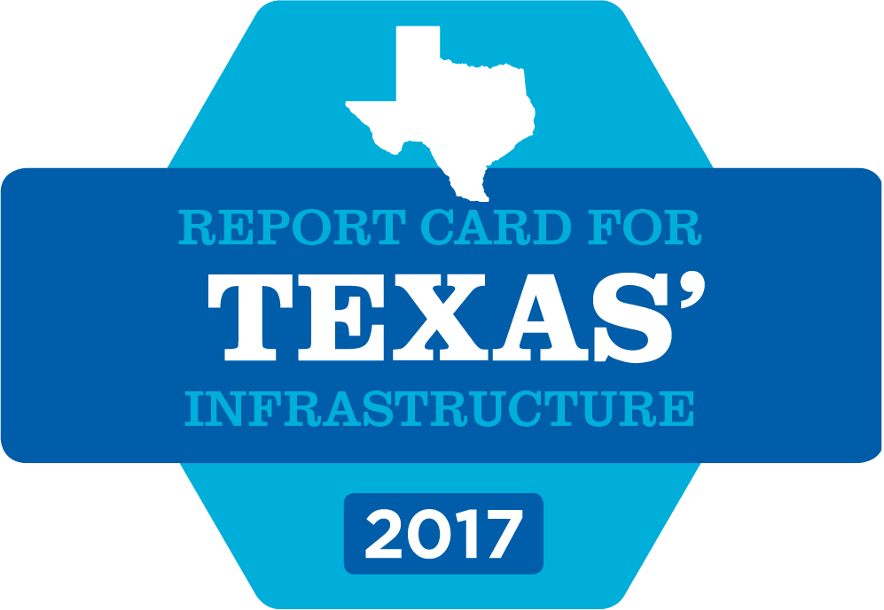
TexASCE.org/IRC
Texas’ GPA = C-
Report Card is released every 4 years
2017 Report Card builds on 10+ years
of infrastructure evaluations
Continues the Society’s mission to bring the declining state of America’s infrastructure to the attention of the public and our elected leaders
Notes:
ASCE Texas Section also publishes an Infrastructure Report Card for our state.
Using a simple, familiar A to F school report card format, the Report Card examines current infrastructure conditions and needs, assigning grades and making recommendations to raise them.
What would your parents say if you brought home a report card with a C minus?
This report card is used as a tool to educate the general public, and to help our elected leaders understand the level of investment needed to modernize our infrastructure.

Slide 10
Economic Consequences
As ASCE discovered in its 2016 economic study, Failure to Act: Closing the Infrastructure - Investment Gap for America’s Economic Future, failing to close this infrastructure investment gap brings serious economic consequences:
$3.9 trillion in losses to the U.S. GDP by 2025;
$7 trillion in lost business sales by 2025; and
2.5 million lost American jobs in 2025.
On top of those costs, hardworking American families will lose upwards of $3,400 in disposable income each year — about $9 each day.
Notes:
America’s infrastructure bill is long overdue. Every four years, ASCE estimates the investment needed in each infrastructure category to maintain a state of good repair
and earn a grade of B. The most recent analysis reveals the U.S. has only been paying half of its infrastructure bill for some time and failing to close that gap risks rising costs,
falling business productivity, plummeting GDP, lost jobs, and ultimately, reduced disposable income for every American family.

Slide 11




INITIATIVES
ASCE Sustainable Infrastructure
  Propose practical solutions to maintain & modernize our nation’s deteriorating infrastructure
ASCE Grand Challenge
  Reduce the life cycle cost of infrastructure by 50 percent by 2025 & foster the optimization of infrastructure investments for society
  Embrace & encourage civil engineers’ role as contributors to a sustainable world
Raise the Bar
  Increase education requirements for engineering licensure to better protect the public in the future
Notes:
ASCE maintains a list of 21 Talking Points
These Talking Points include ASCE’s three strategic initiatives
You may wish to refer to these Talking Points if you're looking for a particular presentation topic when your ASCE Region 6 Governor visits or for your own use when presenting to other groups within your Student Chapter

Slide 12
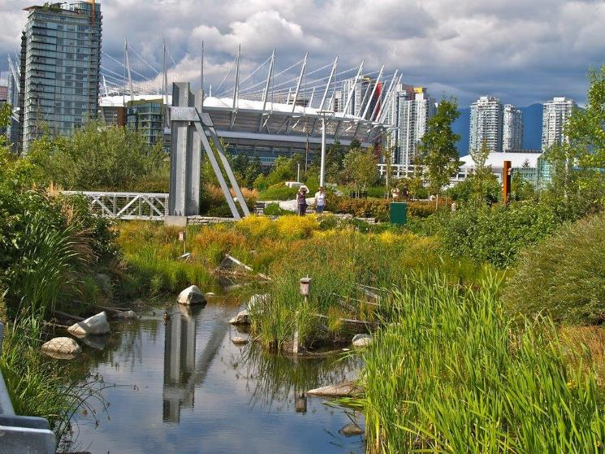
Relevant Policy Statements
Policy 418:
The Role of the Civil
Engineer in
Sustainable Development
Policy 517:
Sustainable Development
Goals
Institute for Sustainable Infrastructure
ASCE
CEC
AMPWA
Notes:
We also address Sustainability in many of our policy statements.
418: The Role of the Civil Engineer in Sustainable Development: The civil engineering profession recognizes the reality of limited natural resources, the desire for sustainable practices (including life-cycle analysis and sustainable design techniques), and the need for social equity in the consumption of resources.
517: Sustainable Development Goals: Engineers of the 21st century play a critical role in contributing to peace and security in an increasingly challenged world. The engineering profession has an obligation to provide solutions to meet the basic needs of all humans for water, sanitation, food, health, and energy, while at the same time protect cultural and natural diversity and conserve and sustainably use resources.
Photo: Vancouver Olympic Village
Ongoing series of HNBD images at the "post-Industrial Urban Renewal" site on SE False Creek in Vancouver (BC). This location is also the site of the Athletes Village from the 2010 Winter Olympics in Vancouver, BC.
And, as a key part of our sustainable infrastructure initiative, ASCE joined with the American Council of Engineering Companies and the American Public Works Association to form a new organization called the Institute for Sustainable Infrastructure.

Slide 13
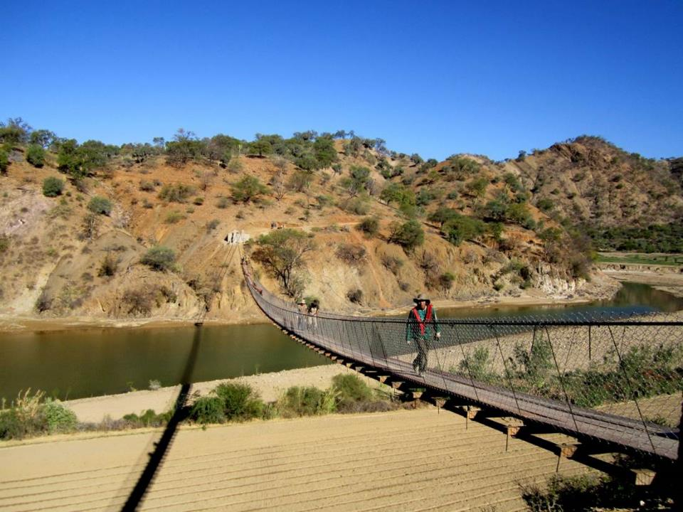
Sustainable Rating System - Envision Project
Notes:
Since 2010, more than 4,900 professionals in 20 countries have become certified to apply the Envision sustainability rating system and have earned the designation ISI Envision Sustainability Professional (ENV SP).
Credentialed individuals can work with a design team to help achieve the highest level of sustainability for an infrastructure project, and guide the project through the Envision verification process.
And now, ISI is offering a credential for college students and recent graduates. Since 2013, ISI has awarded 20 projects with an Envision rating for sustainable infrastructure.
Recently, the Kansas City Streetcar Project in Kansas City, MO, earned an Envision Platinum award.
It is the first transit project, the first streetcar project. The streetcar improves local circulation, supports local development goals, strengthens urban centers and maintains long-term sustainability standards.
Currently, there are 350 other projects also using Envision as a self-assessment tool.

Slide 14
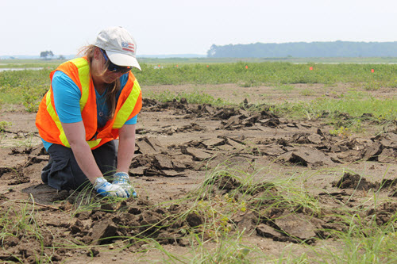
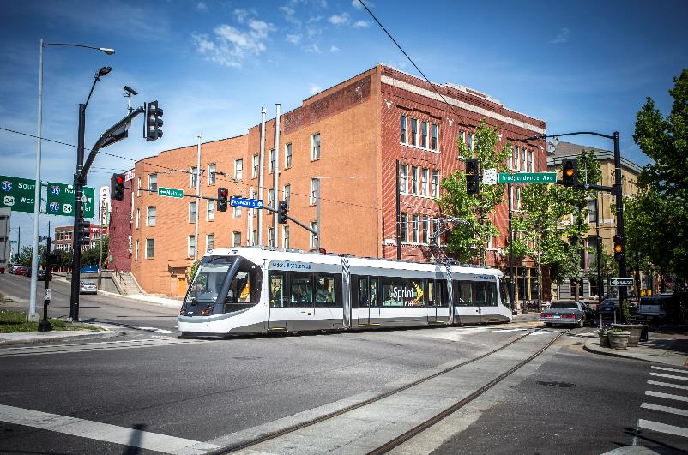
Innovation in Sustainable
Engineering Award
Award Winners:
  2011: Menomonee Valley Industrial Center and Community Park, WI
  2012: Greenlink Windsor Transportation Land Use Planning (Ontario, Canada)
  2013: Chari Chari (Bolivia) Cable Supported Footbridge
  2014: Port of Long Beach, CA
  2015: Paul S. Sarbanes, Poplar Island MD
  2016: City of Burbank Water and Power EcoCampus (Burbank, California)
  2017: Kansas City Downtown Streetcar
Notes:
To encourage our members to share their sustainable projects, ASCE established in 2010 the Innovation in Sustainable Engineering Award.
The award recognizes a completed civil engineering project for creativity in the form of innovative sustainability.
Here’s the list of winners including the 2015 winner: Paul S. Sarbanes Ecosystem Restoration Project at Poplar Island.
Please consider submitting some of your projects for the 2018 award. Nominations are due June 1.

Slide 15
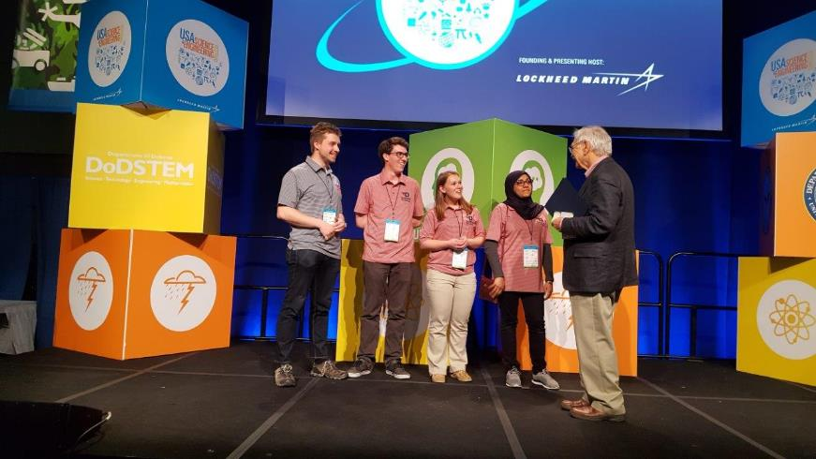
Sustainable Development Award
Notes:
ASCE established a Sustainable Development Award that we give at the EPA’s annual People, Projects and the Planet (EPA P3) Competition.
This year Ohio’s University of Dayton won for its Solar Thermal Adsorption Refrigerator prototype, a solar refrigerator for vaccines.

Slide 16
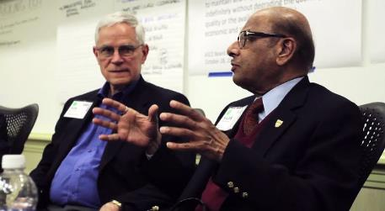
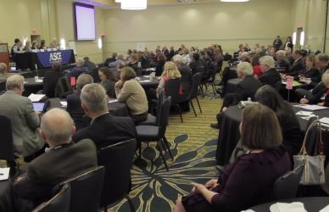
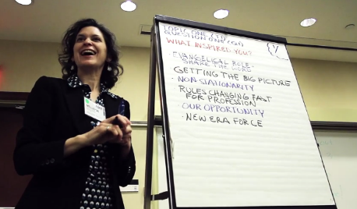
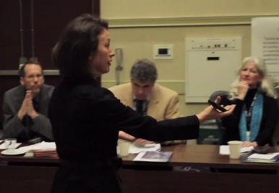
The Sustainability Summit
Notes:
For the 21st century designer, taking sustainability into account and applying it at every stage in the life cycle of every project needs to become second nature.
In January, our three-day Sustainability Summit was just the start of a more aggressive campaign to build greater urgency in the profession and accelerate adoption of sustainability practices.
The summit’s cross-section of industry leaders, stakeholders, and practitioners found inspiration and context in recent events such as the international climate accord signed in Paris and the United Nations’ new Sustainable Development Goals, noting that addressing a future that’s different from the past will rely on civil engineering for solutions.
What we heard at the summit was that the conditions under which infrastructure is being designed today are uncertain, and infrastructure designed in the recent past is inadequate for current conditions; we are designing today the infrastructure for the next 50 to 100 years.
The very basis of civil engineering design has been that conditions of the past can be relied upon as good predictors of future conditions, a concept called stationarity.
Using those conditions, we have developed and relied on formulas, tables, graphs and standards to do work more efficiently, and we have licensed and certified engineers to use those standards to manage risk and liability.
However, decades of overuse of resources, reliance on fossil fuel for energy and continuing release of greenhouse gases and other pollutants into the environment contributing to significant climate change has made this principle no longer relevant or reliable for future development.
If we continue to do what we have done in the past, the infrastructure we deliver will not be functional, reliable or safe under those future conditions nor will it protect the public’s health, safety and welfare.
If we accept that stationarity is no longer viable, then, to ensure that we can fulfill our professional obligations, we must have new standards and processes that can address these issues.

Slide 17
Notes:
ASCE has established the ASCE Grand Challenge.
The ASCE Grand Challenge is a “Call to Action” for ASCE and the profession to increase the value and capacity of infrastructure and to increase/optimize infrastructure investments.
It is about transforming the way we plan, deliver, operate and maintain our nation’s infrastructure to enable us to meet the challenges of tomorrow.

Slide 18
ASCE Grand Challenge
Reduce the life cycle cost of infrastructure by 50 percent by 2025 and foster the optimization of infrastructure investments for society.

Slide 19
What does the Grand Challenge mean?
Sustained approach to improve the condition of America’s infrastructure resulting in:
  Achieving our nation’s economic potential
  Improving our global competiveness
  Increasing resilience in meeting today’s and tomorrow’s challenges
  Maximizing the economic benefit of infrastructure investments
Notes:
Our infrastructure is struggling to efficiently meet today’s needs, impacting all elements of society and the economy.
The Grand Challenge is an opportunity for each of us, and the industry as a whole, to embrace our unique leadership role and rethink, advocate, and deliver what is possible.
While infrastructure funding and policy changes require the support of others, civil engineers control project delivery. We must rethink how we deliver our projects. Can we find lower cost or longer lasting materials? Can we dramatically shorten the time it takes to put new projects into service?
We must look for innovative financing mechanisms. We must transform our engineering and business practices to deliver better value to our clients in exchange for greater investment. As our GameChangers reports show, many of us are already doing so, and more of us must follow their lead.

Slide 20
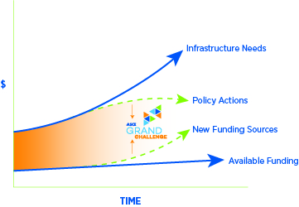
Closing the Infrastructure Gap
Notes:
To address the backlog of needs and to make improvements necessary for economic growth and public well-being, ASCE estimates that $3.6 trillion dollars infrastructure investment is required by 2020 of which 1.6 trillion dollars is currently unfunded.
This funding requirement far outpaces available funding.
We must continue to make the compelling case for new infrastructure funding sources and additional infrastructure funding from traditional sources. We must advocate and influence major legislative, regulatory, and policy changes and remove self imposed limits on our infrastructure’s potential while simultaneously creating new opportunities.
Our policy and funding advocacy are no less important than in the past. However, they cannot close the gap alone.
Most importantly, we must do what our profession alone is uniquely qualified to do. We must lead the significant improvement in the delivery and life cycle performance of infrastructure investments through innovation spurred on by performance based standards; increased focus on life cycle performance, especially through life cycle cost analysis, and enhanced resilience.

Slide 21
What will it take to meet the Grand Challenge?
Challenge Our Assumptions and Be Open to Change
Create New Possibilities and Solutions
Continuously Improve Our Practices, Processes, Solutions and the Profession
Notes:
To achieve the Grand Challenge, we need to broaden our understanding of what our obligations are as civil engineers. Protecting the health, safety, and welfare to the community includes considering ways to make the most of our limited funding dollars for infrastructure. Our focus on outcomes needs to include an emphasis on total performance. Our solutions must meet today’s and tomorrow’s needs.

Slide 22
How is ASCE addressing the Grand Challenge?
Creating a Comprehensive Focus on Improving Infrastructure Delivery
Performance Based Standards
  Innovation
  Life Cycle Cost Analysis
  Enhanced Resilience
Leveraging our complementary efforts on policy and infrastructure funding to help close the infrastructure gap
Notes:
ASCE’s members and its technical committees and other professional groups provide the nucleus from which industry-wide transformation can be driven. As we migrate our standards and practices from prescriptive- to performance-based ones, we will open the aperture for new solutions, new approaches and encourage innovation across the profession. New tools, validation, and quality measures will be required and we are uniquely positioned to deliver them.
Life cycle cost perspectives will open the door to new solutions and increasingly leverage our technical prowess. The Grand Challenge will drive us to optimize for the longer term reflecting the long term nature of these investments and their impacts.
The growing emphasis on life cycle performance will enhance the resilience of what we design, build, operate, and maintain, and this will be reflected in our performance standards.
This is the essence of the Grand Challenge and ASCE’s role in achieving it. The Grand Challenge will not diminish our efforts for intelligent policy changes and increased infrastructure funding. If anything, it will strengthen our resolve and leverage as we are increasingly seen as a key solutions provider.

Slide 23
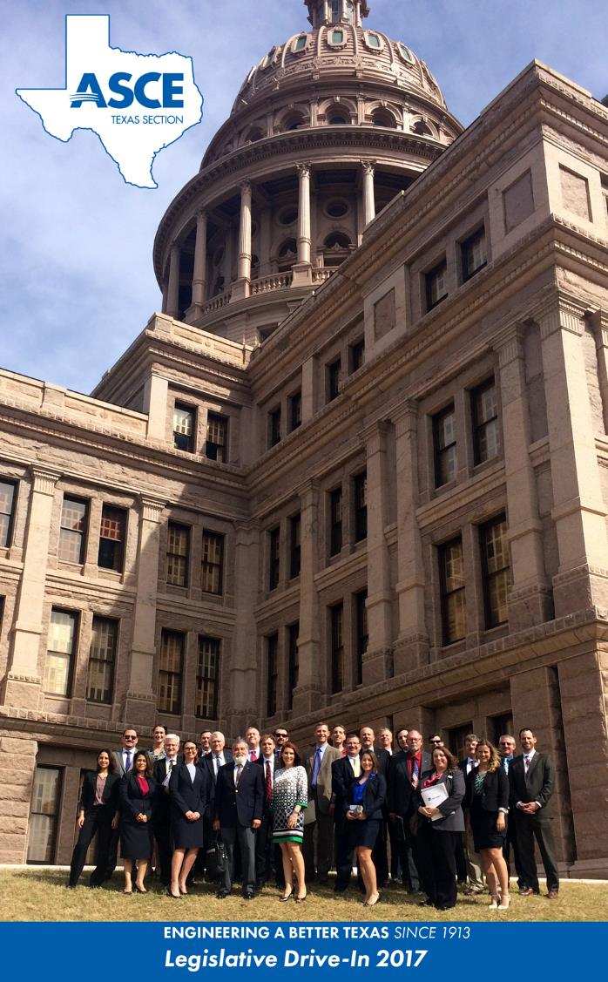
Legislative Drive-In
TexASCE.org
Save the Date:
Spring 2019
Meet with elected officials to discuss INFRASTRUCTURE and other CE topics
Notes:
The ASCE Texas Legislative Drive-In will be held in Austin every 2 years, concurrent with Texas’ Legislative Session
Section leaders are applying lessons learned from ASCE’s Legislative Fly-In to benefit members in Texas

Slide 24
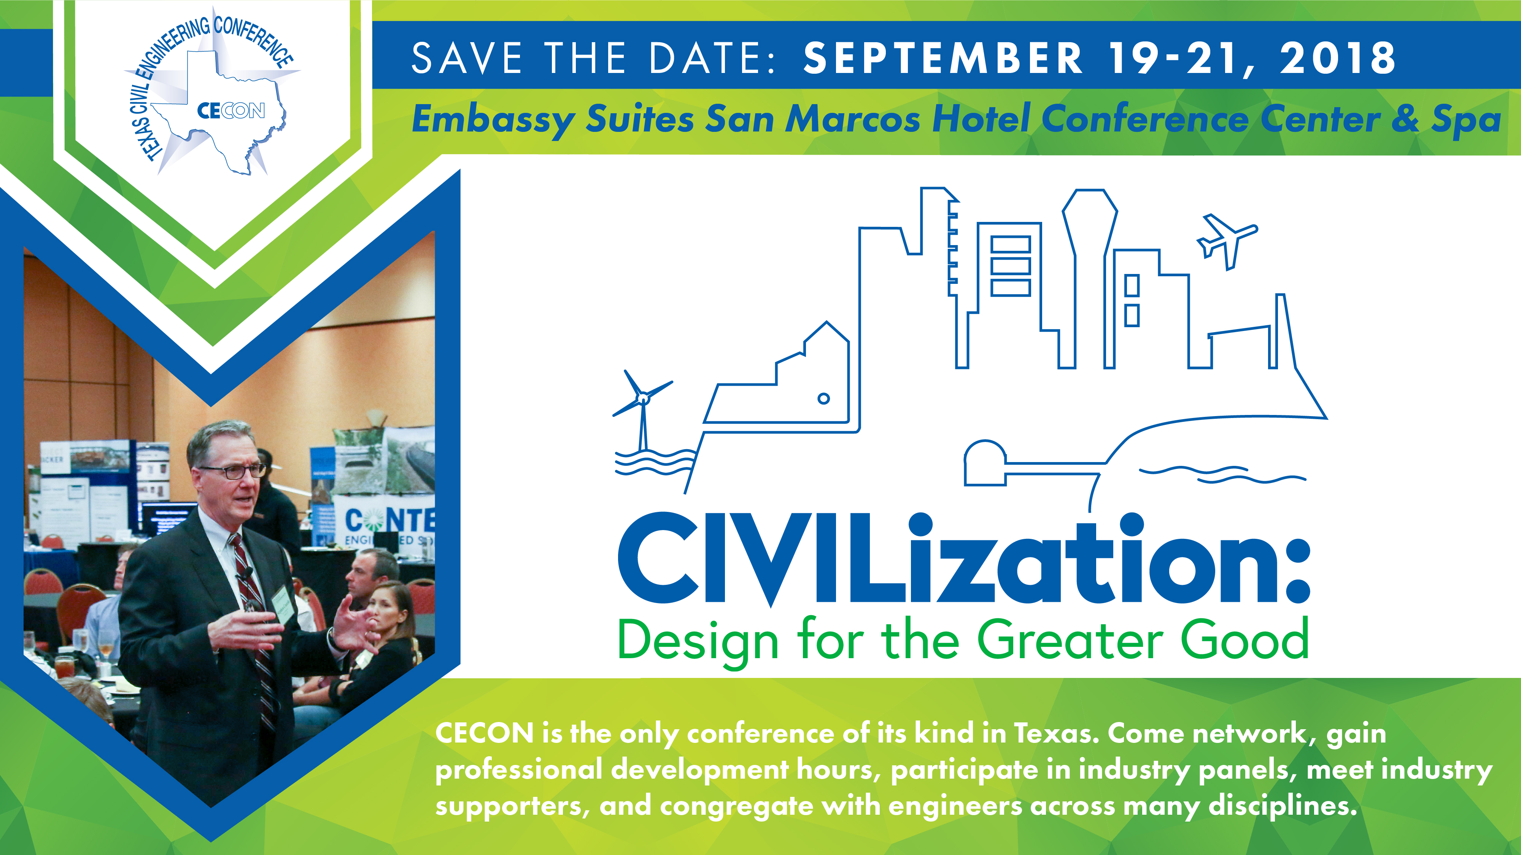
Notes:
CECON is the premier conference for civil engineers in Texas and Beyond.
Discounted conference registration is available for students.

Slide 25
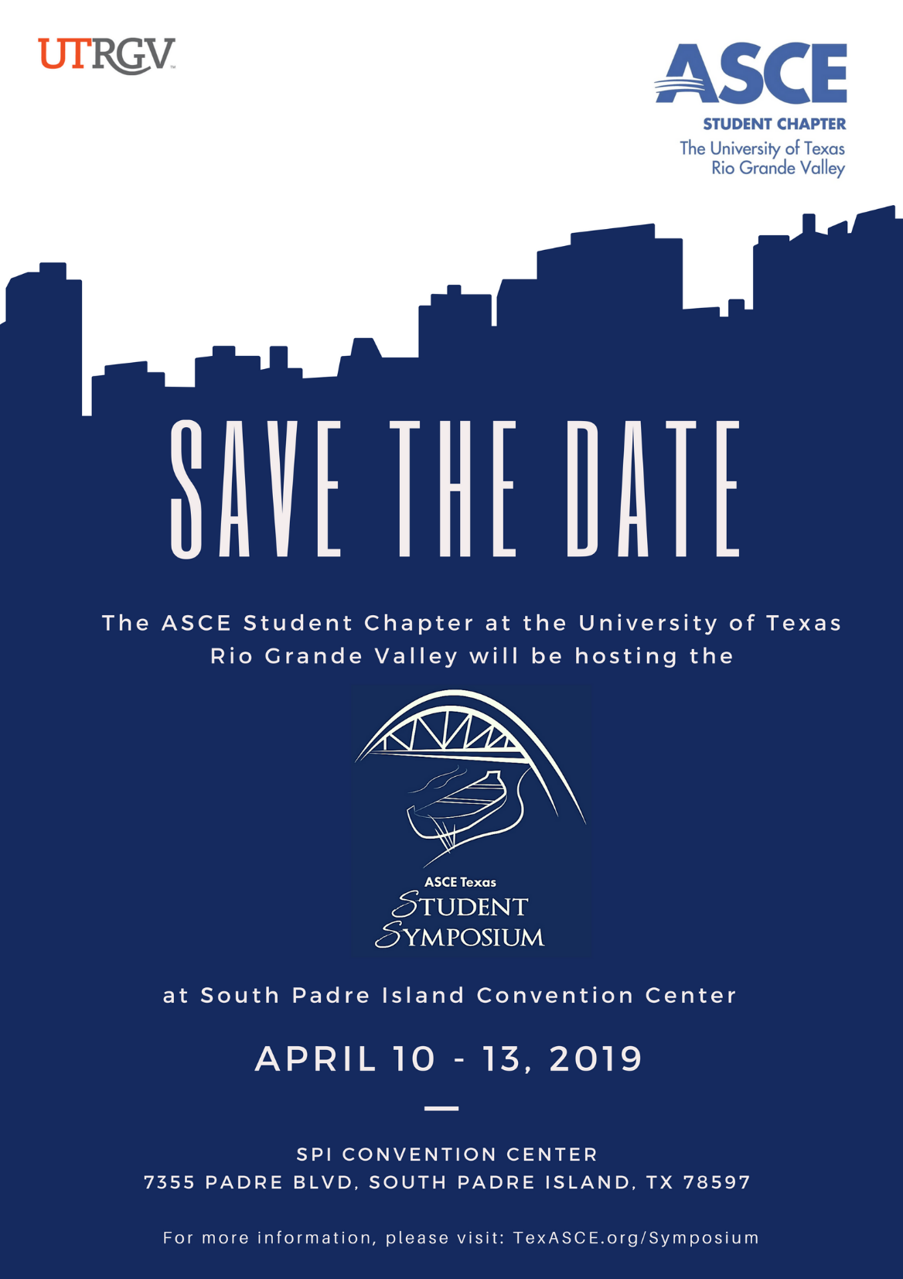
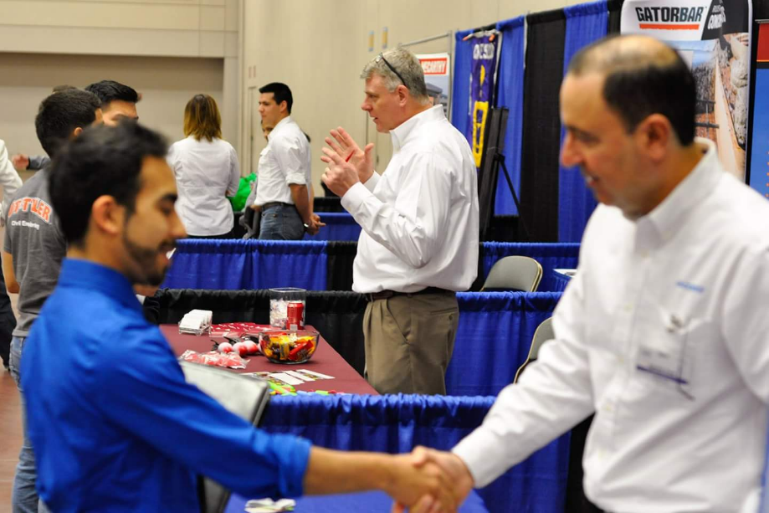
TexASCE.org
Notes:
This event combines the Texas-Mexico Student Conference's steel bridge and concrete canoe competitions, a career fair, and seminars into one FUN event.
Symposium attendees and ASCE Student Members, are some of the brightest civil engineering minds engaged in leadership, teamwork, and professionalism. Our Career Fair participants are excited to meet them!
Also, I look forward to seeing you all for the 2019 ASCE Texas Student Symposium in South Padre Island, hosted by the ASCE Student Chapter at The University of Texas Rio Grande Valley. (call for applause for UTRGV planners if present)

