Slide 1
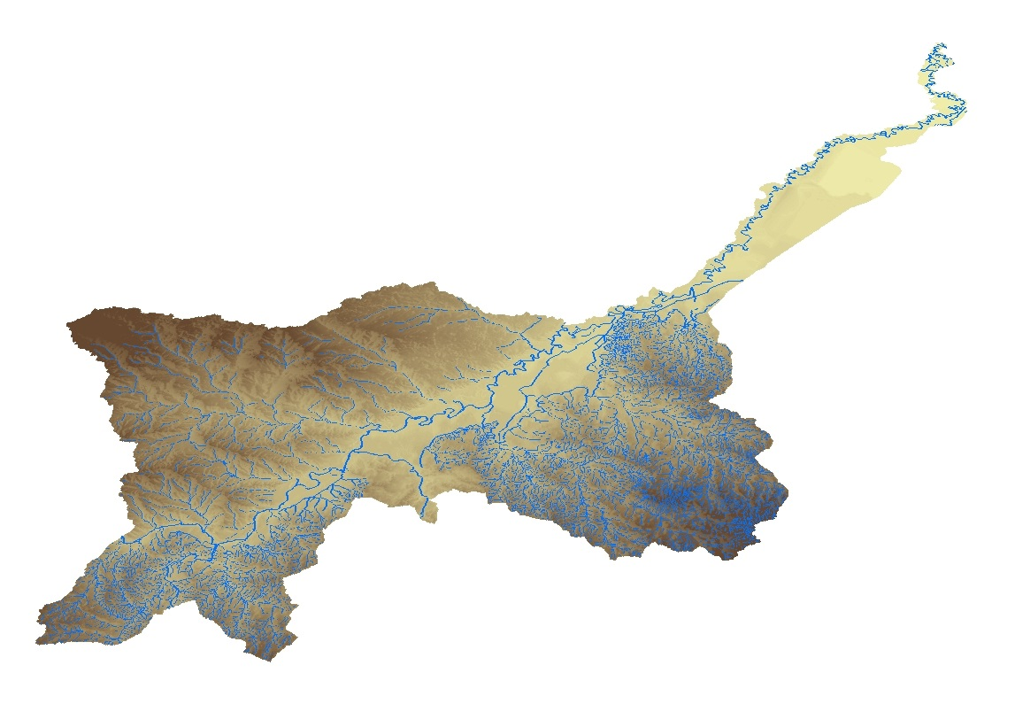
The Lower Rio Grande /Río Bravo Water Quality Initiative (LRGWQI)
20th Annual Lower Rio Grande Valley Water Quality Management and Planning Conference
May 18, 2018
Roger Miranda, P.G.
Texas Commission on Environmental Quality

Slide 2
The Lower Rio Grande/Río Bravo Water Quality Initiative
Binational effort to restore and protect water quality in the Lower Rio Grande/Río Bravo
Conducted under the auspices of the International Boundary and Water Commission (CILA/IBWC)
Six agencies involved:
US Mexico
IBWC, USEPA, TCEQ CILA, CONAGUA, SEDUMA (SEDUMA)

Slide 3
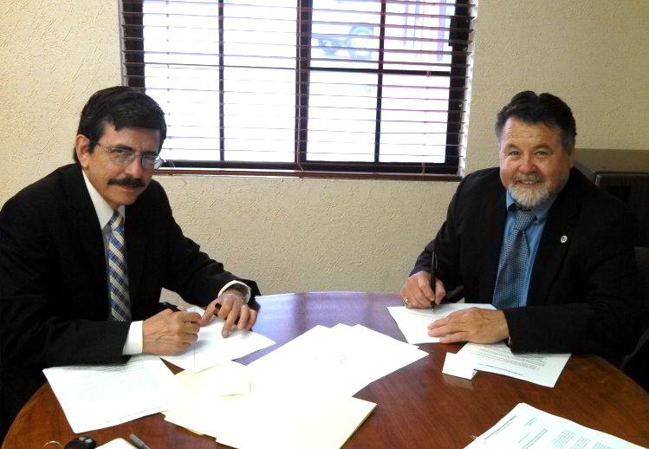
Terms of Reference
Exchange of Letters Signed September, 2013
Developed Common Terms of Reference (TOR) for the Project
The TOR established the study area, goals and objectives of the project and the structure of the binational working groups
Established a Core Group of agency representatives and a Binational Technical Work Group to advise the Core Group

Slide 4
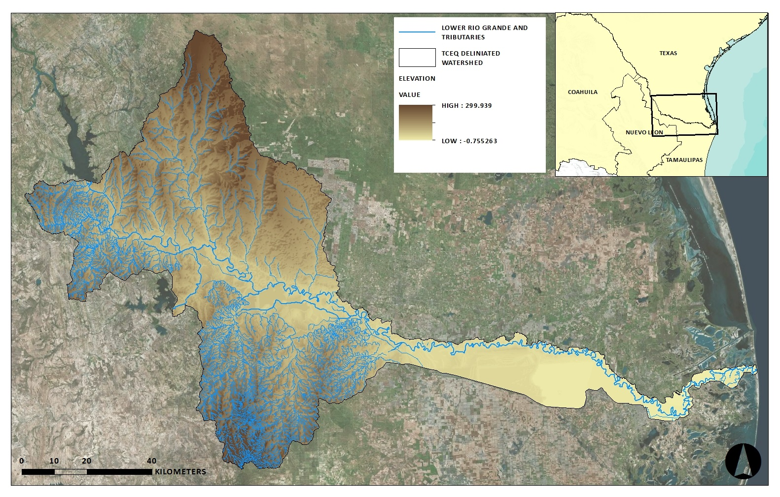
Study Area

Slide 5
LRGWQI Objectives
Address current and future water quality issues
Evaluate management strategies for point sources
Evaluate other mechanisms and strategies to improve water quality under steady-state conditions, including salinity management
Suggest implementation strategies
Goal = “Binational Watershed Based Plan”

Slide 6
Technical Approach
Binational Data Exchange
Historical Data Review
Identification of Data Gaps
Data Collection
Data Analysis and Modeling

Slide 7
Technical Approach
Binational Data Exchange ✓
Historical Data Review ✓
Identification of Data Gaps ✓
Data Collection ✓
Data Analysis ✓ and Modeling

Slide 8
Technical Approach
Binational Data Exchange ✓
Historical Data Review ✓
Identification of Data Gaps ✓
Data Collection ✓
Data Analysis ✓ and Modeling

Slide 9
Work Completed since September of 2013
5 Synoptic Surveys of Water Quality
Watershed Characterization
Historical Data Review and Analysis
Point Source Analysis
Geospatial Analysis (Nonpoint Sources)
5 LA-QUAL Models Developed
Decision Support Software in Development

Slide 10
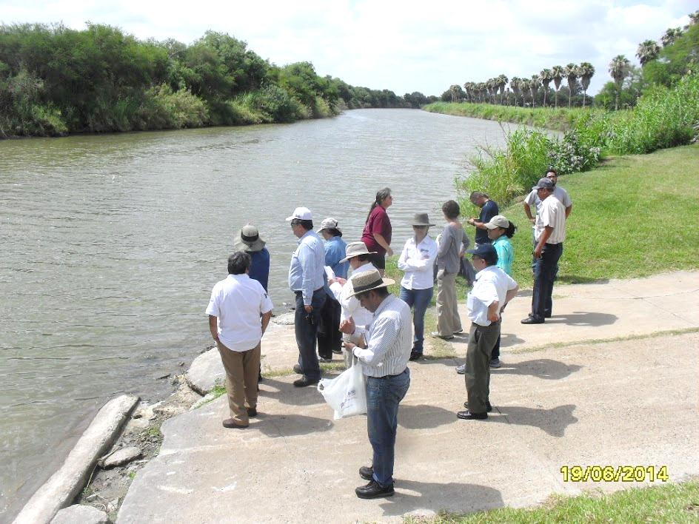
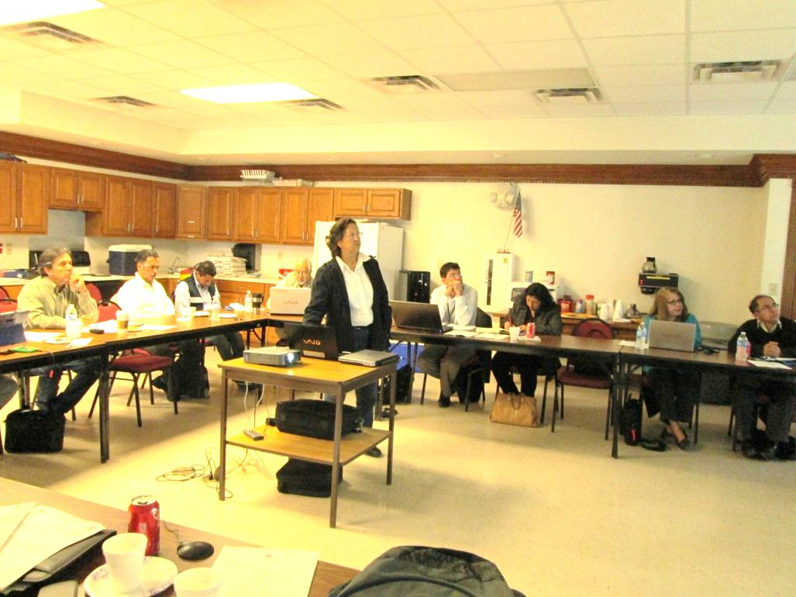
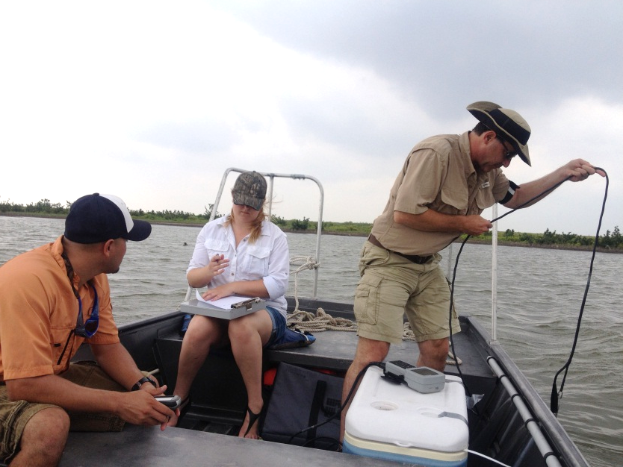
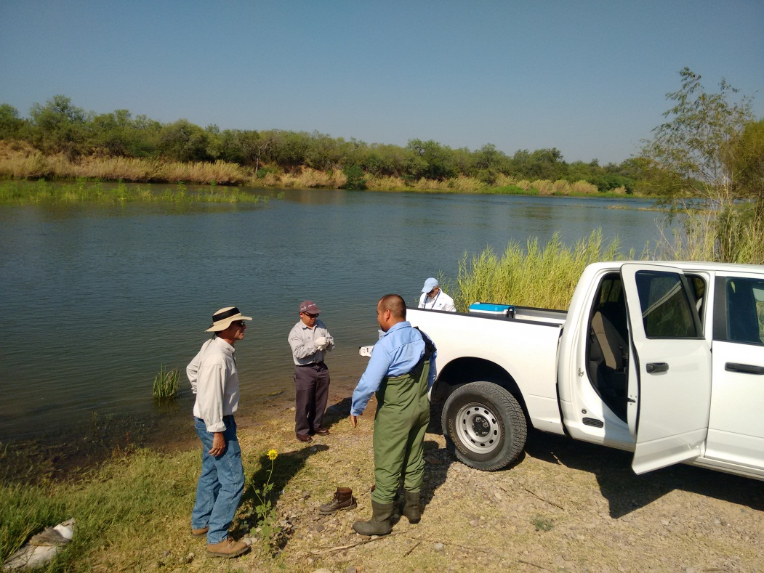

Slide 11
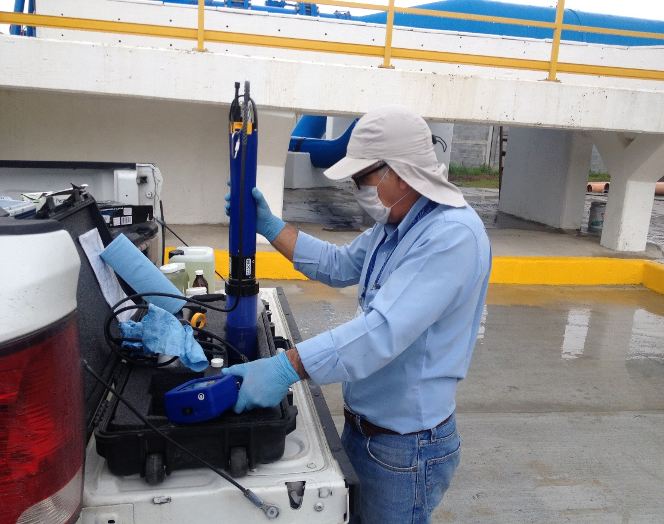
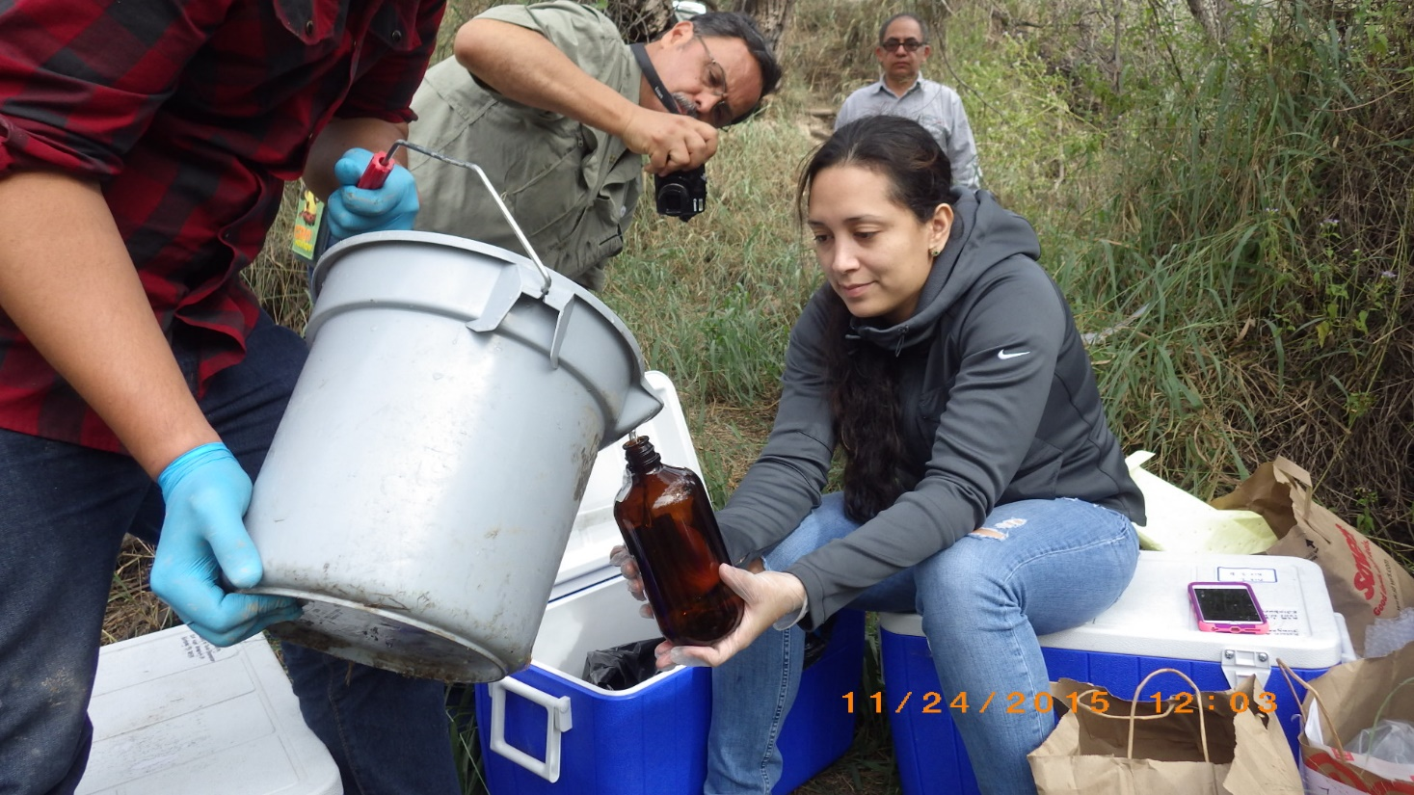
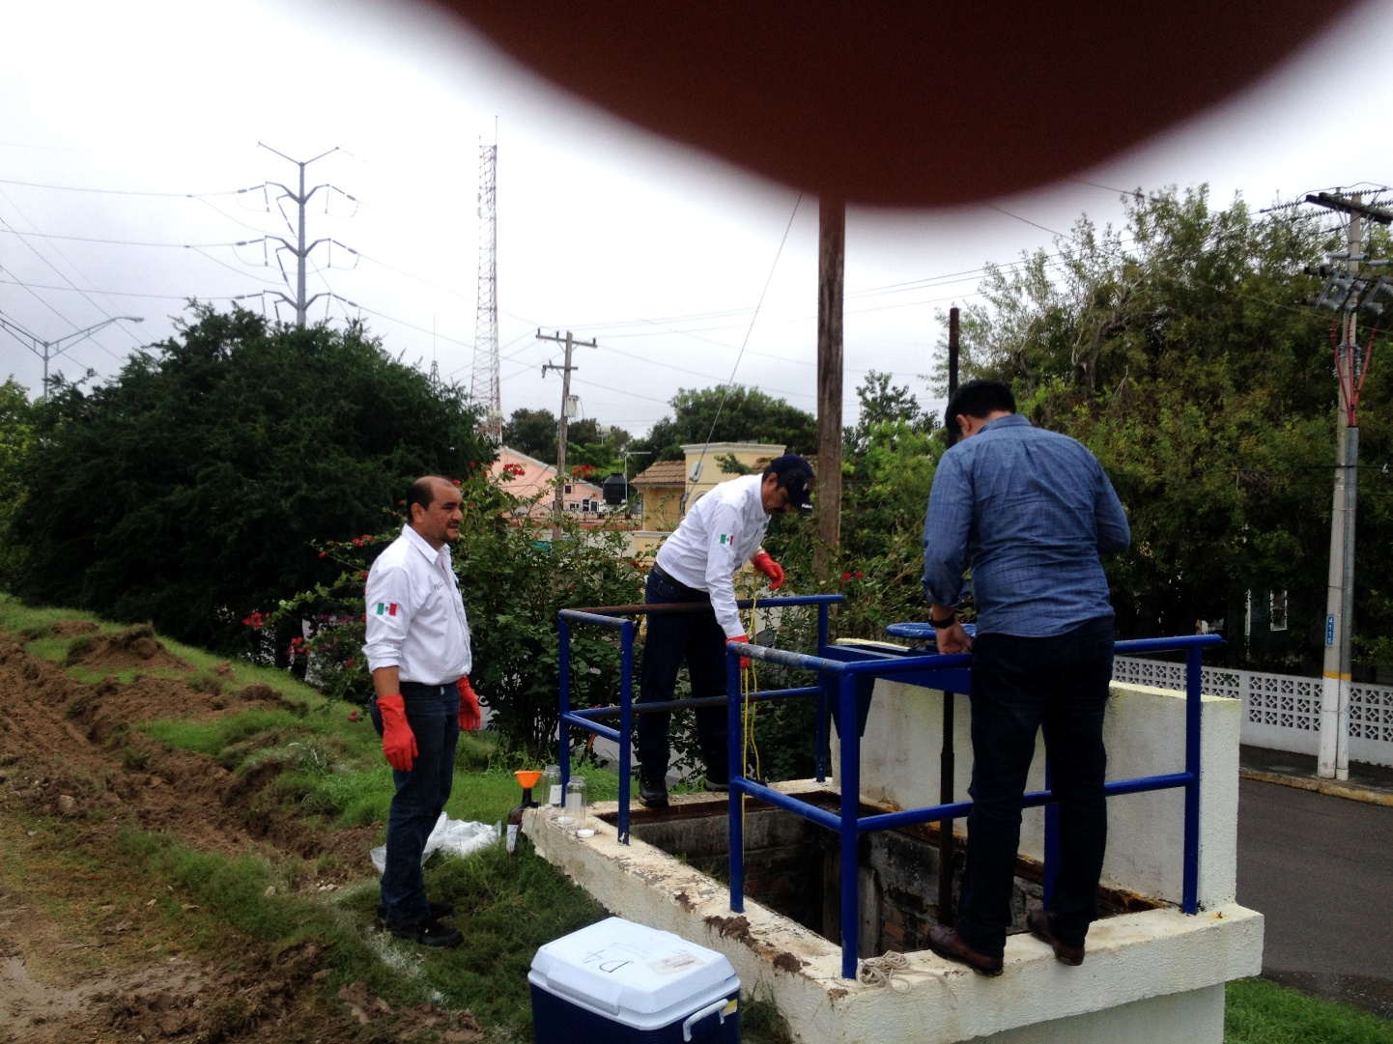
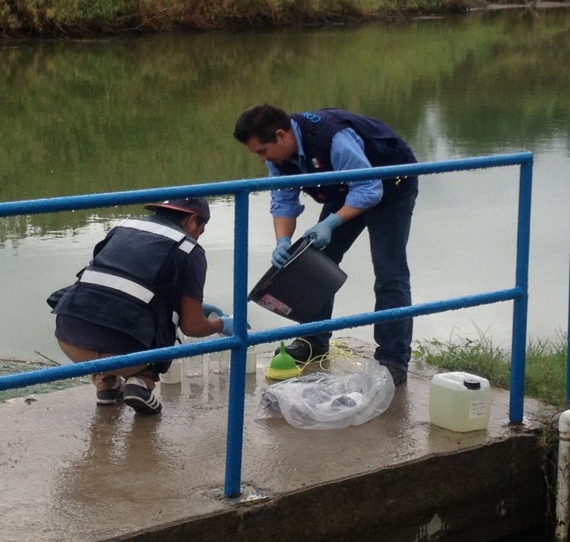

Slide 12
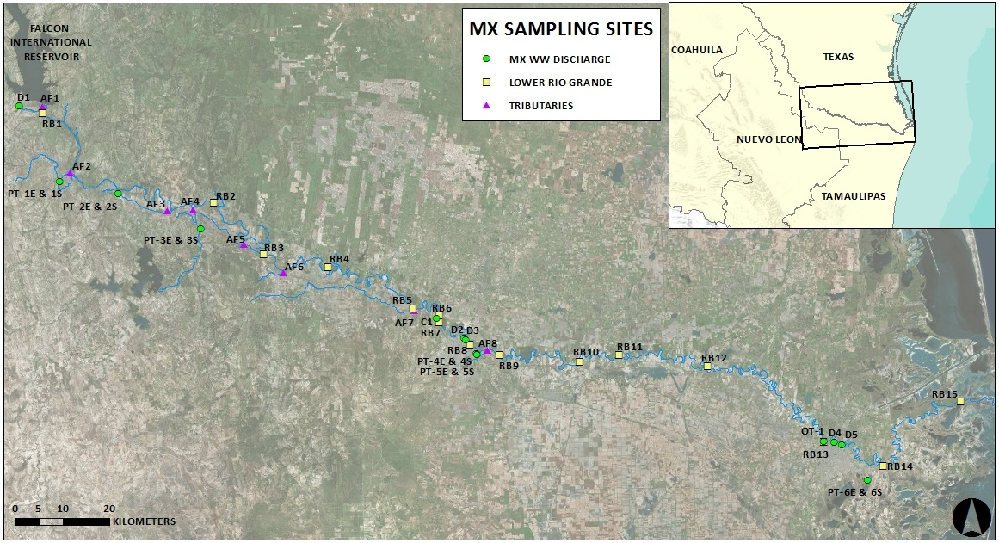
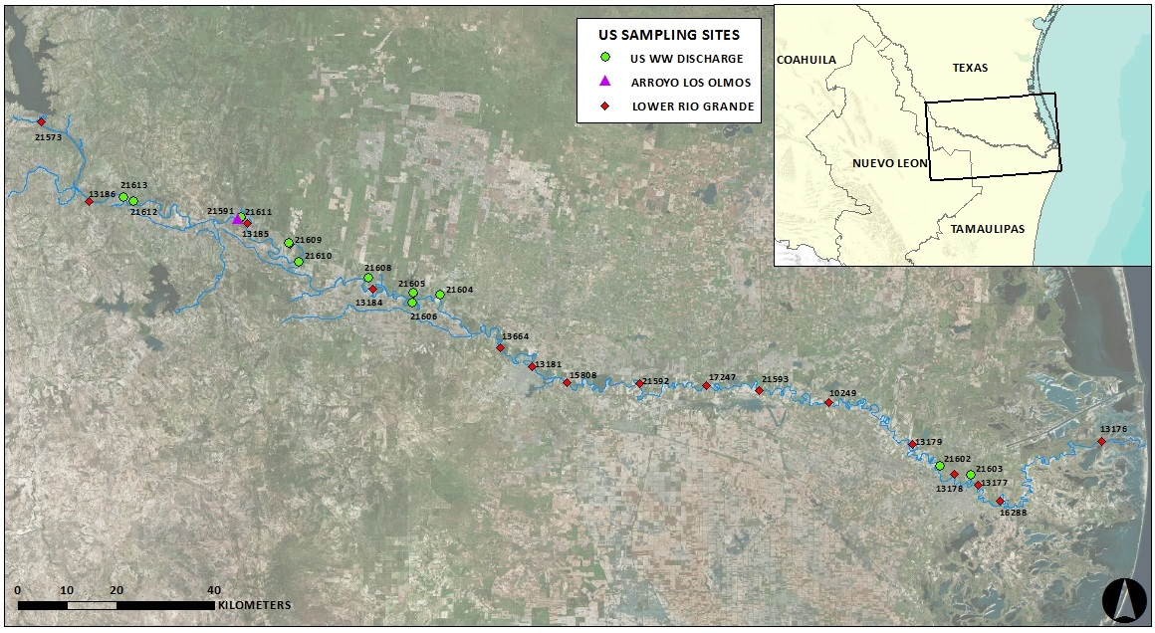
Binational Synoptic Surveys of the Lower Rio Grande – March 2015, August 2015, November 2015 and April 2016
15 sites on the Lower Rio Grande – 10 tributaries (3 US and 7 MX )
16 Wastewater Treatment Facilities (10 US and 6 MX ) – 4 untreated Outfalls (MX)
Notes:
I’d like to make a point that, while routine monitoring can give us a general picture of persistent (more accurately consistent) water quality problems and trends
Routine monitoring is not always able to capture sporadic upsets, or pulse events
A good example is a synoptic survey we conducted in 2014 as part of a binational project I’ve been working on for a while now.
We sampled sixteen sites on the river, one US tributary (Arroyo Los Olmos) and eleven US wastewater treatment facilities.

Slide 13
Water Quality Parameters
Field Parameters
Temperature
pH
Specific Conductance
Dissolved Oxygen (grab and 24 hr)
Secchi Depth
Instantaneous Stream Flow
Conventional Parameters and Bacteria
Total Dissolved Solids
Chloride
Sulfate
Total Suspended Solids
Nutrients (Ammonia Nitrogen, NO₂+NO₃, PO₄-P, TN, TP)
Chlorophyll a
Bacteria (Fecal Coliform, E. coli and Enterococcus)
Non-Conventional Parameters and Toxicity*
Metals
Organics (e.g., vocs, svocs, pesticides, etc.)
Toxicity

Slide 14
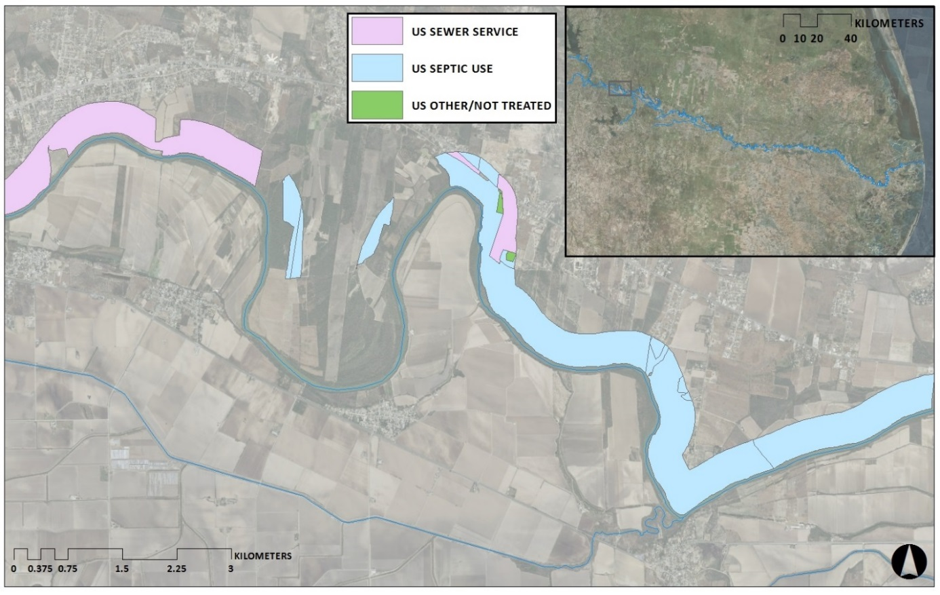
Geospatial Analysis of US Residential Nonpoint Sources in the LRG/RB Watershed

Slide 15
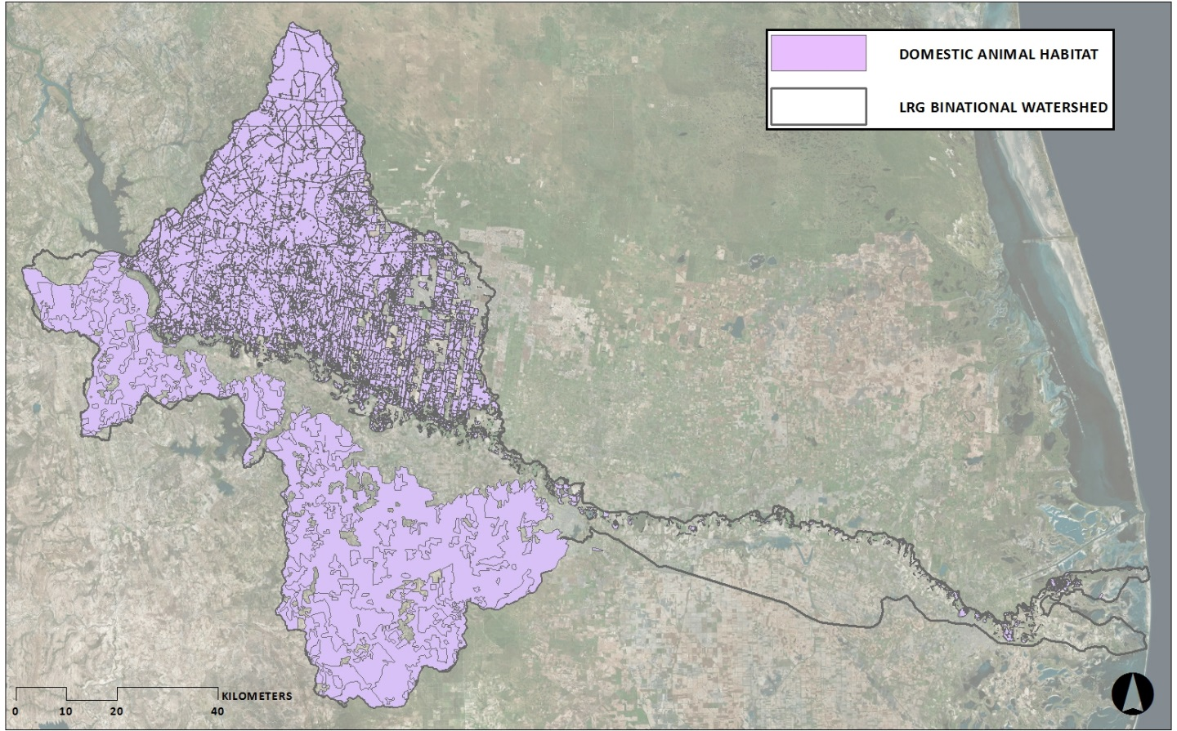
Grazing Habitat for Livestock and Domestic Animal in the LRG/RB Watershed

Slide 16
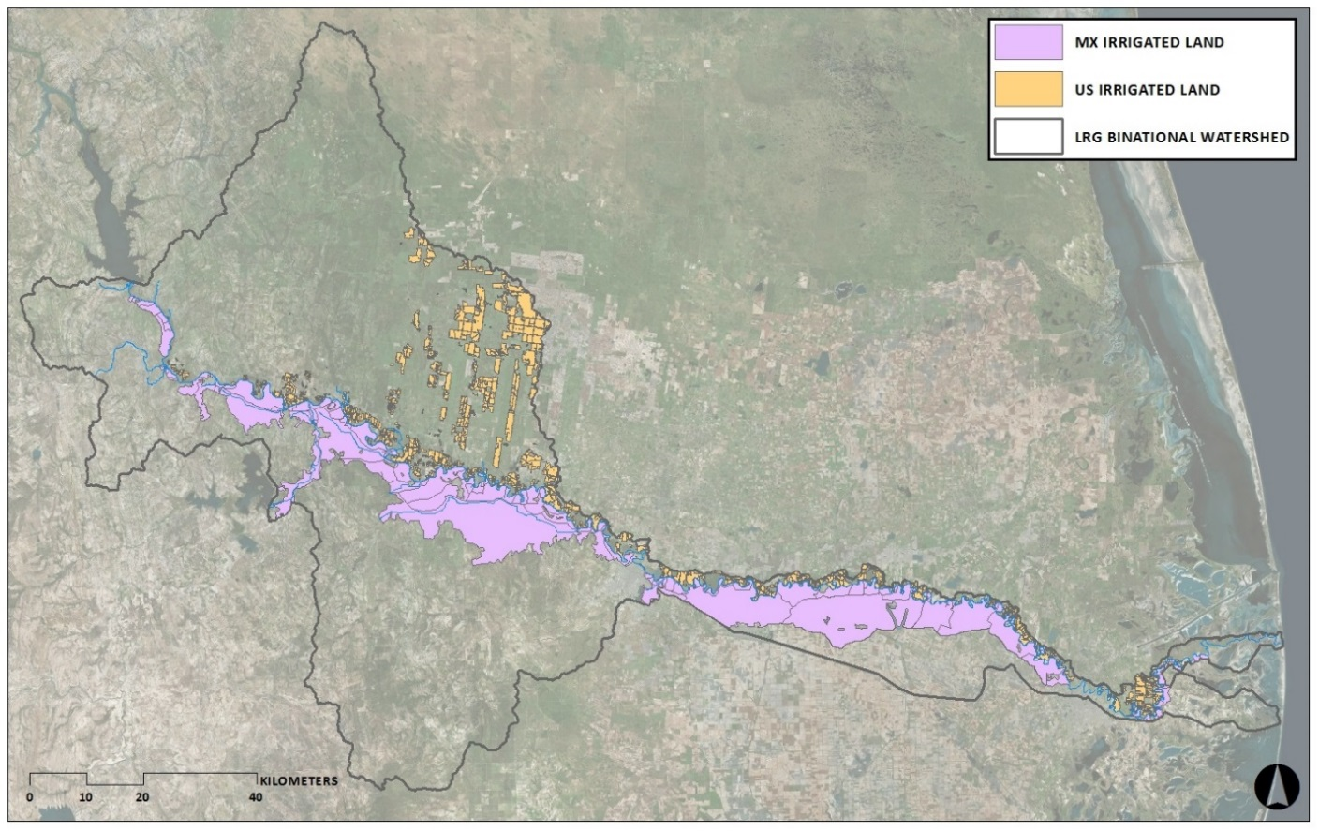
Irrigated agricultural land in the LRG/RB Watershed

Slide 17
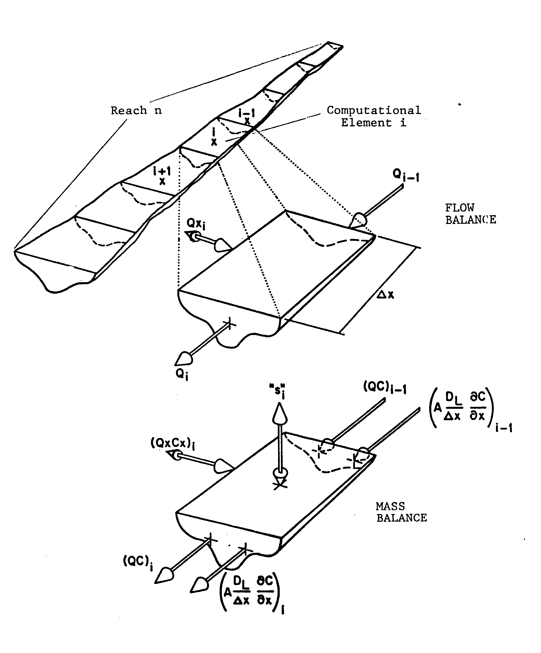
LA-QUAL Model
e
One - Dimensional
Steady- State

Slide 18
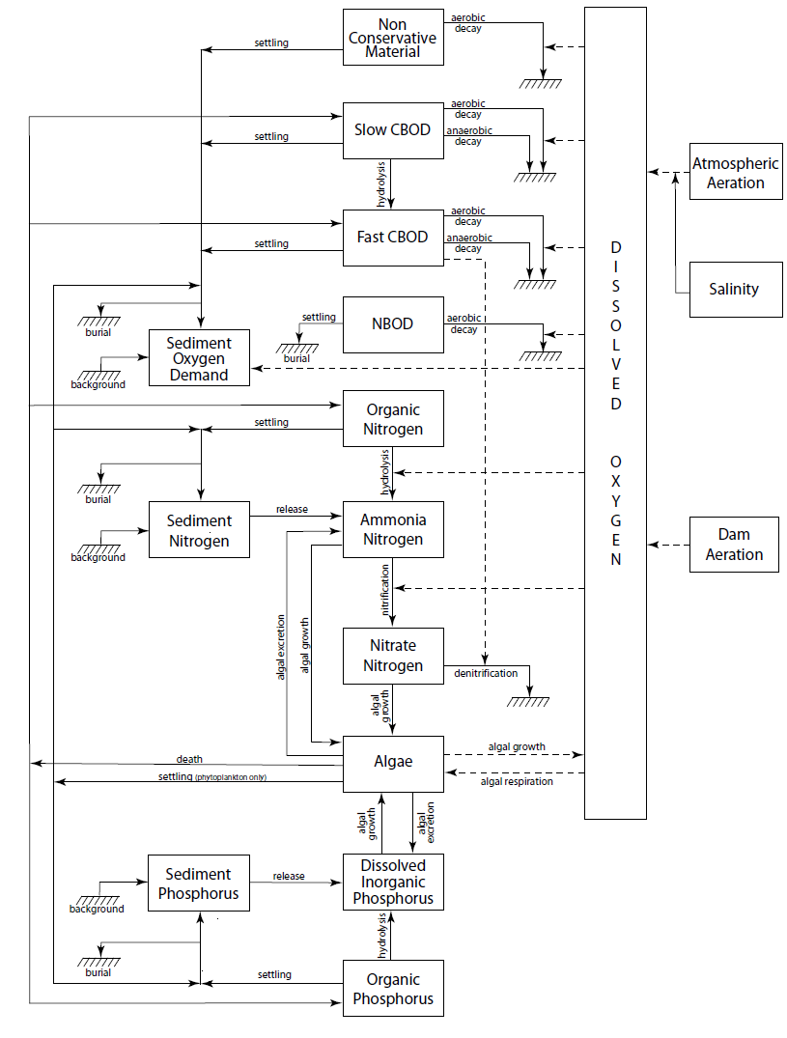

Slide 19
LRGWQI Decision Support System
TCEQ effort to develop a decision support tool for the LRGWQI
Nonproprietary software (Open Source Libraries)
Generate LA-QUAL input file from user input
user defined PS and NPS loading
GIS interface
Parse/read LA-QUAL output file
Post-processor and graphical output display
*Goal: suitable for planning needs - user needn’t be a water quality modeler

Slide 20
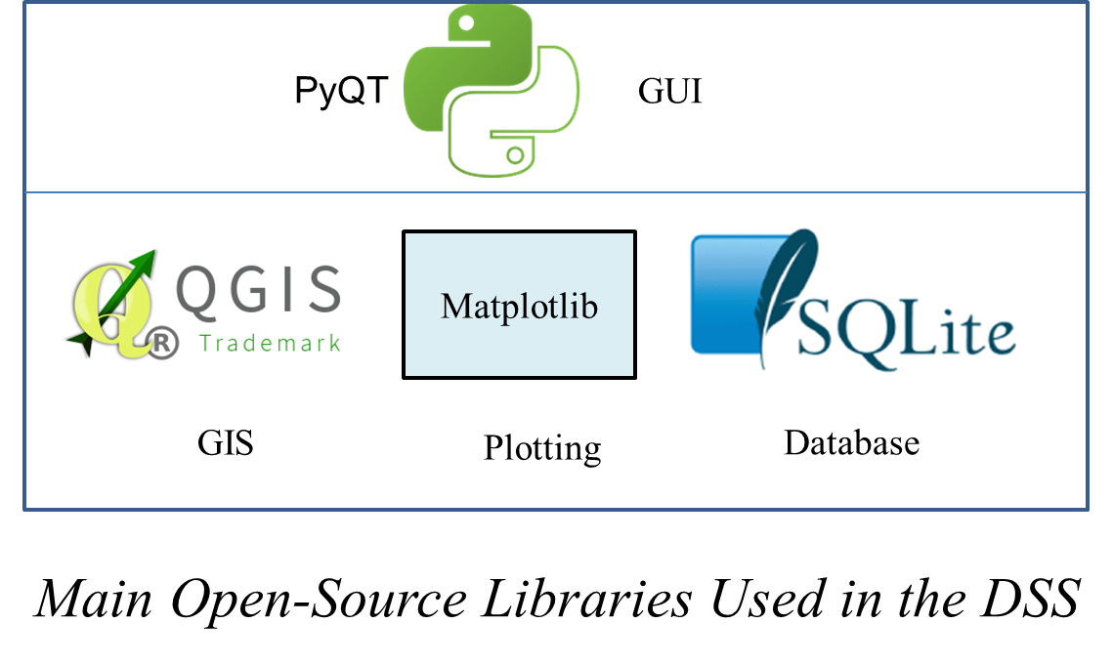

Slide 21
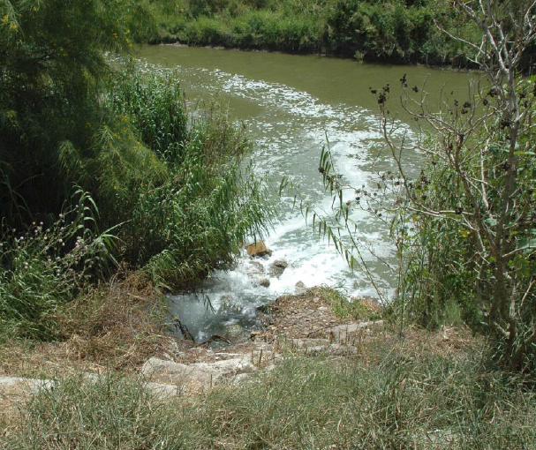
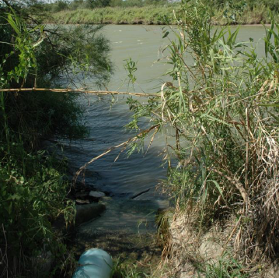
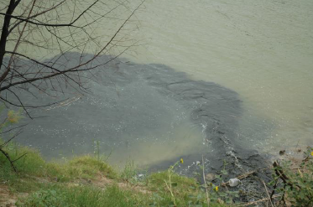
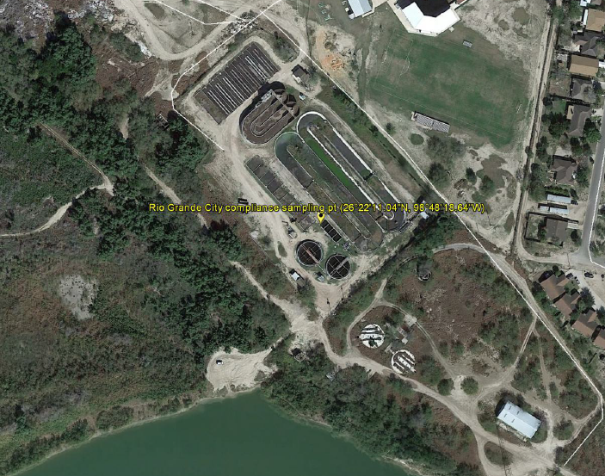

Slide 22
Modify Input File for Calibrated LRGWQI
LA-QUAL Model
Change Existing WWTF Effluent Limits
Specify Location and Effluent Limits of New WWTF
User Inputs
Use Case Diagram
Point Source Loading Module

Slide 23
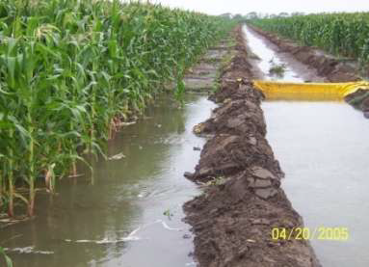
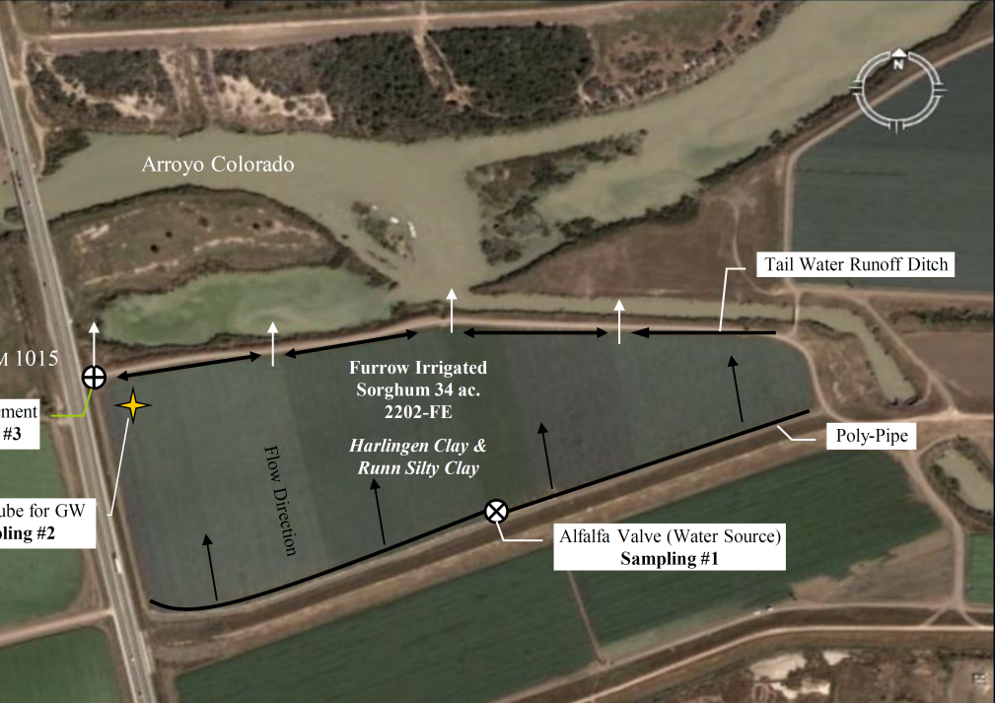
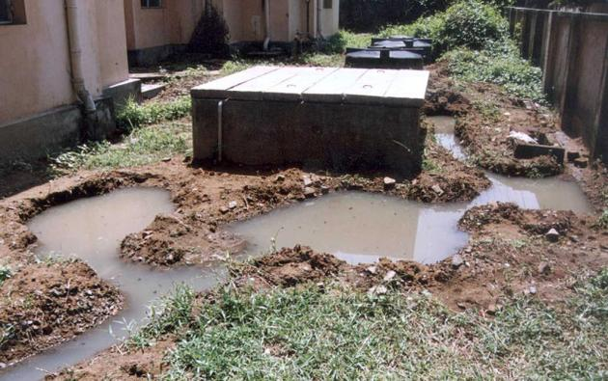
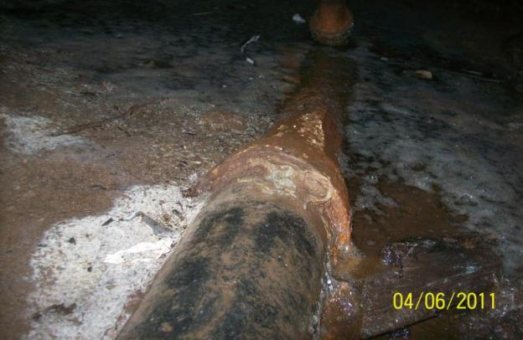

Slide 24
Modify Input File
LA-QUAL Model
Load Estimation Engine
NPS Pollutant Loading
(BOD, NH3-N, Fecal Coliform, etc.)
Human Waste
Animal Waste
Population Served by Public Sewer System
Population Served by Onsite Sewer System
Population with No Sanitation
Livestock
Wildlife
User Inputs
Use Case Diagram
Nonpoint Source Loading Module

Slide 25
Next Steps in the LRGWQI
Finalization of LRGWQI DSS
Scenario Simulations
Development of Binational Recommendations
Approval and Adoption of Recommendations by LRGWQI Core Group
Completion of Binational WBP
Binational Agreement (Joint Engineering Report, Exchange of Letters or Treaty Minute)
Implementation – Stakeholder outreach, Financing, etc.

Slide 26
Roger Miranda
roger.miranda@tceq.texas.gov
(512)239-6278
http://www.tceq.texas.gov/waterquality/tmdl

Slide 27
The Following are “Reserve Slides.” They will be presented only of there is a need to illustrate an answer to a question from the audience.

Slide 28
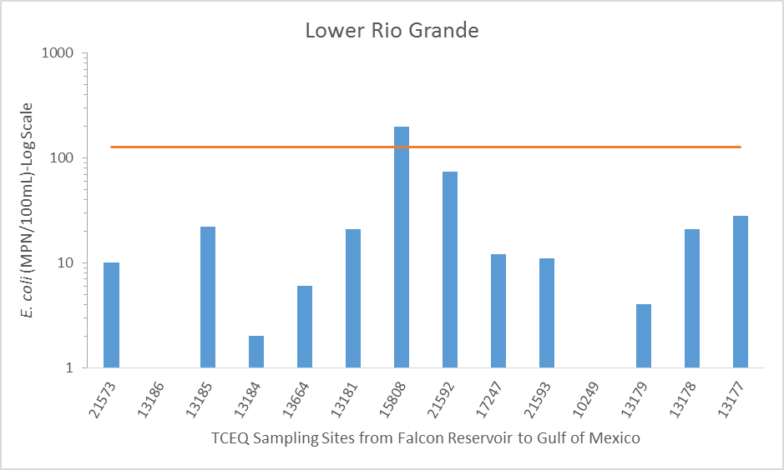
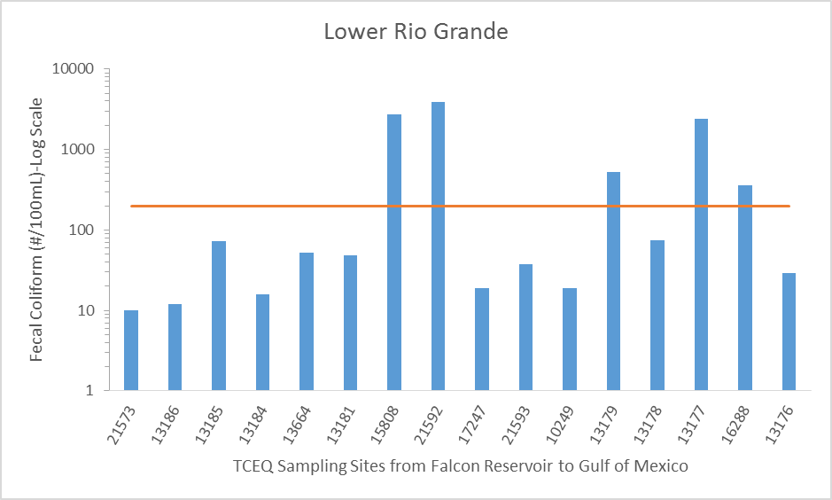
E. coli
US Synoptic Survey
Hidalgo-Reynosa
Fecal Coliform
Hidalgo-Reynosa
Brownsville-Matamoros
Notes:
And the results showed high bacteria levels in the river around the Hidalgo-Reynosa area and Brownsville-Matamoros area
These AUs are not listed for bacteria impairments nor do they show concerns for indicator bacteria.

Slide 29
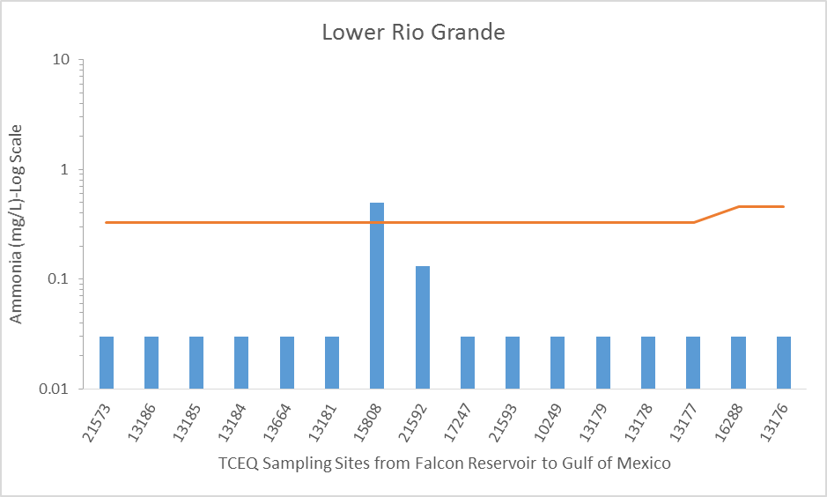
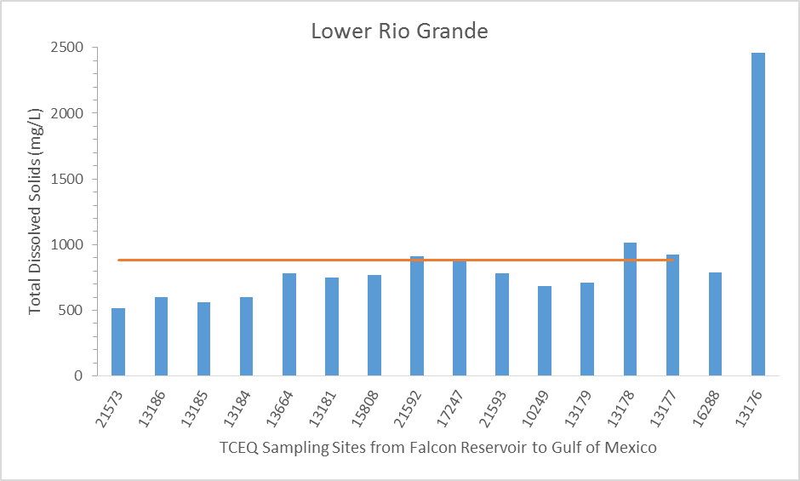
Ammonia-N
US Synoptic Survey
Hidalgo-Reynosa
Total Dissolved Solids
Hidalgo-Reynosa
Notes:
Similarly, we found high ammonia in the Reynosa-Hidalgo area and high dissolved solids downstream of the Reynosa-Hidalgo area .
Again, concerns for the these parameters are not reported for these AUs
So, the WQ snapshot we took of the river in 2014 shows that there can be conditions on the river, perhaps temporary ones, that can affect water quality
And these conditions may not be captured by routine monitoring.

Slide 30
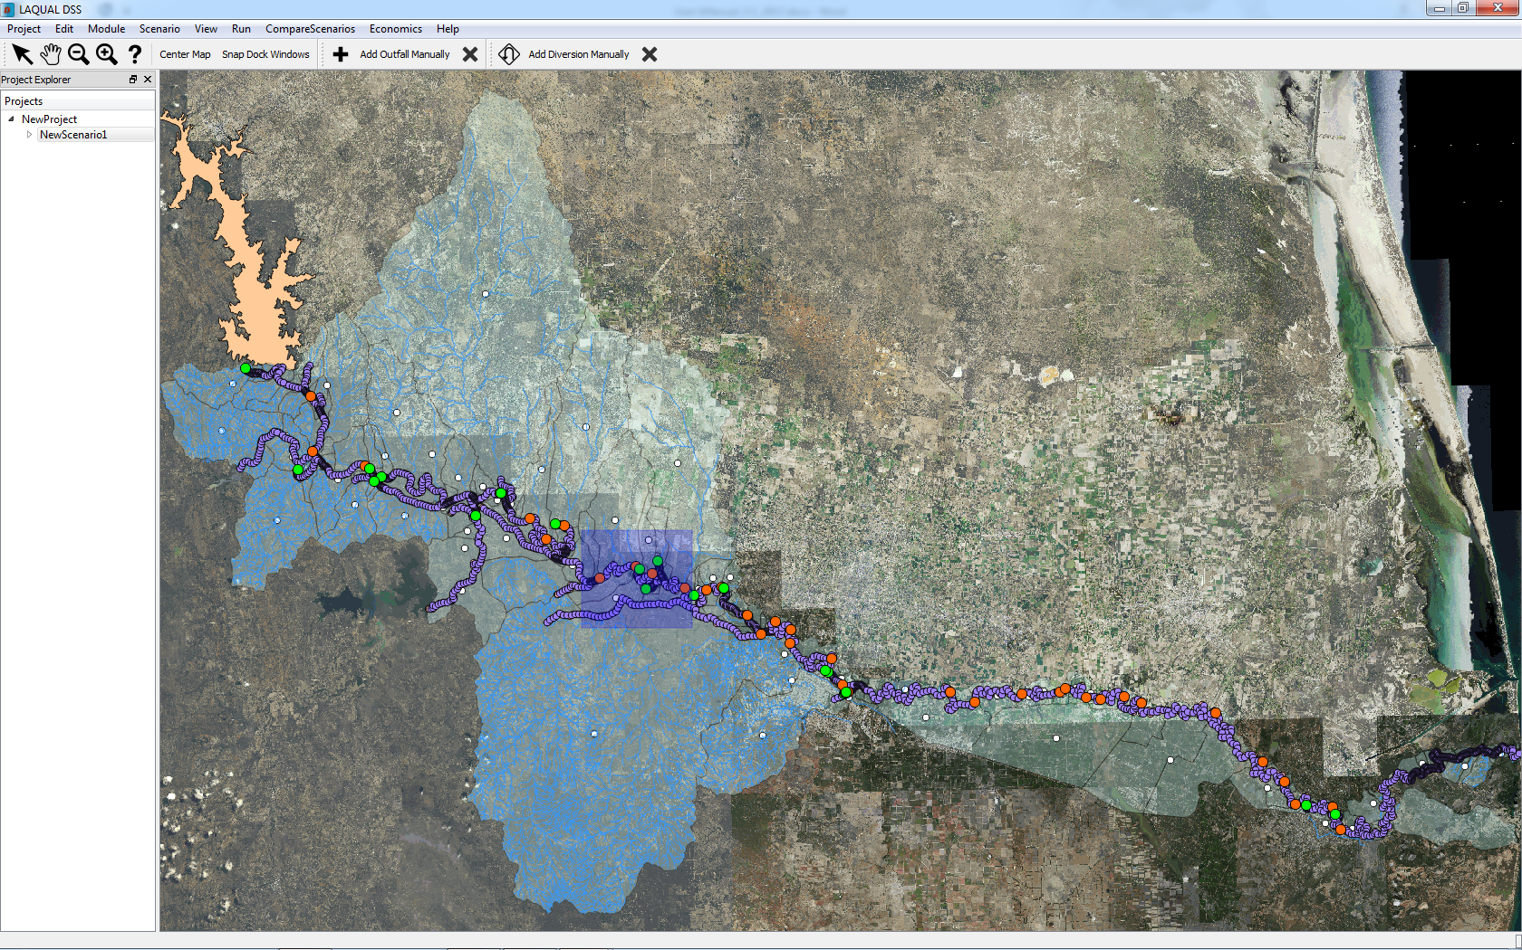

Slide 31
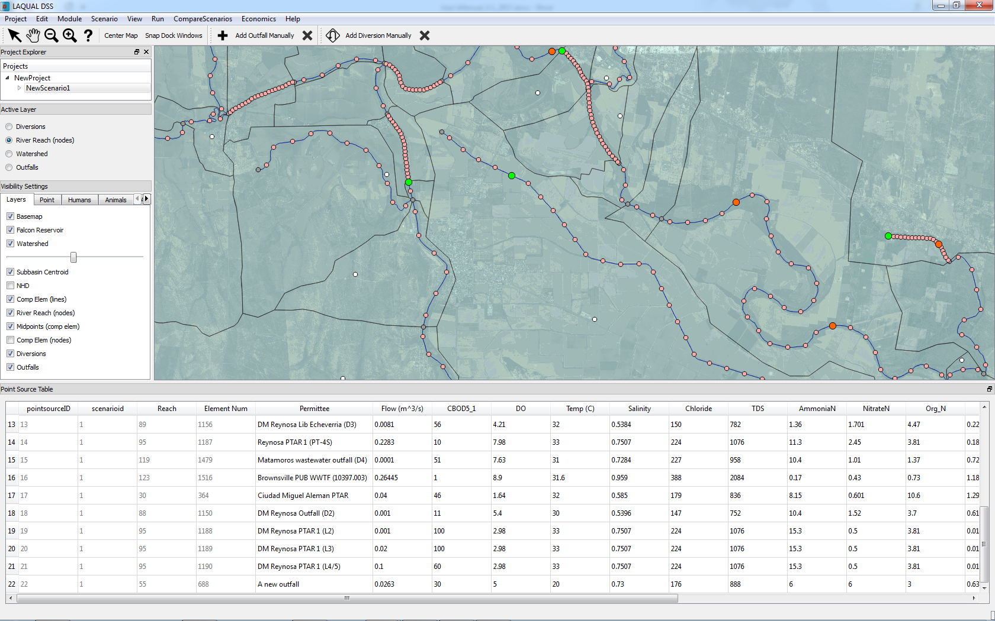

Slide 32
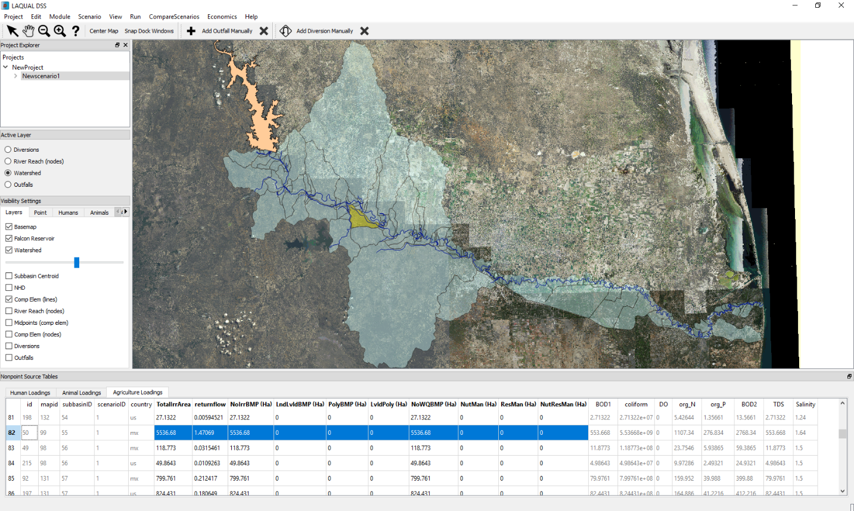

Slide 33
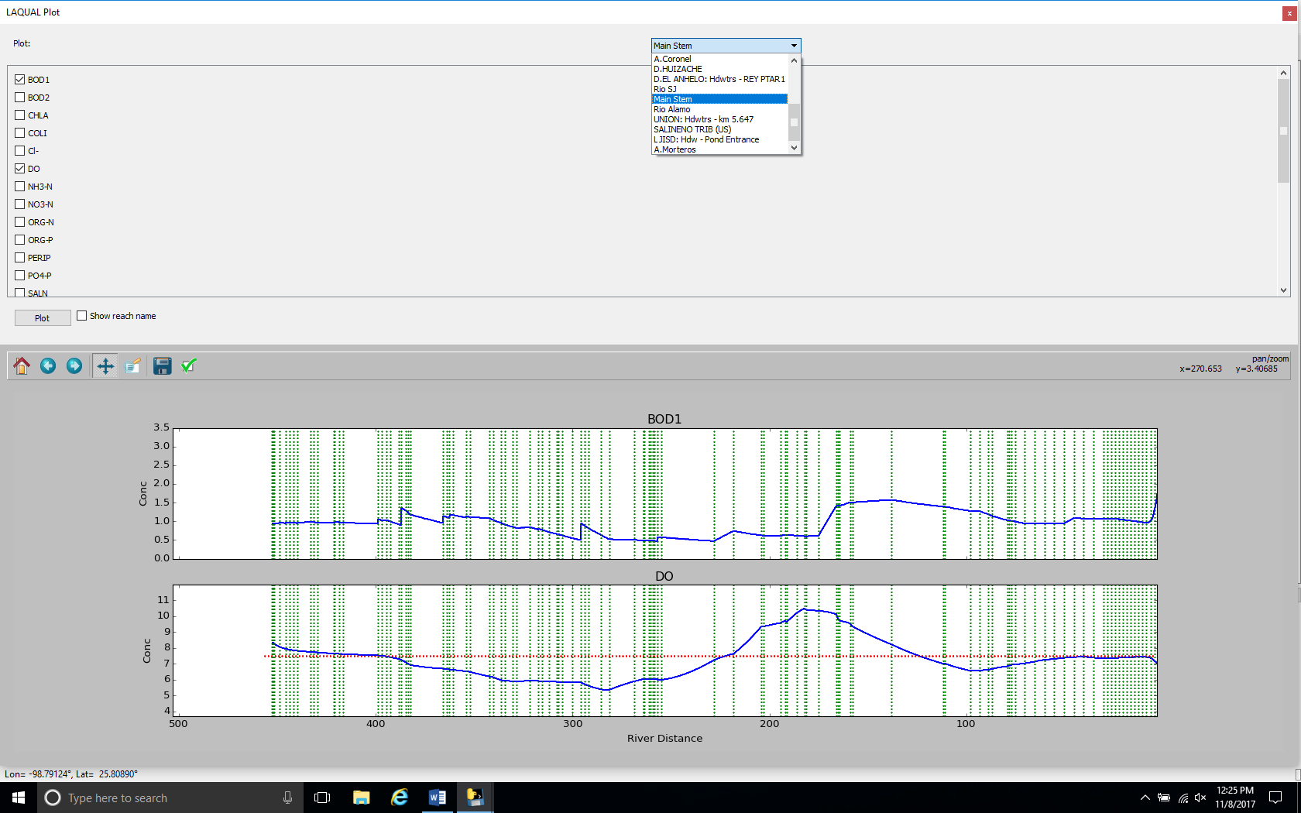

Slide 34
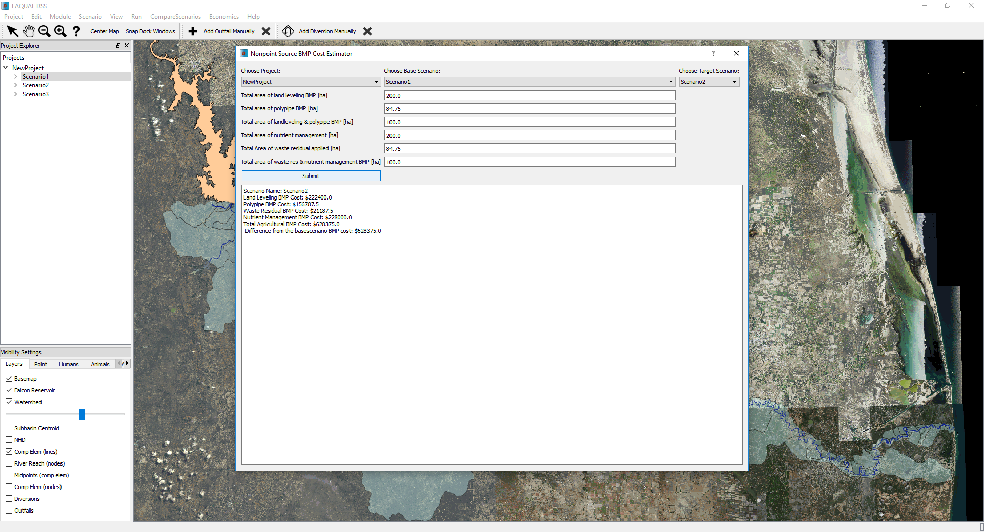

Slide 35
LRGWQI Synoptic Survey of the Lower Rio Grande - 2014
16 sites on the Lower Rio Grande – 1 tributary (Arroyo Los Olmos)
11 Wastewater Treatment Facilities on the US side
Notes:
I’d like to make a point that, while routine monitoring can give us a general picture of persistent (more accurately consistent) water quality problems and trends
Routine monitoring is not always able to capture sporadic upsets, or pulse events
A good example is a synoptic survey we conducted in 2014 as part of a binational project I’ve been working on for a while now.
We sampled sixteen sites on the river, one US tributary (Arroyo Los Olmos) and eleven US wastewater treatment facilities.

Slide 36
Water Quality Parameters
Field Parameters
Temperature
pH
Specific Conductance
Dissolved Oxygen (grab and 24 hr)
Secchi Depth
Instantaneous Stream Flow
Conventional Parameters and Bacteria
Total Dissolved Solids
Chloride
Sulfate
Total Suspended Solids
Nutrients (Ammonia Nitrogen, NO₂+NO₃, PO₄-P, TN, TP)
Chlorophyll a
Bacteria (E. coli, Enterococcus, etc.)
Notes:
The kind of WQ parameters collected at these stations are shown on this list. The parameters are grouped into three categories,
field parameters, which includes, well things one can measure in the field like temperature, pH, dissolved oxygen (which you’ll see referred to as DO), etc.
Conventional parameters, which include things like dissolved solids, nutrients and even indicator bacteria, such as E. coli or Enterococcus.
And non-conventional parameters, such as metals, organics (such as pesticides and other toxic chemicals) and toxicity (which helps us know if there might be something causing a problem that we’re not testing for).
On occasion we will also conduct biological sampling to assess the health of fish and benthic communities and we’ll also sample sediment and edible fish tissue.

