Slide 1
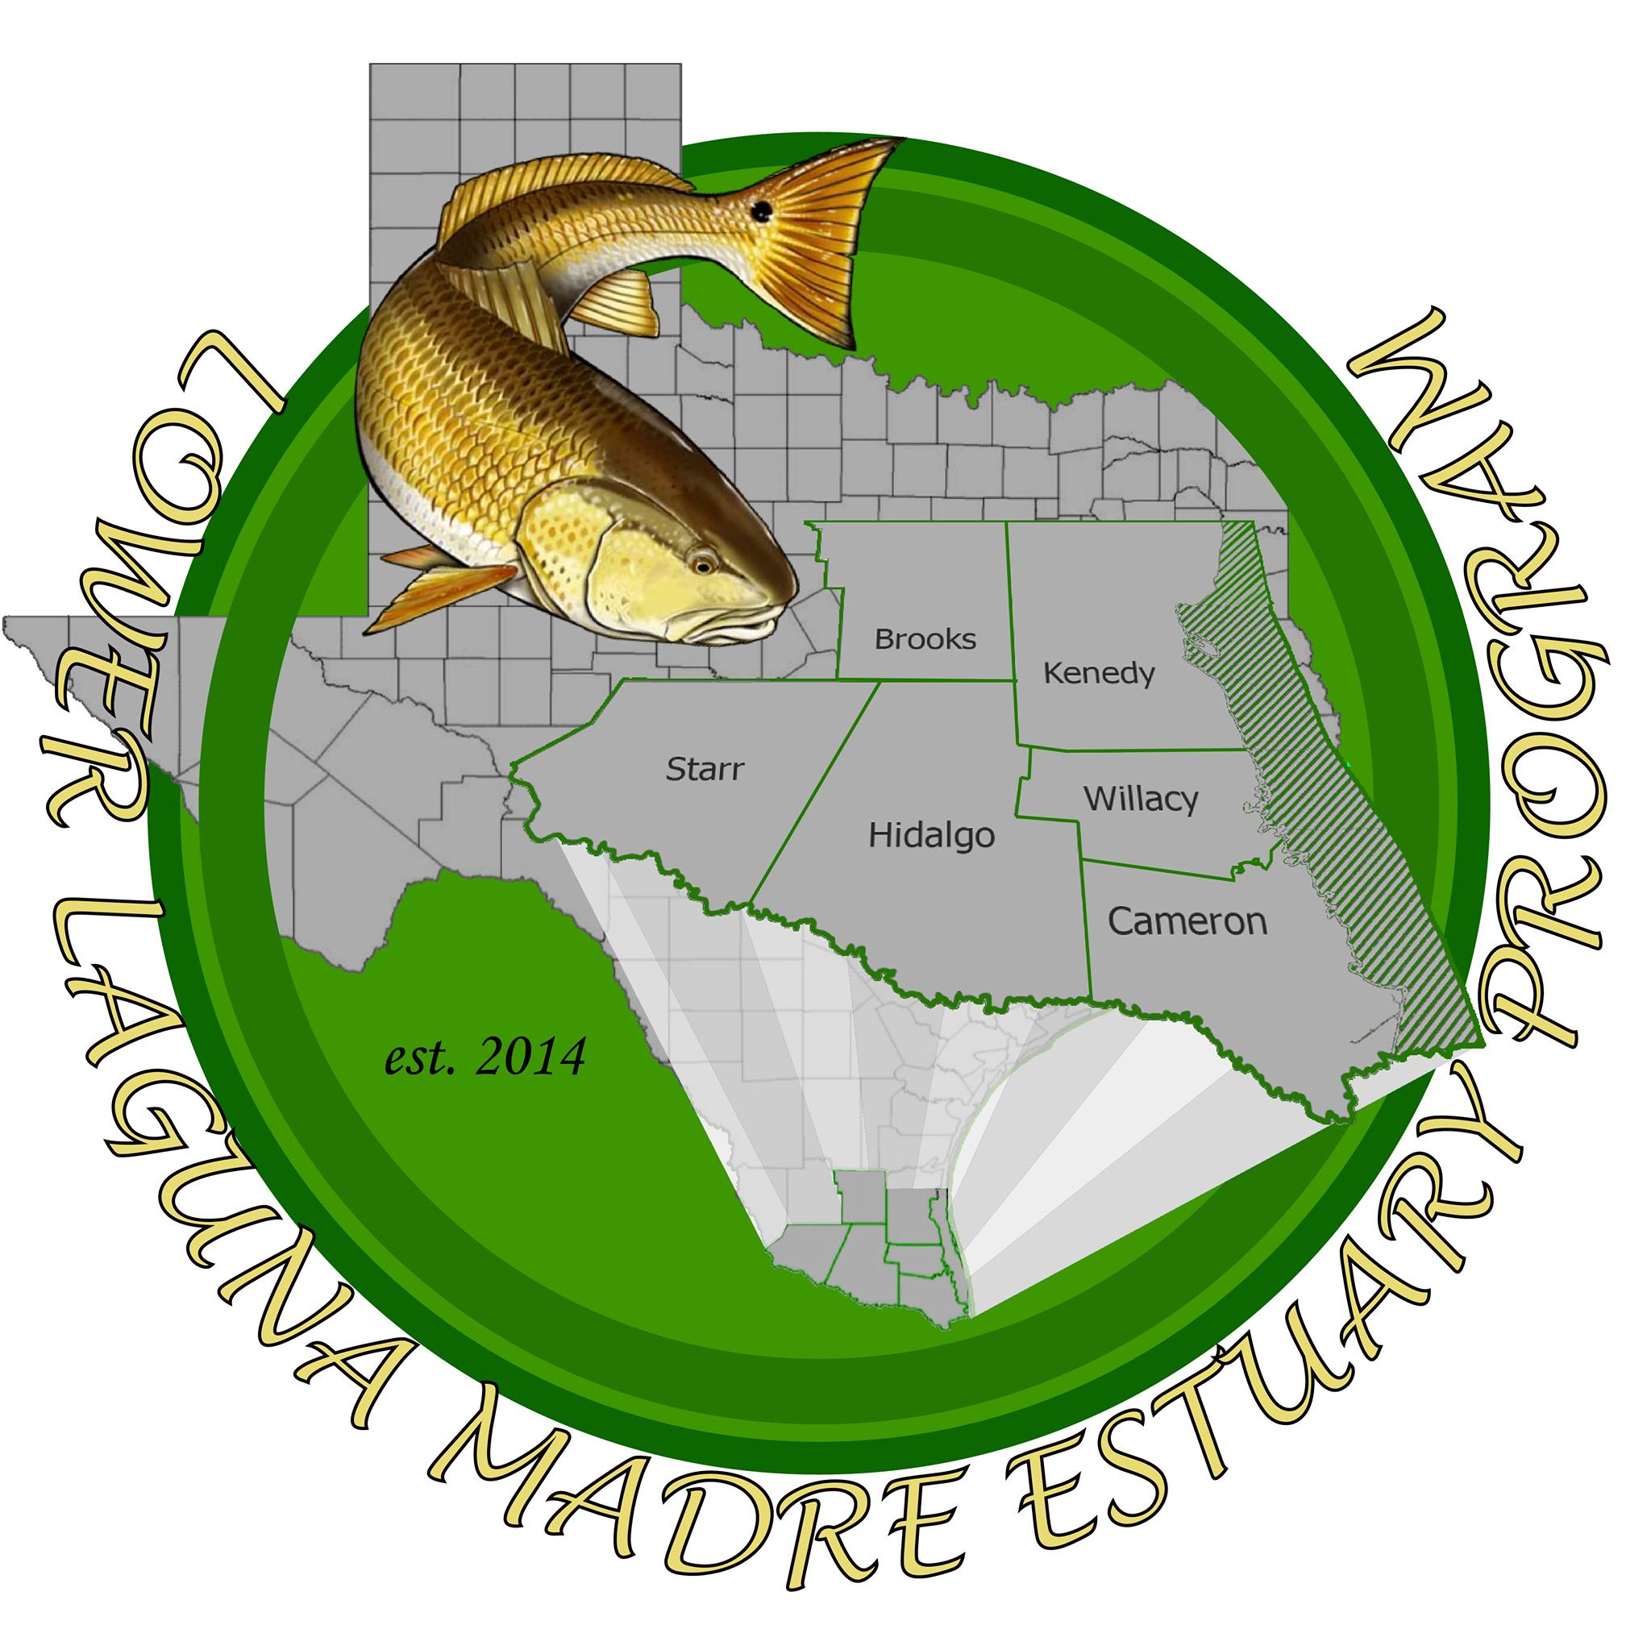
Lower Laguna Madre Estuary Program
South Padre Island, tx. May 24rd, 2019

Slide 2
Mission Statement
The mission of LLMEP is to combine the knowledge, resources and talents of federal, state, and local governments, citizens, industry, agriculture, academics, non-governmental organizations, and other interested parties to identify and develop sound scientific information about the Lower Laguna Madre estuary to create effective management solutions for regional economic development, resiliency and sustainability. Furthermore, LLMEP will facilitate synergies between all stakeholders to promote responsible stewardship of the air, water, land, habitat and infrastructure.

Slide 3
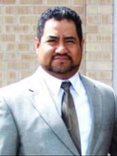
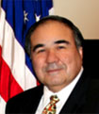
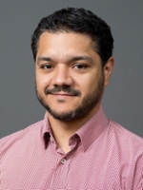
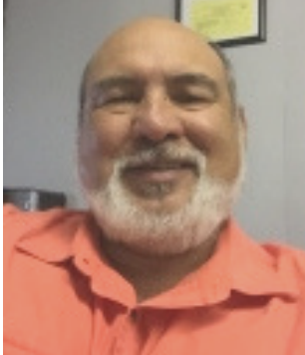
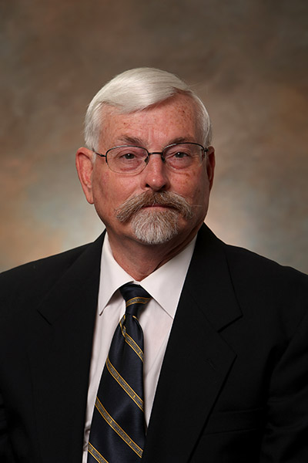
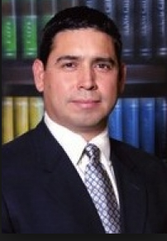
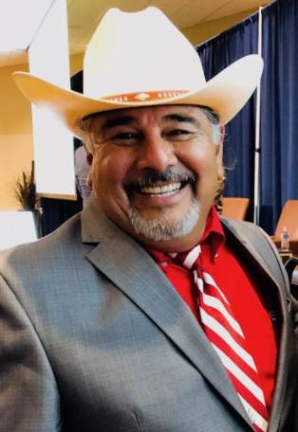
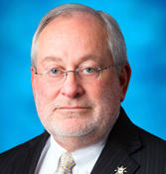
LLMEP Board

Slide 4
Cameron County
Natural Resources engineer

Slide 5
Natural Resources Management Plan
LLMEP
STETC Water Lab and Ed. Operations
Strategic Environmental Projects
Engineering and Surveying
GIS
Public Works
Administrative support
Logistics
Department of Transportation
Natural Resources Engineer
Department of Parks and Recreation
Stormwater Management
Floodplain Management
Beachfront Construction
Permitting and Regulatory Issues
Shoreline Protection
External Funding Program
Strategic Research Partnerships
Committees and Advisory Boards Involvement

Slide 6
External Resources
Corporate Partnerships (Private foundations, LNG, Space X, etc)
Federal and State Grant programs such as (TGLO CMP Coastal Management Program, TCEQ and TSSWCB 319(h) funds, RESTORE, TWDB, USDA Rural Development Grant, etc.)
TCEQ’s Supplemental Environmental Project (SEP)

Slide 7
Strategic Partnerships
Research, Applied Technology Education Services Inc. (RATES)
University of Texas Rio Grande Valley
Texas A&M University – Kingsville
South Texas College
Texas State Technical College (TSTC Harlingen)

Slide 8
Committees, Advisory Boards, etc
Cameron County Dune Protection Committee
LRGV TPDES Stormwater Taskforce
LRGVDC Water Management Workgroup
Lower Laguna Madre/Brownsville Ship Channel Watershed Partnership Steering Committee
Lower Laguna Madre Estuary Partnership Board of Directors
Lower Laguna Madre Initiative Team (USFWD)
American Shore and Beach Protection Association
Texas Floodplain Managers Association
American Society of Civil Engineers

Slide 9
Strategic Environmental Projects
Establishment a Wetland Mitigation Bank
Expansion of the Bahia Grande Restoration Project
Green Infrastructure integration to existing subdivision and zoning ordinances
Watershed Based Plans for water quality and flooding
Centralized, digital and publicly available environmental and natural resources data repository (interactive maps, cyberinfrastructure, etc).

Slide 10
LLMBSC Watershed Partnership
initiatives

Slide 11
Watershed Partnership

Slide 12
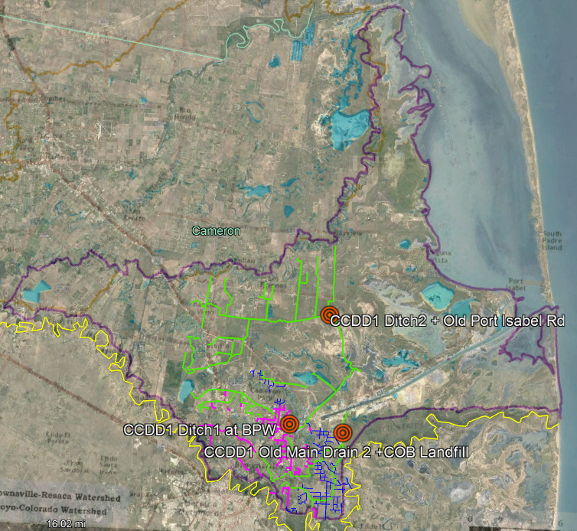
Lower Laguna Madre Watershed

Slide 13
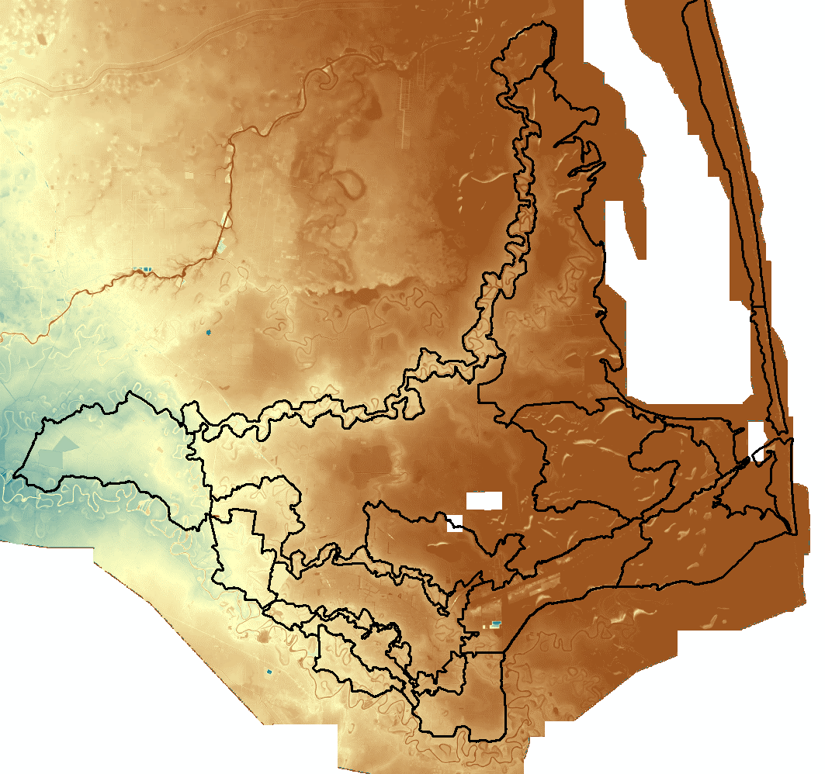

Slide 14
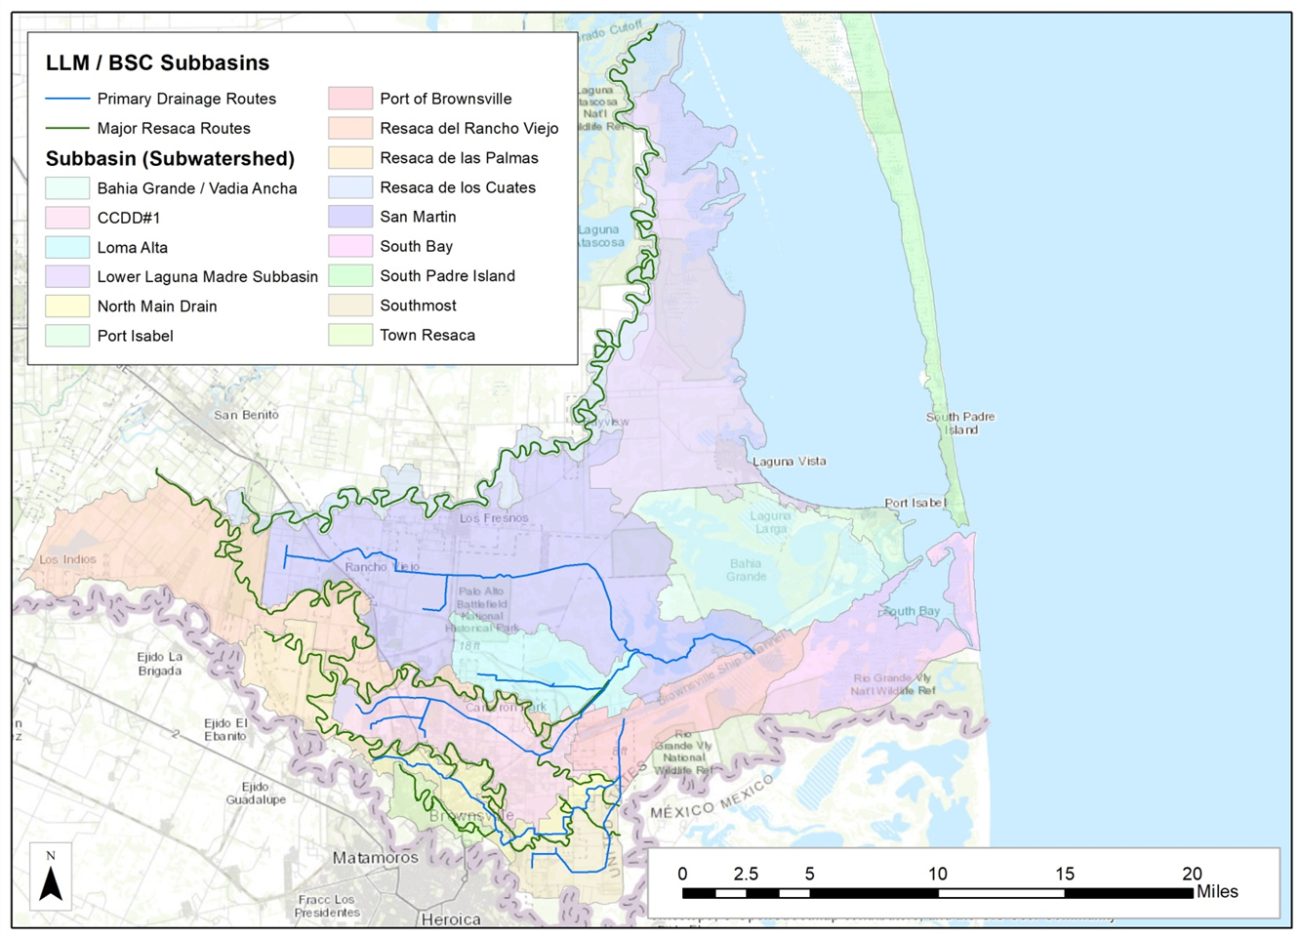

Slide 15
San Martin Lakes Monitoring
It receives freshwater flow from 2 of the main 3 ditches in the LLM/BSC watershed and is connected to the Ship Channel and saltwater flows into the Lake daily.
6 domestic permitted wastewater outfalls and 1 groundwater desalination wastewater outfall with TPDES/NPDES permits that discharge 20.85 MGD into the lake.
Lack of detailed water quality information on San Martin Lake and the various drainage networks.
In FY20 a second phase of funding from the CWA 319(h) program will be available to expand the monitoring network.

Slide 16
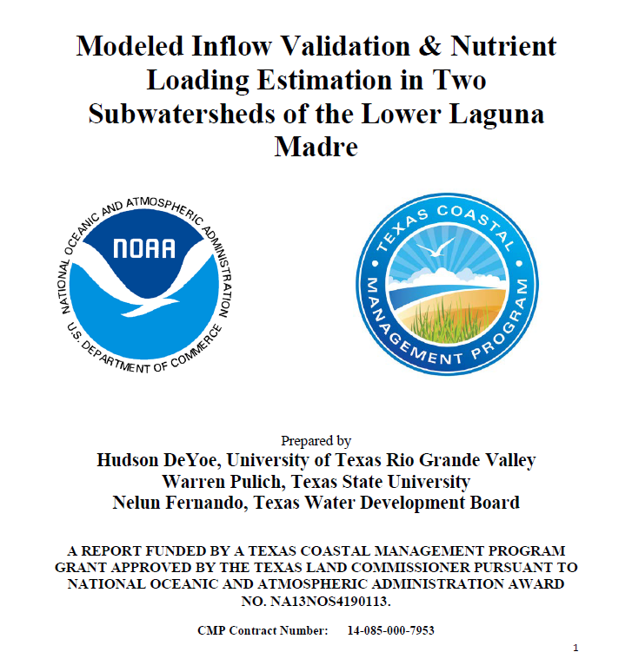
San Martin Lakes Monitoring

Slide 17
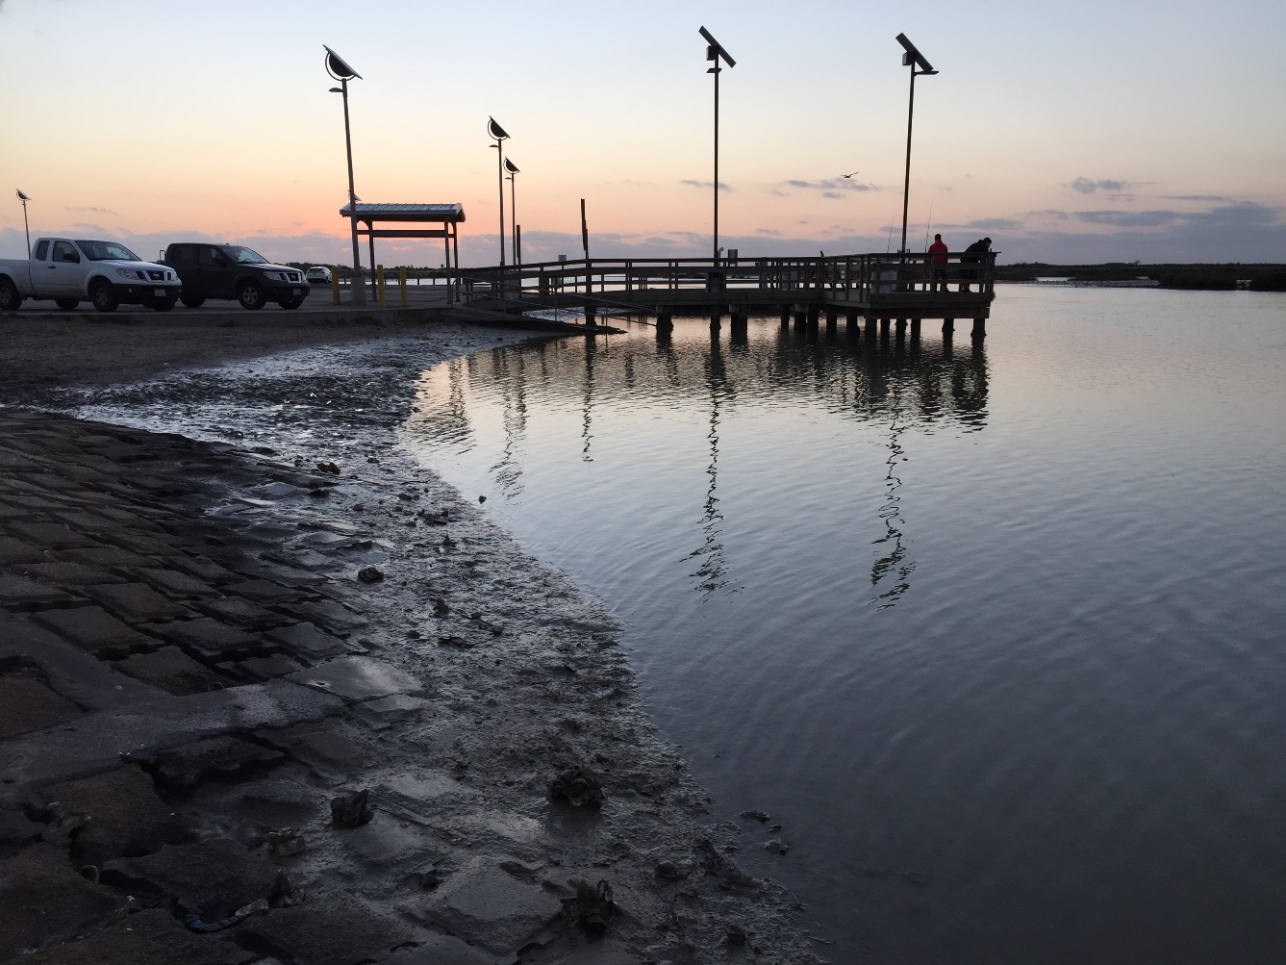
San Martin Lakes Monitoring

Slide 18
Key Stakeholder Support
Cameron County Commissioners Court nomination for TGLO CMP
R.A.T.E.S Equipment/expertise supply.

Slide 19
Ongoing Efforts
Sediment Management Plan (CC/SPI/USACE)
National Association of Counties Resiliency Challenge(CC/WC).
Texas Coastal Study Community Workgroup (CC/SPI/TGLO/USACE)
Institute for Data Driven Research for Coastal Water and Air Resources Management (UTRGV/TAMUK/CC/LLMBSCWP)
Connecting Catchment to Coast: Focus on Freshwater Inflow

Slide 20
Other Initiatives
Laguna Madre Initiative Team (USFW).
Gulf of Mexico Program- Resiliency strategies
EPA-FEMA resiliency workshop (July 2019)

