Slide 1
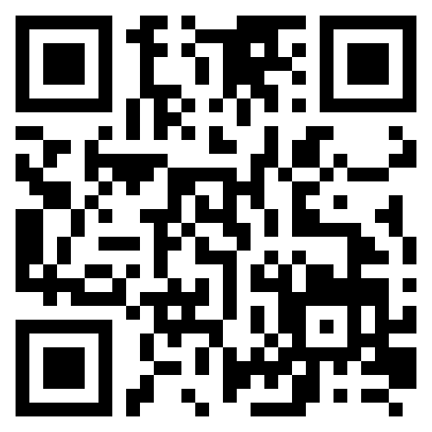
Scan the QR-Code to visit our Website

